Slide 1
HAND GESTURE RECOGNITOIN USING KINECT
Presented By:
Shashank Sonkar (Y9545)
Akshay Kumar (10060)
Mentor:
Prof. Amitabha Mukherjee

Slide 2
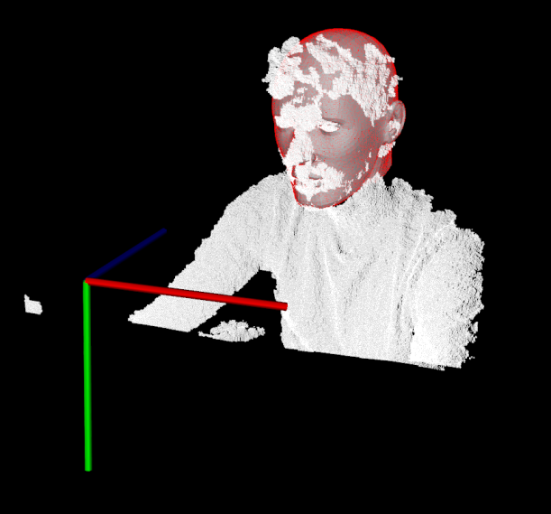
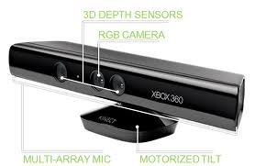

Motivation
Hand gesture – one of the frontier topics of research since the launch of Kinect
Traditional hand gesture methods based on optical sensor still far from satisfactory results
Segmentation of hand – a fairly non trivial task

Slide 3
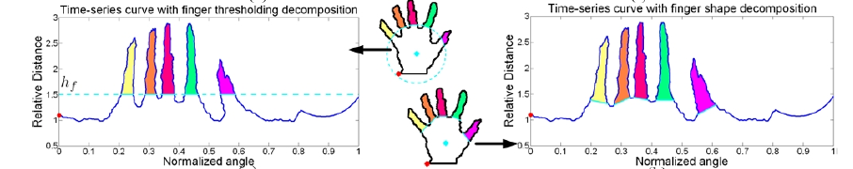

Previous work done
Z. Ren, J. Yuan, and Z. Zhang. Robust Hand Gesture recognition based on finger-earth mover's distance with a commodity depth camera. In Proc. of ACM MM, 2011

Slide 4
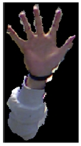

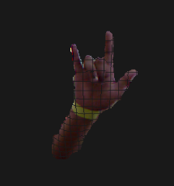
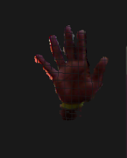
Step 1: Segmenting hand

Slide 5
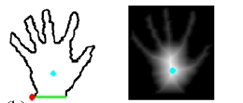
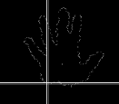
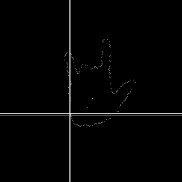
Step 2: Distance Transform

Slide 6
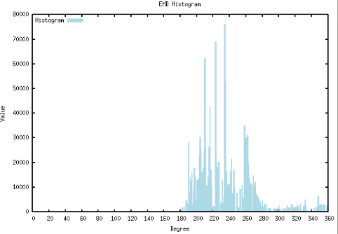
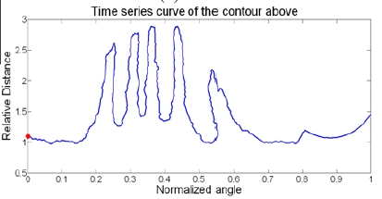
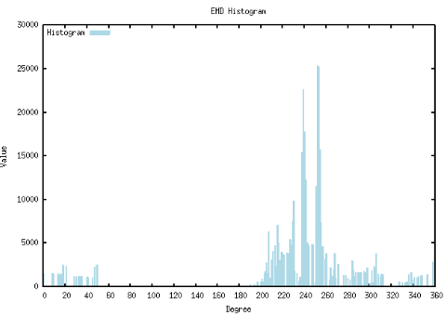
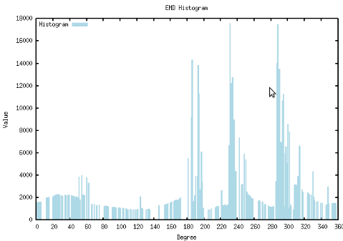
Step 3: Histogram

Slide 7
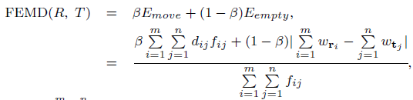
Step 4: EMD + Regularization
Compare two histograms
PENALTY

Slide 8
References
Z. Ren, J. Yuan, and Z. Zhang. Robust Hand Gesture recognition based on finger-earth mover's distance with a commodity depth camera. In Proc. of ACM MM, 2011
The presentation uses images from the aforesaid paper.

Slide 9
Questions???

