Slide 1
Google Similarity Distance
Presented by:
Akshay Kumar
Pankaj Prateek

Slide 2
Are these similar?
Number ‘1’ vs. color ‘red’
Number ‘1’ vs. ‘small’
Horse vs. Rider
True vs. false
‘Monalisa’ vs. ‘Virgin of the rocks’
We need some universal similarity measure!!!

Slide 3

Information Distance
E(x, y) : Given two strings x and y, the length of the shortest binary program, in the reference universal computing system, such that the program computes output y from input x, and also output x from input y is known as the information distance between x and y
Up to a negligible logarithmic additive term,
$$E\left(x, y\right)=K\left(x, y\right)−\min{\{K\left(x\right), K(y)\}}$$

Slide 4
Information Distance
Determines the distance between two strings minorizing the dominant feature in which they are similar.
Not a good measure
If two small strings differ by an ID which is large compared to their lengths, then the strings are not similar. However, if two very large strings differ by the same distance, they are very similar

Slide 5

Normalized Information Distance
To ensure that the ID expresses similarity between two strings, normalize it over the length of the strings
$$NID\left(x, y\right)=\frac{K\left(x, y\right)−min⁡\{K\left(x\right), K(y)\}}{\max{\{K\left(x\right), K(y)\}}}$$
Kolmogorov complexity is uncomputable!!!

Slide 6

Normalized Compression Distance
To counter the problem of uncomputability of K(x), it’s replaced by C(x) where C is some compression technique
$$NCD\left(x, y\right)=\frac{C\left(x, y\right)−\min{\{C\left(x\right), C(y)\}}}{\max{\{C\left(x\right), C(y)\}}}$$

Slide 7
Normalized Google Distance
NGD : a way of expressing NCD
Premise :
Number of web pages indexed by Google is so vast that is actually approximates the actual relative frequency of various search terms
Invariant to growing size of Google database
Uses probability of search terms to define similarity distance

Slide 8
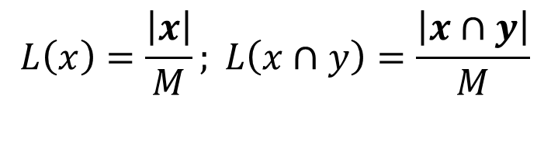
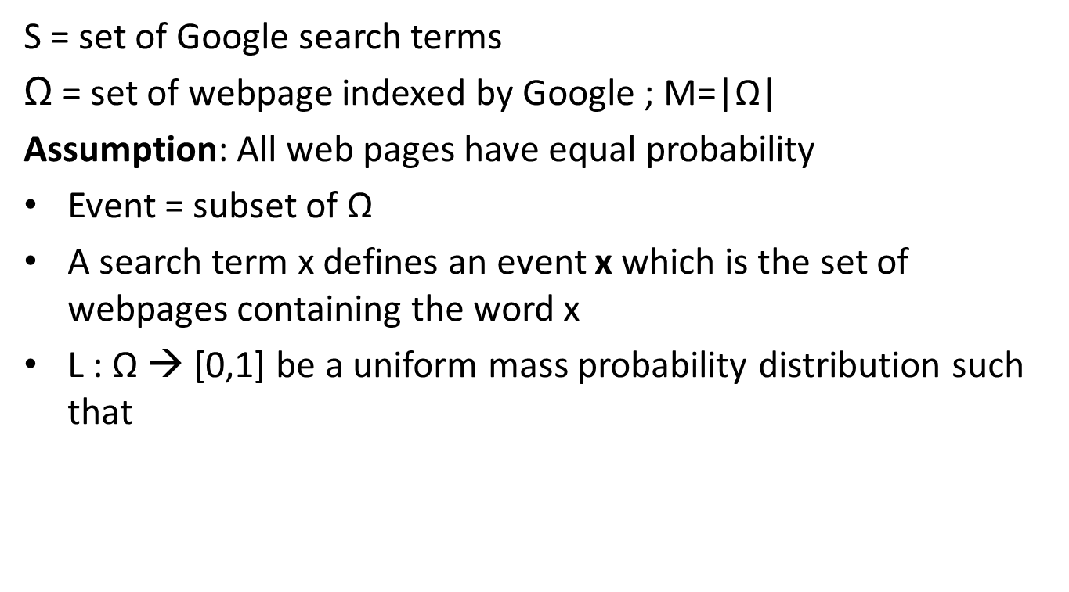
Normalized Google Distance
S = set of Google search terms
Ω = set of webpage indexed by Google ; M=|Ω|
Assumption: All web pages have equal probability
Event = subset of Ω
A search term x defines an event x which is the set of webpages containing the word x
L : Ω → [0,1] be a uniform mass probability distribution such that
$$L\left(x\right)=\frac{\left|x\right|}{M}; L\left(x∩y\right)=\frac{\left|x∩y\right|}{M}$$

Slide 9
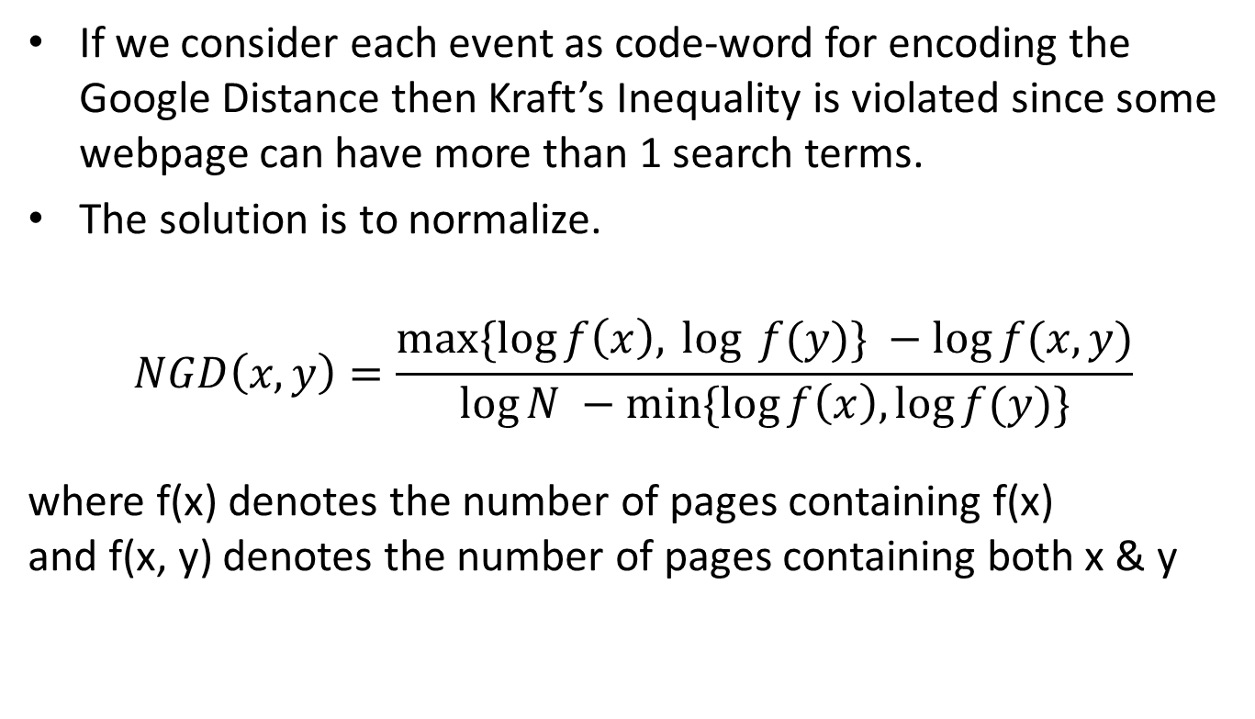
Normalized Google Distance
If we consider each event as code-word for encoding the Google Distance then Kraft’s Inequality is violated since some webpage can have more than 1 search terms.
The solution is to normalize.
$$NGD\left(x, y\right)=\frac{max⁡\{\log{f\left(x\right),\log{ f(y)\} −log⁡f(x,y)}}}{\log{N −\min{\{\log{f\left(x\right),\log{f(y)}}\}}}}$$
where f(x) denotes the number of pages containing f(x) and f(x, y) denotes the number of pages containing both x & y

Slide 10
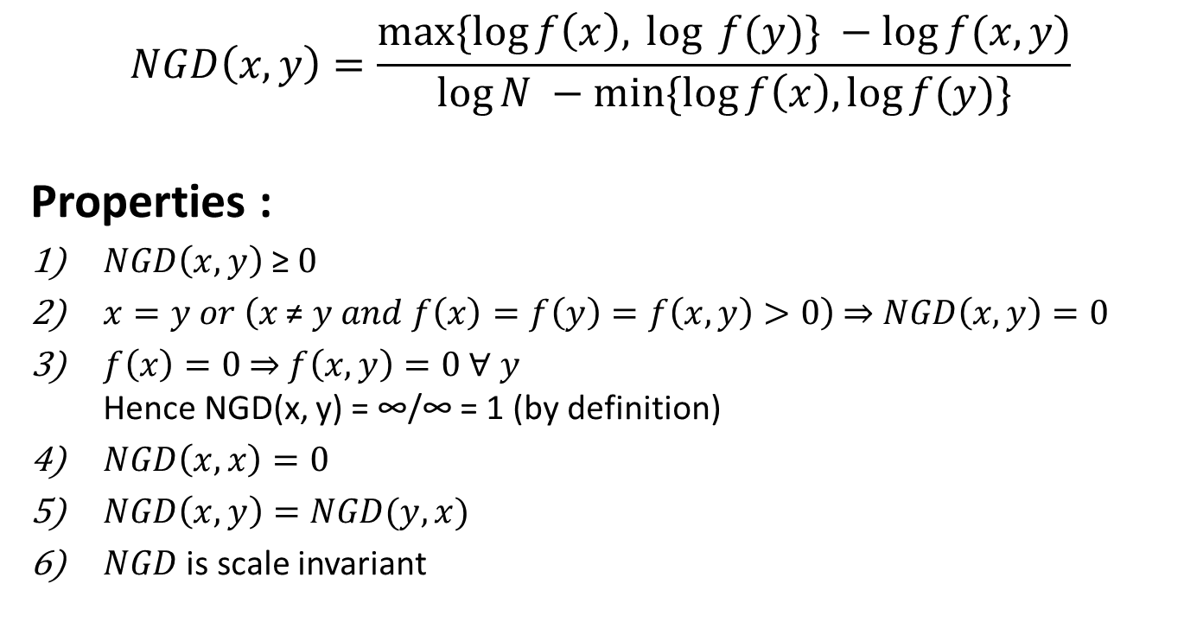
Normalized Google Distance
$$NGD\left(x, y\right)=\frac{max⁡\{\log{f\left(x\right),\log{ f(y)\} −log⁡f(x,y)}}}{\log{N −\min{\{\log{f\left(x\right),\log{f(y)}}\}}}}$$
Properties :
$NGD\left(x, y\right) \text{≥} 0$
$x=y or \left(x \text{≠} y and f\left(x\right)=f\left(y\right)=f\left(x, y\right)>0\right) \text{⇒} NGD\left(x,y\right)=0$
$f\left(x\right)=0 \text{⇒} f\left(x, y\right)=0 \text{∀} y$ Hence NGD(x, y) = ∞/∞ = 1 (by definition)
$NGD\left(x,x\right)=0$
$NGD\left(x, y\right)=NGD(y, x)$
$NGD$ is scale invariant

Slide 11
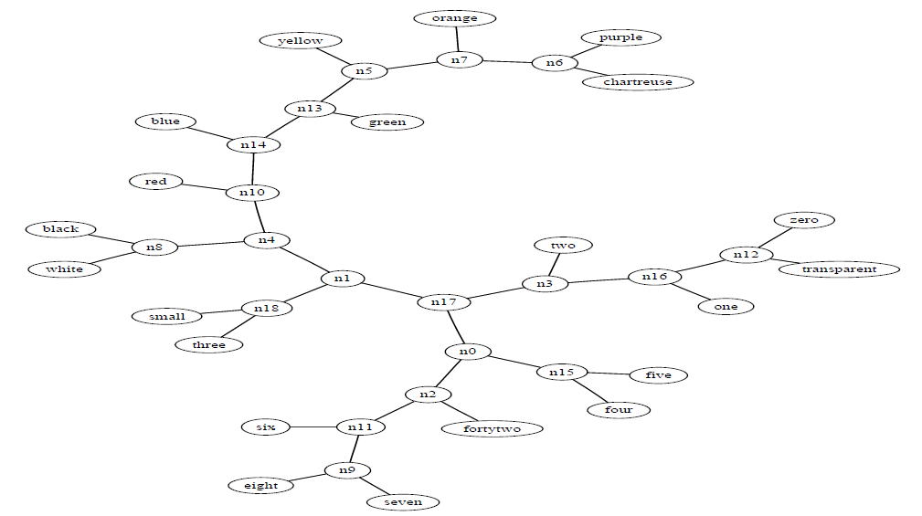
Example

Slide 12
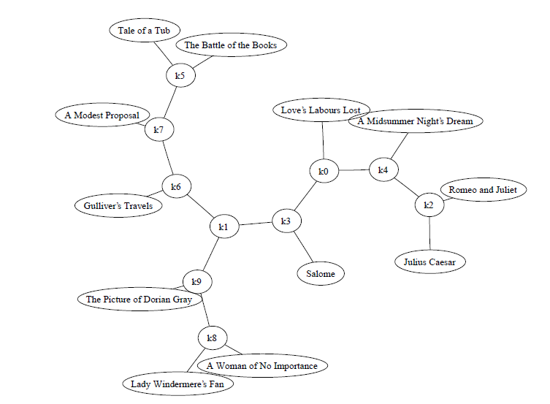
Example

Slide 13
Errors/Shortcomings
Not applicable to small datasets.
Definition of N is still erroneous, the NGD can still be greater than 1 (Kraft’s inequality is violated)
Ignored the number of occurrence of a term on a page
Page count analysis ignore the position of a word in a page
Even though 2 words appear on the same page, they may not be related.
Page count of a polysemous word might contain a combination of all its senses, e.g. - Apple.
The probability of occurrence of every page is taken to be the same (it is NOT the same, depends on the page rank)
Given the scale and noise on the WWW, some words might just occur on a page arbitrarily (by random chance)

Slide 14
Suggestions
Can use snippets which are returned along with the web searches to determine the similarity of the words
Only the snippets of the top ranking pages can be processed efficiently and no guarantee exists that all the information we need to measure the semantic similarity is contained in those snippets
Combining information from the web-searches with the information obtained from other databases (Wikipedia, WordNet etc.) to find the similarity measure.

Slide 15
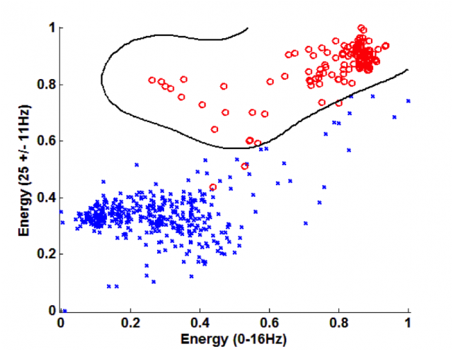
SVM – NGD Learning
A set of n-dimensional data points along with their classes i.e. (x_{i}, y_{i}). Only 2 classes taken here for brevity.
Divide this set into two parts : training set and testing set
Determine a dividing curve to differentiate the points of two classes using learning set.
Validate the results by testing on testing set.
Image Source: http://groups.csail.mit.edu/ddmg/drupal/sites/default/files/images/2.preview.png

Slide 16
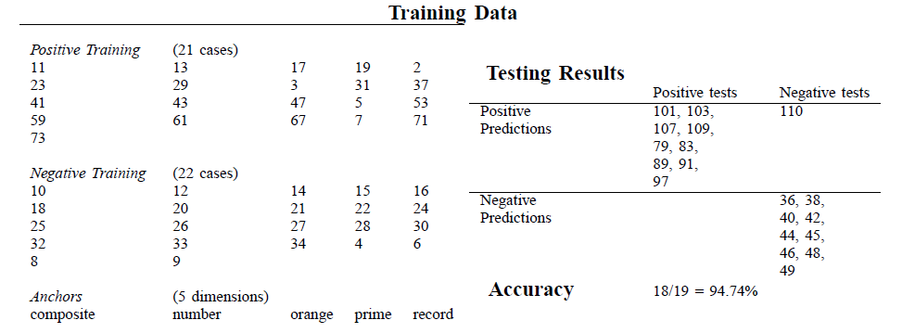
SVM – NGD Learning
Set of training words
Set of anchor words of cardinality n(much smaller than training words set)
Convert each of training word into a n-dimensional vector whose i^{th} dimension is NGD between that word and i^{th} anchor word
Train it using SVM

Slide 17
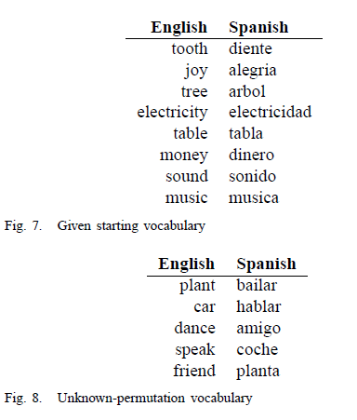
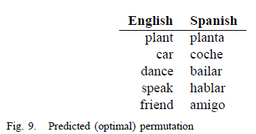
NGD Translation

Slide 18
References
Cilibrasi, Rudi L., and Paul MB Vitanyi. "The Google similarity distance." Knowledge and Data Engineering, IEEE Transactions on 19.3 (2007): 370-383.
Bollegala, Danushka, Yutaka Matsuo, and Mitsuru Ishizuka. "Measuring semantic similarity between words using web search engines." www 7 (2007): 757-766.
http://en.wikipedia.org/wiki/Normalized_Google_distance

