Slide 1


Slide 2
Introduction
‘Philosophical Approach Towards Extreme Technology’! Seems like one of those ‘hard to digest’ things, doesn’t it?
Well, given that philosophy itself is the thing which can deal with virtually anything out there, we can say that there must be some link between these two apparently opposite poles.

Slide 3

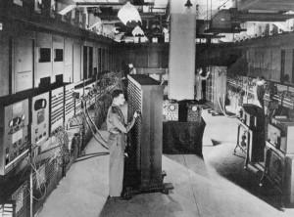
We started our journey of technology with very basic things.
We had the first generation computers as large as a room. The input was given through direct coding. Clocking, 60 Hz!
Things changed, technology evolved.
Now...
The First Generation Computer.

Slide 4
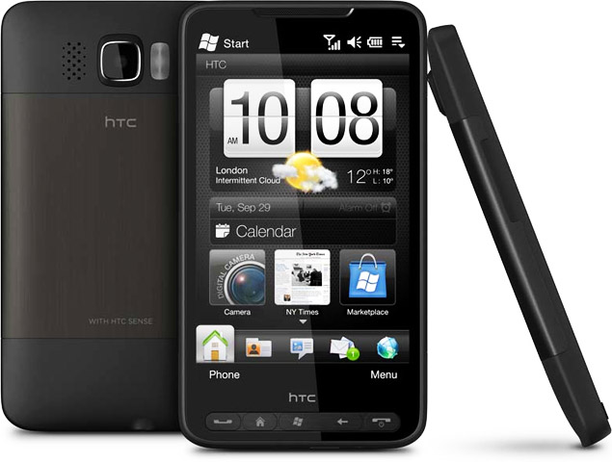
We have a 11 mm thick pocket PC clocking at 1GHz, i.e., faster than 10⁸ times the first generation computers.
Still a thing remains unchanged…
HTC HD2

Slide 5
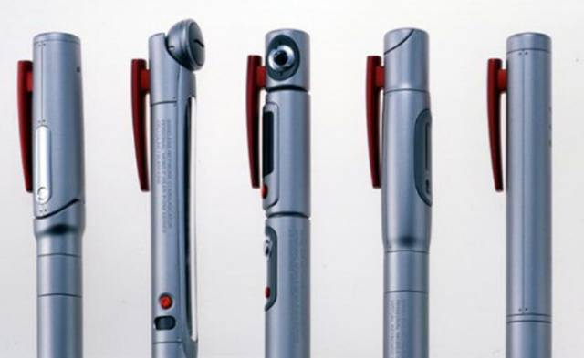
Can you guess what these things are? This is a technology from Japan.
Guess!

Slide 6
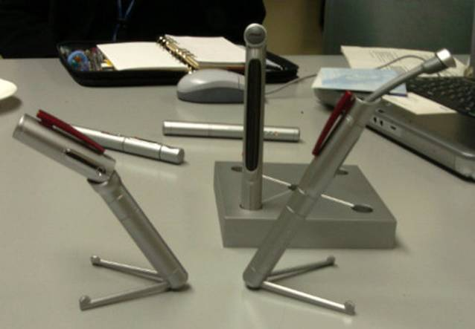
Can you guess what these things are? This is a technology from Japan.
Cameras in pens?
No!
Any other wild guesses?
Guess!

Slide 7
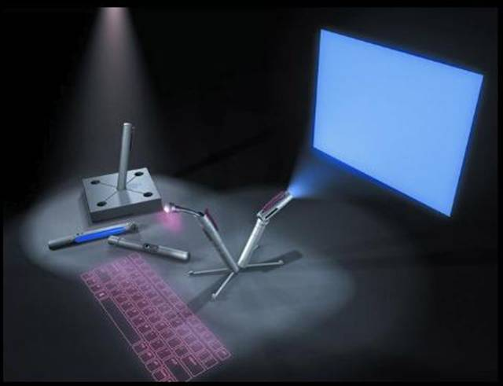
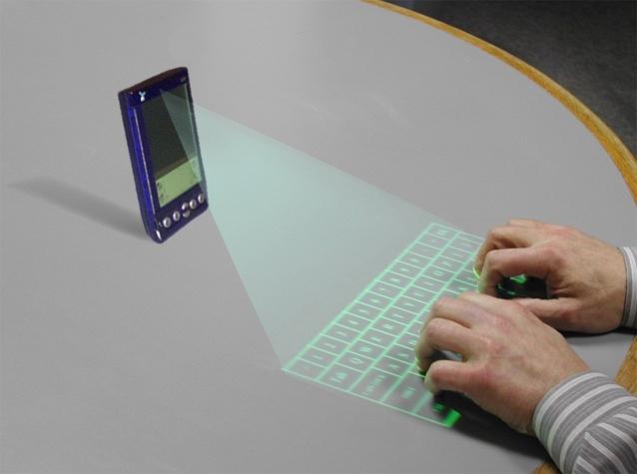
They’re computers. One can ‘produce’ monitor and keyboard on any flat surface with them.
Technology is advancing exponentially.
Still a thing remains unchanged…
Yeah, computers!

Slide 8


Slide 9


Slide 10

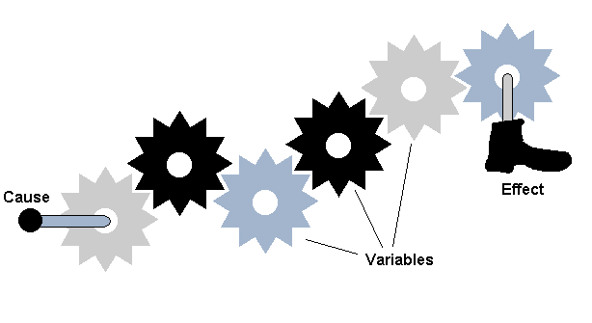
However the technology may evolve, the machines have everything determined. They take some input and result is unique! There can’t be any other result for the same cause. Causal principle seems to be obeyed perfectly.
Determinism

Slide 11
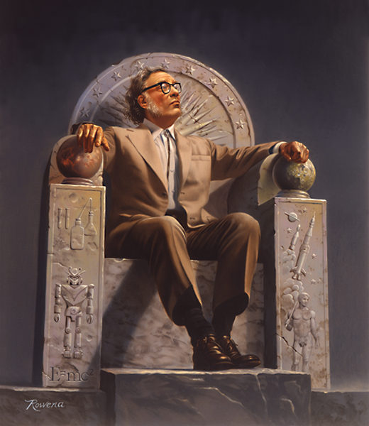
Sir Isaac Asimov
Debate can be made between ‘free will’ and ‘determinism’ as far as its human world.
But, as Sir Isaac Asimov depicts in his book ‘I, Robot’, if the world is taken over by machines completely, we can conclude that everything will be pre-determined!

Slide 12

Contradiction
This claim relies completely on the assumption that machines generate defined results for given a input. But, do they, really?
The claim of ‘deterministic machine world’ can be denied once the assumption is proved false!

Slide 13

A bit of Unpredictability
There are some things even about machines which are not predictable. The simplest example is music shuffling. Same program, on two devices, gives different shuffled lists at the same time. Results are not predictable!
Let’s extend the idea further…

Slide 14
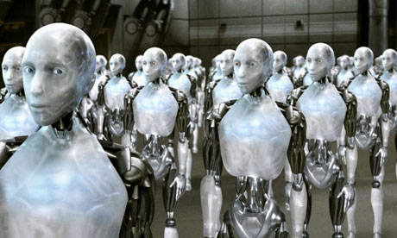
If we consider that machines in Sir Isaac’s world are sure to come across the ‘randomizing stuff’, we can say that the results won’t be predictable. Randomness in each machine will lead to a totally random world.
Thus the claim of determined world is proved false.
Robot World

Slide 15

As we say ‘No’ to determinism, we tend to think in about free will! But, can really free will be the base of such world, or its just illusion?
Again answer is not so straightforward.
Let’s think about the question a bit deeply…
Free Will!

Slide 16
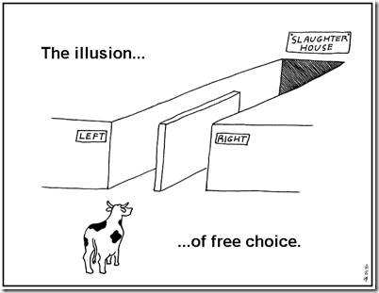
To start with, free will can be defined as freedom to choose. Now, though the machine world does not satisfy the criteria for deterministic world, it fails to do the same for free will too!
Machines do not have freedom to choose!
Freedom to choose?

Slide 17
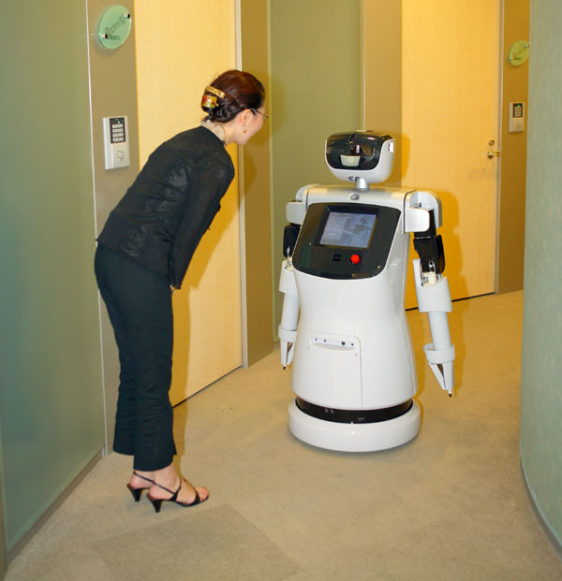
Once the input is given or taken, they have to give result. They do not choose anything. They can just process the things.
Now, we come to conclusion that the so called ‘machine world’ is not based on the concept of free will.
Hey, tell me what to do!

Slide 18
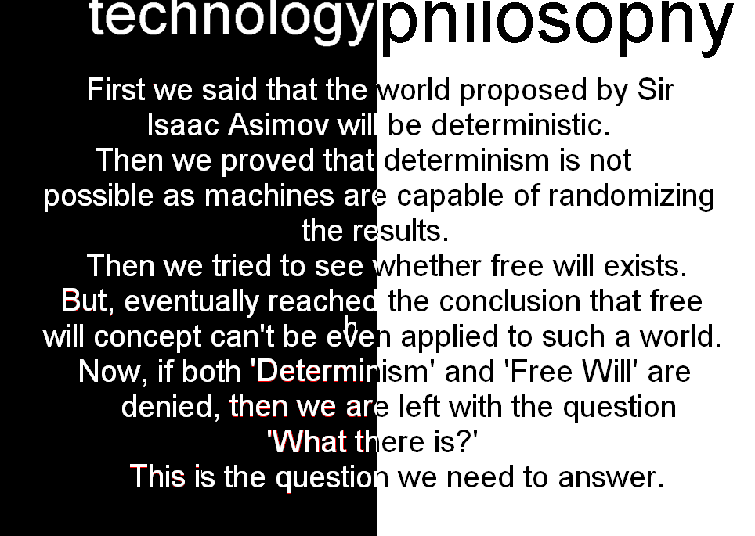

Slide 19


