Slide 1
Predicting Coral Reef Bleaching Using Time Series Models
Submitted by:
Sreya Mynampati 22BAI1163
Akshita Jawahar 22BAI1264

Slide 2
Introduction to Coral Bleaching
Definition: Coral bleaching is a process where corals expel the algae (zooxanthellae) living in their tissues, turning them white.
Cause: Typically occurs due to environmental stress, primarily from rising sea temperatures.
Impact: Leads to coral weakening, higher mortality rates, and impacts marine biodiversity.

Slide 3
Project Background
Problem Statement: Coral bleaching is a significant environmental issue, often linked to rising sea surface temperatures (SST) and other factors.
Goal: To analyze historical coral bleaching data, explore key environmental factors, and build predictive models for future bleaching events.

Slide 4
Dataset Overview
Attributes: Date, Place Name, Latitude, Longitude
Environmental variables: SST (Sea Surface Temperature), Chlorophyll-a Concentration, Salinity, Pressure, Wind Speed, etc.Sea Surface Salinity, Sea Level Pressure, Wind Speed. Solar Radiation, Cloud Cover, Wave Height, Precipitation: Rainfall amount. Bleaching:
Bleaching Indicator: Binary column indicating whether bleaching was observed (1 for bleaching, 0 for no bleaching)

Slide 5
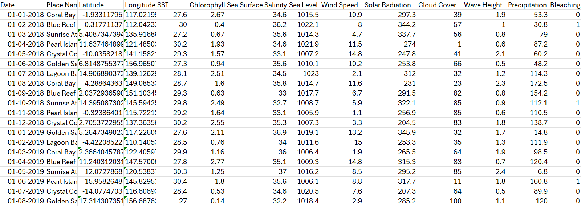

Slide 6
Dataset Preprocessing
Data Cleaning: Checking for missing values, standardizing data types, ensuring data consistency.
Feature Selection: Identifying key environmental variables influencing coral bleaching.

Slide 7
Conditions to Identify Likely Bleaching Events
Thresholds Defined:
High SST: Temperatures above 29.5°C
Low Salinity: Less than 34 ppt (parts per thousand)
Low Cloud Cover & High Radiation: Clear skies and high sunlight contribute to warmer waters.
Rationale: These conditions increase stress on corals, likely leading to bleaching.

Slide 8
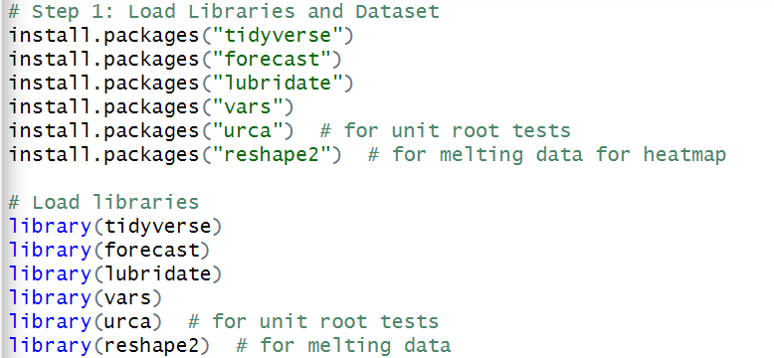
Step 1 - Libraries and Data Loading
Libraries Used: Tidyverse, Forecast, Lubridate, Vars, UrCA, Reshape2.
Dataset Loading: Load the dataset, convert date format, and check for missing values.

Slide 9
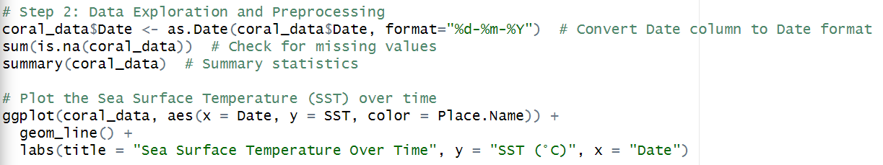
Step 2 - Data Exploration and Preprocessing
Date Conversion: Convert date format for analysis.
Data Quality Check: Check for missing values and review summary statistics.
SST Plot: Visualize SST trends over time by place.

Slide 10
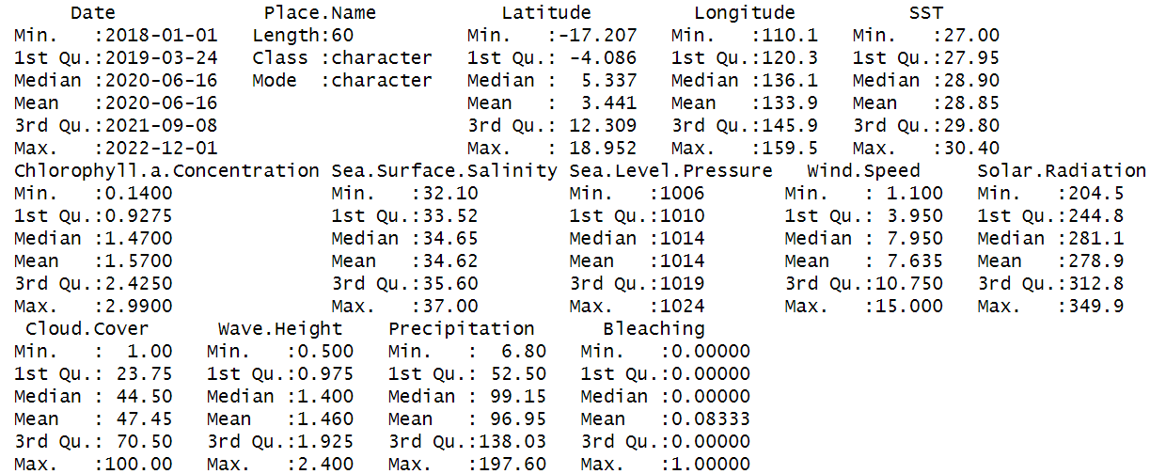

Slide 11
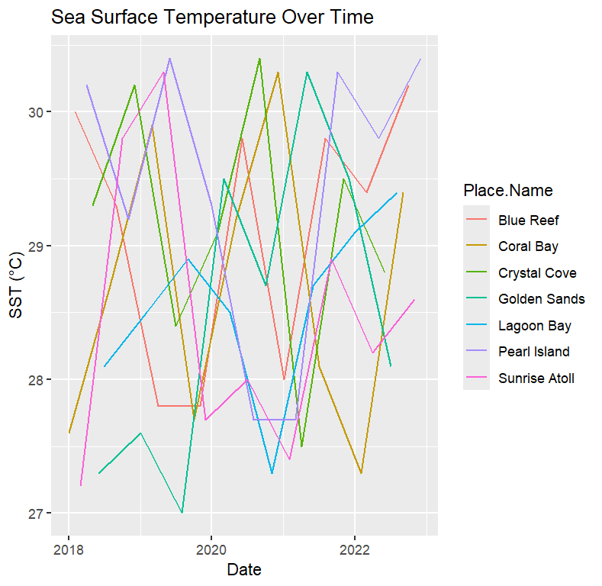

Slide 12
Step 3 - Exploratory Analysis of Key Variables
Scatter Plot: Plot SST vs. Solar Radiation to see relationships with bleaching events.
Insights: Highlight any visible trends or patterns in the plot.

Slide 13
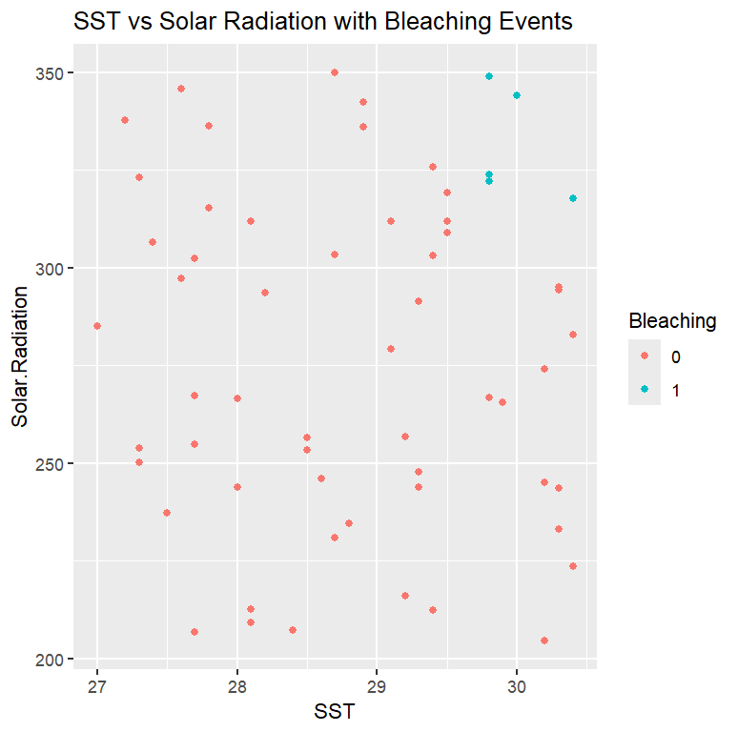

Slide 14
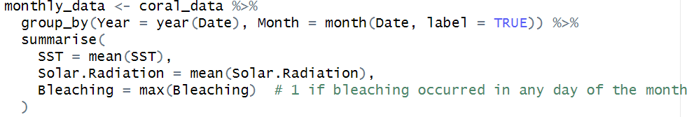
Step 4 - Data Aggregation for Time Series
Monthly Aggregation: Group data by month and compute monthly averages for SST, Solar Radiation, and maximum bleaching events.
Result: Summarized monthly data for easier time series analysis.

Slide 15
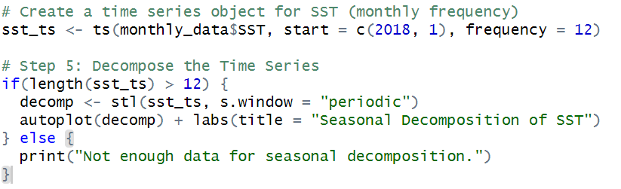
Step 5 - Decomposition of SST Time Series
Goal: Decompose the SST time series to analyze seasonal trends.
Method: Use STL decomposition for visualizing seasonality, trend, and residuals.

Slide 16
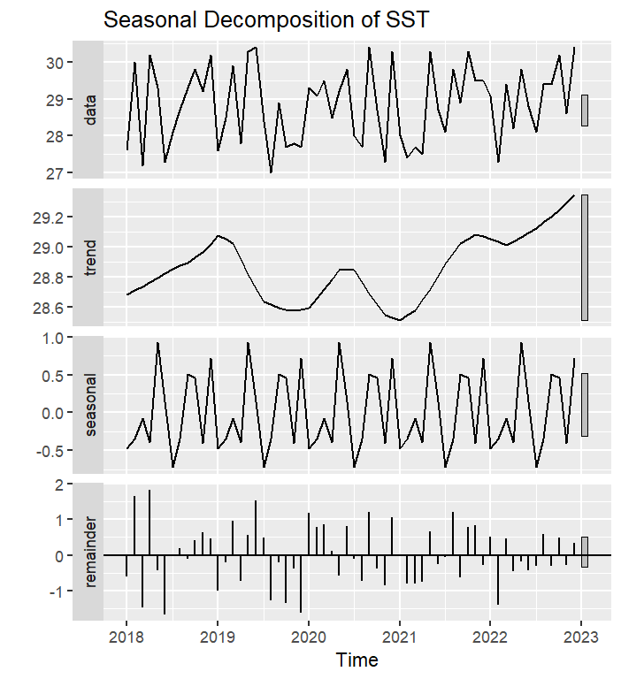

Slide 17
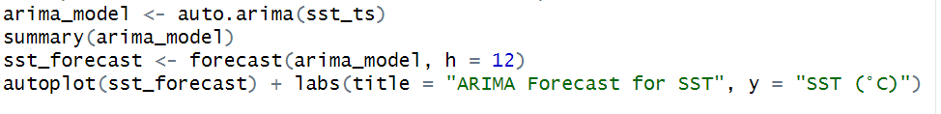
Step 6 - Building Predictive Models
Model 1: ARIMA for SST Forecasting

Slide 18
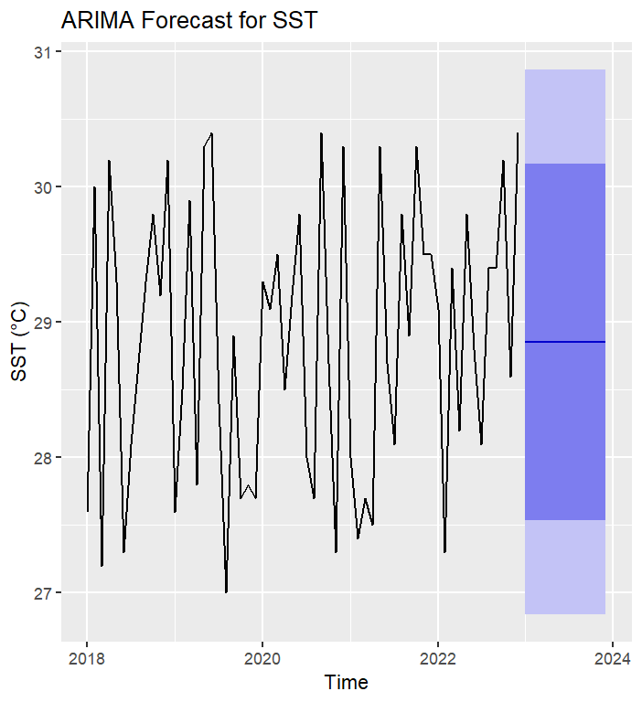

Slide 19
Step 7 - Bleaching Threshold Definition
Threshold for Bleaching: SST values above 29.5°C are considered high risk for bleaching. Predicted Bleaching Events: If forecasted SST exceeds threshold, bleaching is expected.

Slide 20
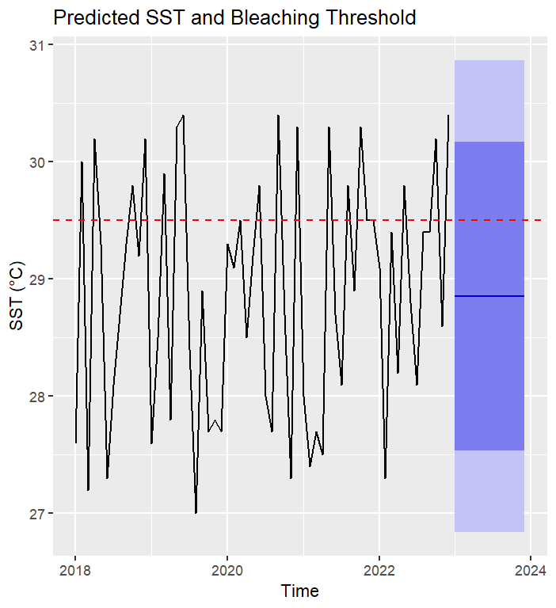

Slide 21
Step 8 - Exogenous Variables with ARIMAX
Model 2: ARIMAX Model- Adds Solar Radiation as an exogenous factor in predicting SST.
Forecast with Exogenous Factor: Improved SST forecast using additional variable.

Slide 22
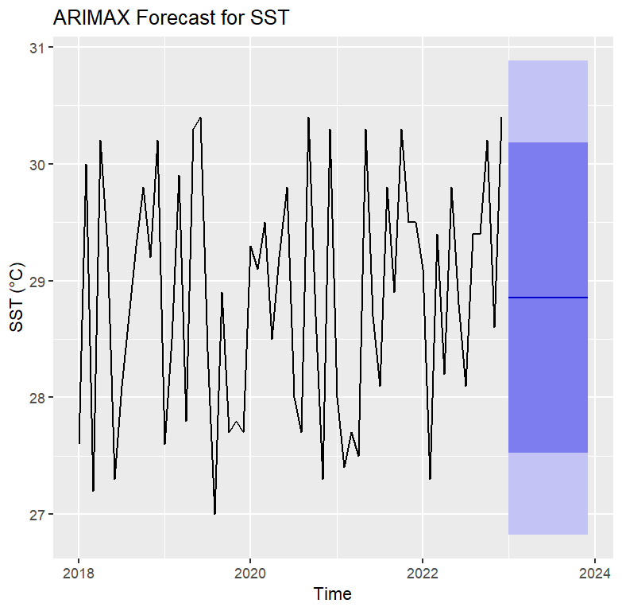

Slide 23
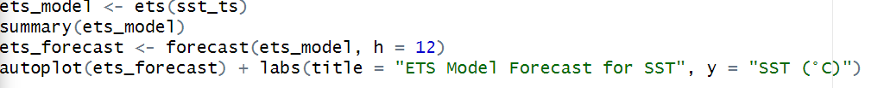
Step 9 - Other Models (ETS and VAR)
Model 3: ETS Model
Forecast SST using Exponential Smoothing.

Slide 24
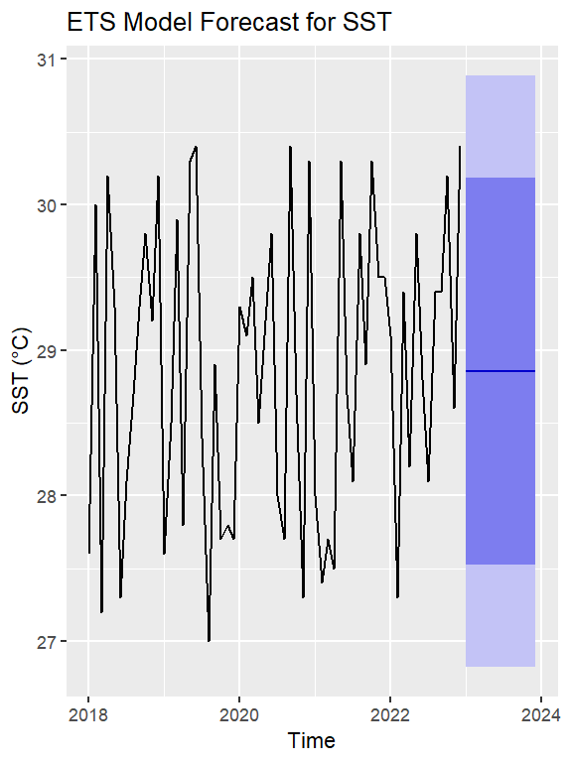

Slide 25
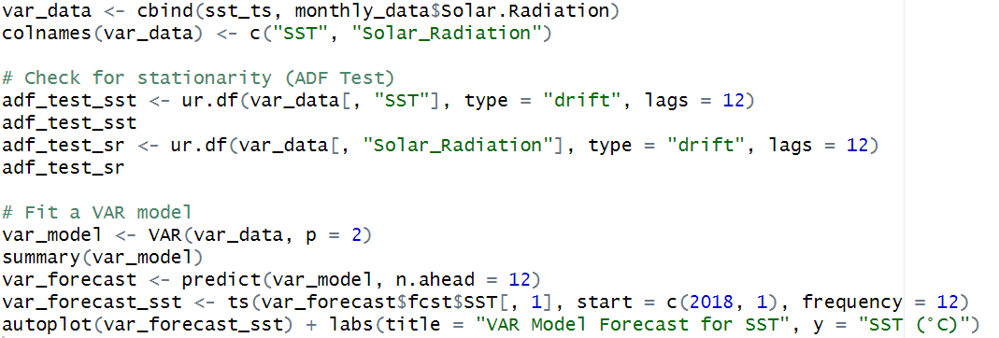
Model 4: VAR Model - Jointly models SST and Solar Radiation to analyze interactions.

Slide 26
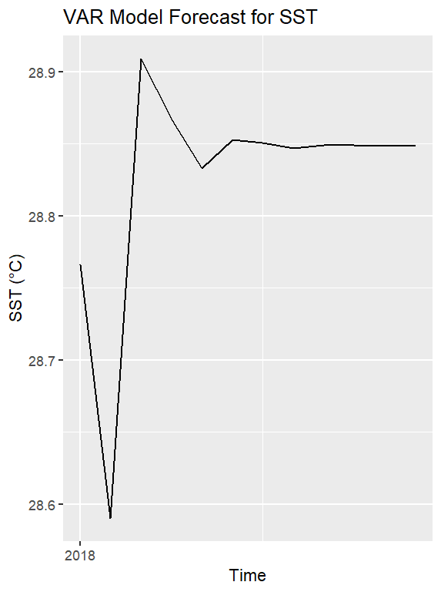

Slide 27
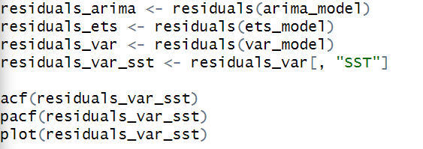

Slide 28
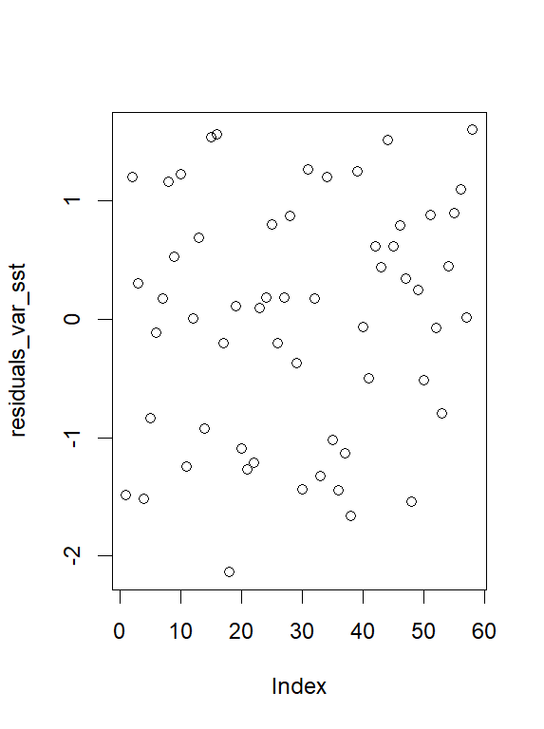
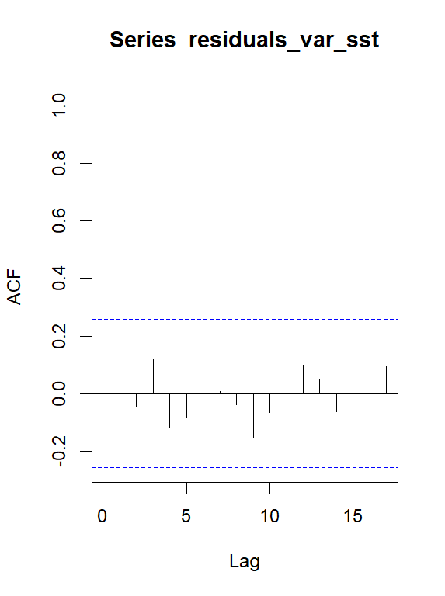
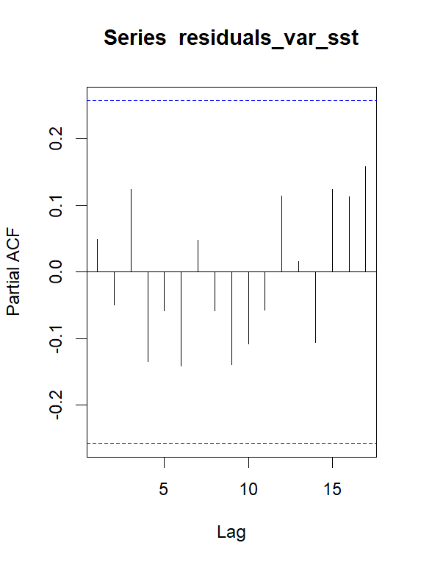

Slide 29
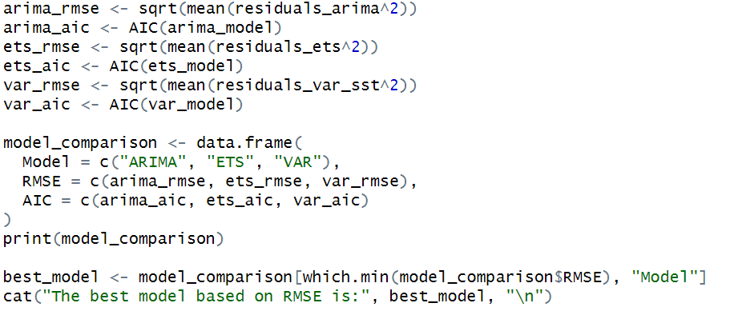
Step 10 - Model Comparison
Model Comparison Metrics: Compare ARIMA, ETS, and VAR models using RMSE and AIC.
Best Model Selection: Choose the model with lowest RMSE for final predictions

Slide 30


Slide 31
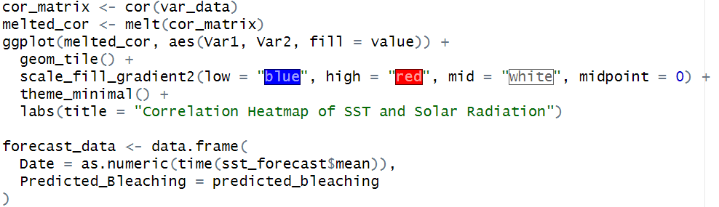
Step 11 - Sensitivity Analysis
Correlation Heatmap: Examine correlations between SST and Solar Radiation. Conclusion: Visual analysis of factor relationships impacting coral bleaching.

Slide 32
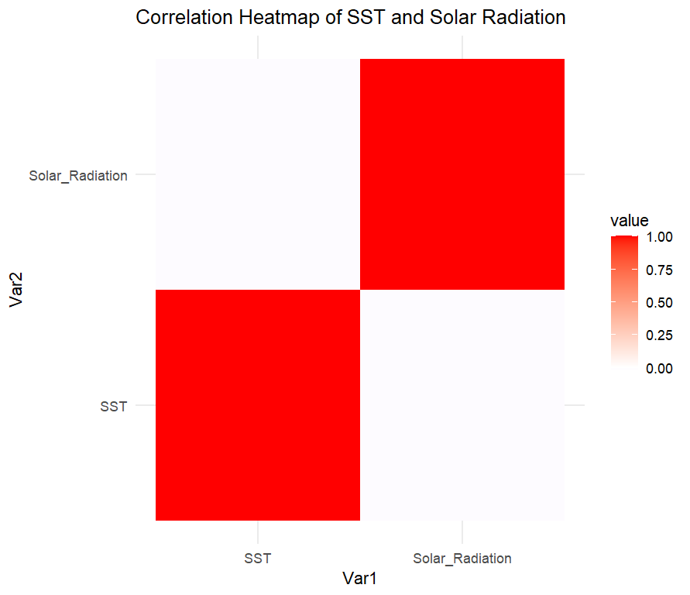

Slide 33
Conclusion
SST and Bleaching Link: High Sea Surface Temperature (SST) above 29.5°C correlates with coral bleaching events.
Best Model: The model ETS provided the most accurate SST forecasts, useful for predicting bleaching risks.
Key Environmental Insights: Solar Radiation, Cloud Cover, and Wind Speed affect SST and coral health.
Forecasting Benefits: Early SST predictions enable proactive conservation efforts during high-risk periods.
Future Scope: Include more variables, expand regionally, and apply insights to conservation policies.

