Slide 1
Presentaion_Bis15
JKAbrams, ASrivatsa

Slide 2
Does culture moderate relationships between rumination and symptoms of depression and PTSD?
-Based on 2022 paper, “https://journals.plos.org/plosone/article?id=10.1371/journal.pone.0278328” -Akshanth: religion, gender, education(1-5; change to factors) -JKA: depression, anxiety, age, trauma type for PTSD -For Cultures Studied: First 109 participant ids are Euro-Australian, next 144 are Malaysian

Slide 3
More Information About the Data
2 Cultures: 0,1 = Euro-Australian, Malaysian (convert to factors) -Culture = Groups 1,2 = Euro-Australian, Malaysian (change to factors) -Gender (convert to factors): M = 1 F = 2 Declined to state = 5
-Education (Highest level achieved): Secondary = 1 Post-secondary = 2 Undergrad degree = 3 Graduate degree = 4 Other = 5
-Religion codes: None = 1 Christian = 2 Muslim = 3 Buddhist/Taoist = 4 Hindu = 5 Other (incl Sikh, Agnostic) = 6
PTSD dataset:
-Index trauma type (what the PTSD is thought to be in response to):
Accident/serious injury/illness = 1 Non-sexual assault/abuse = 2 Sexual assault/abuse = 3 Witnessing death = 4 War/natural disaster = 5 Other = 6
-HADS = Hospital Anxiety and Depression Scale:
had_sdep = depression subscale total had_sanx = anxiety subscale total had_stotal = overall HADS total
-pts_dtotal = overall score on PTSD assessment scale
-RRS-B = Brooding scale - want sum of all RRS scores

Slide 4
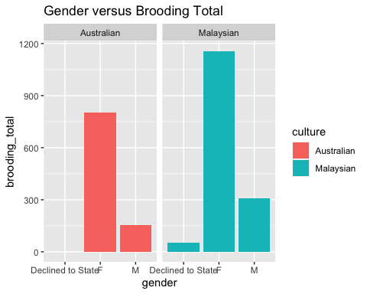
How Does Gender Affect Brooding Scores?

Slide 5
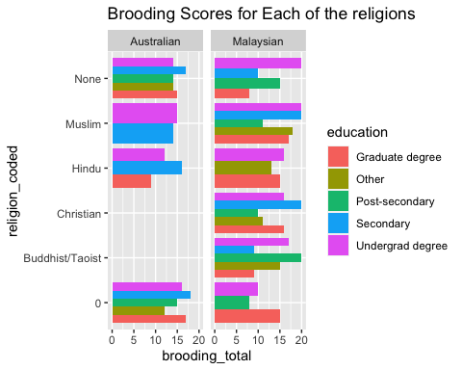
How does Religion and Education level affect Brooding Scores?

Slide 6
-Too complicated. Is there a better way to graph this?

Slide 7
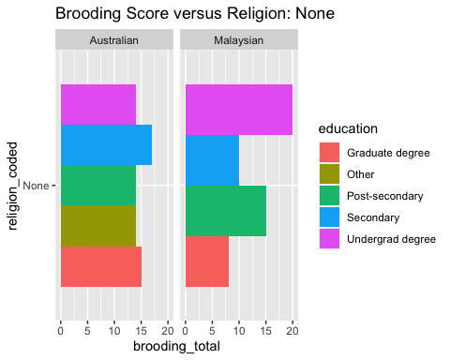
How does each religion affect Brooding scores?
-Only graphed Religions with differences of brooding scores*

Slide 8
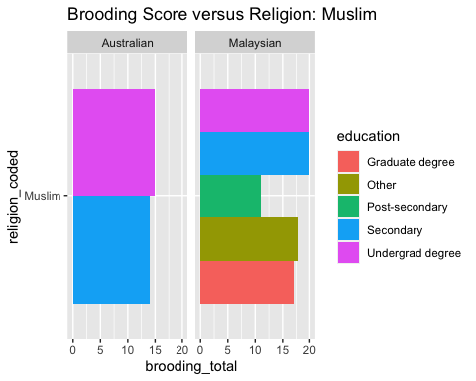
1st Religous Brooding Score

Slide 9
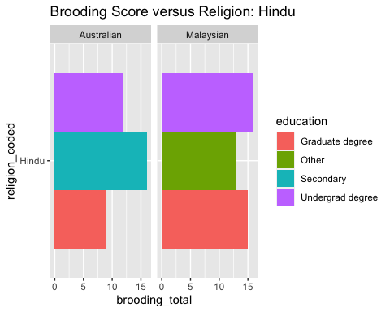
2nd Religous Brooding Score

Slide 10
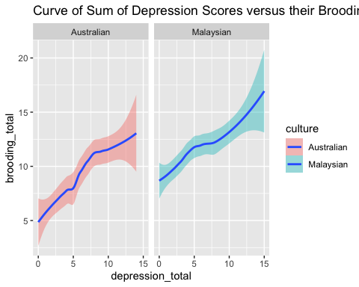
How does Depression Scores affect Brooding scores?
## `geom_smooth()` using formula = 'y ~ x'

Slide 11
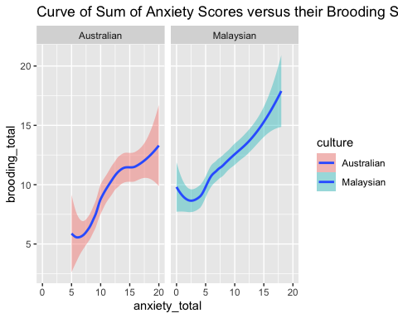
How does Depression Scores affect Brooding scores?

Slide 12
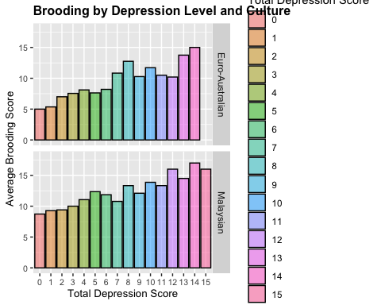
Graphically, how does that compare amongst different groups?

Slide 13
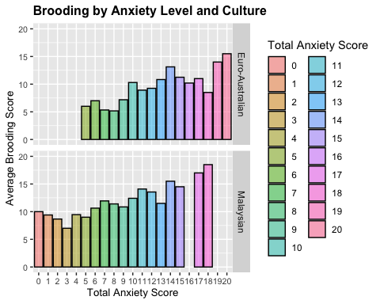
How about Anxiety level?

Slide 14
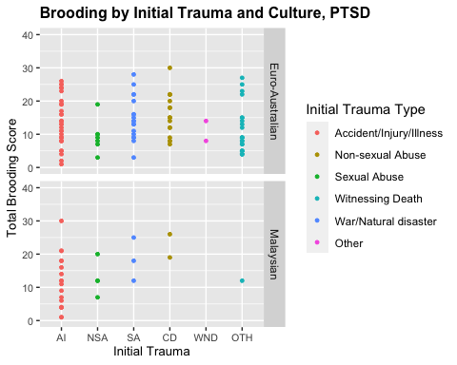
PTSD values
## Scale for colour is already present. ## Adding another scale for colour, which will replace the existing scale.

Slide 15
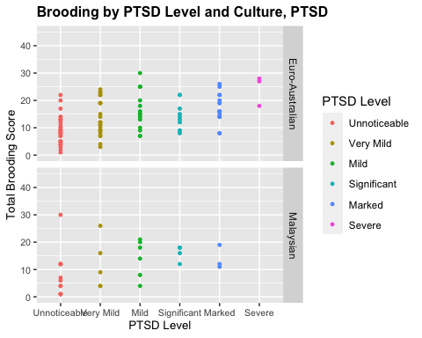
PTSD level and Culture
## Scale for colour is already present. ## Adding another scale for colour, which will replace the existing scale.

Slide 16
Conclusion
-What are the correlations between the variables (religion, age, education, axiety level, depression level, culture) on the brooding levels?
-Brooding levels tend to have a positive correlation with the above variables
-What does that mean for Brooding levels?

