Slide 1
analysis of yelp data-Set
Team - The data analytics group
- Akshay Karki
- Gaurav Gawade
- Shristika Yadav

Slide 2

Agenda
Introduction
Dataset
Implementation
CSV files
Data cleaning
Algorithm
Data Analysis and Visualization
Results and observations

Slide 3
Introduction
Yelp ratings are often seen as a respectable metric for businesses.
With the given yelp dataset, we will try to make business overview analysis which will help businesses judge how well they are doing at what time or during which day in the week.

Slide 4
Dataset
The dataset consist of 1.6 Million records which is spread over multiple JSON files.
The data in all the files are interlinked.
JSON files were parsed using Python and Pandas library and csv files were generated.
The csv files generated was further used for visualization and analysis.

Slide 5
Implementation
Consist of 3 stages -
Dataset collection/assembly
Clean data and analyze
Data mining and visualization

Slide 6
CSV files
checkins.csv - Consisted of the business names and the count of check-ins for each day.
time.csv - Consisted of the business names and the count of check-ins for each time range in the entire day.
rating.csv - Consisted of the business name and the count of ratings given to that business.
business.csv - Consisted of the business ID, business name, state, city and major category of each business.

Slide 7

Data cleaning
Removed data depending upon domain knowledge.
While creating csv file from business.json file, 100 major categories from all the given categories were selected and businesses belonging to these categories were only selected. Categories which consisted of minimal number of businesses were removed, since it will not be useful for the overall data mining procedure.
While creating csv file from check-in.json, there were lots of check-ins with 0 values. But, that is not a missing value since it is possible to have 0 check-ins for a given day. Thus, any records with 0 values over a period of five days were removed which was around 28k records out of 140k records.

Slide 8
Data cleaning
Removed data with missing values.
Businesses which had no categories were removed.
Businesses with missing business-Id were moved.
We did not have to deal with incorrect column names or useless attributes since the CSV file was generated by us.
We did not remove duplicate records if the business ID is different but all the days have exactly same check-ins. This is because it is probable for two different business IDs to have the same order of check-ins.

Slide 9
Algorithm
In order to identify the best value of k in K-means clustering, we implemented the KMean algorithm in Python3 using the scikit library.
We used the elbow method to determine the best value of K (i.e. the number of clusters). In this method, the sum of squared errors (SSE) is plotted against the various values of k (here, we choose the value ranging from 2-10).

Slide 10
Algorithm
The algorithm was run iteratively on business.CSV file which contains check-ins for business on each day of the week and time.CSV file which contains check-ins for the different sets of time ranges.
In order to identify the best value of k in K-means clustering, elbow method was used. In this method, the sum of squared errors (SSE) is plotted against the various values of k (value ranging from 2-10 were chosen).
The SSE can be described as the squared distance between the data points and centroids of a particular cluster.

Slide 11
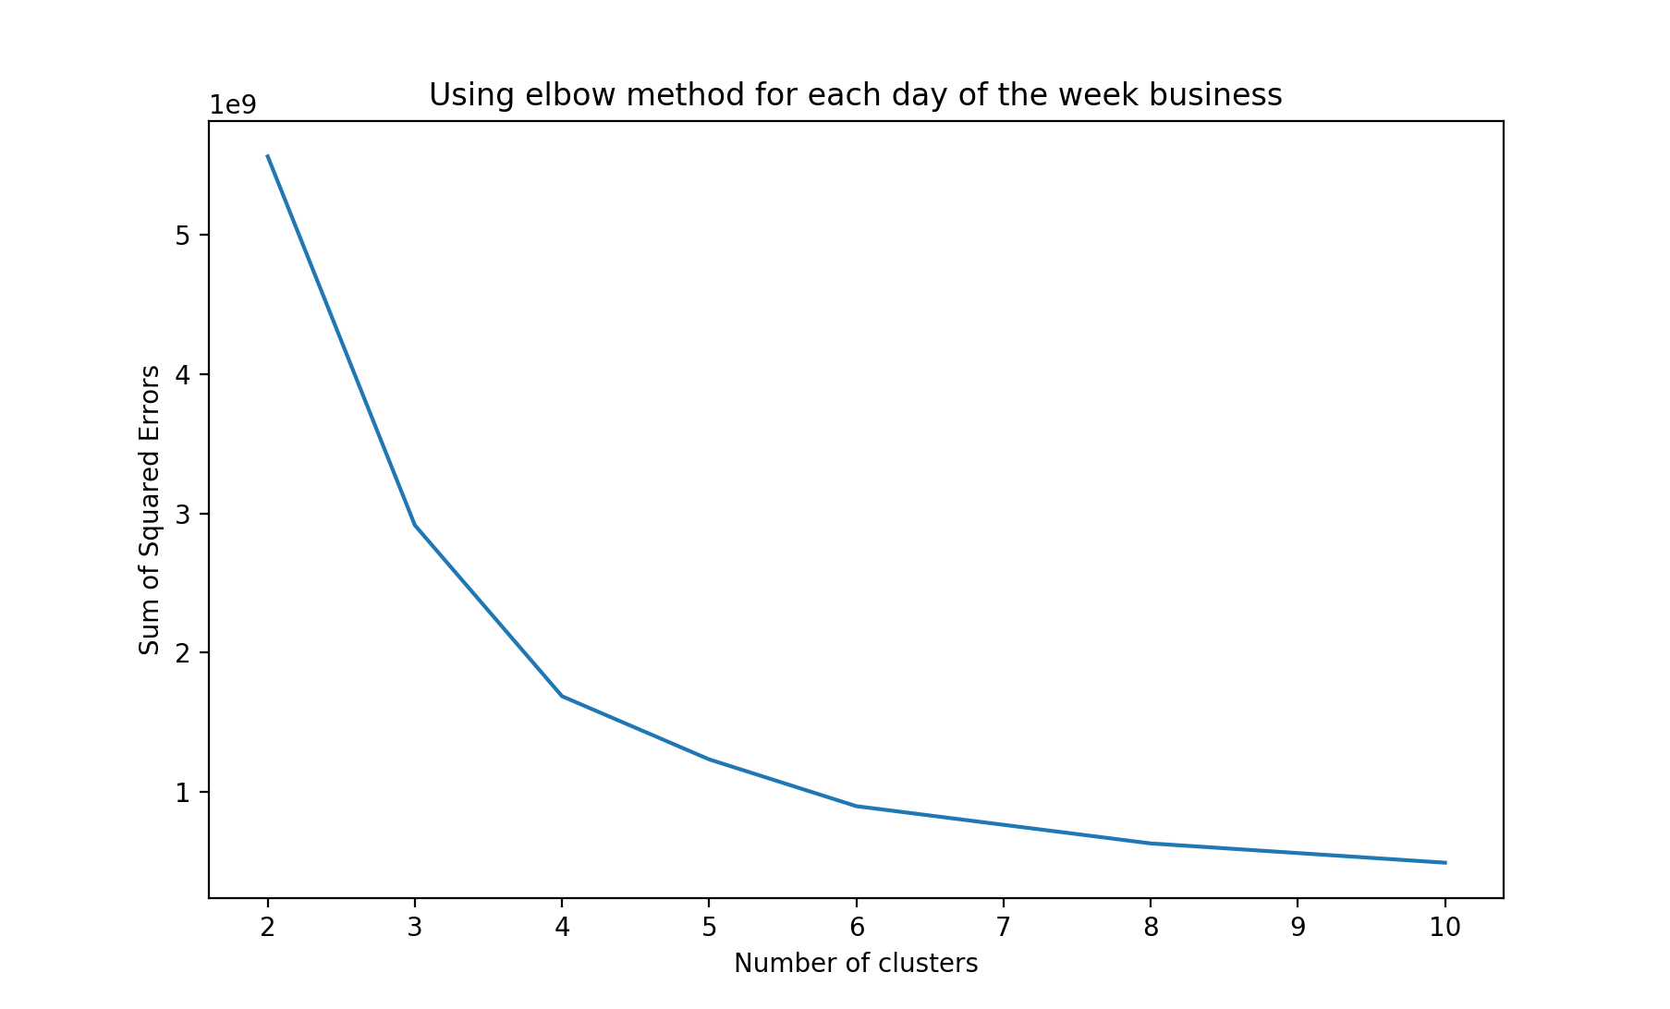
Algorithm
In the given figure, elbow points occurs at around 4 clusters. This tells us that if we have around 4 clusters, we will have the most optimal results as per our given data. This was same for time range graph too.

Slide 12
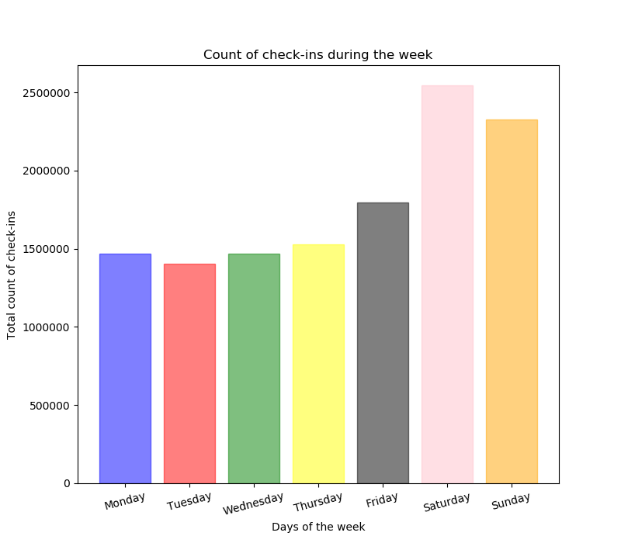
Data Mining and Visualization
To check which days are attracting a lot of customers, a bar graph was plotted showing which day has highest number of check-ins.

Slide 13
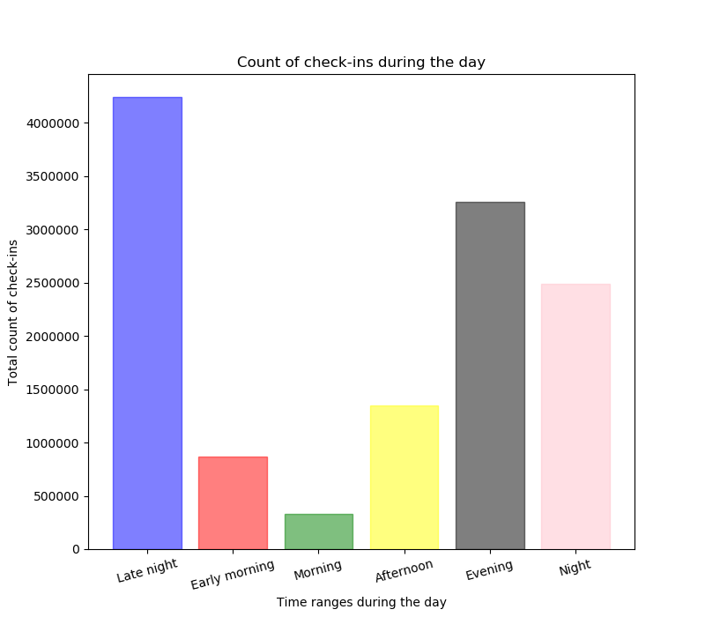
To check what time of the day is attracting a lot of customers, a bar graph was plotted with 6 distinct time-ranges.

Slide 14
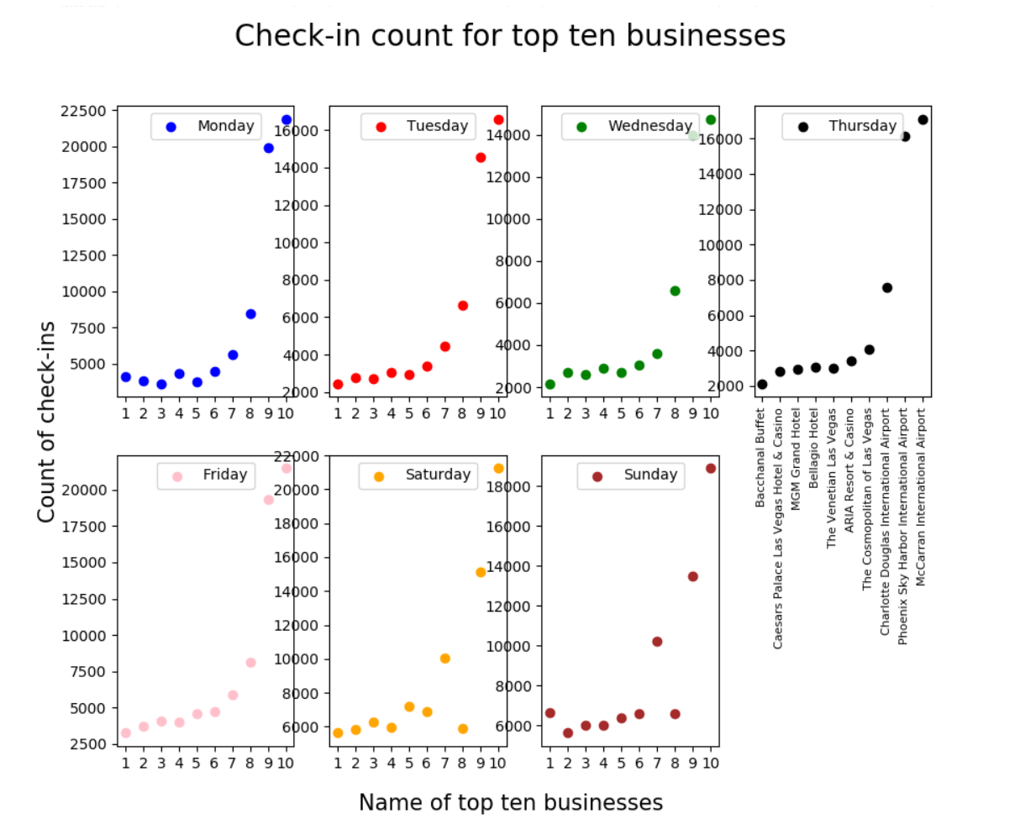
We then check each business according to the days of the week and compare which business does well on a given day.

Slide 15
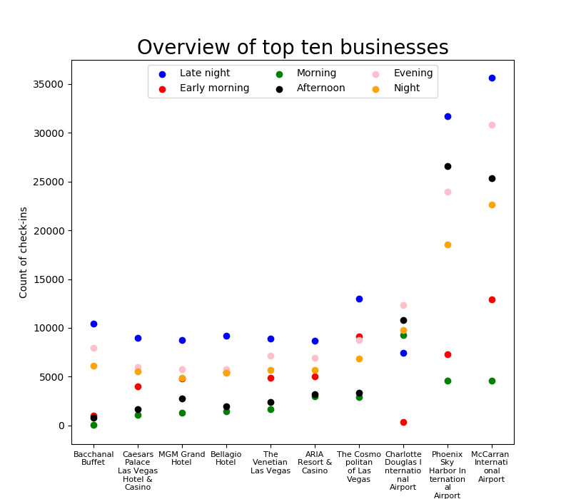
From the checkin.csv file, we extracted the list of business names and the sum of all its corresponding check-ins for the entire day. This list was used to show top ten businesses and see how these businesses compare to each other in terms of check-ins over the entire day.

Slide 16
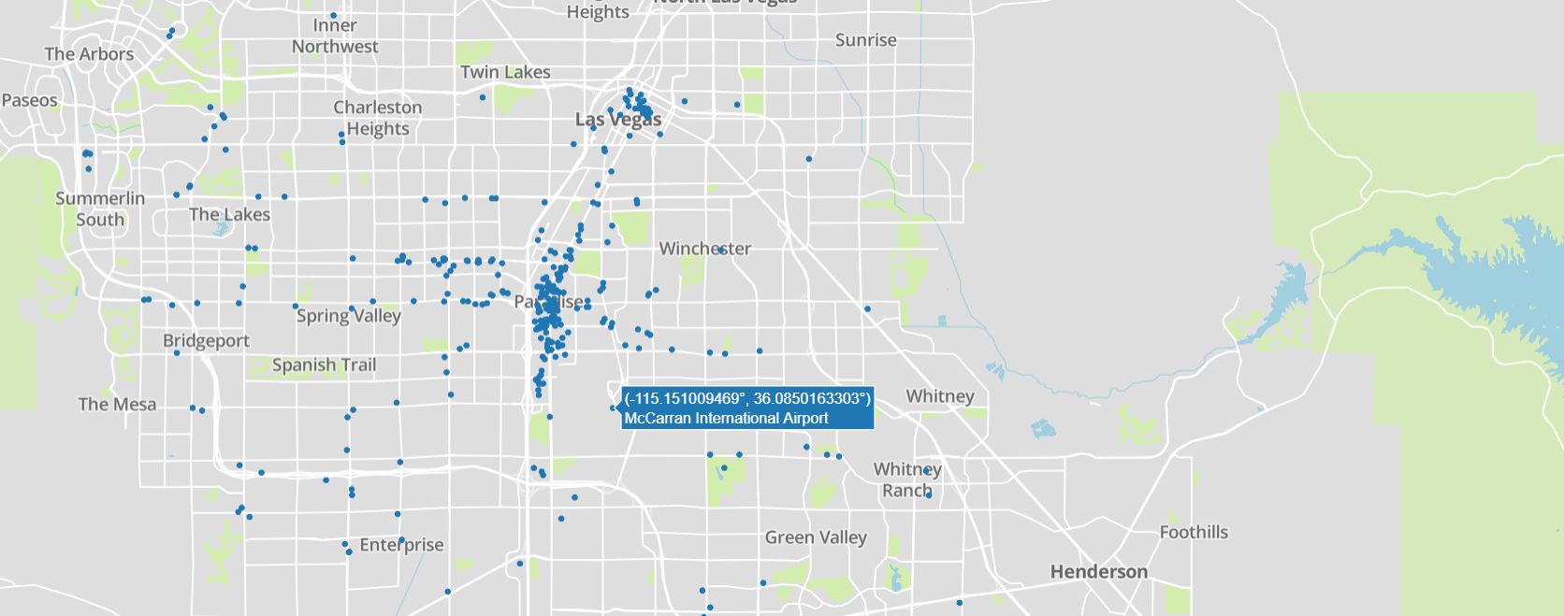
Plot.ly API integration with Python
Using the Plot.ly API, we integrated the API into our Python code. This helped us to plot the top 500 businesses on a world map using their latitudes and longitudes. Las Vegas contained the most busiest businesses.

Slide 17
Results and observations
We were able to calculate which day has highest and lowest number of check-ins. According to our data, saturday has highest number of check-ins.
We were able to calculate which time of the data has highest and lowest number of check-ins. We found that 0:00 am to 4:00 am, has the highest count of check-ins where as the lowest count was from 8:00 am to 12:00 pm.
Using the days of the week, we were able to plot which day had most check-ins using the checkins file. We did this for an entire day too using different time ranges for the businesses.
We used the Plot.ly API for Python and plotted the businesses. This revealed that many continents had a number of busy businesses. Las Vegas contained the most busiest businesses.

Slide 18
Thank you!!

