Slide 1
Logic Design Final Project
Fall 2016
Topic: Traffic Light
+
Reaction Time Game
Team #: 12
Members: 何榮晟 and 賀冠軒

Slide 2
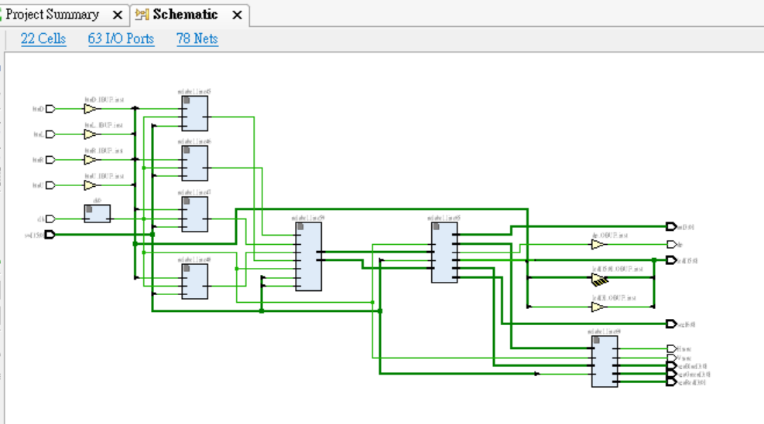
Baseline Design
Set and display traffic signal for cars and pedestrian
Architecture design
  System block diagram
  Gate count: 8658
Logic Design

Slide 3
Extension
A game to train one’s reaction time
LED: output signal (random 1 of 8 possible LEDs)
  Player has to choose the corresponding switch
Switch: player input
  Timer stops when the switch below the lit LED is flipped
Seven-segment display: timer for reaction time
  Displays in milliseconds
  Counter adds every 1/1000th second
Logic Design

Slide 4
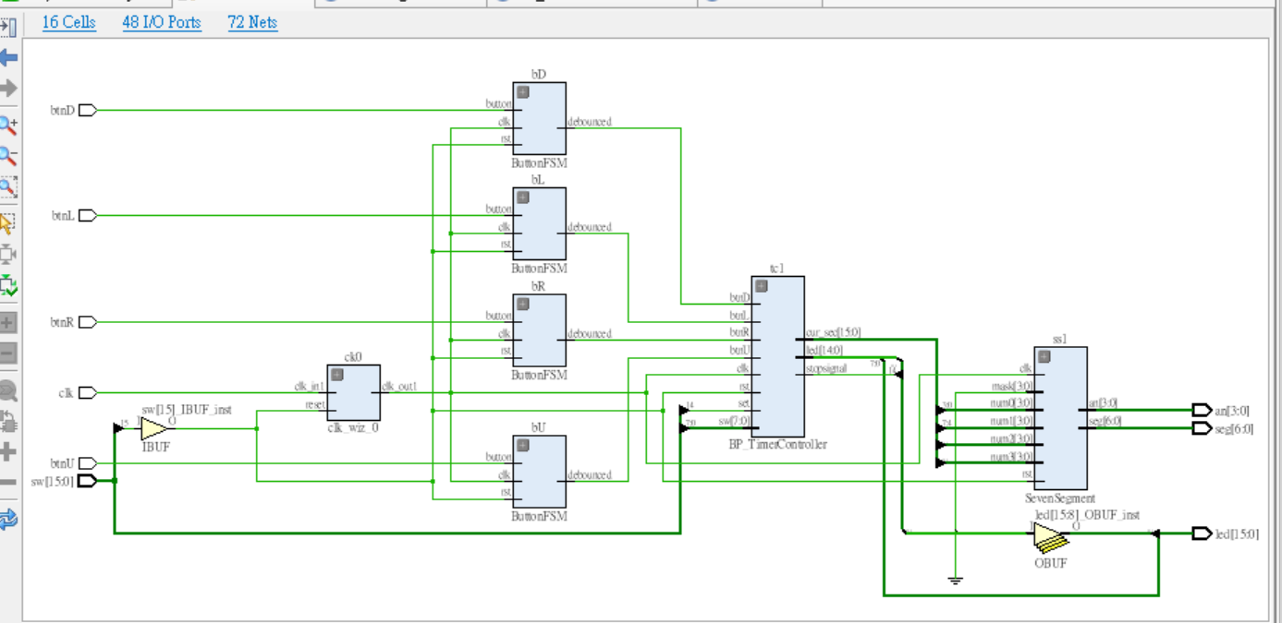
Extension
Architecture design
  System block diagram
  Implemented binary-to-BCD encoder
    Double dabble algorithm (aka shift-and-add-3)
      Shift when greatest place > 4
  Implemented pseudo-random number generator
    Uses the delay of time until next user input to seed random number
  Gate count: 602
Logic Design

Slide 5
Demo
Logic Design

Slide 6
Teamwork
Baseline Submodule
  Trafficlight: 賀冠軒
  MP_TimerController: 何榮晟
  DisplayController: 何榮晟 and 賀冠軒
Extension
  All files: 何榮晟 and 賀冠軒
Presentation
  Slides: 何榮晟 and 賀冠軒
  Demo: 何榮晟 and 賀冠軒
Overall: 何榮晟 = 50%, 賀冠軒=50%
Logic Design

