Slide 1

Blimey
AKSHAT TIWARI & YASH SAINI

Slide 2
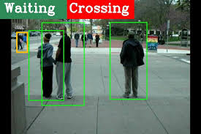
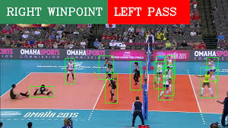
Vision
formulating a weakly supervised joint learning framework for fast collective activity recognition
Making the model user friendly
Incorporating it with the resources available for the physically challenged

Slide 3
Objectives
Focus
Write Model
Get Required Dataset
Data Analysis
Detect Objects
Ensure
Provide Voice Output
Train Model
Track Objects
Real Time Updates
Maintain high accuracy
Process it into speech

Slide 4
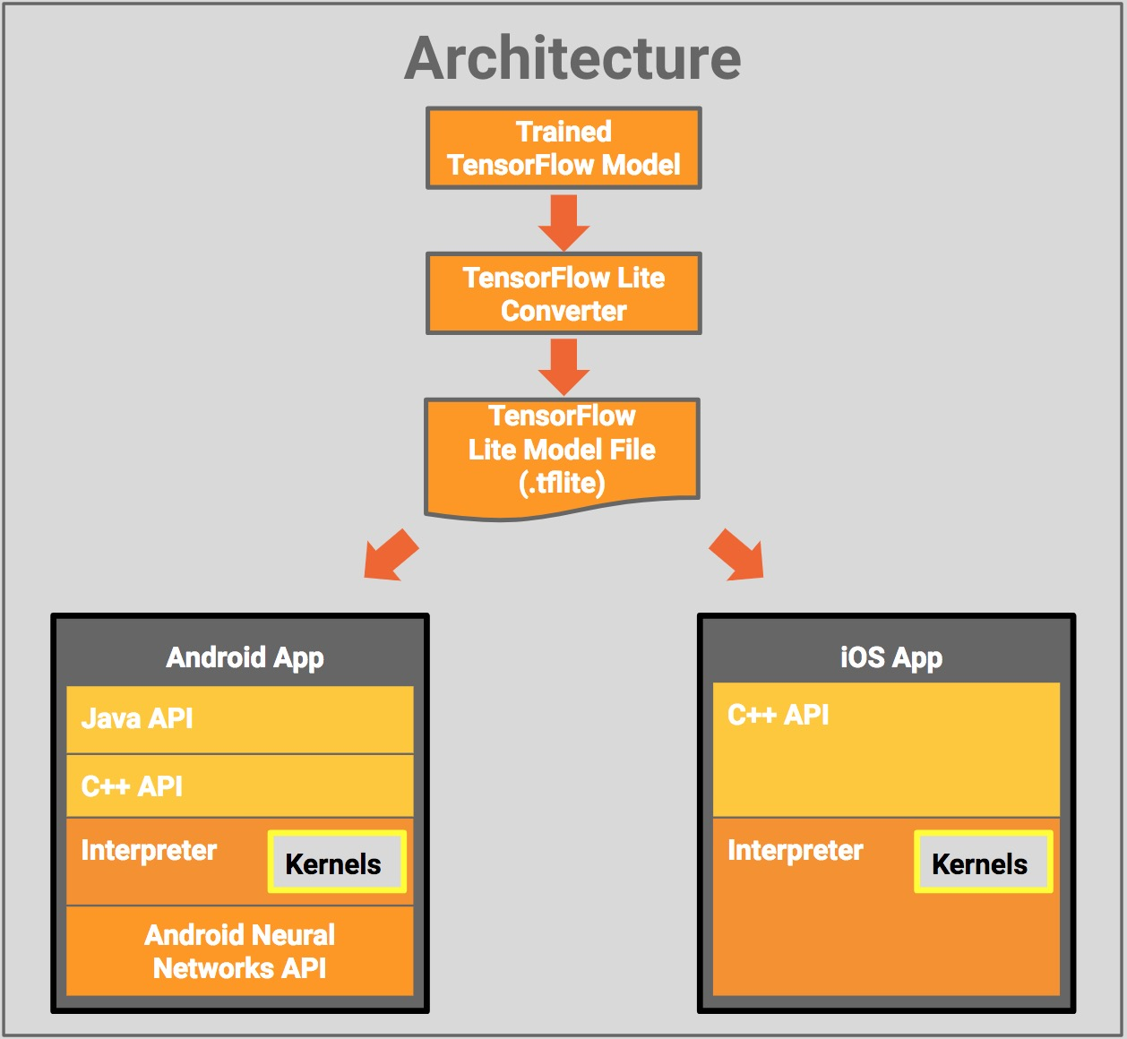
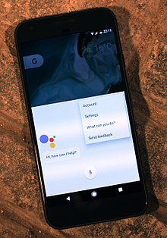

Proposed System

Slide 5

Thanks
MANAGED & DESIGNED BY :
AKSHAT TIWARI
YASH SAINI

