Slide 1

Grade 9 · AI Revolution & Digital Futures
UPI Fraud Awareness Assistant
Team Worksheet · Work through this together as a group
THE STORY
YOUR CHALLENGE
UPI scams are rising fast in India. Most people know how to use UPI but don't know the common tricks scammers use. Your team is building a chatbot that helps people spot these tricks before they lose money.
Design a chatbot that helps people recognise common UPI fraud tricks and stay safe, before they lose money. This worksheet covers research, ideation, and design.
Deliverables: a researched list of fraud tricks and red flags · a documented chatbot conversation design · a pitch and safety poster for your assistant
HCL JIGSAW | Edition 7 | Grade 9 · AI Revolution & Digital Futures · UPI Fraud Awareness Assistant · Team Worksheet

Slide 2

UPI FRAUD AWARENESS ASSISTANT - TEAM WORKSHEET
STEP 1 · RESEARCH THE FRAUD TRICKS
Q1. Research and document 5 common UPI fraud tricks from news articles or police advisories. For each: the fraud's name, how it works in simple steps, and one red flag to spot it.
1. Fake “Collect Request” scam
How it works: Scammer poses as an OLX/Marketplace buyer (or says they owe you money), sends a UPI collect request, and says “accept it to receive the money.” Entering your PIN to “accept” actually pays them — it doesn’t receive anything.
🚩 Red flag: you're asked to enter your UPI PIN to “get” paid — receiving money never needs a PIN.
2. Screen-sharing / remote-access app scam
How it works: A caller poses as bank/UPI support, says there's an urgent problem, and talks you into installing AnyDesk/TeamViewer/QuickSupport “to fix it.” Once installed, they see or control your screen and drain your account.
🚩 Red flag: any request to install a remote-access app or share a screen-access code.
3. QR code scam
How it works: You're told to scan a QR code to “receive” a payment, refund or prize. Scanning opens a PAY screen, not a receive screen — entering your PIN sends money out instead.
🚩 Red flag: being asked to scan a code AND enter a PIN just to “receive” something.
4. Fake KYC / account-block phishing (SMS/WhatsApp)
How it works: A message warns your UPI ID or bank account/KYC will be blocked within hours unless you click a link and “verify.” The link leads to a fake page or app that steals your details.
🚩 Red flag: urgency + a link, e.g. “blocked in 2 hours — click here.”
5. Fake customer-care number scam
How it works: You Google “[bank/app] customer care” for help, call a number planted by scammers in search results or social comments, and the “agent” asks for your OTP/PIN or asks you to install an app.
🚩 Red flag: a customer-care number found via search/social media instead of your passbook, card, or the official app.
Researched from: RBI & NPCI fraud advisories, I4C/Cyber Dost alerts, and 2026 fraud-pattern reports by Razorpay and AuthBridge.
HCL JIGSAW | Edition 7 | Grade 9 · AI Revolution & Digital Futures · UPI Fraud Awareness Assistant · Team Worksheet

Slide 3
UPI FRAUD AWARENESS ASSISTANT - TEAM WORKSHEET
STEP 1 · RESEARCH THE FRAUD TRICKS
Q2. Find 2-3 real statistics about UPI fraud in India (how common it is, how much money is lost), and cite where you found them. Then name 2 emotions or tricks scammers use to make people fall for scams think fear, urgency, greed, or trust.
Real statistics on UPI fraud in India:
1. ₹805 crore was lost to UPI fraud in just the first 8 months of FY26, across 10.64 lakh reported incidents (FY24-25 saw ₹981 crore lost across 12.64 lakh cases). (Source: government data reported by The420.in)
2. 1 in 5 Indian families with a UPI user has faced fraud at least once in the last 3 years — and 51% of victims never even filed a complaint. (Source: LocalCircles survey, via Business Standard, 2025)
3. RBI's Annual Report 2024-25 recorded 13,516 digital-payment fraud cases worth ₹520 crore — digital payments now make up 56.5% of all reported banking-fraud value. (Source: RBI Annual Report 2024-25)
Emotions/tricks scammers use:
Urgency & fear — “your account will be blocked in 2 hours” pushes people to act before they think it through.
Greed & trust — posing as a known buyer, a bank employee, or offering a refund/cashback/prize makes the story feel ordinary, so people lower their guard.
HCL JIGSAW | Edition 7 | Grade 9 · AI Revolution & Digital Futures · UPI Fraud Awareness Assistant · Team Worksheet

Slide 4
UPI FRAUD AWARENESS ASSISTANT - TEAM WORKSHEET
STEP 2 · TALK TO REAL PEOPLE
Q3. Talk to 2 people about their UPI experience. Have they seen a suspicious message or call? What happened? Write what each person said, and their age or relation to you.
⚠️ This one is for your team to fill in after real conversations — use this template:
PERSON 1 — Name/initial: ______ Age: ______ Relation to you: ______
• Have they seen a suspicious UPI message, call, or payment request? ______________________________
• What happened, and what did they do? ______________________________
• What would they have wanted a safety chatbot to tell them? ______________________________
PERSON 2 — Name/initial: ______ Age: ______ Relation to you: ______
• Have they seen a suspicious UPI message, call, or payment request? ______________________________
• What happened, and what did they do? ______________________________
• What would they have wanted a safety chatbot to tell them? ______________________________
Tip: talk to one older relative and one person your own age — they usually describe very different scams (phone-call scams for older relatives, QR/refund scams for teens), and that contrast is worth a line in your findings.
HCL JIGSAW | Edition 7 | Grade 9 · AI Revolution & Digital Futures · UPI Fraud Awareness Assistant · Team Worksheet

Slide 5
UPI FRAUD AWARENESS ASSISTANT - TEAM WORKSHEET
STEP 2 · TALK TO REAL PEOPLE
Q4. Find out what NPCI, a bank, or the police have already done to warn people about UPI fraud. What's missing? A quick web search for “UPI safety campaign” is a good start.
What's already been done:
• RBI has run “RBI Kehta Hai” since 2016 — financial-literacy and fraud-awareness videos on social media.
• NPCI launched the “Main Moorkh Nahi Hoon” UPI safety campaign with actor Pankaj Tripathi.
• MHA's I4C runs “Cyber Dost” on social media and, with CBSE, a nationwide school cyber-awareness initiative.
• The government runs the 1930 helpline and cybercrime.gov.in portal for reporting fraud.
What's missing:
All of these are one-way broadcasts — a video, a poster, a tweet. None of them can answer “is THIS call/message/QR code happening to me right now a scam?” in the exact moment someone is confused, which is when they need help most. That gap probably explains why 51% of victims never even report it — nobody to ask, before or after. A two-way, judgment-free chatbot that reacts to a person's actual situation is the missing piece.
HCL JIGSAW | Edition 7 | Grade 9 · AI Revolution & Digital Futures · UPI Fraud Awareness Assistant · Team Worksheet

Slide 6
UPI FRAUD AWARENESS ASSISTANT - TEAM WORKSHEET
STEP 3 · DESIGN YOUR CHATBOT'S FLOW
Q5. Compare 2 free chatbot-building tools (like ManyChat, Tidio, or Landbot) - which is easier for your team to use, and why? Then draw or describe a simple flowchart (4-5 boxes): user describes a situation → chatbot asks a question → chatbot decides if it's a scam → chatbot gives a warning.
Landbot vs. Tidio:
Landbot is a visual, drag-and-drop flowchart of blocks and buttons — that maps directly onto a decision tree like ours (“user describes situation → bot asks a follow-up → branches to a verdict”). Its free Sandbox plan (100 chats/month, 1 seat) is enough to pilot-test with our 5 people.
Tidio is built more for e-commerce live-chat (Shopify/WooCommerce) with basic automation — its free tier is less suited to multi-step branching logic without upgrading.
Our pick: Landbot — we can build our exact flow as connected blocks with no code, and share a working link immediately.
Our chatbot flowchart:
[1] User describes their situation (free text, or a quick-pick: payment request / screen-share app / QR code / KYC message / customer-care call)
↓
[2] Chatbot asks ONE clarifying question specific to that type (e.g. “Did it ask you to enter your UPI PIN?”)
↓
[3] Chatbot checks the answer against known red flags (PIN/OTP requested, urgency wording, unknown app/link/number)
↓
[4] Decision: any red flags found?
→ YES: names the scam, explains why, gives 2-3 next steps (don't pay/share, block, report to 1930)
→ NO: reassures it looks fine, and still repeats one golden safety rule
HCL JIGSAW | Edition 7 | Grade 9 · AI Revolution & Digital Futures · UPI Fraud Awareness Assistant · Team Worksheet

Slide 7
UPI FRAUD AWARENESS ASSISTANT - TEAM WORKSHEET
STEP 3 · DESIGN YOUR CHATBOT'S FLOW
Q6. Pick 1 fraud type and write the full conversation: what the user says, what the chatbot asks, and what warning it gives make it sound natural, not robotic. What should the chatbot say if the situation isn't actually a scam? It should reassure without sounding dismissive.
Chosen fraud type: Fake “Collect Request” scam
User: “Someone buying my old phone on OLX said he already sent ₹15,000 — I just need to ‘accept’ the request to get it.”
Chatbot: “One quick check — when you open that request, does it ask you to enter your UPI PIN?”
User: “Yeah, it says enter UPI PIN to accept.”
Chatbot: “🚩 Please don't enter it — that's the giveaway. On UPI, your PIN is only ever needed to SEND money, never to receive it. That ‘accept to receive’ request is actually asking you to pay him ₹15,000. This is a common OLX/Marketplace scam. Don't enter any PIN, decline the request, and block the buyer.”
User: “Omg, I almost typed it in. So how do I actually get paid safely next time?”
Chatbot: “Just share your UPI ID or QR code — that's it. Receiving money never asks you for anything, not a PIN, not an OTP. If it ever does, stop.”
If it ISN'T a scam (reassurance, without being dismissive):
User: “My friend sent me ₹500 for dinner on GPay and I got a ‘money received’ notification. Is that safe?”
Chatbot: “Yes, that's exactly what a normal, safe UPI payment looks like — you received a notification and never had to enter a PIN. All good! Just remember: you'd only ever need your PIN if YOU are sending, never receiving.”
HCL JIGSAW | Edition 7 | Grade 9 · AI Revolution & Digital Futures · UPI Fraud Awareness Assistant · Team Worksheet

Slide 8
UPI FRAUD AWARENESS ASSISTANT - TEAM WORKSHEET
STEP 4 · WRITE THE MESSAGES & DESIGN THE POSTER
Q7. Write your chatbot's opening message. Keep it short, friendly, and clear about what it does. Then write 2 warning messages for 2 different fraud types; each should clearly say it's a scam, explain why, and tell the person what to do. Be clear and calm - not scary or preachy.
Opening message:
“Hi, I'm UPI Suraksha Mitra 🛡️. Tell me what happened — a call, message, payment request, or QR code that felt a bit off — and I'll help you figure out if it's a scam, in under a minute. I won't judge, and nothing you type leaves this chat.”
Warning 1 — screen-sharing scam:
“🚩 This matches the fake customer-care screen-sharing scam. No real bank or UPI app support will ever ask you to install AnyDesk/TeamViewer or share a screen-access code. Please uninstall the app now, don't share any code or OTP, and call your bank using the number on your card — not the one they gave you. Already shared access? Report at 1930 or cybercrime.gov.in right away.”
Warning 2 — fake KYC / account-block message:
“🚩 Two classic scam signs here: urgency (‘blocked in 2 hours’) plus a link to ‘update KYC’. Real banks and NPCI never update KYC through an SMS link. Please don't click it or enter any details — just delete the message. Want to check your KYC status? Only do it through your bank's official app or a branch visit.”
HCL JIGSAW | Edition 7 | Grade 9 · AI Revolution & Digital Futures · UPI Fraud Awareness Assistant · Team Worksheet

Slide 9
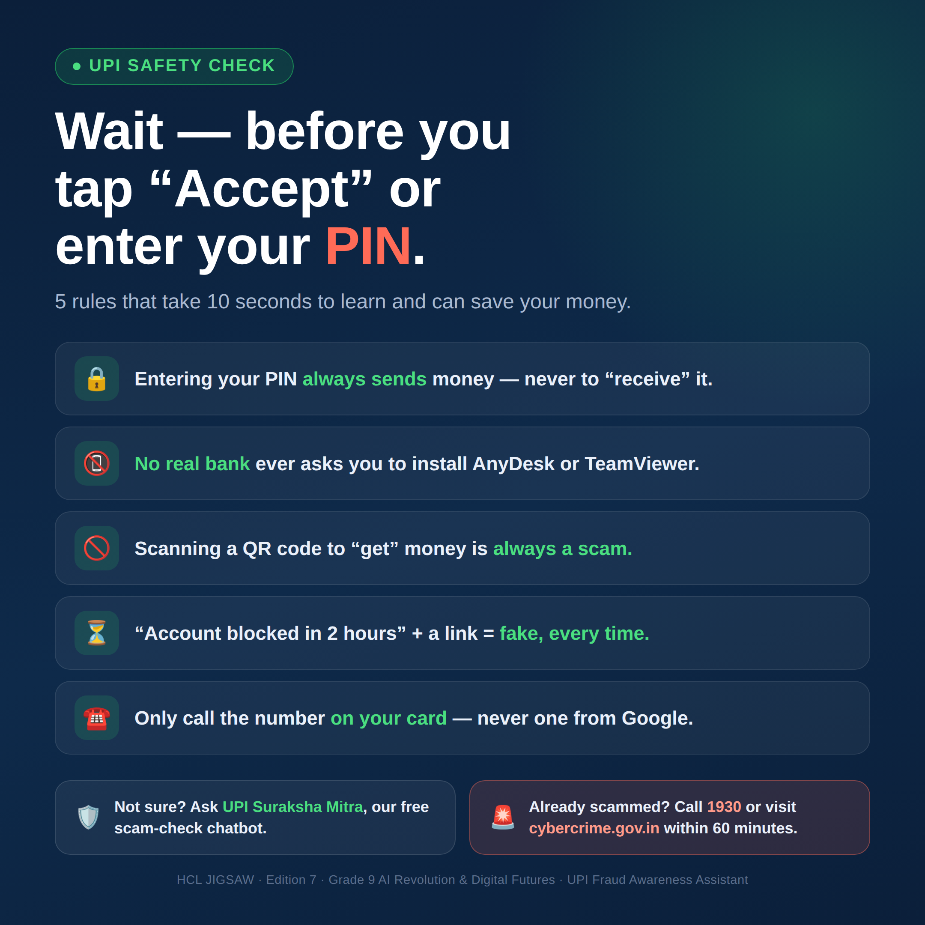
UPI FRAUD AWARENESS ASSISTANT - TEAM WORKSHEET
STEP 4 · WRITE THE MESSAGES & DESIGN THE POSTER
Q8. Sketch a simple safety poster for WhatsApp with your top 5 UPI safety rules. Think about what would make someone actually stop and read it. Upload a photo of your sketch hand-drawn is fine.
HCL JIGSAW | Edition 7 | Grade 9 · AI Revolution & Digital Futures · UPI Fraud Awareness Assistant · Team Worksheet

Slide 10
UPI FRAUD AWARENESS ASSISTANT - TEAM WORKSHEET
STEP 5 · PLAN YOUR TESTING & PITCH IT
Q9. Plan how you'll test your chatbot with 5 real people over a few days. Who will you ask? Then write how you'll measure if they learned something: 2-3 simple before/after questions, asked the same or similar way both times.
Who we'll ask (mix of ages/tech comfort):
1 parent · 1 grandparent/older relative · 1 friend our age · 1 teacher · 1 shopkeeper/vendor who uses UPI daily.
How:
Show them the chatbot and walk through 2 scenarios (one real scam type, one normal/safe case), over 2 sittings a few days apart — a short “before” chat, then an “after” chat once they've had a few days with the link.
Before/after questions (asked the same way both times):
1. “On a scale of 1-5, how confident are you that you could spot a fake UPI payment request?”
2. “If a QR code says ‘scan to receive ₹X’, what would you do?” (open-ended — look for “I wouldn't enter my PIN”)
3. “What's one thing you'd check before trusting a call about your bank account?”
We'll count “learned something” as a correct new red flag showing up in Q2/Q3's answer, not just a higher confidence score — confidence alone can be misleading.
HCL JIGSAW | Edition 7 | Grade 9 · AI Revolution & Digital Futures · UPI Fraud Awareness Assistant · Team Worksheet

Slide 11
UPI FRAUD AWARENESS ASSISTANT - TEAM WORKSHEET
STEP 5 · PLAN YOUR TESTING & PITCH IT
Q10. Write your pitch: the problem, your chatbot solution, and what you're asking a school or the police to do. End with a clear, specific ask.
THE PROBLEM
UPI fraud is exploding — ₹805 crore lost in just the first 8 months of this financial year, across 10.64 lakh cases, and 1 in 5 Indian families have been targeted. Over half of victims never even report it. Existing awareness campaigns are one-way — none can answer “is THIS happening to me right now a scam?” in the exact moment someone is confused.
OUR SOLUTION
UPI Suraksha Mitra — a free chatbot anyone can message the moment something feels off. They describe the situation in their own words, answer one quick follow-up, and get an instant, judgment-free verdict plus exactly what to do next, built on the same red flags real UPI scams use and tested with real people across two generations.
OUR ASK
To our school: give us 10 minutes at the next student assembly or PTA meeting to demo this chatbot, and share its link once in the official school WhatsApp broadcast group.
To the local Cyber Cell: review the chatbot's fraud logic with us, and if it holds up, share the link through your own outreach and the 1930/cybercrime.gov.in channels — so it reaches families beyond our one school before their next scam call comes.
We already built a working prototype — try it yourself: upi-suraksha-mitra.onrender.com
HCL JIGSAW | Edition 7 | Grade 9 · AI Revolution & Digital Futures · UPI Fraud Awareness Assistant · Team Worksheet

