Slide 1


Team Details
  Team name: AVA-AI (product: TalkToBuy) · Alok Jain, Vaibhav Singh, Akshada Borhade
  Team leader name: Alok Jain
  Problem Statement: Grocery apps assume people can type, search and navigate menus in English. Senior citizens and first-time smartphone users are left out. TalkToBuy lets anyone shop by speaking in their own language, and still keeps them in control of every purchase.

Slide 2
Brief about the idea
A voice-first AI shopkeeper that lets anyone shop in their own language
Namaste Vaibhav! How can I help you?
Step by step. I want to make veg biryani for 50 people.
Say it the way you would at the corner shop: “two litres of milk, a paav kilo of tomatoes”, or “I want to make veg biryani for 50 people”. TalkToBuy answers in Hindi or English, asks only what changes the list, fills the cart with real pack sizes, and checks out after one fingerprint on the shop's own payment screen.
It embeds in a shopping app as a web component, on top of the app's own catalogue, cart and checkout through open commerce protocols (UCP and AP2). The app keeps its systems and reaches shoppers who find today's apps hard to use.
Lovely! Is there anything you already have at home?
Salt and oil.
Shopkeeper (blue) and shopper (yellow)
Talk or tap
One cart
Address & slot
Fingerprint
Order placed

Slide 3
Opportunities
670M
9.04M
$0.01–0.04
people aged 60+ in Asia-Pacific in 2022, 1.3B by 2050 (ESCAP)
people 65+ in Japan with difficulty accessing food, 2020 (MAFF)
per voice session in our test runs, so it scales cheaply
How is it different?
How does it solve it?
Our USP
Voice ordering today takes orders; TalkToBuy turns a goal into a full list
Judges amounts: 50 people means about 5 kg of rice, not 50 packets
Tap and talk share one live cart
Plugs into a store instead of replacing it
No typing, no menus: just speak in Hindi or English
Replies in the shopper's language, with captions on screen
Never rushes: one question at a time, step by step by default
Nothing guessed is bought, and payment is by fingerprint only
A goal becomes a complete cart in one conversation
Understands Indian units: paav kilo, dedh litre
Elder-first trust: no OTP or PIN asked, no health claims, no media stored
Open standards (UCP, AP2): integrates faster than it can be built

Slide 4
List of features offered by the solution
1
Speech-to-speech voice
2
Goal to full list
3
Indian units
4
Tap or talk, one cart
Real-time Hindi and English conversation on Gemini Live. Interrupt any time; captions on screen.
“Veg biryani for 50” becomes every ingredient with real amounts; skips what you have or already carted.
“Paav kilo”, “dedh litre”, “do kilo” become exact pack plans from the catalogue.
Browse, search and add by tapping. Voice and taps share one cart, even “cancel my order”.
5
Your own pace
6
Shows what you show
7
Checkout by fingerprint
8
Safe and private
Step by step by default, quick for shoppers in a hurry. Change it by voice any time.
Hold up an empty packet: it names the product and asks before adding it.
Address and slot, a spoken read-back of items, total and delivery, then one fingerprint.
No OTP or PIN asked, no health claims, family told only with consent, no audio or video stored.

Slide 5
Process flow diagram or Use-case diagram
Shopper's phone
Session server
Gemini Live
Demo store
1
2
3
4
5
Shopper speaks or taps
Relays audio to Gemini Live
Understands and picks a tool
Checks the call, asks the store
Search, cart, checkout (UCP)
Use cases
Spoken list
Goal to list
Tap and talk cart
Checkout
“Cancel my order”
9
8
7
6
Shopkeeper announces the order
Verifies and places the order
Confirms cart; fingerprint pays
Pushes cart and cards to the app
Payment rule: the fingerprint is checked in the browser and goes straight to the store, never through voice.

Slide 6
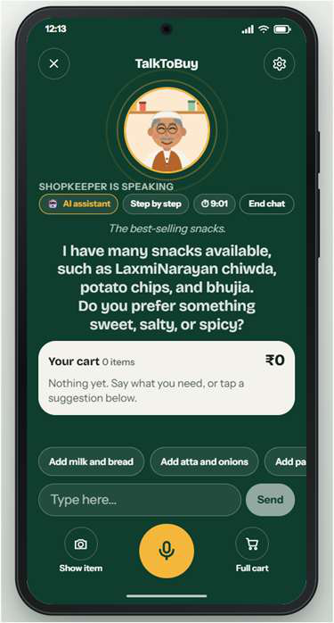
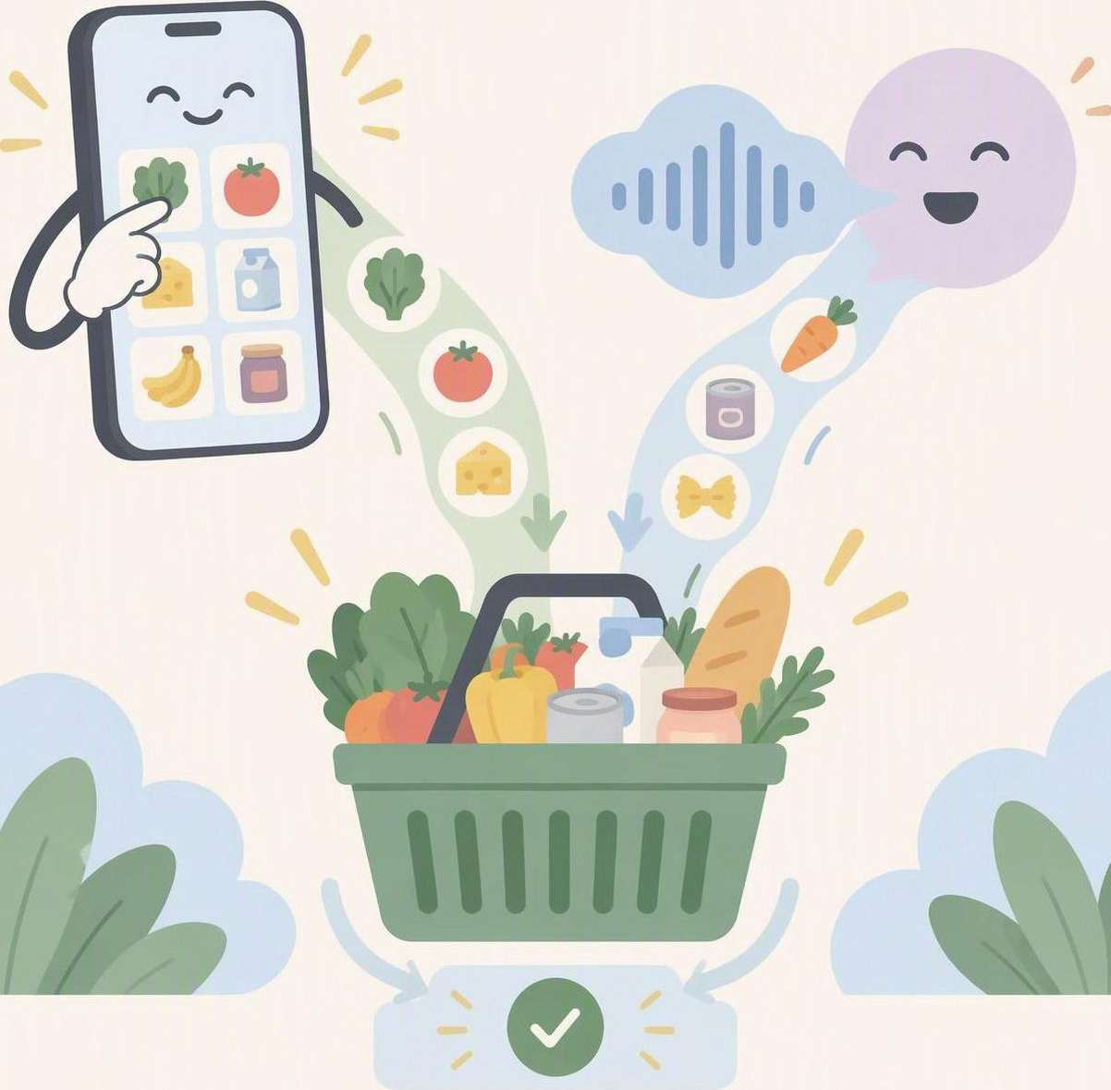
Wireframes/Mock diagrams of the proposed solution (optional)
1
“AI assistant” label always visible
2
Pace chip: step by step or quick
3
Session timer and End chat
1
3
2
Live captions of what is said
4
4
5
Running cart with its total
5
6
One-tap suggestions
7
Type instead of speaking
6
7
Show item (camera), mic, full cart
Tap or talk, one cart. Whatever the shopper taps or says lands in the same cart, so nothing is lost or duplicated.
8
8
Screen from the working app: the shopkeeper asking what kind of snack the shopper wants.

Slide 7
Architecture diagram of the proposed solution
Shopper's phone · browser
Session server · FastAPI
Google Cloud · Vertex AI
TalkToBuy widget
Lit web component · Web Audio mic and speaker · WebSocket client
Session orchestrator
audio relay · captions · idle and time caps
Gemini Live
voice + tools
2.5 Flash
safety check
Flash-Lite
captions
Embedding
search
Tool router + guards
JSON-Schema checks · approval before inferred items
Cloud Firestore
session state
Shop app
Browse, cart, checkout
Planner
dish lists · Hindi unit parser · pack plans
Demo store · FastAPI · Cloud Run
Biometric payment
WebAuthn fingerprint on the shop's own payment screen
UCP catalogue, cart, checkout
Safety + shared cart
warning-sign check · cart re-read before each cart action
AP2 mandates, ES256 signed
WebAuthn verification
Links: phone ⇄ server: audio + text (WebSocket) · server ⇄ Google Cloud: live audio, tools, state · server ⇄ store: UCP over HTTPS
Payment: the fingerprint is checked in the browser and goes straight to the store, never through voice.

Slide 8
Technologies to be used in the solution
Google product | What we use it for
Gemini Live (Vertex AI) | Real-time voice conversation and tool calling
Gemini Live Avatar | Optional animated shopkeeper, off by default
Gemini 2.5 Flash | Safety classification of what is said
Gemini 2.5 Flash-Lite | Low-cost English captions (display only)
Gemini Embedding | Meaning-based catalogue search, Hindi and English
Vertex AI + Gen AI SDK | Model access with project-scoped credentials
Cloud Run + Artifact Registry | Hosts and ships the two services
Cloud Firestore | Session state when running in the cloud
Firebase Hosting | Serves the shop app, routes API calls
Open standards and frameworks
UCP 2026-08-25: catalogue, cart, checkout
AP2 mandates, ES256 signed, test mode
WebAuthn fingerprint approval
Python 3.12, FastAPI, Pydantic
TypeScript, Lit web component, React
Web Audio and WebSocket streaming
JSON Schemas shared by Python and TypeScript
Open Food Facts catalogue: 525 products (ODbL, CC BY-SA)
Nine Google Cloud products power TalkToBuy, each behind an interface we own.

Slide 9
Estimated implementation cost (optional)
$0.01–0.04
10 min
0
per voice session in our test runs
hard cap per session, plus an idle timeout
models trained or hosted by us: managed Google services only
Cost driver | How it is charged | Our estimate
Gemini Live voice and tool calls | Per audio minute and tokens | $0.01–0.04 per session, measured in test runs
Live Avatar video (optional) | Per video; rate not yet published | Off by default, so not in the estimate
Gemini 2.5 Flash and Flash-Lite | Per token, short texts | Tiny per-caption calls, logged per session
Embeddings | Once, when the catalogue is built | 525 products embedded one time
Cloud Run, Firestore, Firebase | Pay per use | Small at pilot scale; to be checked against billing
Build effort | People and time | 9–18 Oct 2026 sprint, team of three
Notes:
Per-session cost range comes from the team's test runs. Live Avatar pricing is not published, so avatar video is off by default and excluded. Cloud Run, Firestore and Firebase figures still need reconciling with GCP billing.

Slide 10
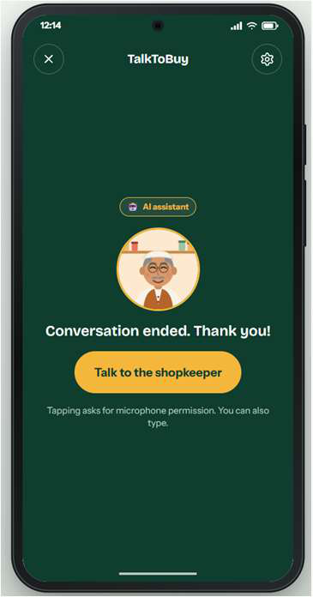
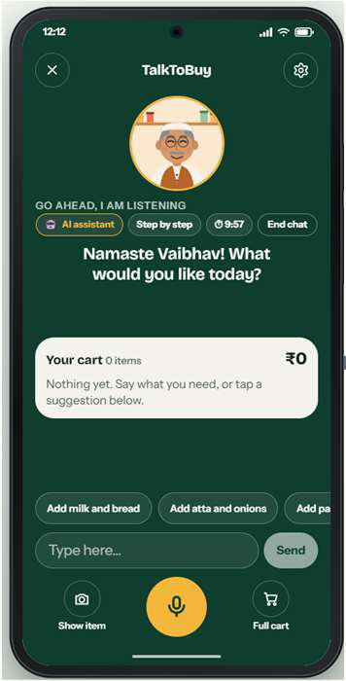
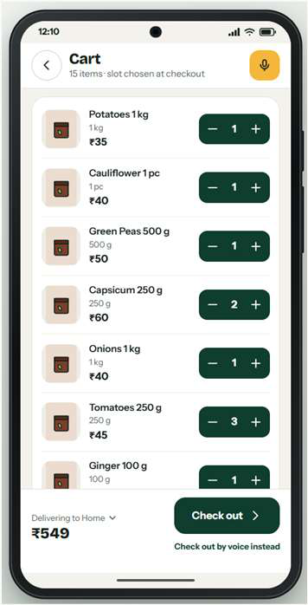
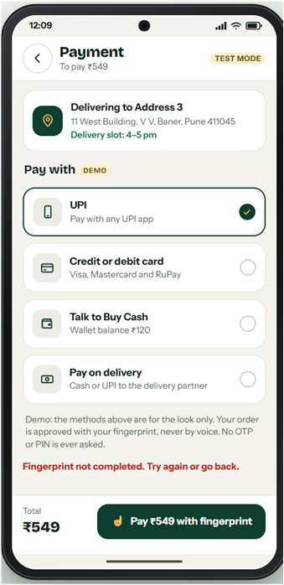
Snapshots of the prototype
1 Greets by name and starts on a tap
2 Listens in Hindi or English
3 Asks one question at a time
4 Cart with real amounts
5 Fingerprint payment (test mode)

Slide 11
Prototype Performance report/Benchmarking
525
385
$0.01–0.04
0
products in the demo catalogue
automated tests, plus a full order walkthrough
per voice session in test runs
audio, video or transcripts stored
What we measured | Target | Result so far
First reply after the shopper stops | Under 1.5 s | 5.5–7.4 s in text-mode rehearsal; voice run felt natural; mic timing still to measure
Stops talking when interrupted | Under 300 ms | Audio queue flushed on interrupt (widget tested); timing to measure on demo machine
Safety and product claims | Zero violations | 24-prompt safety suite passes; 27-case claims check, 0 violations
Right item, right quantity | Exact | 2 L milk and 250 g tomatoes added by voice; read-back equals the cart
One approval to pay | Exactly one | A spoken “yes, pay” places no order; one fingerprint completes it
Avatar video bandwidth | n/a | About 4–5 Mbit/s, so audio-only is the default
Notes:
Latency: 5.5-7.4 s is from the text-mode rehearsal logged on 12 Oct (target is 1.5 s). The voice run felt acceptable but has not been timed with a microphone yet. Test counts and cost per session are the team's figures; re-run the suites before submitting.

Slide 12
Additional Details/Future Development (if any)
Now
Next
Later
Voice and tap shopping in Hindi and English, one cart, fingerprint checkout
More JAPAC languages, real merchants through UCP, live pilot on Cloud Run
Pilots with senior communities and family-assisted ordering
Built to scale across JAPAC
1
Language is one setting
2
Voice fits mobile-first markets
3
Any merchant can plug in
4
Scales without a rebuild
Hindi and English today. Each new language is a setting, not a rebuild.
Speaking works for shoppers who live on their phones, whatever their reading level.
Open protocols (UCP, AP2) connect any store and payment method.
Managed Google Cloud services grow with demand, from pilot to region.

Slide 13
Provide links to your:
GitHub Public Repository: [add link]
Demo Video Link (3 Minutes): [add link]
Final Product Link: [add link]
Team AVA-AI · Alok Jain (leader), Vaibhav Singh, Akshada Borhade
TalkToBuy: a voice-first AI shopkeeper that lets anyone shop in their own language

Slide 14


