Slide 1
Marketing and Retail Analytics: Capstone Project
Submitted By-
Akshada Kumari Joshi

Slide 2
INDEX
PROBLEM STATEMENT
EDA & VISUALIZATION
ASSOCIATION RULES MINING
APRIORI ALGORITHM
PARETO ANALYSIS
MARKET BASKET ANALYSIS

Slide 3
PROBLEM STATEMENT- I
In the recent past, e-commerce companies have emerged and flourished in the industry. They offer the convenience to order from a wide variety of options from the comfort of one’s home. But how do they offer these “wide variety of options or products”? To be able to meet the demands of the customers, any e-commerce company would obviously need to store tons and tons of products in warehouses. Now, some of these warehoused products might be fast-moving products which sell very quickly and some others might be slow-moving. Each of the products being stored incurs a cost to the company in terms of space and maintenance. Since storing these products obviously add to the costs that the company incurs, it is absolutely necessary for the organisations to plan their inventory well.

Slide 4
PROBLEM STATEMENT- II
Now, OList is one such e-commerce company that has faced some losses recently and they want to manage their inventory very well so as to reduce any unnecessary costs that they might be bearing. In this assignment, you have to manage the inventory cost of this e-commerce company OList. You need to identify top products that contribute to the revenue and also use market basket analysis to analyse the purchase behaviour of individual customers to estimate with relative certainty, what items are more likely to be purchased individually or in combination with some other products.

Slide 5
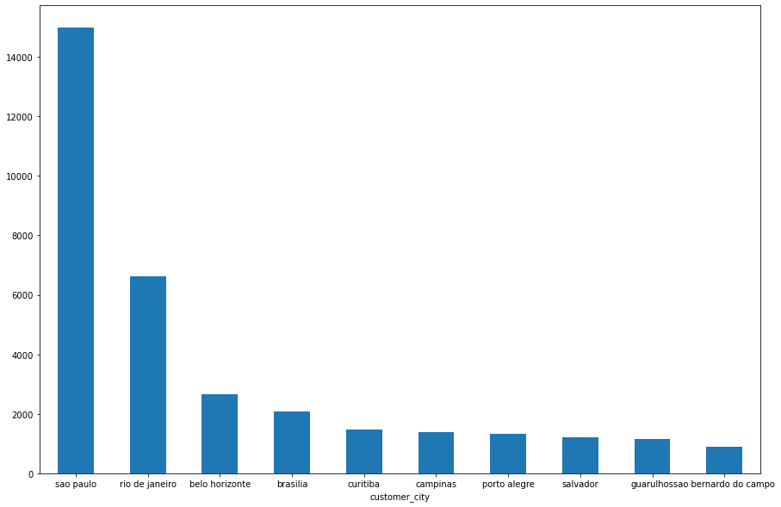
TOP CONSUMERS BY CITY
Insight: The top customer cities are Sao Paulo and Rio de Janerio

Slide 6
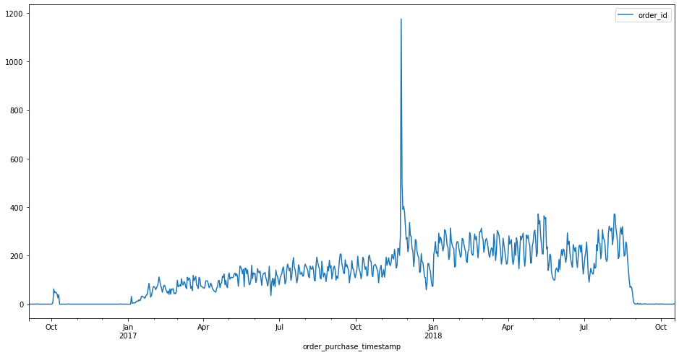
Peak month of purchase
Insight: The top Purchases are made between the duration of October and January

Slide 7
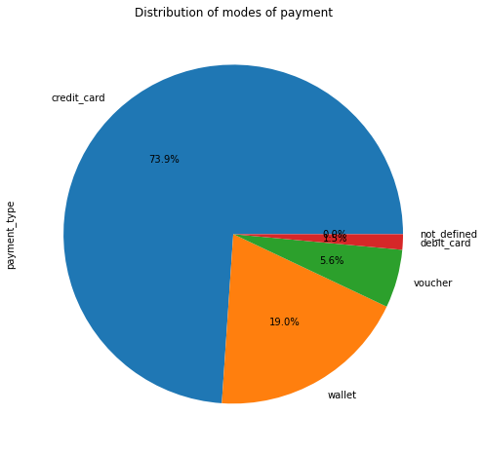
Distribution of Payment Mode
Insight: The maximum number of payments is done through Credit Card i.e, 74%, The 19% of payment is done by wallet

Slide 8
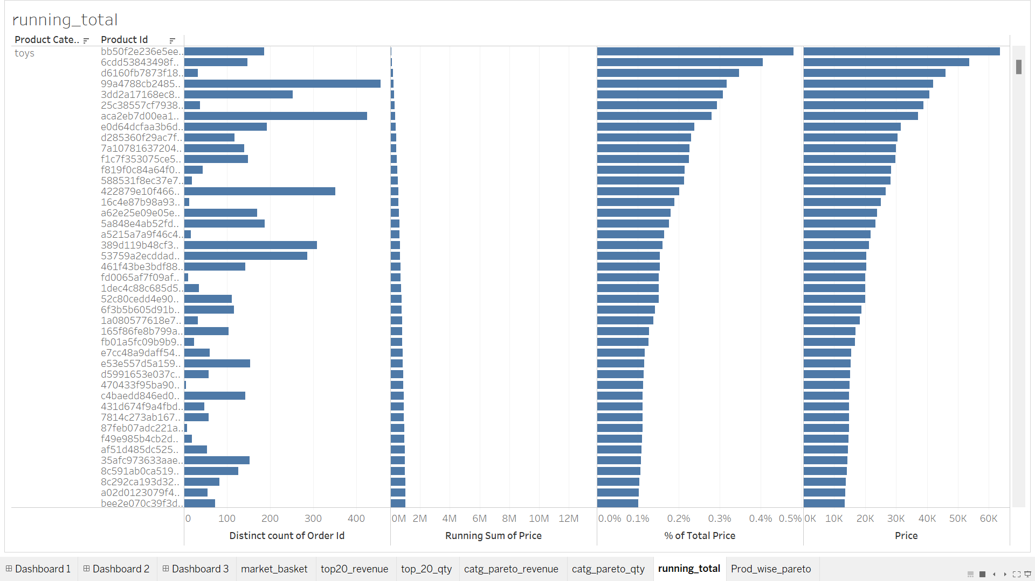
Running Total

Slide 9
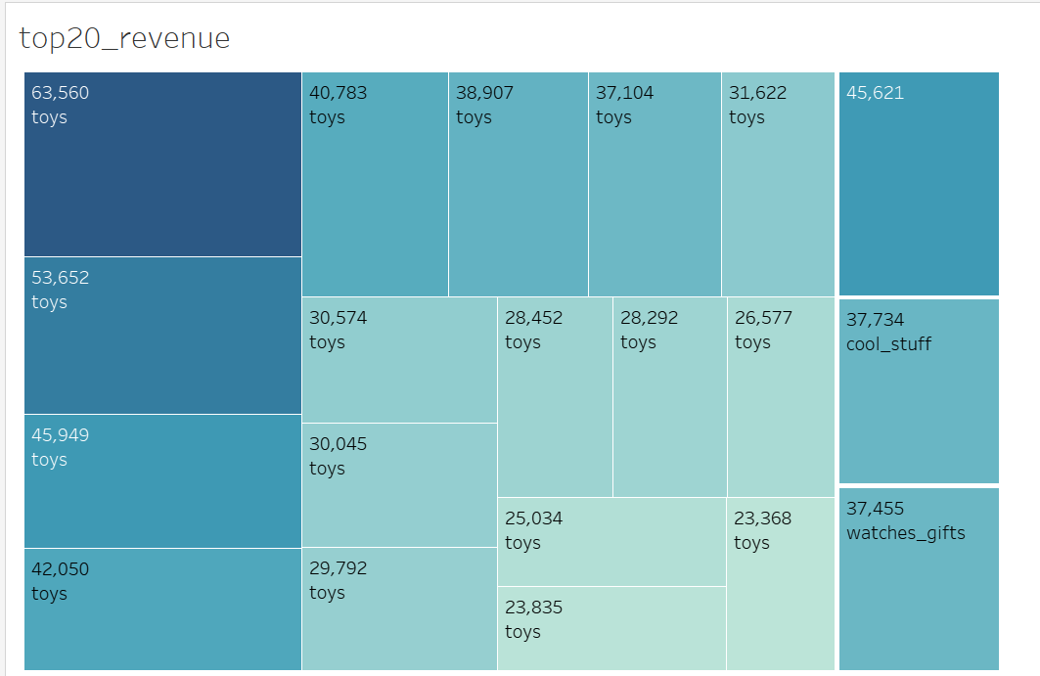
Top 20 Product by Revenue

Slide 10
ASSOCIATION RULE MINING
Association Rule Mining is used when you want to find an association between different objects in a set, find frequent patterns in a transaction database, relational databases or any other information repository. The applications of Association Rule Mining are found in Marketing, Basket Data Analysis (or Market Basket Analysis) in retailing, clustering and classification.
The most common approach to find these patterns is Market Basket Analysis, which is a key technique used by large retailers like Amazon, Flipkart, etc to analyze customer buying habits by finding associations between the different items that customers place in their “shopping baskets”. The discovery of these associations can help retailers develop marketing strategies by gaining insight into which items are frequently purchased together by customers. The strategies may include:
Changing the store layout according to trends
Customer behavior analysis
Catalog design
Cross marketing on online stores
What are the trending items customers buy
Customized emails with add-on sales etc..
Online retailers and publishers can use this type of analysis to:
Inform the placement of content items on their media sites, or products in their catalog
Deliver targeted marketing (e.g. emailing customers who bought products specific products with other products and offers on those products that are likely to be interesting to them.)

Slide 11
APRIORI ALGORITHM
Apriori algorithm assumes that any subset of a frequent itemset must be frequent. Its the algorithm behind Market Basket Analysis.
Measure 1: Support.
This says how popular an itemset is, as measured by the proportion of transactions in which an itemset appears
Measure 2: Confidence.
This says how likely item Y is purchased when item X is purchased, expressed as {X -> Y}. This is measured by the proportion of transactions with item X, in which item Y also appears.
Measure 3: Lift
This says how likely item Y is purchased when item X is purchased, while controlling for how popular item Y is.

Slide 12
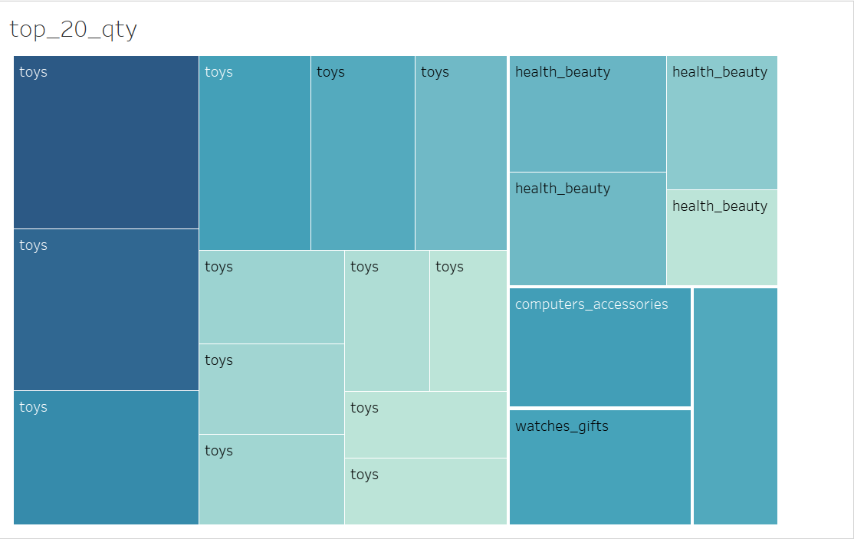
Top 20 Products By Quantity

Slide 13
PARETO ANALYSIS
The Pareto Principle states that 80 percent of a project's benefit comes from 20 percent of the work. Or, conversely, that 80 percent of problems can be traced back to 20 percent of causes. Pareto Analysis identifies the problem areas or tasks that will have the biggest payoff. The tool has several benefits, including:
Identifying and prioritizing problems and tasks.
Helping people to organize their workloads more effectively.
Improving productivity.
Improving profitability.

Slide 14
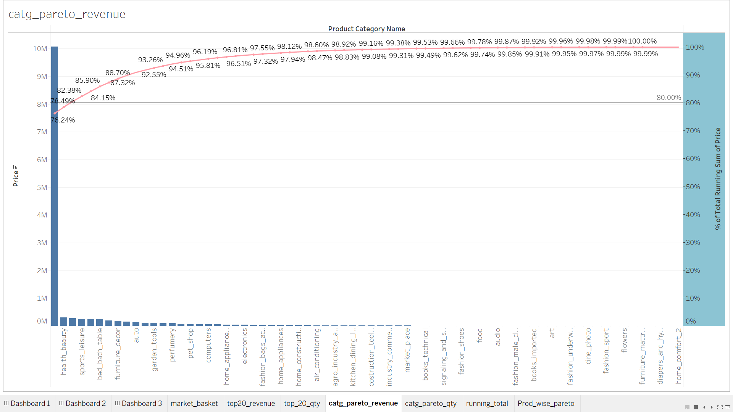
Pareto Analysis By Revenue

Slide 15
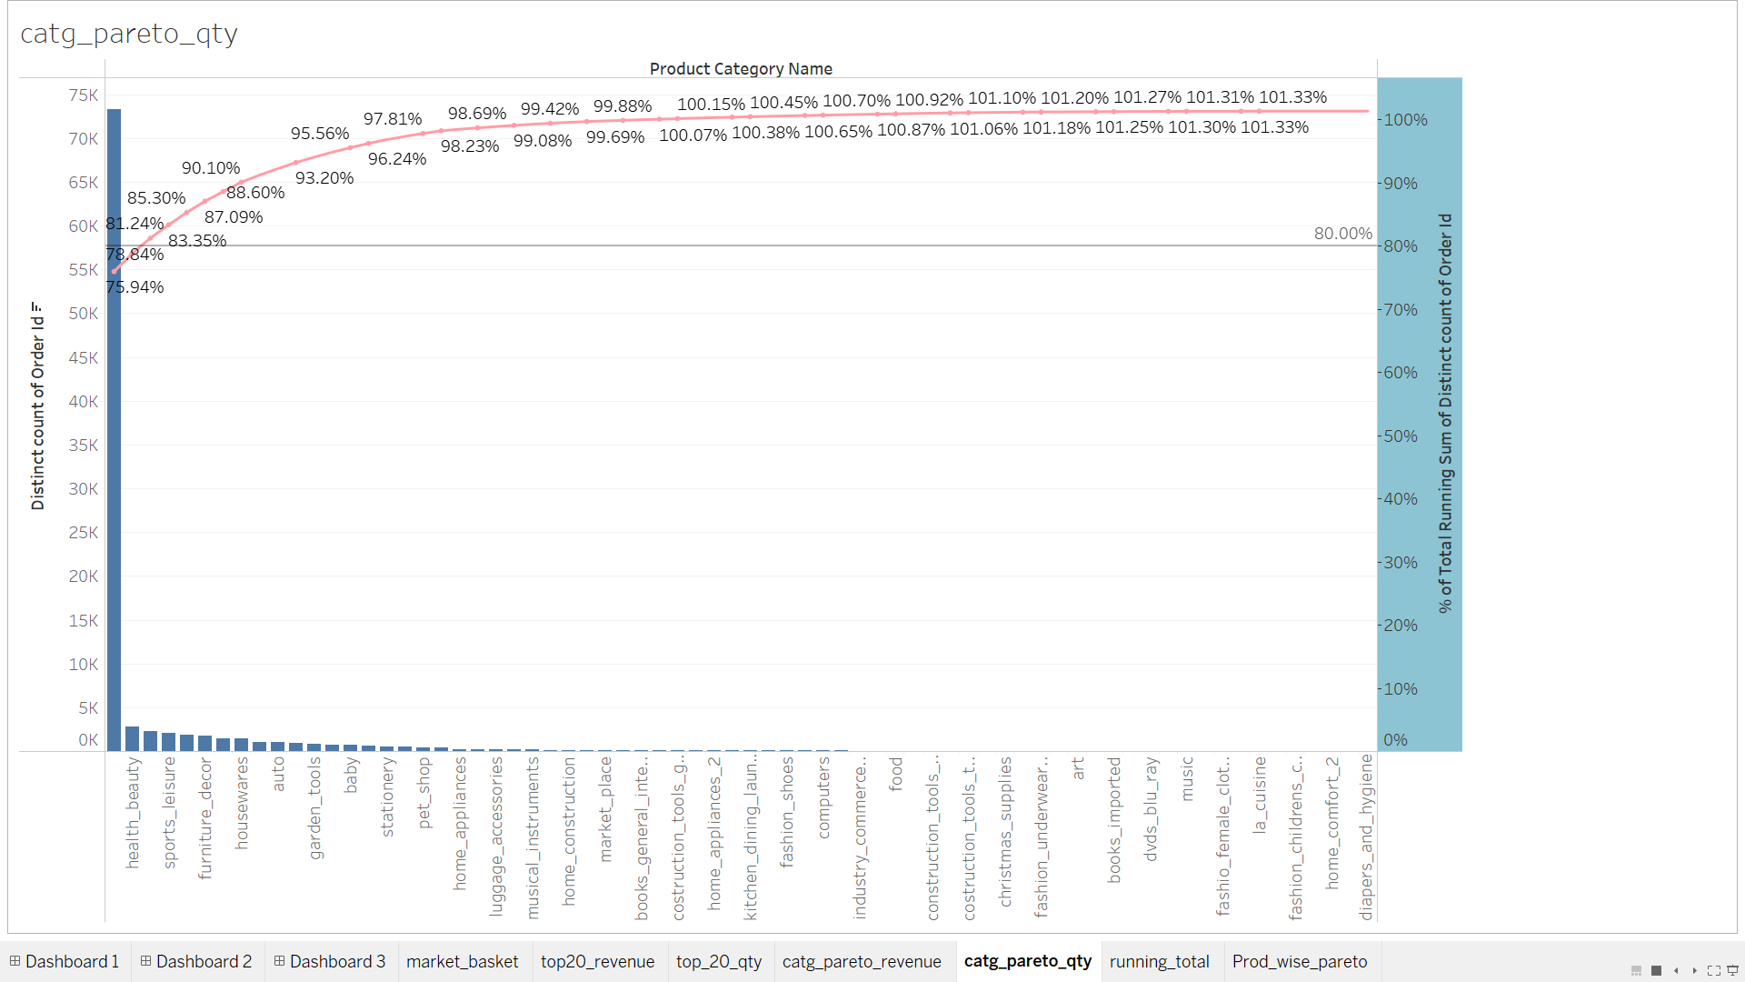
Pareto Analysis by Product Quantity

Slide 16
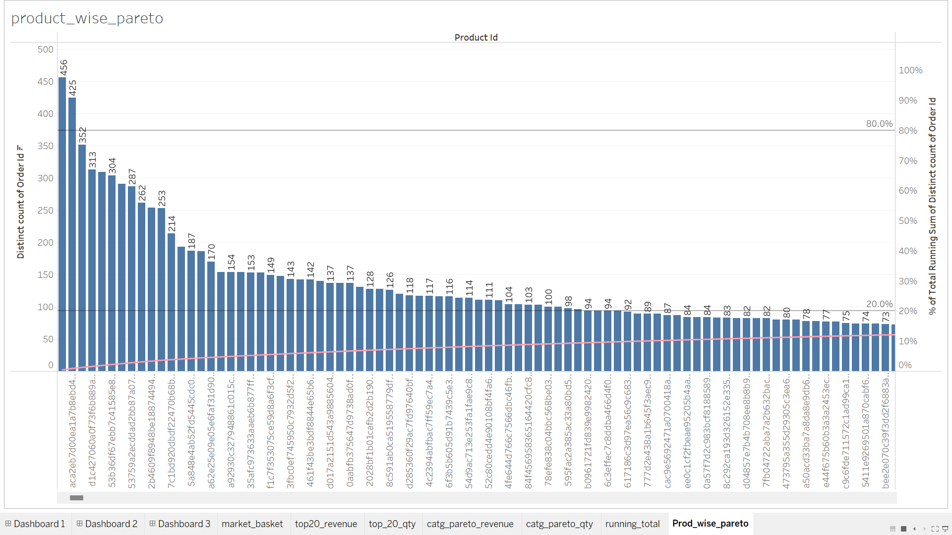
Pareto Analysis by Product wise

Slide 17
MARKET BASKET ANALYSIS
Market basket analysis (MBA) is an example of an analytics technique employed by retailers to understand customer purchase behaviors. It is used to determine what items are frequently bought together or placed in the same basket by customers. It uses this purchase information to leverage effectiveness of sales and marketing.

Slide 18
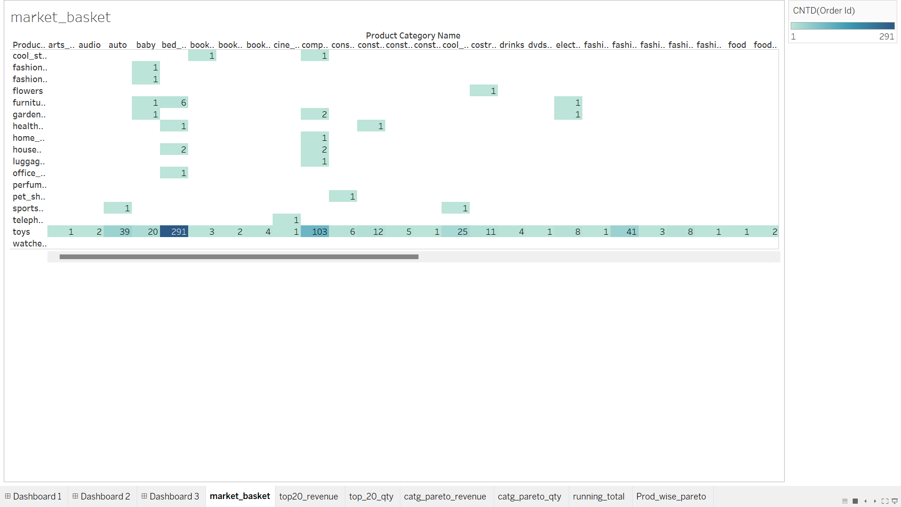
Market Basket Analysis

Slide 19
THANK YOU

