Slide 1

Group 34
Convolution Code
Prof Yash Vasavada
Mentor:
Shrey Bavishi
Divyesh Ramani
Prajapati Sujalkumar 202301478
Mihirsinh Chavda 202301479
Jenish Bhagiya 202301480
Kalp Shah 202301481
Rushil Soni 202301482
Dhanush B. Pillai 202301483
Soham Mevada 202301484
Modak Akshada Rajesh 202301485
Maharshi Patel 202301486
Yug Tejani 202301487
Manthan Gajera 202301488

Slide 2
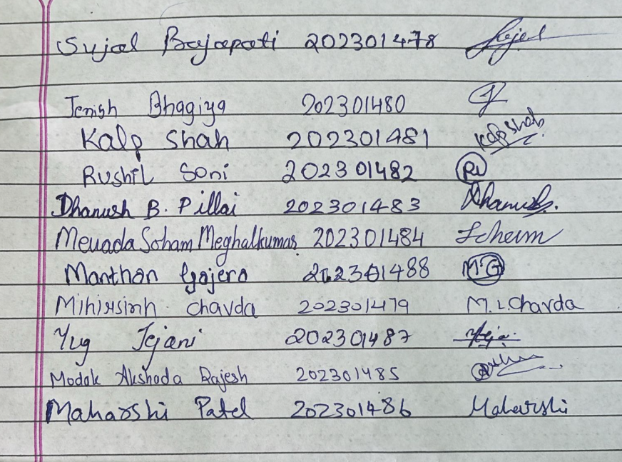
Honor Code
We declare that
→ the work that we are presenting is our own work
→ We have not copied the work (Matlab code, results, etc.) that someone else has done
→ Concepts, understanding and insights we will be describing are our own
→ Wherever we have relied on an existing work that is not our own, we have provided a proper reference citation
→ We make this pledge truthfully. We know that violation of this solemn pledge can carry grave consequences

Slide 3
Outline
1. Honor Code
2. Problem Statement
3. Encoding,transfer function and State Diagram
4. AWGN
5. BPSK Modulator and Demodulator(Hard)
6. Viterbi Decoder
7. Hard decoding
8. BPSK Demodulator(Soft)
9. Soft Decoding
10.Simulation results and graphs
11.Summary
12.References

Slide 4
Problem Statement
1. Main deliverable:
Convolutional encoder for the rates and constraint lengths for the following rates and constraint lengths [r, Kc]:
A. {r = 1/2, Kc = 3}
B. {r = 1/3, Kc = 4}
C. {r = 1/3, Kc = 6}
Pass the output of the encoder to a BPSK modulator, and the transmitted BPSK symbols to an AWGN channel which introduces a per-symbol SNR of ES/N0.
Perform soft decision and hard decision Viterbi decoding and demonstrate the performance by varying the SNR Eb/N0 ∈ {0, 10} in steps of 0.5 dB. Produce the curves showing the probability of detection errors as a function of Eb/N0 for each value of r.
2. Analysis:
A. Study and explain the derivations of the performance of the soft decision decoder of convolution code
B. Study and explain the derivations of the performance of the hard decision decoder of convolution code [8, Section 8.2.4].
C. Compare the simulation results of SDD and HDD with their respective analysis results for all the three convolution codes mentioned above.
4. Performance validation

Slide 5
What are Convolution Codes?
A convolutional code is a type of error-correcting code used in digital communications to detect and correct errors that occur during data transmission.Convolutional codes encode continuous bit streams using shift registers and XOR operations.
Why it is called convolution:
They use a convolution (sliding-window weighted sum) of current + past input bits to generate encoded outputs.
The encoder's shift registers perform this continuous "convolving" of data streams, unlike block codes.
Uses :
Wireless Communication : Used in 3G,4G and 5G for error correction in noisy channels
Deep Space and Satellite Communication : NASA’s Voyager, Mars rovers, and satellites use convolutional codes (often with Viterbi decoding) for reliable data transmission.
Digital TV and Video BroadCasting : DVB (Digital Video Broadcasting) standards use convolutional codes to reduce errors in TV signals.

Slide 6
Key Concepts
Generator Matrix :
Defines how input bits are combined to produce encoded outputs.
For a rate 1/2 code with 4 states (Kc=3), the generator polynomials are often represented in octal form (e.g., g₁ = 101₂ = 5₈, g₂ = 111₂ = 7₈).
Modulation & Noise (BPSK & AWGN):
BPSK (Binary Phase Shift Keying): Encoded bits (0,1) are mapped to ±1 for transmission.
AWGN (Additive White Gaussian Noise): Random noise added during transmission, modeled as a Gaussian distribution.
Trellis Diagram & Decoding:
Represents encoder states and transitions.
Viterbi Algorithm: Maximum-likelihood decoding (finds most probable transmitted sequence).

Slide 7
Key Concepts
Encoder Structure:
Uses shift registers and module-2 adders (XOR gates).
Operates on a sliding window of input bits (memory-based encoding).
Parameters:
Constraint Length (Kc): Number of past bits affecting the current output (e.g., Kc=3 means current + 2 previous bits).
Code Rate (R = k/n): Ratio of input bits (k) to output bits (n) (e.g., R=1/2 means 1 input → 2 encoded bits).
Hard Decision vs. Soft Decision Decoding:
Hard Decision: Decoder uses binary (0/1) values (less accurate but simpler).
Soft Decision: Decoder uses probability levels (e.g., 0.8 for "likely 1"), improving performance.

Slide 8
Flow-diagram
Message
Channel Encoder
BPSK Modulator
AWGN Channel
Decoded Message
Viterbi Decoder
BPSK Demodulator

Slide 9
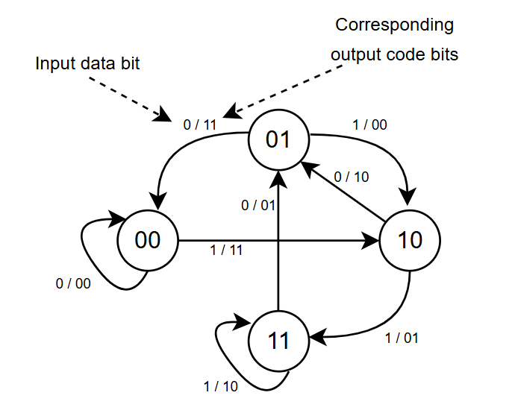
State Diagram
A convolutional encoder is a finite state machine, and can be represented
in terms of a state diagram.

Slide 10
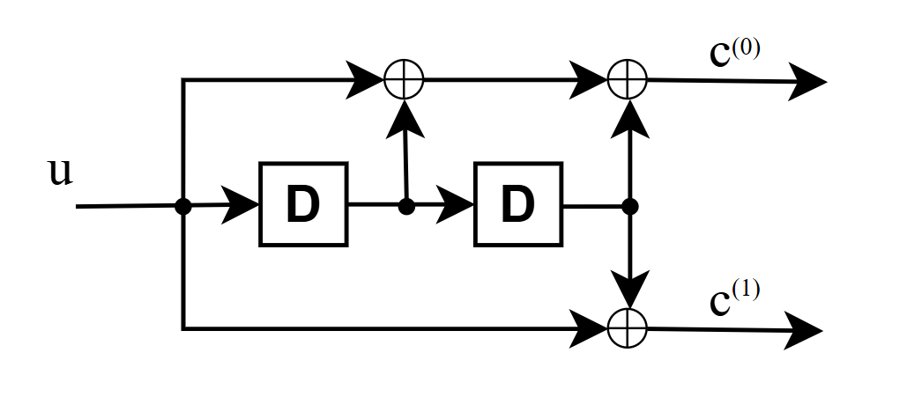
Encoding
For the encoding part we have done it by taking first taking the xor of input bit and the 2 register bits and then taking the xor of input bit and the 2nd register bit.
This gives the generator matrix :-
G = [ 1 1 1]
[ 1 0 1]2*3

Slide 11
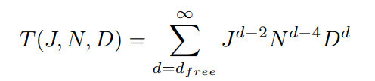
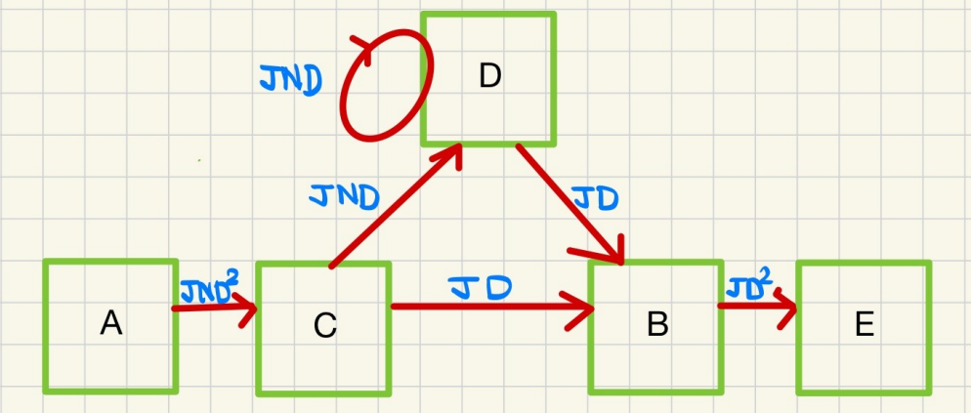
Transfer Function
A convolutional code's distance properties are examined using a transfer function. It primarily helps in performance analysis and error detection.
Here, d = hamming distance with respect to all zero codeword or no. of ones in the output codeword.
Exponent of J = length of input
Exponent of N = no. of ones in the whole

Slide 12
Encoding | Pseudocode
function encoder_from_diagram(input_seq):
encoded_stream = [] // To store the encoded output bits
D1 = 0 // First delay register (initially zero)
D2 = 0 // Second delay register (initially zero)
for i = 0 to length(input_seq) - 1:
u = input_seq[i]
// Compute outputs based on the given diagram
c0 = u XOR D1 XOR D2 // Upper XOR output
c1 = u XOR D2 // Lower XOR output
encoded_stream.append([c0, c1]) // Store the output as a tuple/list
// Shift the delay registers
D2 = D1
D1 = u // Current input goes into D1
return encoded_stream

Slide 13
State diagram | Pseudocode
function generate_state_diagram(G, Kc, n):
total_states = 2^(Kc - 1) // Total number of states
state_memory = zeros(total_states, Kc - 1) //Stores binary representation of each state
// Populate memory content for each state
for state_index from 0 to total_states - 1:
binary_state = to_binary(state_index, Kc - 1)
state_memory[state_index] = binary_state
// Step 2: Initialize the state diagram matrix
// Format: [output_if_0, output_if_1, next_state_if_0, next_state_if_1]
diagram = zeros(total_states, 4)
// Step 3: Compute transitions and outputs
for current_state from 0 to total_states - 1:
current_bits = state_memory[current_state]

Slide 14
State Diagram | Pseudocode
// --- Input Bit = 0 —
input0 = prepend(0, current_bits)
output0 = mod(G × input0, 2)
diagram[current_state][0] = binary_to_int(output0)
next_state_bits_0 = input0[0:Kc-1]
diagram[current_state][2] = binary_to_int(next_state_bits_0)
// --- Input Bit = 1 —
input1 = prepend(1, current_bits)
output1 = mod(G × input1, 2)
diagram[current_state][1] = binary_to_int(output1)
next_state_bits_1 = input1[0:Kc-1]
diagram[current_state][3] = binary_to_int(next_state_bits_1)
return diagram

Slide 15
AWGN
Definition: Additive White Gaussian Noise (AWGN) is a fundamental noise model in communication systems, characterized by a constant spectral density (white) and a Gaussian amplitude distribution.
Characteristics: AWGN is additive, meaning it combines linearly with the signal, and its power is uniformly distributed across all frequencies.
Impact: It degrades signal quality in wireless, satellite, and digital communication systems, affecting bit error rates and system performance.
Applications: AWGN is widely used in simulations to test the robustness of communication systems and signal processing algorithms.
Mitigation: Techniques like error correction coding and signal amplification are employed to minimize the effects of AWGN in practical systems.

Slide 16
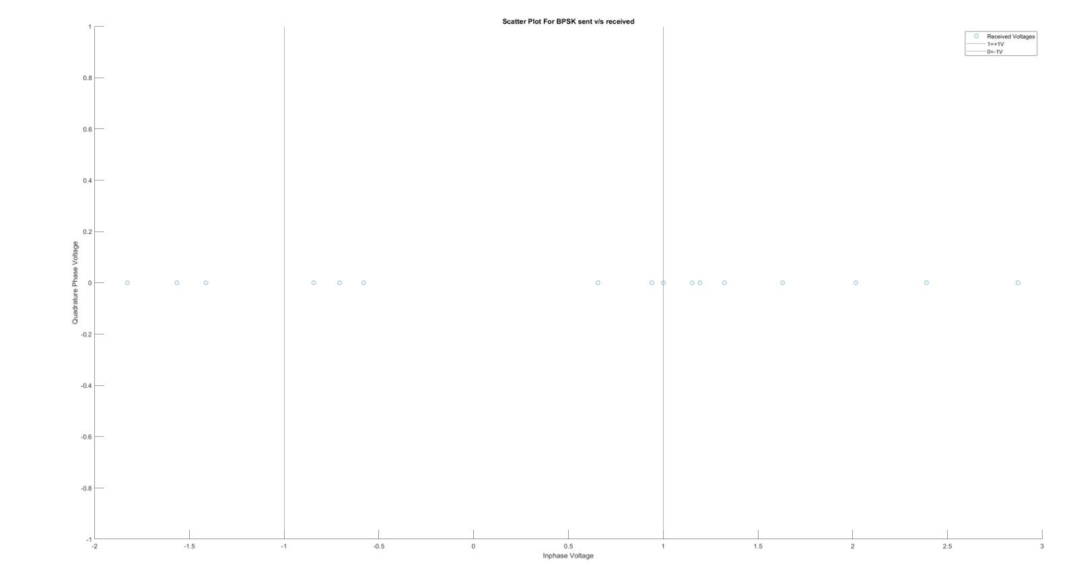
AWGN (Scatter plot of received voltages)

Slide 17
BPSK Modulator
Definition: A BPSK modulator is a digital modulation technique that encodes binary data by varying the phase of a carrier signal, typically using two phases (0° and 180°).
Operation: It maps binary 0 to one phase and binary 1 to the opposite phase, enabling robust data transmission over noisy channels.
Advantages: BPSK offers high noise immunity and simplicity, making it suitable for low-data-rate applications in wireless and satellite communications.
Applications: Commonly used in systems like Wi-Fi, GPS, and deep-space communication due to its efficiency in power-limited environments.
Limitations: BPSK has a lower data rate compared to advanced modulation schemes, requiring more bandwidth for higher throughput

Slide 18
BPSK Demodulator(Hard)
Definition: A BPSK Demodulator is an algorithm used to recover the original binary data from BPSK signal.
How does it work?
Signal reception: The BPSK demodulator receives noisy analog signals from the channel, typically affected by AWGN.
Threshold Decision : If the received value is greater than or equal to 0 it is demodulated as bit 1 and if the received value is less than 0 it is demodulated as bit 0.
Bit reconstruction : The demodulator converts each received symbol into a binary bit, reconstructing the bitstream from the analog signal.
Input to decoder : The resulting binary bits are passed to Viterbi decoder to recover the original message.

Slide 19
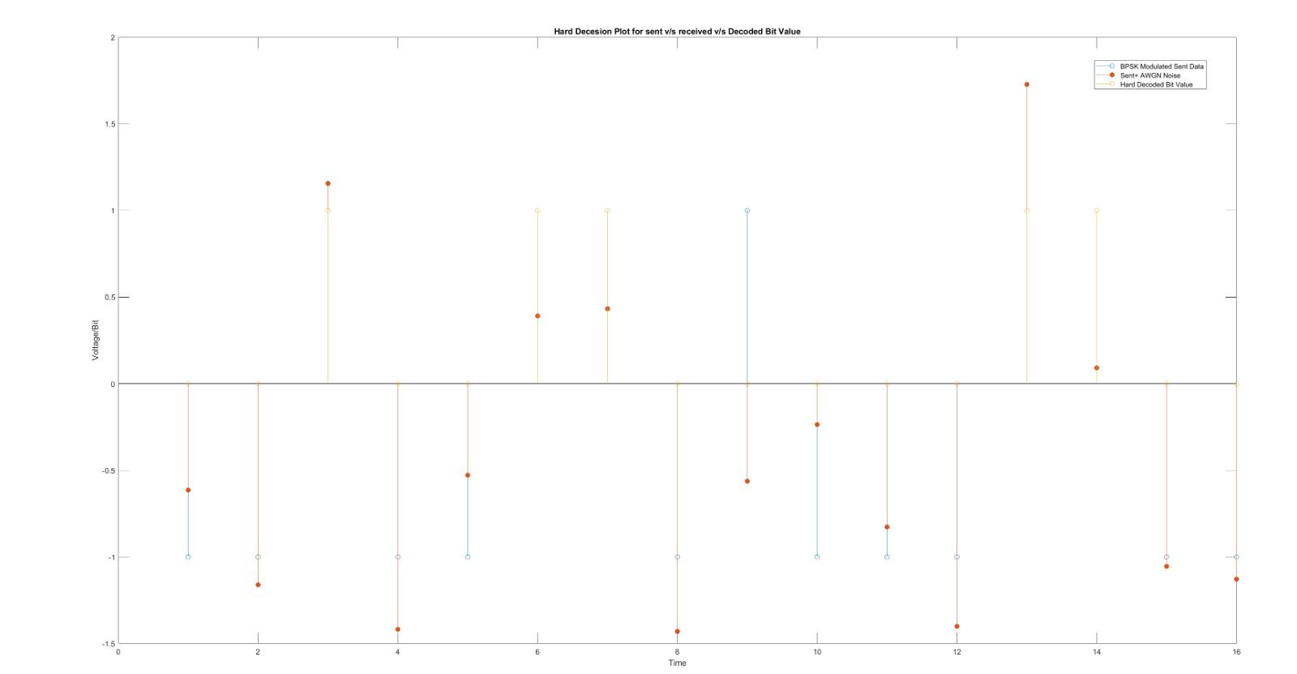
BPSK Demodulator(Hard)

Slide 20
BPSK Demodulator | Pseudocode
function bpsk_demodulate(received_signal):
demodulated_bits = [] // Initialize an empty list to store binary bits
for i = 0 to length(received_signal) - 1:
symbol = received_signal[i]
// Hard decision demodulation
if (symbol >= 0):
bit = 0
else:
bit = 1
demodulated_bits.append(bit) // Append the decoded bit
return demodulated_bits

Slide 21
Viterbi Decoding
Viterbi decoding is an algorithm used to determine the most likely transmitted bit sequence in convolutional codes.
It operates by analyzing a trellis diagram, which represents all possible state transitions of the encoder.
The received sequence is processed and the decoder calculates branch metrics -typically based on Hamming or Euclidean distance, and path metrics -to determine optimum path(i.e the most likely transmitted sequence).
At each step in the trellis, only the transition that gives the minimum path metric for the current state is retained, while the others are discarded.
The final decoded bit sequence is obtained through a traceback procedure starting from the end state and moving backward to start state.

Slide 22
Viterbi Decoder (Pseudocode)
Pseudocode(Viterbi Decoder)
decodedMsg=ViterbiDecoder(input,stateDiagram)
n=rate*length(input)
input=reshape ‘input’ into (n,lenOfOutput) sized matrix
weight=INF //initialize a 3D matrix size(noOfState,n+1,2) with INF value
//here weight(:,:,1) represent weight at each node.
//weight(:,:,2) represent the previous node.
weight(1,1,1)=0 //since we start from ‘00’ state
//This is a dynamic programming approach
For i (2,n):
For j in (1:noOfState):
(prevState,output)=PreviousState(j,stateDiagram)
Possible_Weight=weight(prevState,i-1,1)+BranchMetric(input(i),output)
weight(j,i,1)=min(Possible_Weight);
weight(j,i,2)=state at which min(Possible_Weight) was achieved
End
End

Slide 23
Viterbi Decoder (Pseudocode)
Pseudocode(Viterbi Decoder)
//Now we will find the path which starts from state ‘00’ and ends at state ‘00’
//Path=Backtrack the weight(:,:,2) matrix from position n+1 to 1.
while(prev~=INF)
prev1=weight(prev,pos,2)
path=[path,inputForTransition(prev1,prev)]
prev=prev1
End
Branch Metric:
value=BranchMetric(a,b)
//below are some types of branch metrics used in computation value=HammingDistance(a,b);//w=sum(a xor b) value=EuclideanDistance(a,b);//w=sqrt(sum((b-a).^2)) value=ManhattanDistance(a,b);//w=sum(abs(b-a))

Slide 24
Hard Decoding
Hard decoding in convolutional coding is a decoding method where the receiver decides each bit as either 0 or 1 from received carrier voltages without considering confidence levels (“hard” decisions).
Algorithms like the Viterbi decoder are used to find the most likely transmitted bit sequence by calculating Hamming distances based on these hard decisions.
It is faster and less complex in comparison to soft decoding.
On the other hand, it has a lower decoding performance, especially in noisy channels(For eg- AWGN).
In spite of this, hard decoding is often preferred in applications where speed is critical(due to simpler algorithm) and the channel conditions are relatively good(meaning less noise).

Slide 25
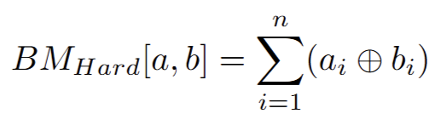
Branch and Path Metric
Branch Metric (BM)
The branch metric measures the cost or error associated with a specific transition between two states in the trellis. It is the Hamming distance between the received output bits and the ideal output bits corresponding to that branch.
Path Metric (PM)
The path metric is the cumulative metric that is associated with the total cost of a path through the trellis, from the start state to the current state. It is essentially the sum of hamming distances of all branches in the path taken in consideration.(For single input)

Slide 26
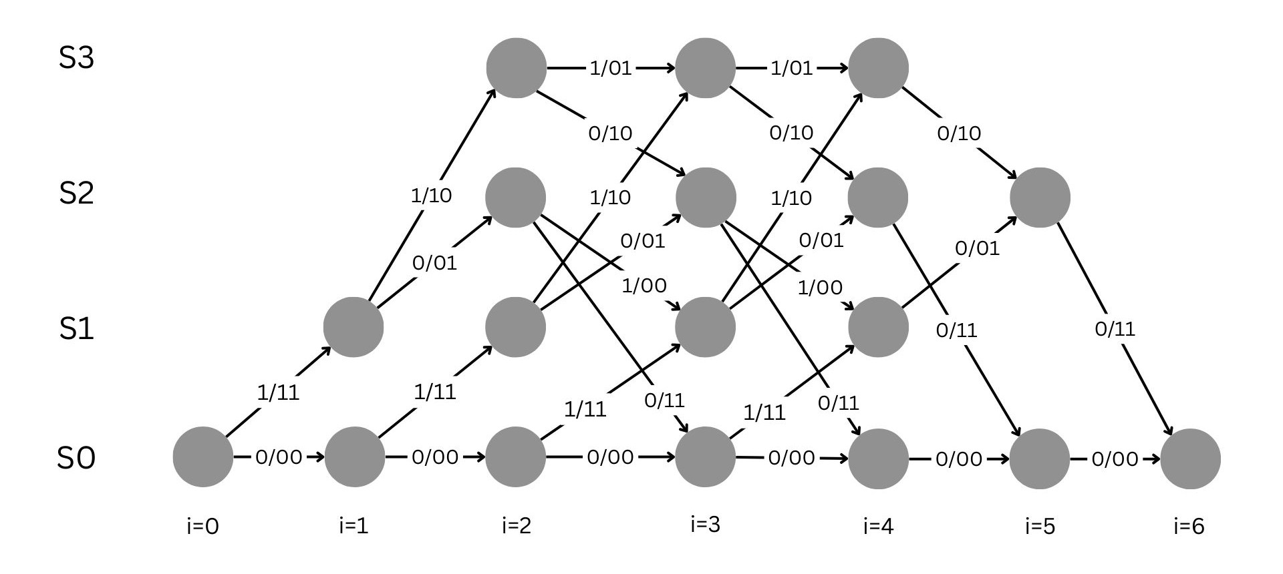
Trellis Diagram
Trellis Diagram(for r=½, Kc=3)

Slide 27
Example for R=½ and Kc=3 convolution code
Let’s understand the viterbi decoder using an example.
For input message, u = [1 1 0 1 0 0]
Encoded codeword, c = [1 1 1 0 1 0 0 0 0 1 1 1]
Let received codeword, r = [1 1 1 1 1 0 0 1 0 1 1 0] where every 4th bit is in error.
Now, We will determine the most likely input message using viterbi decoder.

Slide 28
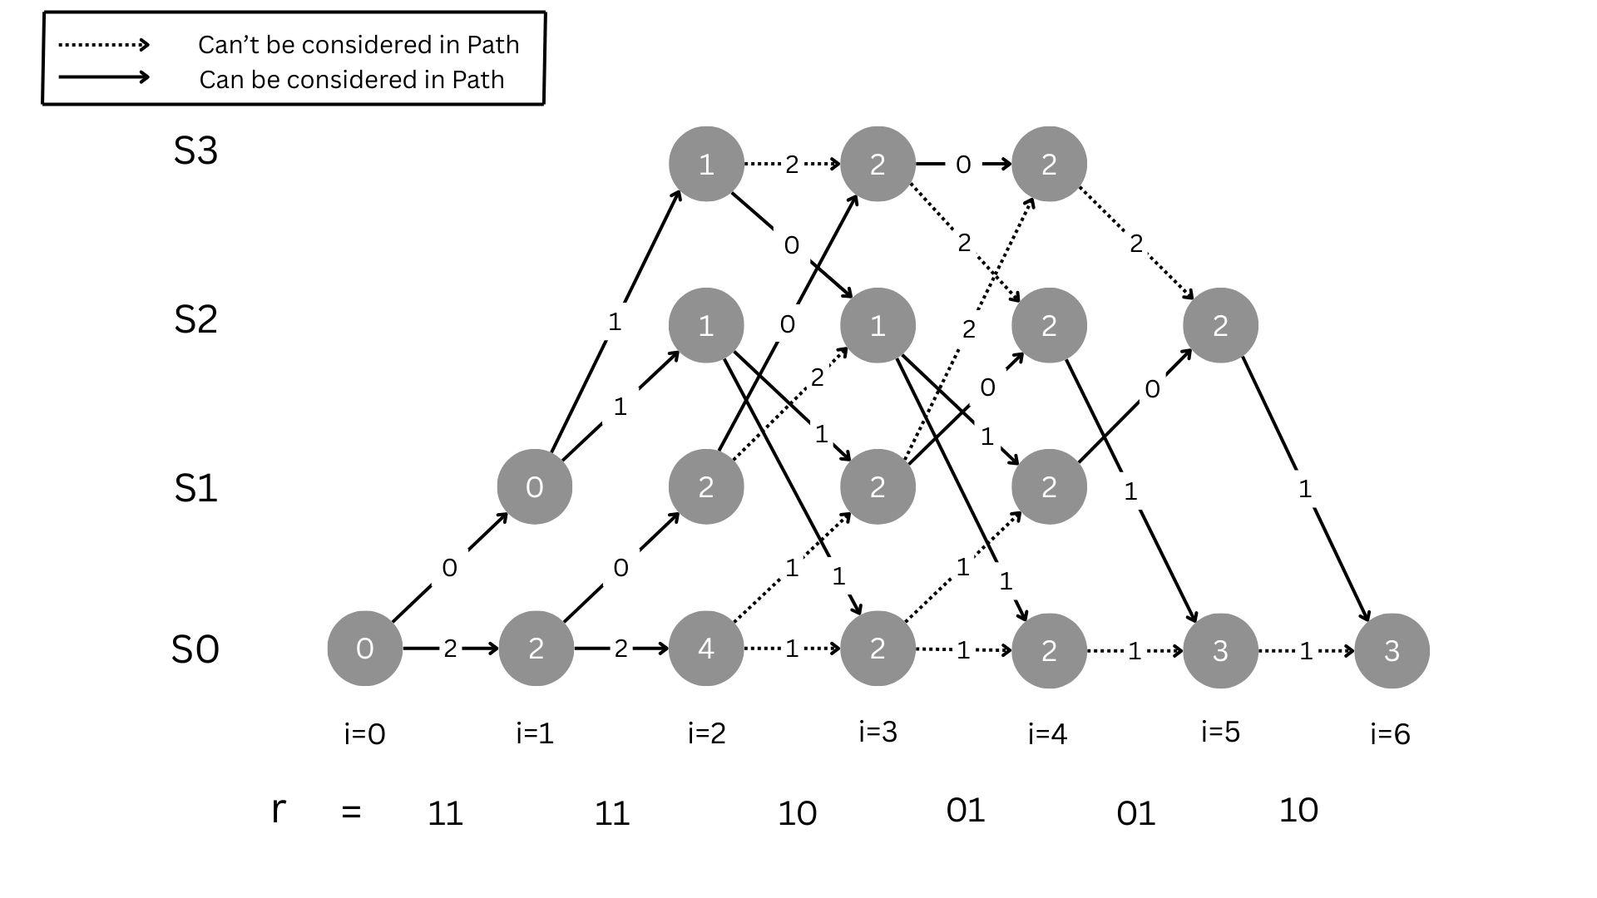
BM Representation
Representation of Branch metrics using Hamming Distances

Slide 29
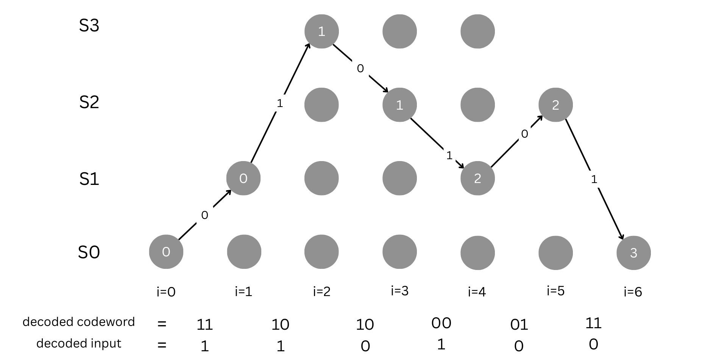
Optimum Path
Overall Path Metric

Slide 30
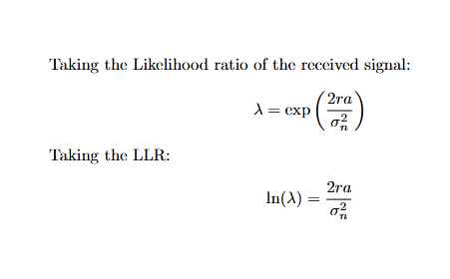
BPSK Demodulator(Soft)
For the BPSK soft receiver we have implemented a different type of demodulator than the hard receiver.
After receiving a modulated signal with AWGN Noise, we first take the Log Likelihood Ratio (LLR) of the received signal as follows:

Slide 31
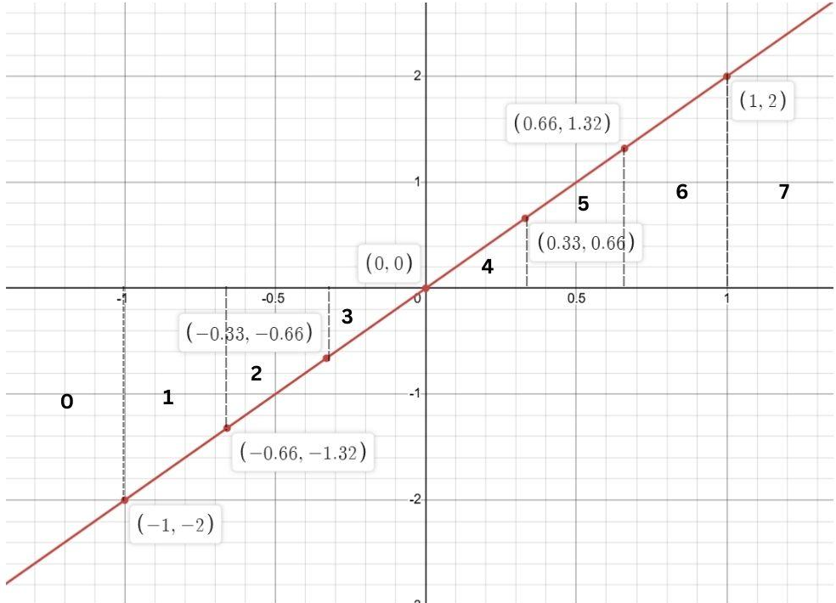
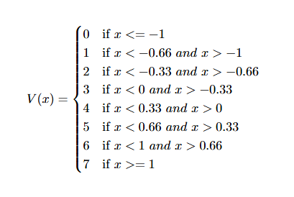
BPSK Demodulator(Soft)
And then to distinguish the quality of the received voltage/bit we have implemented a Quantizer which will give the value between 0 and 7 with 0 determining ‘0’ received bit and 7 representing ‘1’ received bit.

Slide 32
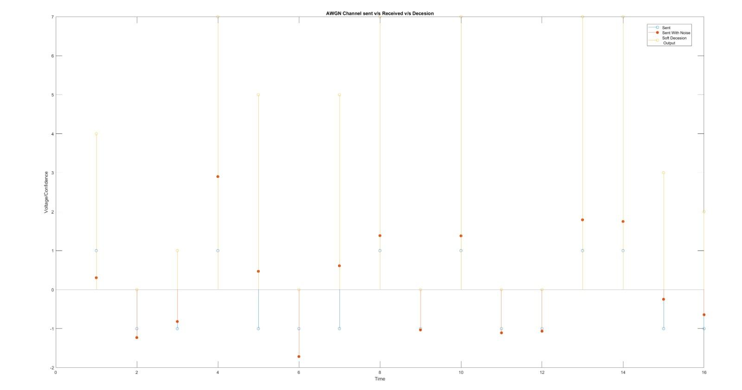
BPSK Demodulator(Soft)
BPSK Demodulator(Soft)

Slide 33
Soft Decision Decoding
1.Euclidean Distance :-
After demodulating the signal into 8 parts , we will traverse the Trellis tree and instead of taking the Hamming Distance , we will take the Euclidean distance to measure the weight in the transition from one state to another.
This gives us much more accurate results as it also takes in account of how good a received bit is, higher the value, more the distortion in the received bit
Branch Metric(BM) :-The branch metric measures the cost or error associated with a specific transition between two states in the trellis. It is the Euclidean distance between the received output bits and the ideal output bits corresponding to that branch.

Slide 34
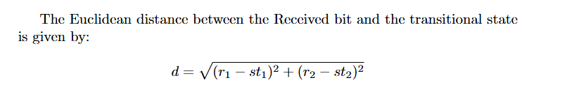
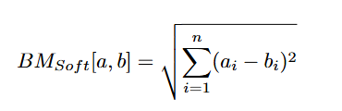
Soft Decision Decoding
The Path Metric(PM) remains as it was in hard decoding as we will always take the minimum sum of distances from the BM.

Slide 35
Soft Decision Decoding
2. Manhattan Distance:-
Now instead of using the Euclidean distance as Branch Metric, we also used the Manhattan distance to improve the decoding probability drastically (Remark: It gives better output for small inputs only.) as it will have much higher value if the received demodulated bit is bad/not good (around 3 or 4) and will have low value for an almost correct bit. It takes out the flaws easily and we can eliminate the higher weighted path more quickly thus reducing errors.

Slide 36

Soft Decision Decoding
Branch Metric(BM):- It just takes the absolute difference between the received demodulated bit and the state transitional bits.
The Path Metric(PM) remains as it was in hard decoding as we will always take the minimum sum of distances from the BM.

Slide 37
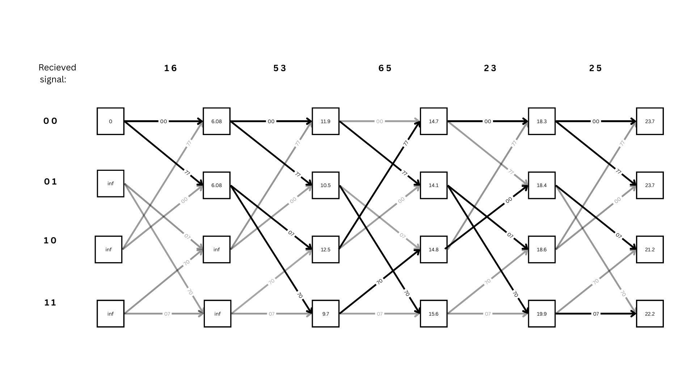
Soft Decision Decoding - Trellis Tree

Slide 38
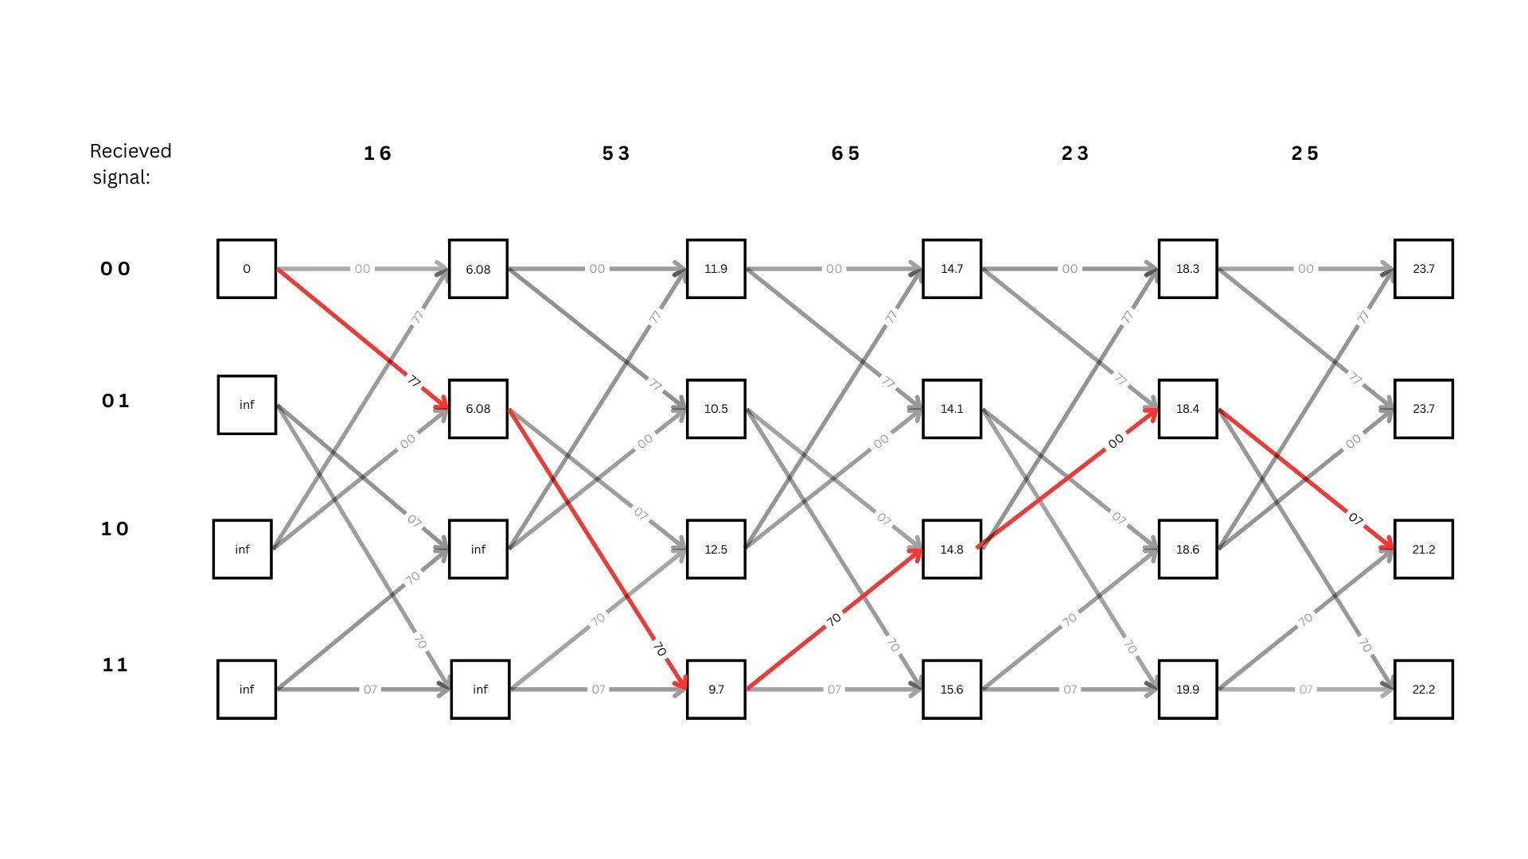
Soft Decision Decoding - Trellis Tree Optimum path
Transition States= 00 01 11 10 01 10
Decoded input = 1 1 0 0 1

Slide 39
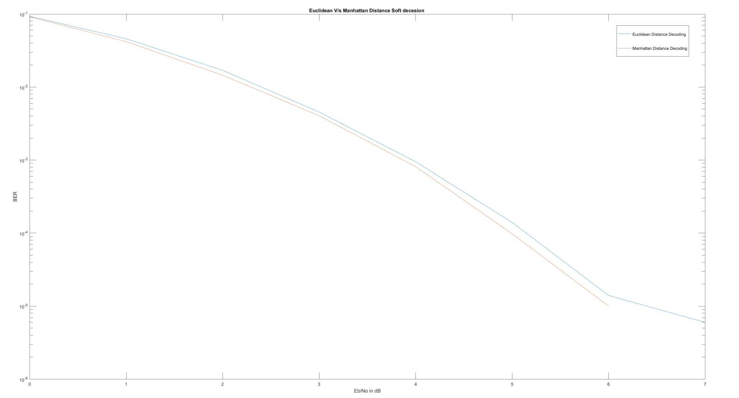
Euclidean v/s Manhattan Distance comparison
As we can see, Manhattan distance (for small input) performs very well compared to euclidean distance due to above mentioned reasons. So, we can send data in small packets through the Manhattan distance branch metric.

Slide 40
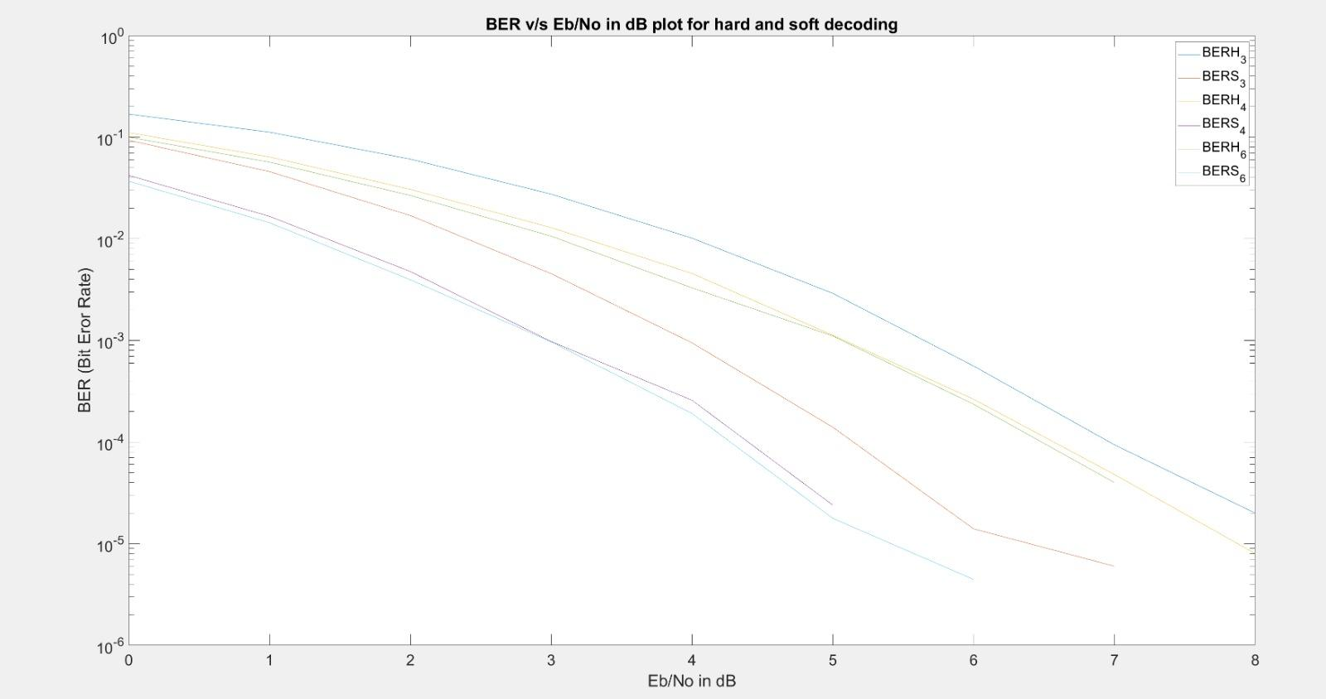
BER V/S Eb/No,Output for Kc=3,4,6
•The plots depict the performance of the Viterbi hard and soft decoders for different rates and constraint lengths.

Slide 41
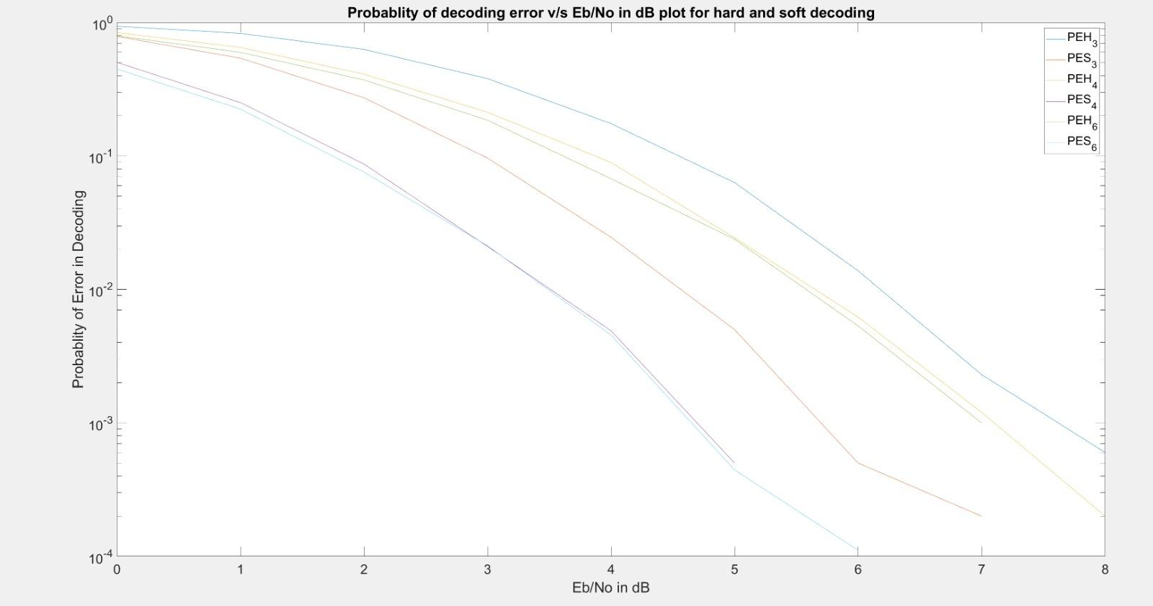
Probability of decoding error v/s Eb/No,Output for Kc =3,4,6

Slide 42
Observations from above plots
Performance of both Viterbi hard and soft for each case increases with the increase in SNR.
The BER and PDE is higher for lower SNR which suggests that Viterbi decoding performs better for minimal noise.
Larger constraint length enhances error correction significantly but the cost is significant increase in time due to increase in computation complexity.
The overall performance of soft decision decoding is much better than the hard decision. The reasons can be:
i) In hard decision decoding, each of the received symbol is demodulated to bits considering a specific threshold. This leads to ambiguity because decoder may choose incorrect bits due to uncertainty.
ii) Soft decision in addition to representing the bit received it also attaches the information of how reliable the bit is. Thus reducing errors due to misjudged bit values.

Slide 43
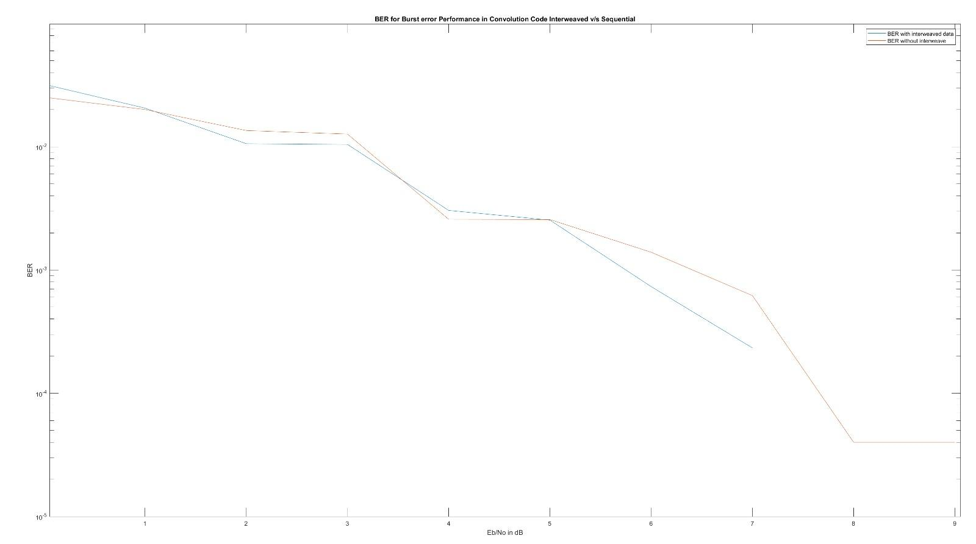
Simulation by Interweaving sent bits.
Motivation: Since error in channel for space communications occurs in burst.This may corrupt the whole output length. So instead we send all c0’s first then c1’s after it. Thus reducing probability of all corrupt codeword.

Slide 44
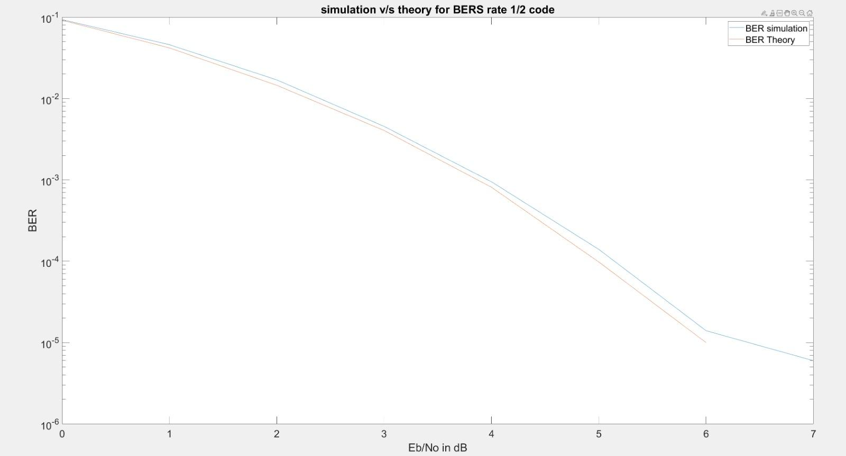
Comparison of theoretical and simulation report

Slide 45
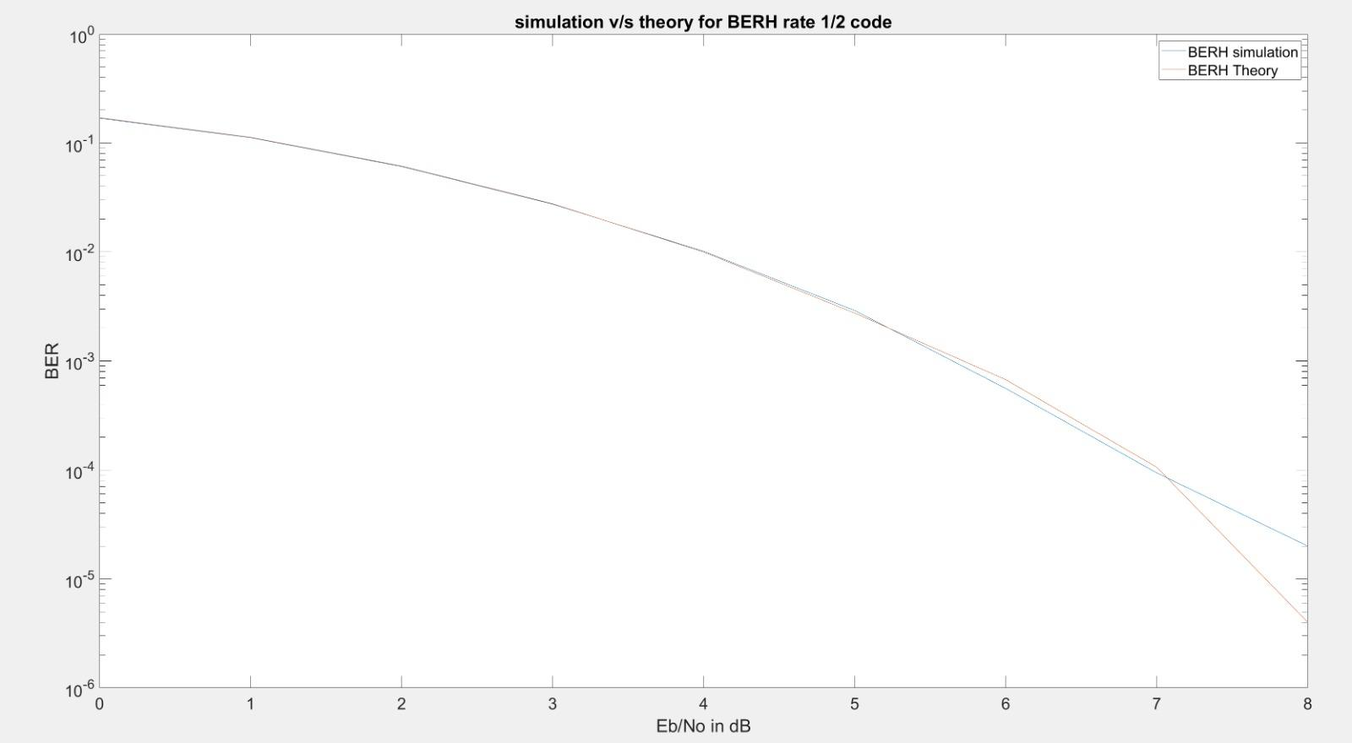
Comparison of theoretical and simulation report

Slide 46
Summary
This project explores convolutional codes, a type of error-correcting code used in digital communication to enhance data transmission reliability. Convolutional codes encode continuous bit streams using shift registers and XOR operations.
The project involves designing a convolutional encoder for specific code rates and constraint lengths. The encoded output is modulated using BPSK and transmitted through an AWGN channel.
The core of the project is the implementation and analysis of Viterbi decoding, a technique used to find the most likely transmitted sequence, for both hard and soft decision decoding. Hard decision decoding uses binary values, while soft decision decoding uses quantization levels for real life implementation.
Performance analysis is conducted by varying the SNR and comparing the bit error rate performance.
The project also examines key concepts like generator matrices, trellis diagrams, and distance metrics (Euclidean, Manhattan).
Ultimately, the project aims to expand our knowledge in capacity achieving codes (Shannon Limit approaching) such as convolution code and their applications and implementations in real life.

Slide 47
References
https://ocw.mit.edu/courses/6-451-principles-of-digital-communication-ii-spring-2005/43162a4e10d73639903282f4dd58001b_chap9.pdf
Digital Communications by Jhon G Proakis (https://arnabiitk.wordpress.com/wp-content/uploads/2013/02/proakis-digital-communications-4th-ed.pdf)
Channel Coding for IEEE 802.16e Mobile WiMAX,Matthew C. Valenti
https://www.youtube.com/watch?v=dKIf6mQUfnY

