Slide 1
Capstone Project - 2
Healthcare Insurance Prediction
Akshada Rane

Slide 2
Problem Statement
Dataset Structure
Gender: Insurance contractor gender, female, male
Body mass index (BMI): Body mass index, providing an understanding of body, weights that are relatively high or low relative to height
Number of children: Number of children covered by health insurance / Number of dependents
Smoking status: Yes/No
Region: the beneficiary's residential area in the US, northeast, southeast, southwest, northwest
Income: Earnings of the insurance holder
Education: Degree/Education of the insurance holder
Occupation: Profession of the insurance holder
Type of insurance plan: The category of health insurance plan selected
Charges: Premium amount paid for healthcare coverage
The Healthcare insurance industry faces the challenge of balancing fair premium rates with financial sustainability.
This report explores the development of a predictive model to estimate health insurance premiums using demographic and lifestyle data.
The model leverages machine learning techniques to provide personalized premium recommendations, enhancing both customer satisfaction and insurer efficiency.

Slide 3
Data Wrangling
We took the below steps for Data Cleaning Data Transformation:
• Checked for duplicates, we found no duplicates in out dataset
• Checked for missing values, we found that medical_history & family_medical_history had missing values, therefore we filled these values with ‘No history’
• We checked if columns ‘BMI’ or ‘Charges’ have outliers, we found no outliers in these columns
• We derived is_active column & weight_status column from exercise_frequency & bmi columns to better get the insights from data

Slide 4
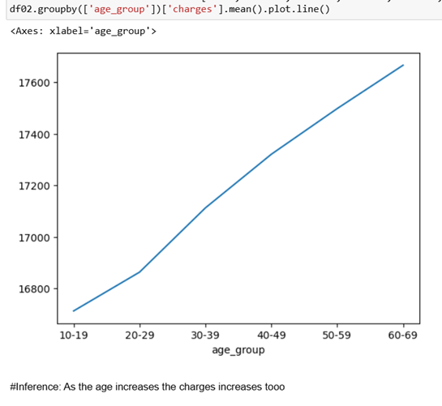
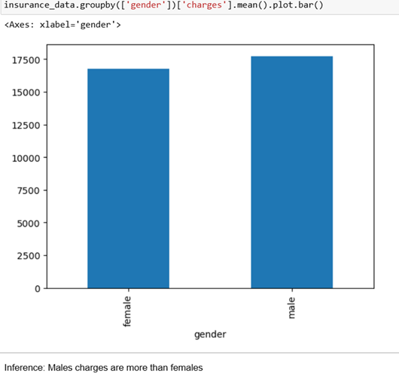
Exploratory Data Analysis
As the age increases of population the premiums/charges too go up.
Charges charged to male’s are more than females

Slide 5
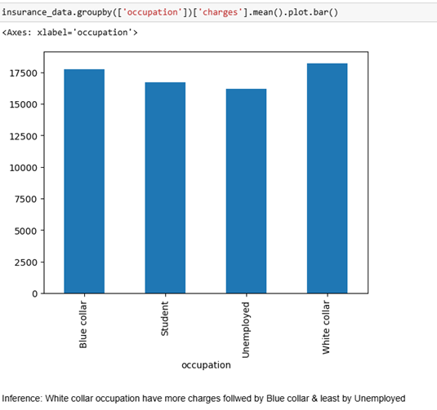
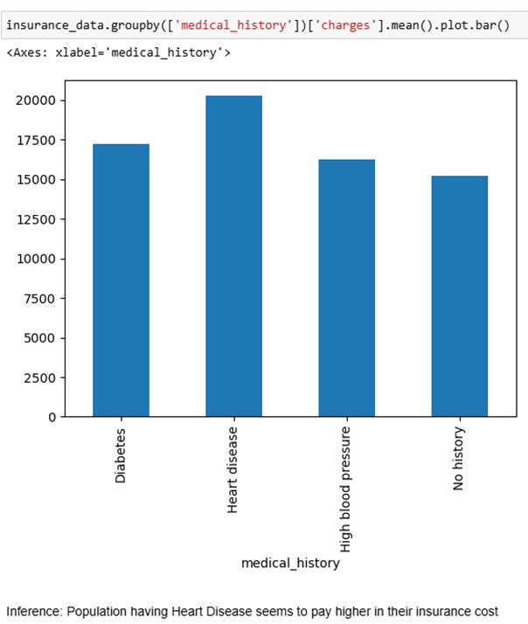
Exploratory Data Analysis
White collar occupation people pay Highest charges & Unemployed & Student pays the lowest.
Population Having Heart disease pays higher charges

Slide 6
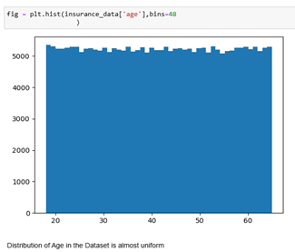
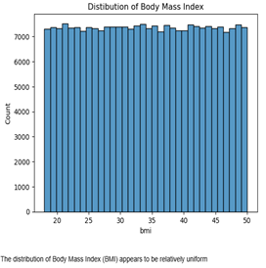
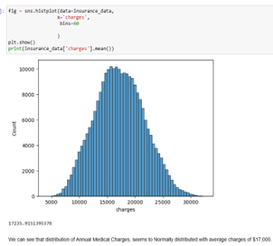
Exploratory Data Analysis
Distribution Of Age
Distribution Of BMI
Distribution Of Charges
Distribution of Age & BMI in the dataset appears to be uniform as per above visualization & charges have uniform normal distribution with average charges to $17,000

Slide 7
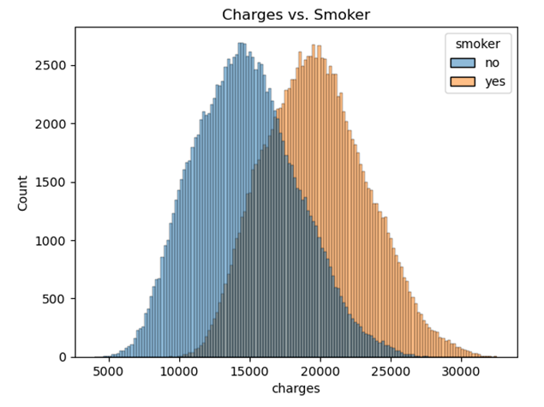
Exploratory Data Analysis
Summary of EDA:
Advanced age, male gender, heart disease & white-collar job occupation are associated with higher insurance cost
Medical/family history of high blood pressure has least correlation with heart problem people. Family/medical history of High blood pressure do not have heart problems
People who smoke, takes premium coverage level, family/medical history of heart disease make most contribution to charges
Significant difference in median charges of the people who smoke & who don’t
Median charges who Smokes = $19000
Median charge who doesn’t smoke = $14000

Slide 8
Feature Engineering
Key Steps in Feature Engineering:
Categorical Data Processing
Converted categorical variables (gender, smoker, region, etc.).
Applied one-hot encoding, dropping the first category.
Correlation & Multicollinearity Analysis
Identified strong correlations (±0.75) and used VIF > 5 to detect multicollinearity.
Removed highly correlated features (is_active_True, exercise_frequency_Rarely).
Feature Selection
Used OLS regression to filter out statistically insignificant features.
Dropped high p-value features (weight_status_obese, weight_status_overweight).
Final Feature Set
Retained only meaningful features for predicting insurance charges.
Dropped unnecessary columns: weight_status_obese, weight_status_overweight, is_active_True, and exercise_frequency_Rarely

Slide 9
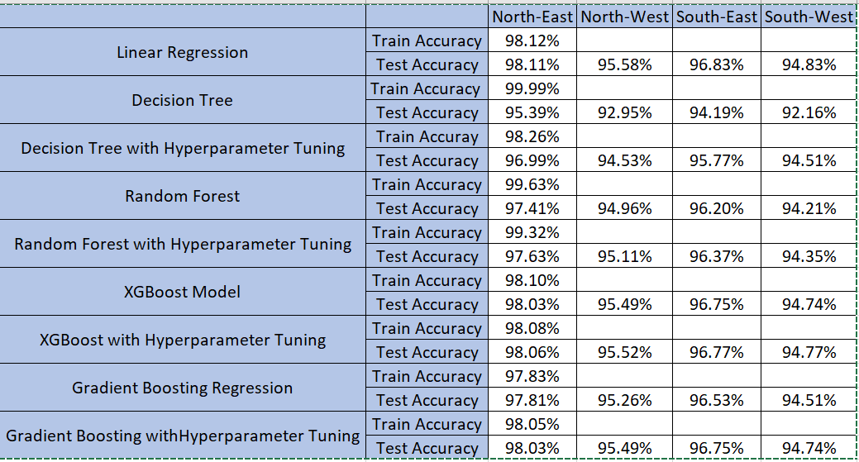
Data Modelling

Slide 10
Data Modelling - Summarized
• Trained our model to predict charges based on various lifestyle & demographic feature
• XGBoost (Tuned) and Gradient Boosting (Tuned) are the best models, with consistently high-test accuracy across all regions.
• Random Forest (Tuned) also performs well but is slightly less generalizable than boosting methods.
• Decision Trees have high training accuracy but suffer from overfitting, making them less reliable.
• Linear Regression is only effective if the data follows a linear trend.

Slide 11
Thank you

