Slide 1
Capstone Project - 3
Movie Recommendation System
Akshada Rane

Slide 2
Problem Statement
Dataset Structure
Streaming platforms face the challenge of guiding users through overwhelming content libraries effectively.
This report presents a hybrid recommendation engine using collaborative and content-based filtering techniques.
The system analyzes user behavior and movie attributes to deliver personalized suggestions.
Accurate recommendations aim to boost user satisfaction, engagement, and retention.
By catering to diverse preferences, the model helps platforms reduce churn and better serve niche audiences.
User ID
Age
Gender
Occupation
Zip-code
Movie Information
Movie ID
Title
Genre(s)
Release Date
Ratings:
User ID
Movie ID
Rating (1–5)
Timestamp
Data Source:
MovieLens 100k Dataset – Kaggle

Slide 3
Data Wrangling
We took the below steps for Data Cleaning Data Transformation:
• Checked for duplicates, we found no duplicates in out dataset
• Checked for missing values, we found that release_date, video_release_Date, IMDB_url had missing values, therefore dropped these rows
• We transformed date field such as ‘timestamp’ to date-time format

Slide 4
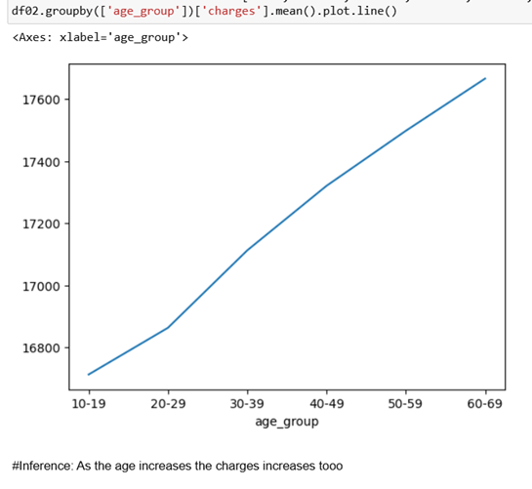
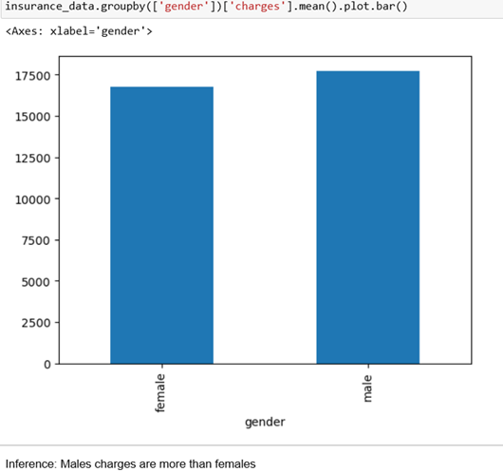
Exploratory Data Analysis
As the age increases of population the premiums/charges too go up.
Charges charged to male’s are more than females

Slide 5
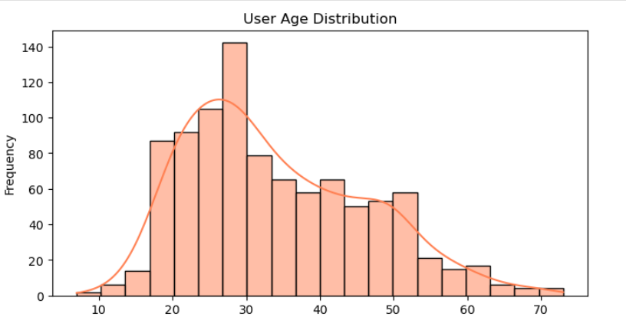
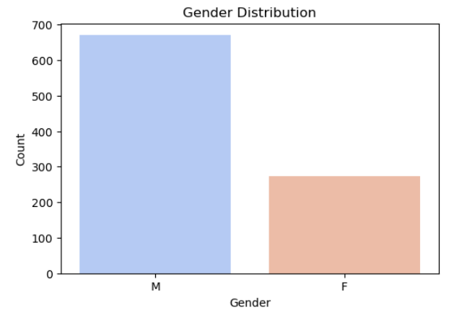
Exploratory Data Analysis
Population with age between 25-30 are the highest user of the movie platform
.
Males are the highest consumers of the movie platform

Slide 6
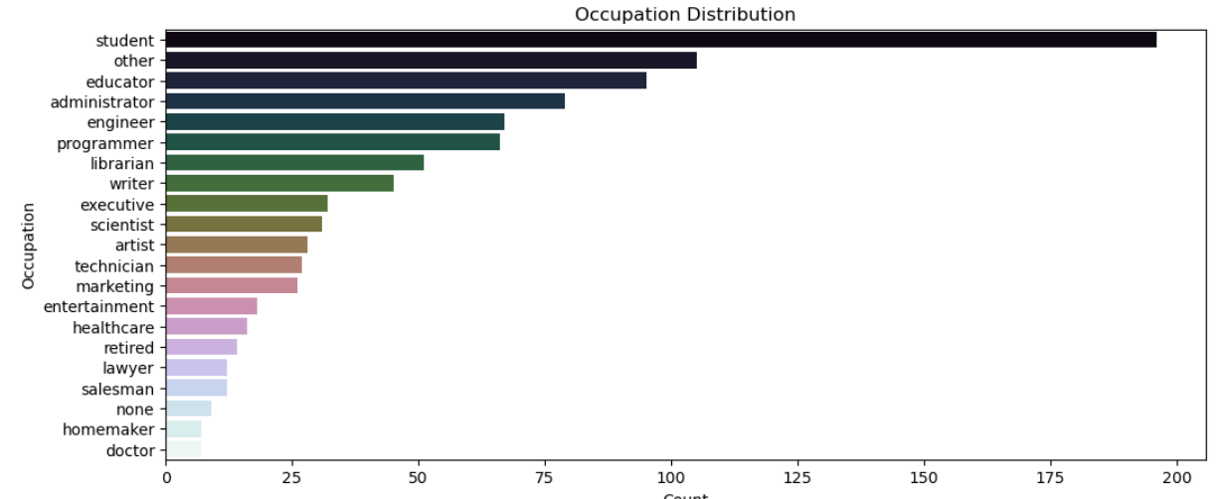
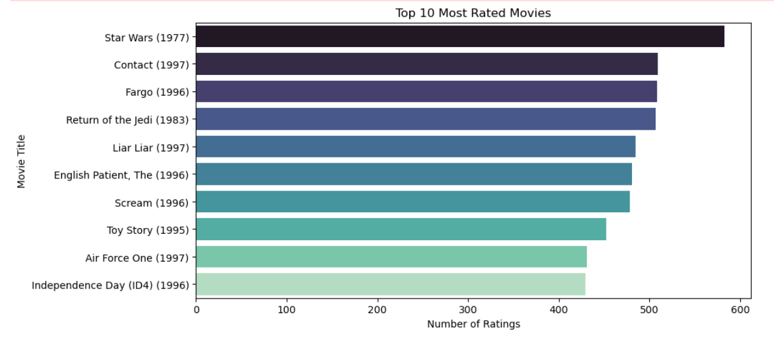
Exploratory Data Analysis
Above are the top 10 rated movies - Highest is Star Wars (1977)
Students are the highest consumer of the movie platform.

Slide 7
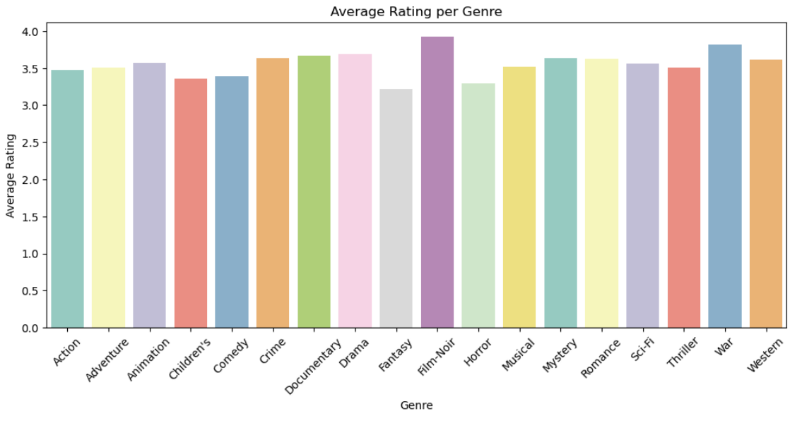
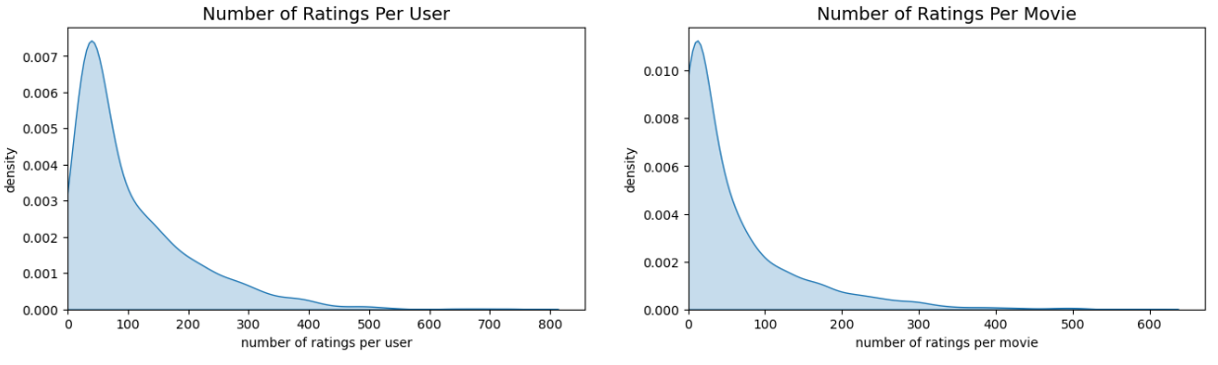
Exploratory Data Analysis
Ratings are highest for Film-Noir Genre & lowest for Fantasy Genre

Slide 8
Recommendation System
Output
Item-Item Recommendations
Item-Item Recommendations using k-NN identify movies similar to a selected title based on user rating patterns. By measuring the similarity between movies (using cosine similarity), the model suggests top-k titles that users with similar tastes are likely to enjoy.
Because you watched Toy Story (1995):
Star Wars (1977)
Return of the Jedi (1983)
Independence Day (ID4) (1996)
Rock, The (1996)
Willy Wonka and the Chocolate Factory (1971)
Mission: Impossible (1996)
Fargo (1996)
Raiders of the Lost Ark (1981)
Star Trek: First Contact (1996)
Implementation Steps
Built user-item matrix → Transposed for item vectors.
Selected a target movie for which to find similar titles.
Applied k-NN to identify most similar movies by rating pattern.
Mapped similar item indices back to movie titles for recommendations.

Slide 9
Recommendation System
Movie Recommendation using SVD (Singular Value Decomposition)
SVD is a matrix factorization technique used to predict user ratings for unseen items by learning latent factors from known user-item interactions. It helps in building personalized recommendations by identifying patterns in user preferences.
Output
Evaluation:
Average RMSE: 93.82%
Average MAE: 73.96%
Amadeus (1984)
Casablanca (1942)
One Flew Over the Cuckoo's Nest (1975)
Close Shave, A (1995)
Wallace & Gromit: The Best of Aardman Animation (1996)
Maltese Falcon, The (1941)
Paths of Glory (1957)
North by Northwest (1959)
Manchurian Candidate, The (1962)
Raise the Red Lantern (1991)
Implementation Steps
Loaded training and test data for 5 folds.
Converted data into the required format for the Surprise library.
Trained the SVD model on each training set.
Predicted ratings on the corresponding test set.
Calculated RMSE and MAE for model evaluation.
Identified movies the user hasn’t watched.
Recommended top 10 movies with the highest predicted ratings.

Slide 10
Recommendation System
Movie Recommendation using Collaborative Filtering
The code uses Item-Based Collaborative Filtering with cosine similarity to recommend movies. It predicts a user's rating for unseen movies based on how similar they are to movies the user has already rated.
Output
Star Kid (1997)
Big Bang Theory, The (1994)
Other Voices, Other Rooms (1997)
Men of Means (1998)
Tokyo Fist (1995)
Hugo Pool (1997)
Hush (1998)
Nightwatch (1997)
Entertaining Angels: The Dorothy Day Story (1996)
Further Gesture, A (1996)
Implementation Steps
Merged user, movie, and ratings data into one dataset.
Created a User-Movie rating matrix.
Calculated cosine similarity between movies.
Predicted ratings for unseen movies using a weighted average of similar movies’ ratings.
Recommended the top N highest predicted-rated movies the user hasn’t seen.

Slide 11
Conclusion
Explored collaborative filtering techniques to build personalized movie recommendation systems.
Implemented item-item filtering using k-NN, matrix factorization via SVD, and memory-based filtering with cosine similarity.
Each method predicted user preferences by analyzing historical rating patterns.
SVD captured latent features for robust predictions, while k-NN and cosine similarity offered interpretable suggestions.
These approaches demonstrate the value of recommender systems in enhancing user satisfaction through relevant, tailored movie recommendations.

Slide 12
Thank you

