Slide 1
Detecting BGP Anomalies

Slide 2

Disclaimer
These are research slides to help discussion
Not polished and very high level

Slide 3
Goals
Design statistical methods to mine BGP data for anomalies
This task can be divided into:
Designing BGP data matrix from raw BGP feeds
Noise removal and scope selection
Select few peers to look at
Eg., For detecting anomalies on a US prefix, should I be looking at a peer in China?
Feature/model selection
Detect different features that impact different anomalies
Which unsupervised methods work?

Slide 4
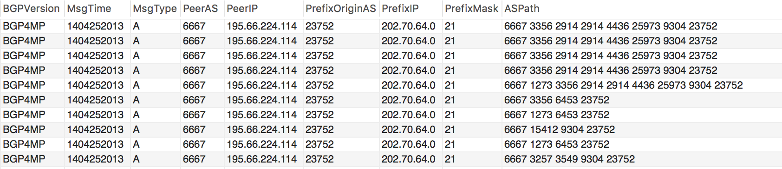
Data processing we should do
Handle duplicate updates
Aggregate stream of updates into one event
Detect BGP table transfers
Keep or remove them as per requirement

Slide 5
Literature Review

Slide 6
Detect Short Term Changes
SRI’s NIDES/STAT algorithm
Hypothesis based
Calculate Q value for different metrics:
BGP Update Arrival Frequency
Number of AS paths in a period
Update Type
AS path occurrence frequency
AS path difference
On Detecting Anomalous Routing Dynamics
http://citeseerx.ist.psu.edu/viewdoc/download?doi=10.1.1.88.6006&rep=rep1&type=pdf

Slide 7
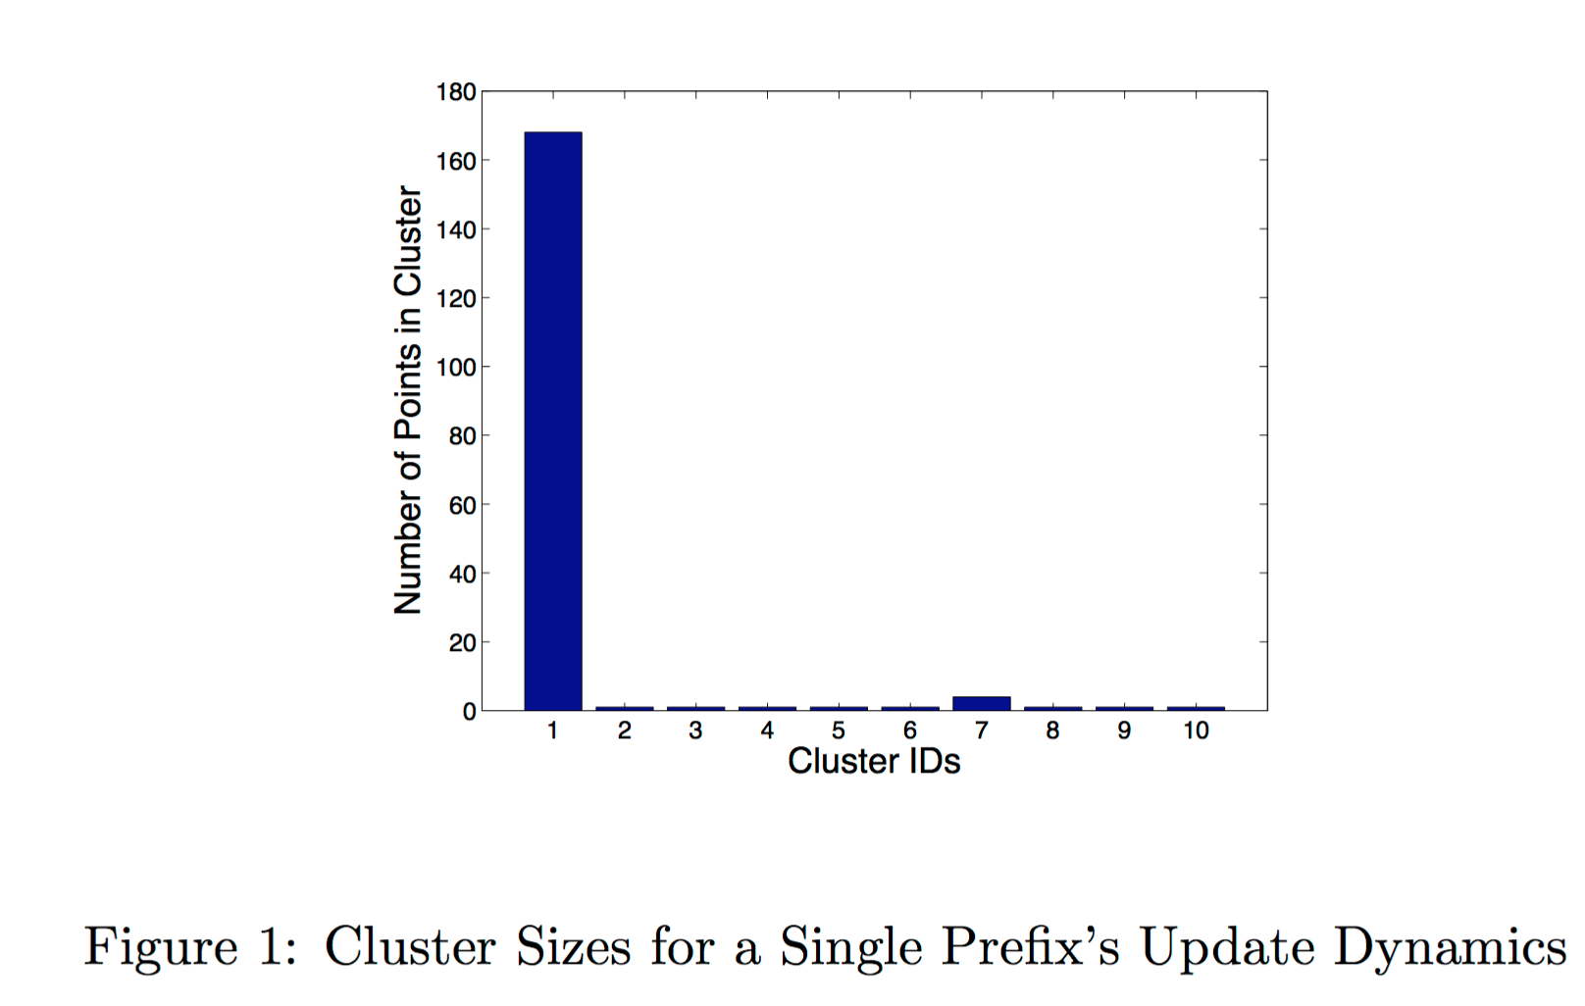
Learning Behavior of Prefixes
Use Haar Wavelet transform on prefix dynamics
Use clustering to detect different categories of prefix dynamics
Prefixes have similar dynamics
Learning-Based Anomaly Detection in BGP Updates
http://www.cs.yale.edu/homes/jf/ZRF.pdf

Slide 8
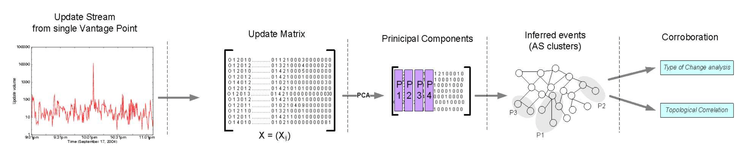
Inferring Event from Update Streams
A lot of updates are a result of same event
Identify clusters of ASes that are affected by same events
Inferring Events from BGP update Streams
http://www-users.cs.umn.edu/~zhzhang/Papers/inferring-major-events-tr1.pdf

