Slide 1

BGP and Ping Data Correlation
Anant Shah

Slide 2
Related Work
Analysis of country wide outages
Characterization of BGP Recovery
Analysis of BGP Prefix Origins during Google’s ‘05 Outage
BGP Eye: Visualization tool for real-time detection of BGP Anomalies

Slide 3
Analysis of Country Wide Outages⁺
Goals of this work:
Study outages (government censorship) in Libya and Egypt in 2011
Show different techniques used by governments to block internet access – mainly BGP-based and firewall-based traffic control
Approach:
Use data plane and control plane traffic to point out which form of internet access disruption was implemented by governments
⁺IMC ‘11

Slide 4
Analysis of Country Wide Outages: Data Used
Used data from RIRs and MaxMind Geolocation data to get prefixes that belong to Egypt and Libya
Control Plane:
BGP data from RouteViews
Data Plane:
Darknet data from UCSD
Active Probing data from CAIDA Ark

Slide 5
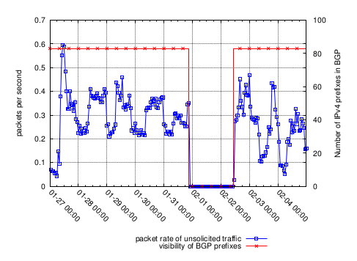
Analysis of Country Wide Outages: Methodology
Plot incoming data to darknet from these prefixes
Get prefixes that belong to desired countries
Map the ASes announcing those prefixes

Slide 6
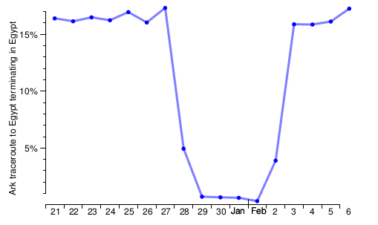
Analysis of Country Wide Outages: Ark Data
Some traceroutes reached the destination or known last hop even during outages:
These are prefixes that were not withdrawn

Slide 7
Take Away from IMC Paper
Comparing data from control and data plane reveals which form of censorship was used
Darknet (Internet Background Radiation) traffic can be used to detect internet outages that are not caused by BGP-based censorship
Traceroute data can be used to detect which prefixes were still available during censorship period

Slide 8
Shortcomings
Most reviewers complained about lack of technical innovation
Different data sets are used, but their correlations are not mined
IPv6 addresses were still reachable during outages
Authors attribute this to lack of censoring methodologies and do not investigate further

Slide 9
Goals of Our Work
Create an infrastructure to mine control plane (BGP) and data plane (Ping) data
Exploit correlations between BGP updates and outages
Develop predictive methodology to raise flag before an internet outage occur
Focus on what happened in neighboring ASes when outage occurred

