Slide 1

Mining Control and Data Plane Outages
Anant Shah, Ela Sienkiewicz

Slide 2
Overview
Past research has shown at any given time 0.3% of internet is unavailable [USC/ISI Technical Report, 2012]
These outages can be detected using either Data or Control Plane traffic
Need: Ways to correlate data from both planes to
Eliminate false positives
Predict outages

Slide 3
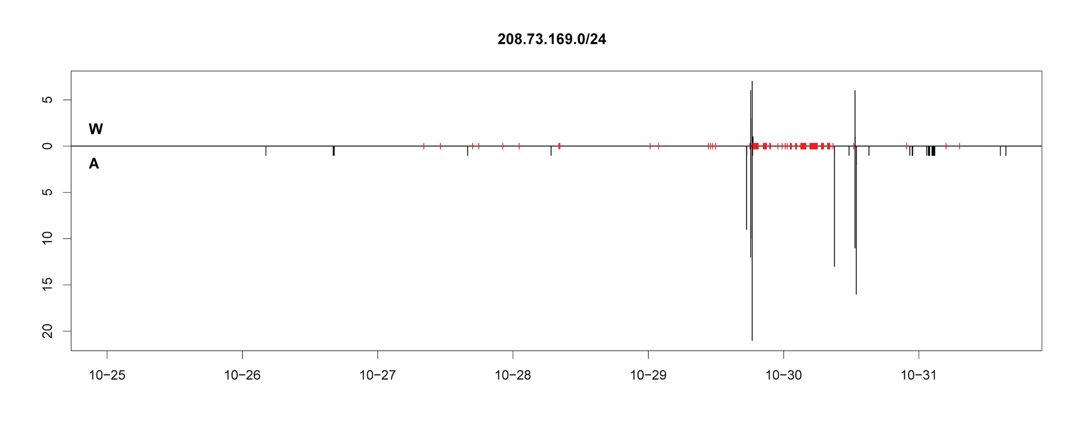
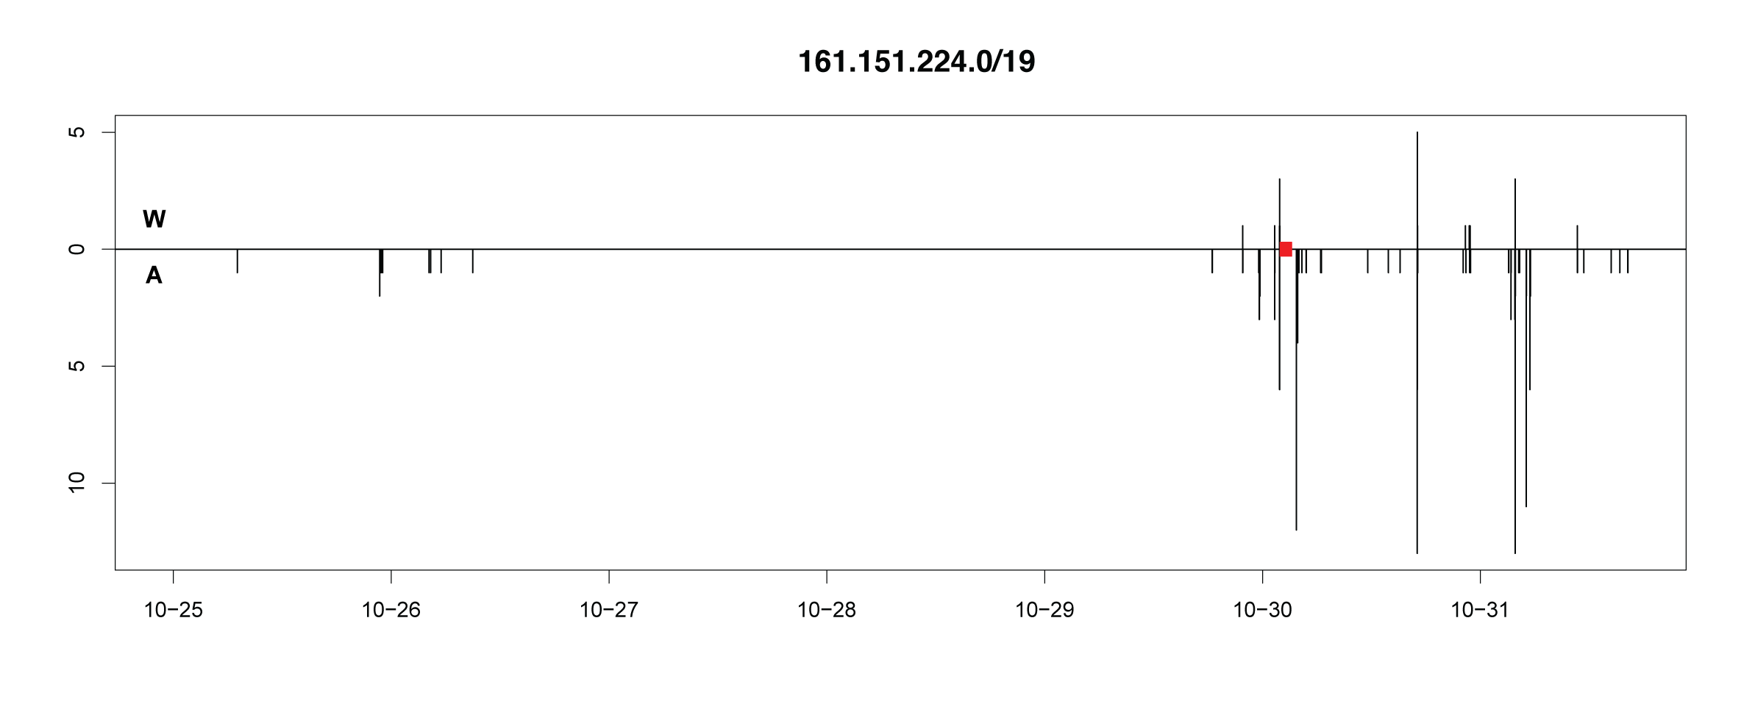
Hurricane Sandy Outage Example
Ping Outage
BGP Updates
208.73.169.0/24
BGP Updates
Significant amount of updates bracket outage
161.151.224.0/19
BGP Updates
No data plane outage seen
Day of Week

Slide 4
Objectives
Create an infrastructure to mine control plane (BGP) and data plane (Ping) data for outages
Exploit correlations between BGP updates and outages
Develop predictive methodology to raise flag before an internet outage occurs

Slide 5
Internet Outage DB
Currently contains BGP data during period 2012-10-25 to 2012-10-31
This time period was chosen to cover Sandy Outage in US
Data includes RIBs at the start of each day and Updates for all 7 days
Data is still being pushed (as of 2014-09-09 14:07)
DB also contains Trinocular data from USC/ISI ANT
This dataset provides the /24 prefixes that were detected unavailable during Sandy

Slide 6
Internet Outage DB Updates
DB now contains BGP data from 126 Routeviews peers
Geo info of peers using Maxmind is added
User can now view updates for outage prefix from multiple geographic locations
Dataset information in DB updated
Now also shows which collector the data came from
AS paths in Message table
AS relationships can be easily studied
New OutageInfo table shows BGP prefix governing outage prefix for each peer at start of each outage

Slide 7
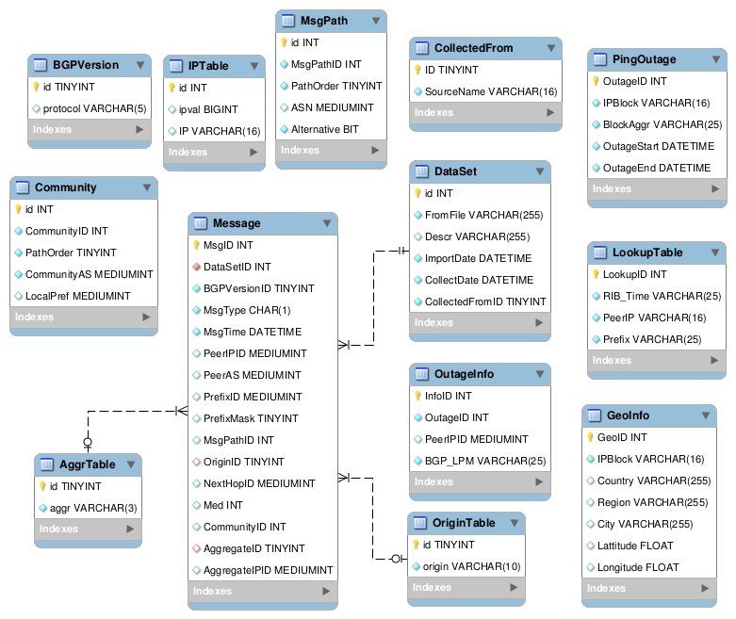
Current Database Schema

Slide 8
Database Schema: Outage Info
Ping Outage Table:
OutageID | IPBlock | BlockAggr | OutageStart | OutageEnd
3 | 68.181.211.0/24 | 68.181.0.0/16 | 2012-10-27 00:27:44 | 2012-11-09 01:43:47
/24 that was detected unavailable
Aggregation of all /24s that were unavailable
Outage Info Table:
OutageID | PeerIP | BGP_LPM
3 | 196.223.21.65 | 68.181.211.0/24
3 | 196.223.21.66 | 68.181.211.0/24
BGP Prefix covering given /24 for each peer

Slide 9
Challenges in prediction of outage
Ping Outage
BGP Updates
Updates do not precede outages
BGP Updates
Day
Updates seen but after outage
No updates for a bigger BGP prefix
New BGP prefixes appearing during/after outage

Slide 10
Ongoing Work
Faster insert of BGP updates into database
Evaluate options to push data into HIVE
Fit statistical models to predict prefix outage

Slide 11
Community Impact
The outage dataset created in this work will be available to the research community via the DHS PREDICT program
This will majorly help researchers in the domain of internet measurements and to larger community to study/predict internet outages

