Slide 1
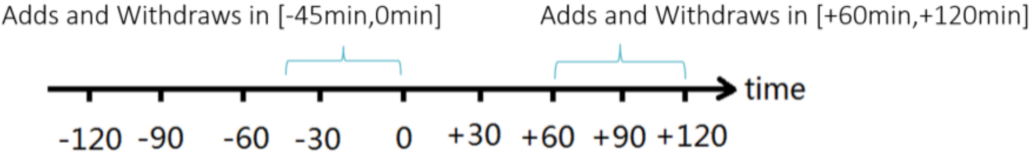
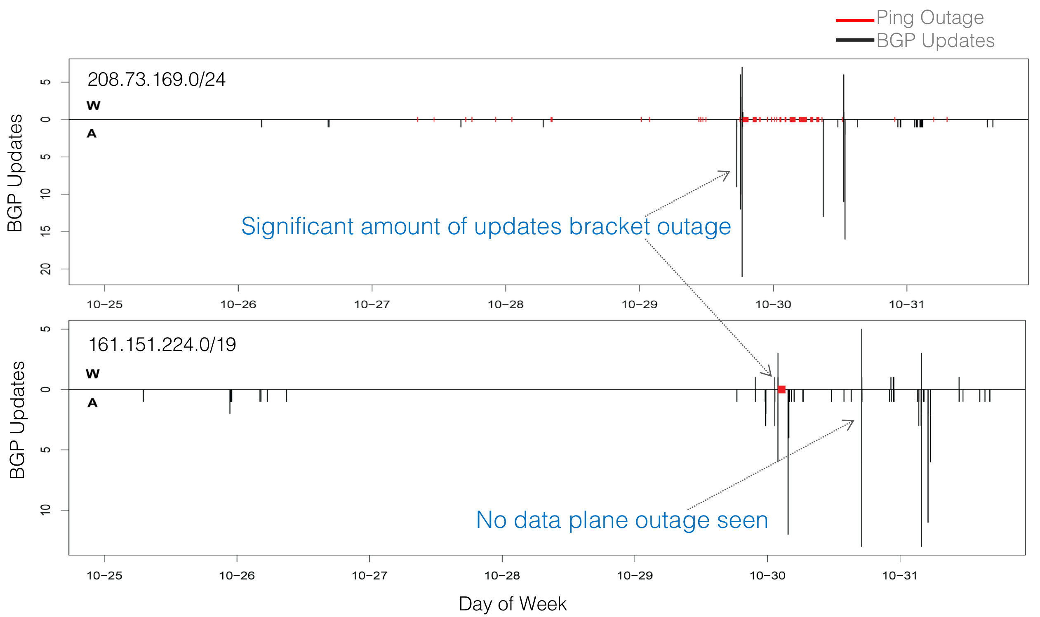
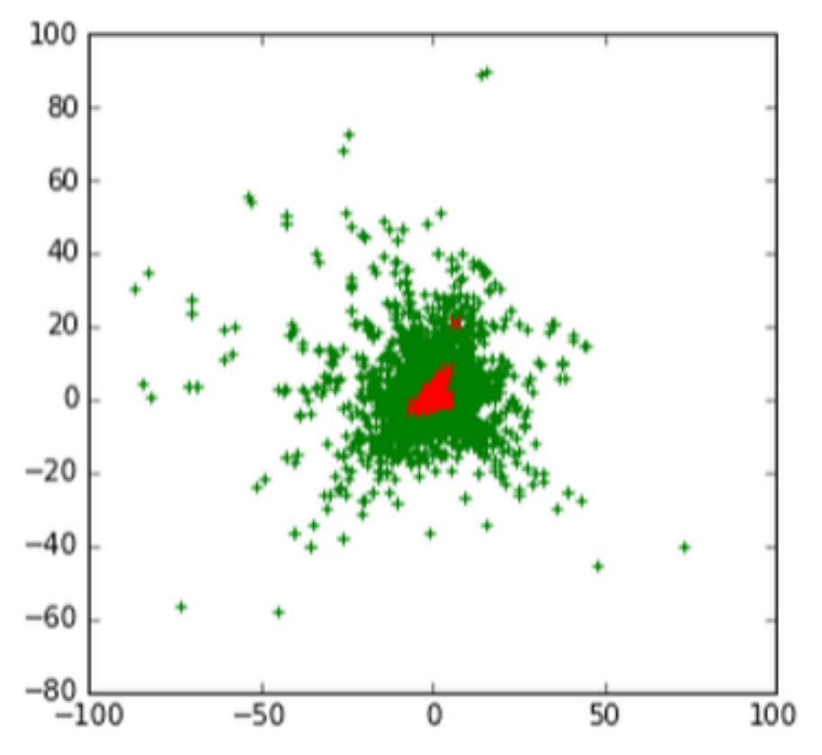
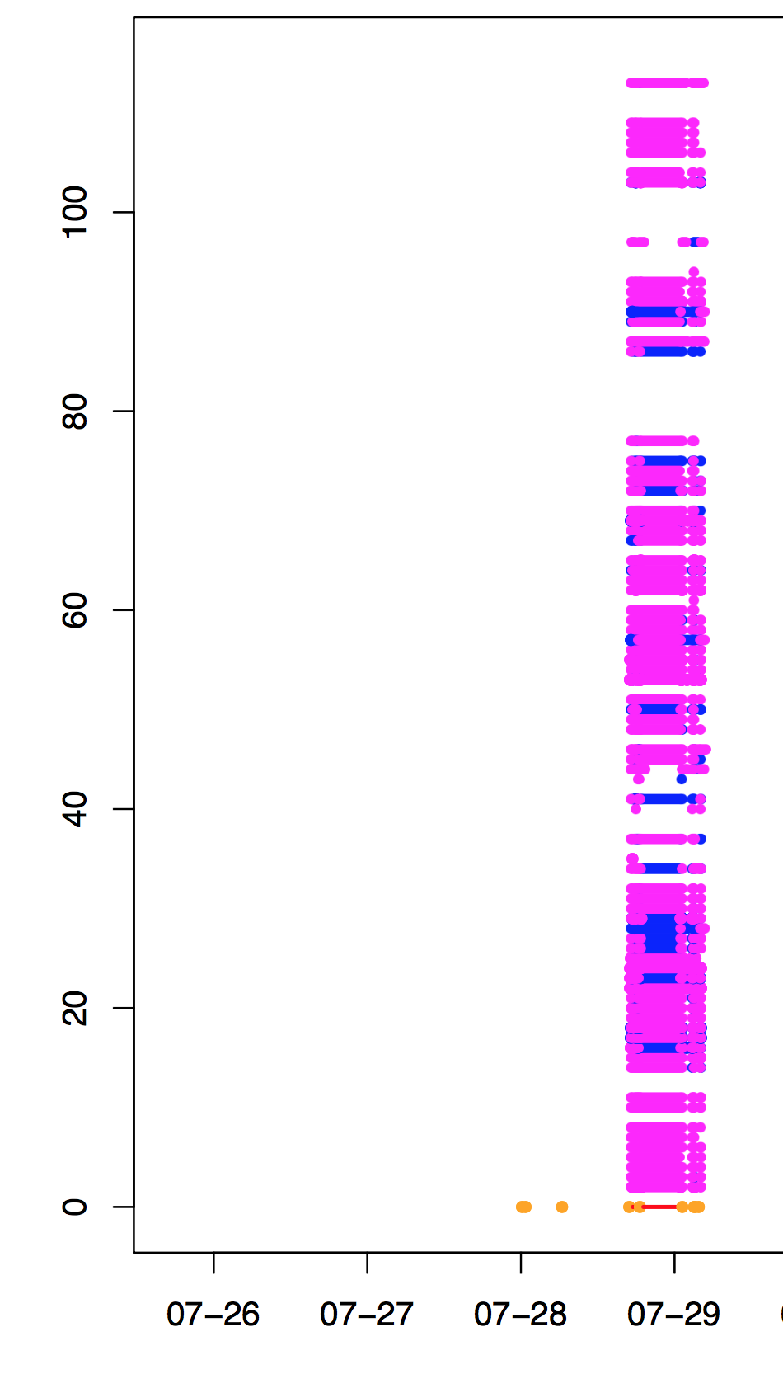
Studying Internet Outages
from Data and Control Plane
Anant Shah, Ela Sienkiewicz, Christos Papadopoulos
{akshah,ela,christos}@cs.colostate.edu
Background and Motivation
Preliminary Findings
Modeling BGP Activity
In more than 40% cases a large churn of BGP updates is observed before and after outage
However, there are cases where either no BGP churn is seen or no data plane outage is seen
Can we mathematically model BGP activity during outage?
Past research has shown at any given time 0.3% of internet is unavailable
Outages can be detected using either data or control plane traffic
Since all outages are not visible in both planes, we need ways to correlate outages from both planes and better understand relationships
Data Matrix
PCA analysis shows PC component values clustered during outages*
PC1
PC2
This characteristic helps separating the anomalous space to detect anomalies
Methodology
We collect outages detected by the Trinocular^{[1]} project (3.5M /24s)
We then fetch BGP updates from RouteViews for prefixes covering given /24s
Finally, we map how each data plane outage was seen by peers in RouteViews
Further Directions
Create predictive models to detect outages using BGP churn
Provide more statistics on how often overlap in outages occurs per peer
Use data plane outage from RIPE Atlas^{[2]}
Prototype visualization on Google Maps:
W followed by A
Some BGP peers do not see any activity during the outage
In most cases, peers see Withdraw followed by Announcement
Only W
Some peers do not see BGP churn
RouteViews Peers
[1] L. Quan et al. “Trinocular: Understanding Internet Reliability through Adaptive Probing”, SIGCOMM’13
[2] A. Shah et al. “Disco: Fast, Good, and Cheap Outage Detection”, TMA’17
* Contributed by Yingnan Liu, Randy Paffenroth (Worcester Polytechnic Institute)
Data Plane Outage
iodb.netsec.colostate.edu

