Slide 1
Machine Translation For Low Resource Scenarios
Akshai Ramesh
Venkatesh B P

Slide 2
Corpus Information
English - Tamil
Hindi - Tamil
Dataset | Number of Sentences
Training set | 2,22,367
Dev set | 500 in Each of {Ubuntu, Tanzil, KDE4, PMIndia}
Test set | 500 in Each of {Ubuntu, Tanzil, KDE4, PMIndia}
Dataset | Number of Sentences
Training set | 100047
Dev set | 500 in Each of {Ubuntu, KDE, Tanzil, GNOME}
Test set | 500 in Each of {Ubuntu, KDE, Tanzil, GNOME}
Followed by this, we also built a baseline NMT system with customized Software data for both English-Tamil and Hindi-Tamil.

Slide 3
Data Preprocessing:
Handling punctuations and symbols
Removing trailing white spaces and duplicate sentence pairs from corpus
Text tokenization
Text Normalization
Convert all letters to lower-case
Processing for MT systems
Moses Text Cleaning
Text Segmentation (Byte Pair Encoding of Words)

Slide 4
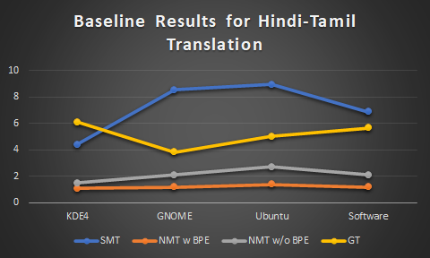
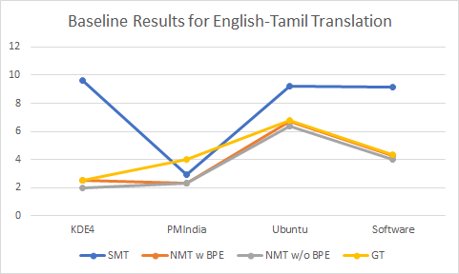
Baseline Results Comparison Using BLEU

Slide 5
Error Analysis on Baseline Systems
Term Definition:
फ्रीसेल - இலவசகளம்
Freecell Freebugs
Transliteration over Translation:
एलीवेटर - எலிவேட்டர்

Slide 6
Error Analysis on Baseline System - Continue
Out of Vocabulary Terms:
सोलिटेयर, पत्ते - சண்டய ும் விதமாக
These words are not available in the training set and thus resulting in irrelevant translation on the target side.
Incorrect Lexical Selection:
हाल में खेले गए खेल के नाम
Condition Hall
Due to the misinterpretation of the contextual meaning, the translation on the target side becomes entirely different from the source side.

Slide 7


