Slide 1

PRE-IDEATHON TEMPLATE
GENESIS
IDEATHON
TEAM & DOMAIN
Introduce your team and the domain you have chosen
Team Name – SECRET AVENGERS
Team Members – SREE GUGAN V S - CB.SC.U4CSE26254
HARSHIL T - CB.SC.U4CSE26259
AKSHAI - CB.SC.U4CSE26766
NITHESH - CB.SC.U4CSE26261
Selected Domain – 1
Problem Statement – AI-POWERED PREDICTIVE & ADAPTIVE ENERGY OPTIMISATION FOR SMART BUILDING

Slide 2


DOMAIN PROBLEM IN OUR WORDS
TEAM
SECRET AVENGERS
Explain the problem in your domain simply, in your own words
What exactly needs to be solved?
We need to solve the problem of “using too much energy when we don't need to” by making the building smart enough to predict demand and automatically reduce energy wastage without affecting students' and staff's comfort.
Why is it important right now?
As campuses become more energy-intensive, we need intelligent systems that can predict and adapt energy consumption instead of wasting energy through fixed, inefficient usage.
Source: chatgpt

Slide 3
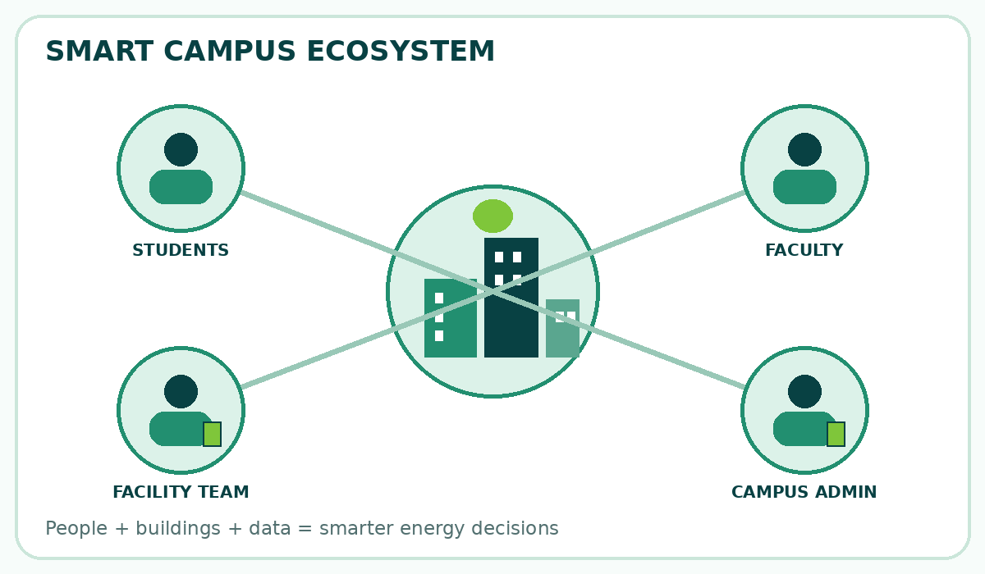
WHO IS AFFECTED?
TEAM
SECRET AVENGERS
Target users, stakeholders, beneficiaries
Primary users / target group
College and University campus Administrator
Facility/Energy management teams
Govt./Pvt Office buildings
Secondary stakeholders
Government and regularity bodies
Electricity and energy providers
Who benefits if the problem is solved?
Students and Faculty
College management
Source: Original AI-generated illustration (OpenAI, 2026)

Slide 4
CURRENT SITUATION & CONTEXT
TEAM
SECRET AVENGERS
Existing scenario, background and how things work today
Existing scenario and background
Most campuses currently manage electricity using manual monitoring, fixed schedules, or basic automation. Lights, fans, air conditioners, laboratory equipment, and other electrical systems are often operated according to predetermined timings rather than actual occupancy or real-time energy demand.
This can lead to energy wastage, especially when classrooms, laboratories, or offices are partially occupied or empty.
Relevant data or facts (if available)
Educational institutions operate multiple buildings and electrical systems simultaneously, creating significant and varying energy demand.
Energy consumption changes based on occupancy, weather, class schedules, time of day, and equipment usage.
Fixed schedules cannot always respond to these changing conditions. AI-based prediction can use historical consumption and real-time data to identify demand patterns and support smarter energy management.
Smart meters and IoT sensors can provide the data required for real-time monitoring and optimization.
Current workflow, step by step
Electricity is supplied → Different buildings consume the Electricity → Equipment is switched ON/OFF → Energy meter records the consumption → Maintenance team monitors the consumption → Staff Investigate and take corrective actions manually if high consumption is noticed

Slide 5
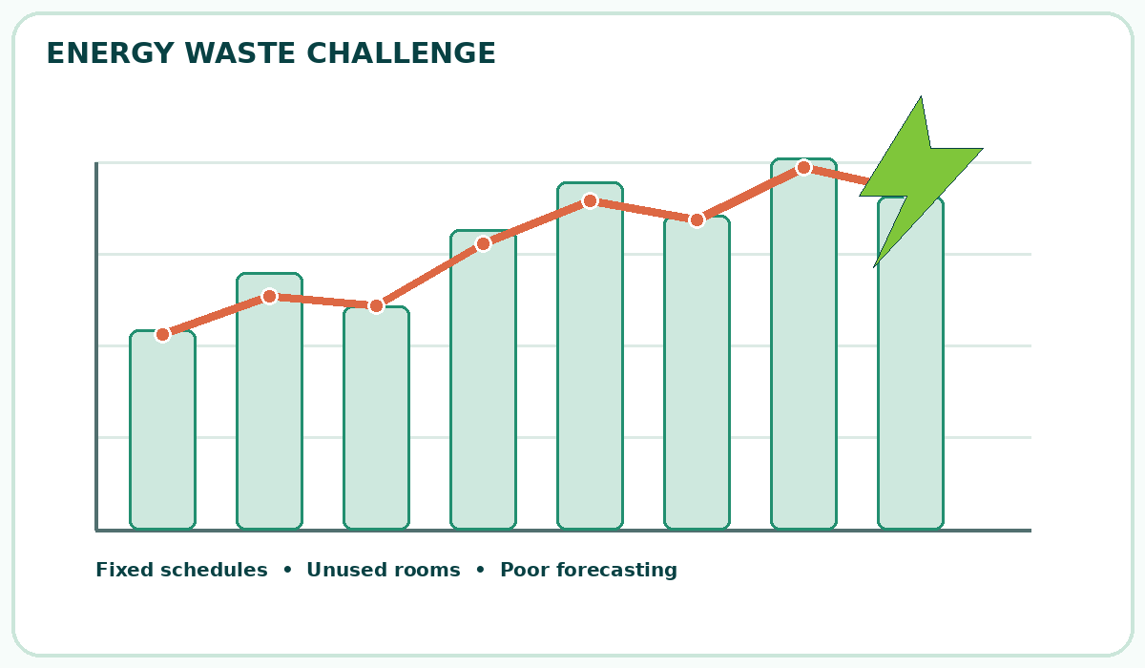
KEY CHALLENGES
TEAM
SECRET AVENGERS
Main difficulties, bottlenecks, root causes and consequences
Main difficulties and bottlenecks
Excessive electricity consumption in classrooms, laboratories, and offices.
Difficulty in predicting energy demand during changing schedules and weather conditions.
Lack of real-time monitoring of electricity consumption across campus buildings.
Limited automation and dependence on manual control of electrical equipment.
Root causes behind them
Absence of intelligent systems to monitor room occupancy and energy usage continuously.
Use of fixed operating schedules that do not adapt to actual requirements.
Lack of integration between energy meters, IoT sensors, and control systems.
Insufficient analysis of historical energy consumption data.
Consequences of leaving them unsolved
Difficulty in identifying abnormal energy consumption and equipment faults.
Reduced energy efficiency and limited progress towards sustainable, smart campuses.
Source: Original AI-generated illustration (OpenAI, 2026)

Slide 6
EXISTING SOLUTIONS / APPROACHES
TEAM
SECRET AVENGERS
What is already being done, and where it falls short
Existing methods, systems or alternatives
Manual monitoring: Staff check electricity meters and switch appliances ON/OFF manually.
Fixed scheduling systems: Lights, fans, and air conditioners operate according to predetermined schedules.
Motion sensors and occupancy sensors: Automatically control lighting based on whether people are present. (Currently present in certain areas of the Amrita campus).
Limitations of each
Manual monitoring: Time-consuming and unable to respond immediately to energy wastage.
Fixed scheduling: Cannot adapt effectively to unexpected changes in classroom occupancy or schedules.
Motion sensors: May not account for future occupancy, changing energy demand, or all types of electrical equipment.
The gap they leave open (Key Challenges)
Lack of prediction: Energy demand is not always forecast using historical consumption, weather, and occupancy data.
Limited adaptability: Systems may not adjust automatically to changing campus activities and real-time requirements.

Slide 7
PROBLEM INSIGHTS & OPPORTUNITY AREAS
TEAM
SECRET AVENGERS
Resources required to solve the problem
Hardware Requirements
Laptop or desktop computer for development and testing.
Internet connection for accessing datasets, weather information, and online services.
Software Requirements
Programming language: Python.
AI/ML libraries: Scikit-learn, Pandas, NumPy.
Development environment: VS Code or Jupyter Notebook.
Prediction model: Machine-learning model for forecasting energy demand.
Data storage: MySQL, SQLite, or CSV files.
Other resources (Including Human Resources)
Testing resources: Simulated campus buildings, classrooms, occupancy patterns, and energy-demand scenarios.
Campus administrator or facility manager: Provides information about energy usage and campus operations.

Slide 8
INITIAL DIRECTION & EXPECTED OUTCOME
TEAM
SECRET AVENGERS
What Is Your Expected Outcome?
What your team intends to do
Develop a software-based AI system to predict campus electricity demand using historical energy consumption data and relevant factors such as weather, time, and occupancy.
Identify potential energy wastage and recommend suitable energy-saving actions.
Provide adaptive optimization recommendations based on changing energy requirements.
What you want to improve
Minimize dependence on manual monitoring and fixed operating schedules.
Help campus administrators make informed, data-driven energy-management decisions.
Improve energy efficiency while maintaining the comfort of students and staff.
What successful improvement should you achieve
Demonstrate that the AI model can forecast energy demand using historical or sample data.
Generate practical recommendations for reducing unnecessary energy consumption.
Source: ChatGPT

Slide 9
TEAM CONTRIBUTION
TEAM
SECRET AVENGERS
Who will handle which part of the execution
Team Member | Role | Responsibility in Execution
Member 1 name | Role | What they will handle
Member 2 name | Role | What they will handle
Member 3 name | Role | What they will handle
Member 4 name | Role | What they will handle

