Slide 1
Diabetes Prediction with Data Mining Algorithm
Presented by-
Akshaj Patil
MT19111

Slide 2
Introduction
Diabetes is caused due to an abnormal increase in blood sugar concentration. Diabetes can lead to various problems or can even lead to premature death. Nowadays diabetes can be predicted using data mining techniques. Pima-Indian-Diabetic-Data-sets is used to train and evaluate data mining algorithms. Data-sets can contain irrelevant data such as noise. This paper tries to overcome the problem of predicting null values and removing outliers.

Slide 3
Preprocessing
In this data we have many rows of Insulin and Skin Thickness with null values, but as they are important attributes so instead of deleting these we will predict these missing values with help of classifier.
For predicting these missing values we will use the KNN
classifier. We will train the KNN model with all attributes in which predicted class will be Insulin/Skin Thickness attribute and fill missing values with predicted values.

Slide 4
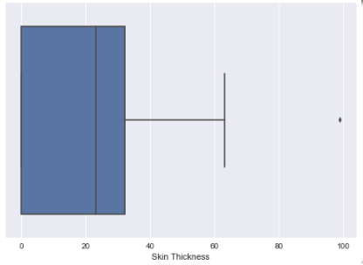
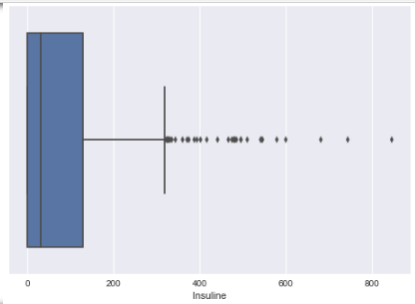
Preprocessing
There is outlier in Skin Thickness and Insulin so delete that particular row.

Slide 5
Classifiers
Decision Tree
Used as it can work well on numerical data and categorical data efficiently. Also Missing values do not affect much in building the tree.
Accuracy of model is: 77.23
KNN
It requires no training period so data can be seamlessly added here.
Accuracy of model is: 79.03
Gaussian Naive Bayes
Performs well on small data and also works well on both discrete and continuous data.
Accuracy of model is: 76.8
SVM
It helps in avoiding over fitting of data by dividing data with help of hyper plane.
Accuracy of model is: 0.79

Slide 6
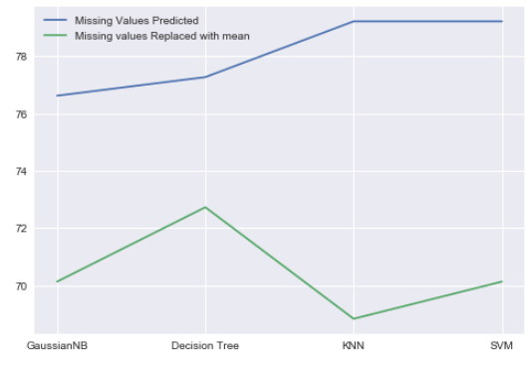
Conclusion
We can also conclude that replacing missing values with prediction is more reliable than replacing missing values with mean because we can see a rise in accuracy in the comparison graph.

