Slide 1

Effective Prediction of Heart Disease using Machine/Deep Learning Techniques
Group Number - 15
Research Project – Big Data Mining in Health Care
Submission By:
Kanika Mittal (MT18075) Akshaj Patil (MT19111)
Dhawal Singh Pundir (MT19120) Nitindeep Singh (MT19069)

Slide 2
Introduction
Significance of Choosing this topic :
Heart disease is amongst the most critical conditions which have a significant impact on human life all over the world.
It also accounts for being the reason for mortality and morbidity.
Thus, it is necessary to diagnose heart diseases in a timely and accurate manner, which can help in the prevention of such heart attacks.

Slide 3
Introduction (Cont.)
What we aim to do :
Apply machine and deep learning-based models for heart disease prediction, which aim to perform binary classification - people with heart disease and people without heart disease.
The structure of our methodology is as follows –
Preprocessing of the datasets
Feature selection
Cross-validation
Applying machine and deep learning classifiers
Evaluating classifiers' performance.

Slide 4
Existing Systems
Palaniappan and Awang designed an expert medical diagnosing heart disease system and applied machine learning techniques such as Naive Bayes, Decision Tree, and ANN in the system. They obtained the accuracy of 88.12%, 86.12%, 80.14% respectively for Naive Bayes, ANN and Decision Tree classifier. [1]
Olaniyi and Oyedotun proposed a three-phase model based on the ANN to diagnose heart disease in angina and achieved a classification accuracy of 88.89%. [2]
Jabbar et al. designed a diagnostic system for heart disease and used machine learning classifier multilayer perceptron ANN-driven back propagation learning algorithm and feature selection algorithm. [3]

Slide 5
Existing Systems (Cont.)
Kahramanli and Allahverdi designed a heart disease classification system used a hybrid technique in which a neural network integrates a fuzzy neural network and ANN. They obtained a classification accuracy of 87.4%. [4]
Detrano et al. proposed a logistic regression classifier based decision support system for heart disease classification and obtained a classification accuracy of 77%. [5]
Gudadhe et al. used MLP and SVM algorithms for heart disease classification. The proposed classification system obtained accuracy of 80.41%. [6]

Slide 6
Baseline Research Paper Improved Study of Heart Disease Prediction System using Data Mining Classification Techniques [7] Chaitrali S. Dangare
Aim: Improved Study of Heart Disease Prediction System using Data Mining Classification Techniques
Objective: The main objective of this research is to build Intelligent Heart Disease Prediction System that gives diagnosis of heart disease using historical heart database. To develop this system, medical terms such as sex, blood pressure, and cholesterol like 13 input attributes are used. To get more appropriate results, two more attributes i.e. obesity and smoking are used, as these attributes are considered as important attributes for heart disease.

Slide 7
Baseline Research Paper (Cont.)
DATA SOURCE:
The publicly available heart disease database is used. The Cleveland Heart Disease database consists of 303 records & Statlog Heart Disease database consists of 270 records. The data set consists of 3 types of attributes: Input, Key & Predictable attribute.
DATA MINING TECHNIQUES USED FOR PREDICTIONS:
Neural Networks
Decision Trees
Naive Bayes

Slide 8
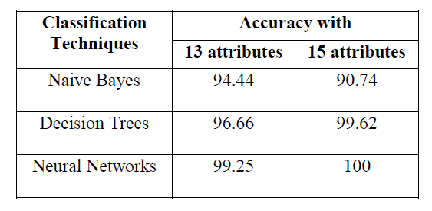
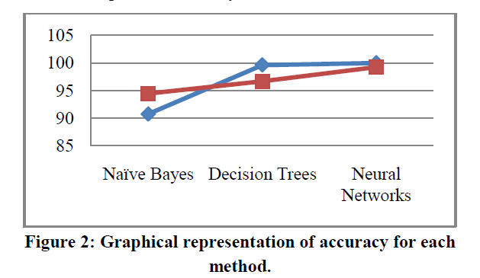
Baseline Research Paper (Cont.)
RESULTS:
Note: Due to update in the Cleveland and Statlog heart dataset, we only have 13 attributes; 2 extra attributes were removed from the latest update.

Slide 9
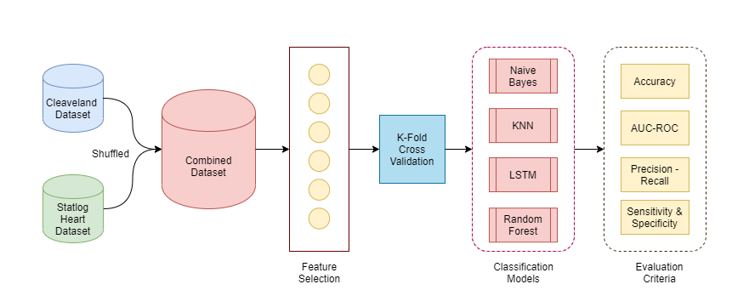
Materials and Methods
Datasets Used (UCI Repository):
Cleveland Dataset
Statlog Dataset
Feature Generation/Selection
Techniques:
PCA
Categorical → Continuous
Select K-Best
Cross-Validation Technique :
Stratified K-Fold Cross Validation

Slide 10
Materials and Methods (Cont.)
Classification Techniques Used :
Naïve Bayes
Decision Tree
Random Forest
SVM
Logistic Regression
MLP
LSTM
Evaluation Parameters :
Accuracy
Sensitivity
Specificity
Precision
AUC-ROC
MCC

Slide 11
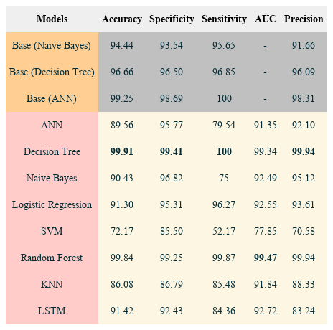
Results
The top three rows show the results of the baseline models.
The results in the table clearly show that our proposed model perform better than the baseline model on all the evaluation metrics.
Decision Tree performed best in comparison to all other classifiers.

Slide 12
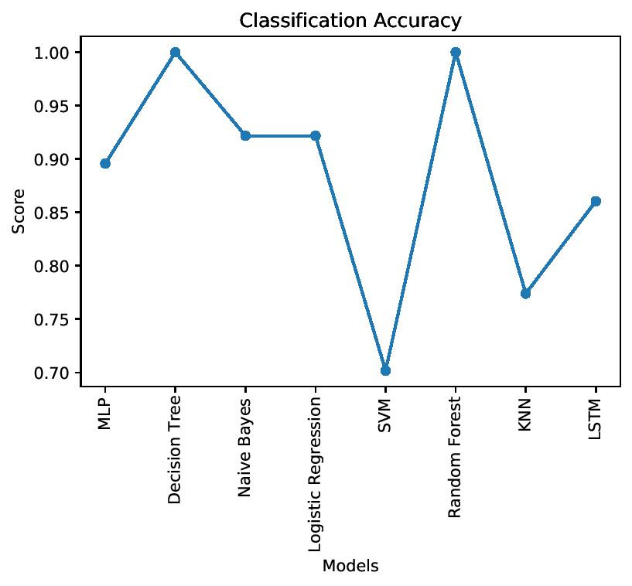
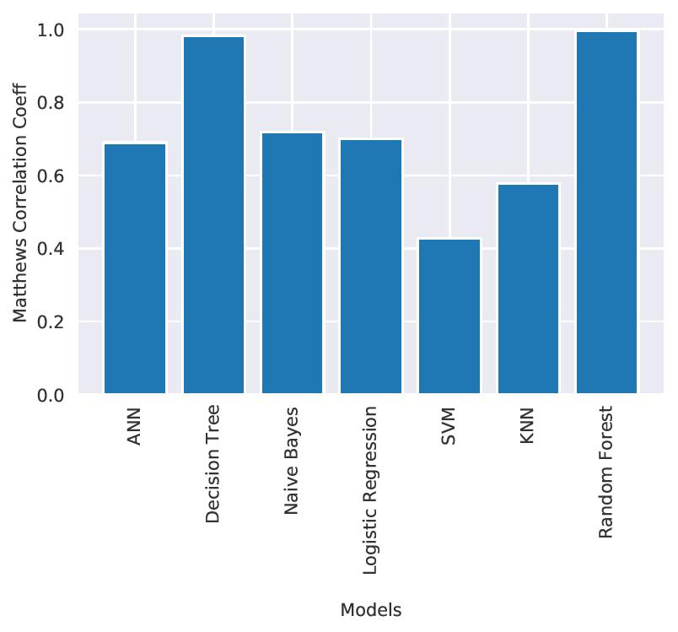
Comparison of Classification Accuracy
Comparison of Matthews Correlation Coefficient

Slide 13
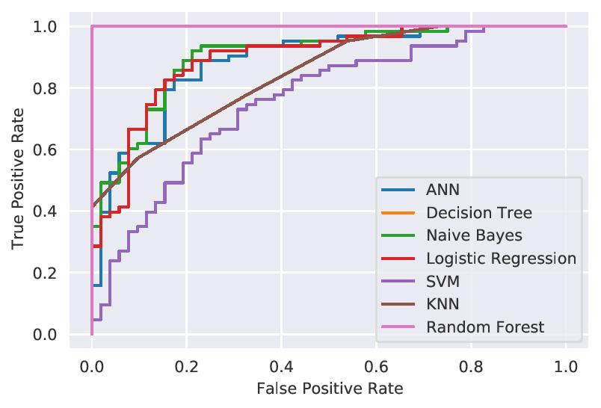
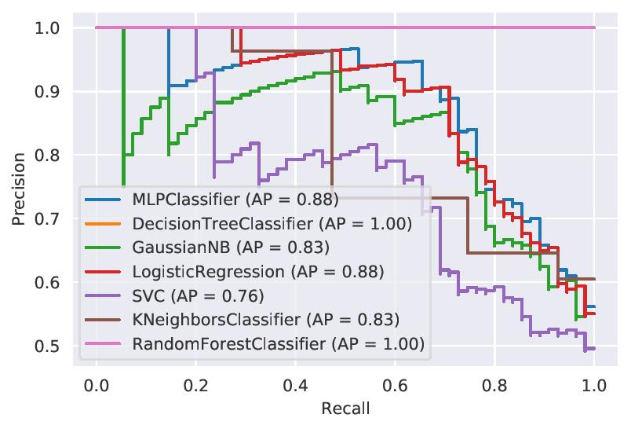
Comparison of ROC curve
Comparison of Precision-Recall curve

Slide 14
Conclusion
In this paper, we have proposed machine and deep learning based system for heart disease prediction.
Decision Tree outperforms all other classifiers in Accuracy, Specificity and Sensitivity while Random Forest performs the best in AUC.
Decision Tree and Random Forest have performed equally with very negligible difference in all the evaluation metrics.

Slide 15
Conclusion (Cont.)
Future Work
Advanced feature selection techniques like Recursive Feature Selection, Minimal-Redundancy-Maximal-Relevance Feature Selection, LASSO can be used in the system to improve the accuracy of various parameters.
We can perform more experiments with more efficient feature selection and deep learning models for getting better predictions.

Slide 16
References
S. Palaniappan and R. Awang, “Intelligent heart disease prediction system using data mining techniques,” in Proceedings of IEEE/ACS International Conference on Computer Systems and Applications (AICCSA 2008), pp. 108–115, Doha, Qatar, March-April 2008.
E. O. Olaniyi and O. K. Oyedotun, “Heart diseases diagnosis using neural networks arbitration,” International Journal of Intelligent Systems and Applications, vol. 7, no. 12, pp. 75–82, 2015.
M. A. Jabbar, B. L. Deekshatulu, and P. Chandra, “Classification of heart disease using artificial neural network and feature subset selection,” Global Journal of Computer Science and Technology Neural & Artificial Intelligence, vol. 13, no. 11, 2013.
H. Kahramanli and N. Allahverdi, “Design of a hybrid system for the diabetes and heart diseases,” Expert Systems with Applications, vol. 35, no. 1-2, pp. 82–89, 2008.
R. Detrano, A. Janosi, and W. Steinbrunn, “International application of a new probability algorithm for the diagnosis of coronary artery disease,” American Journal of Cardiology, vol. 64, no. 5, pp. 304–310, 1989.
M. Gudadhe, K. Wankhade, and S. Dongre, “Decision support system for heart disease based on support vector machine and artificial neural network,” in Proceedings of International Conference on Computer and Communication Technology (ICCCT), pp. 741–745, Allahabad, India, September 2010
C. Dangare and S. Apte, “Improved study of heart disease predictionsystem using data mining classification techniques,”International Jour-nal of Computer Applications, vol. 47, pp. 44–48, 06 2012.

