Slide 1

SMART INDIA HACKATHON 2026
PramaanScope
Institutional evidence review
with correction impact tracking
Problem Statement ID: SIH26261
Problem Statement Title
AI-Powered Application Validation,
Document Authentication and Regulatory
Compliance Verification
Theme: Smart Automation
PS Category: Software
Team Name: CELESTIAL_OUTLAWS
Team Leader: Akshaj Sherekar
Team ID: __________________
Notes:
PramaanScope is a working local prototype for SIH26261. Registered team name and leader supplied by the user. Team ID intentionally left blank at the user's request. Theme is taken from the reproduced problem listing and requires confirmation against the registered portal record. Problem-title source: user-supplied problem-list image. Detailed brief reproduction: https://zaidsayyed.in/tools/sih-problem-statements/sih26261 . The prototype uses synthetic institution records and a demonstration checklist. All statutory decisions remain with competent authorities.

Slide 2

PRAMAANSCOPE
CELESTIAL_
OUTLAWS
Evidence that applies to the right campus
PROPOSED SOLUTION
Read evidence and check institution, campus,
period and historical intake.
HOW IT ADDRESSES THE PROBLEM
Show the original page, the discrepancy
and the exact evidence needed.
INNOVATION AND UNIQUENESS
Preview a correction's impact before acceptance.
Tie earlier reviews to their evidence versions.
Application: Campus A
Submitted certificate: Campus B
Illustrative campuses. Synthetic demonstration case.
Content result, source verification and human review stay separate.
Notes:
Core example: the synthetic application is for Campus A while certificate version 1 names Campus B. That is a scope discrepancy, not proof of forgery. The working feature set includes a requirement-evidence matrix, original page rendering, clarification requests, candidate replacement, impact preview, fingerprint-bound reviews and retained history. Source: current server/rules.ts, server/store.ts and client/App.tsx. Illustration generated using the built-in image generation tool and does not depict actual institutions. Design foundation: W3C credential verification is distinct from reliance on claims under a verifier's policy: https://www.w3.org/TR/vc-data-model/ . Worldwide novelty is not claimed.

Slide 3
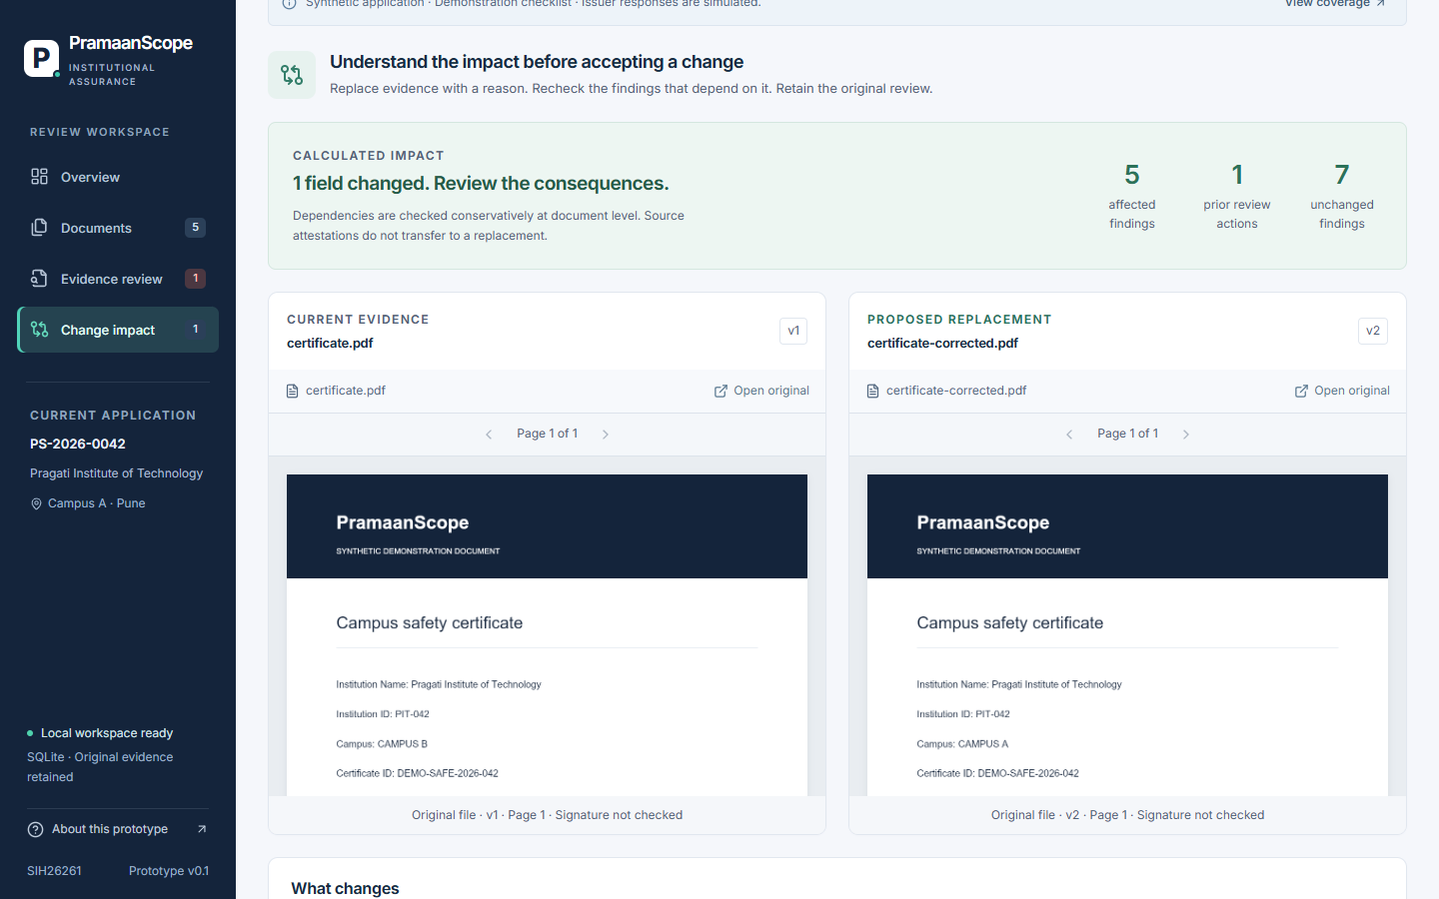
TECHNICAL APPROACH
CELESTIAL_
OUTLAWS
Methodology and process
1 Upload
PDF or image
2 Extract
PDF text / local OCR
3 Evaluate
12 explicit checks
4 Review
Clarification request
5 Correct
Impact and re-review
Technologies used
Working prototype: calculated replacement impact
Layer | Implementation
Interface | React + TypeScript
API | Node.js + Express
Evidence | SQLite + private files
Extraction | pdf-parse + Tesseract
Reports | jsPDF
Server rules evaluate evidence. Original versions and review fingerprints persist.
Notes:
The five methodology stages are native editable diagram objects. The screenshot is captured from the actual synthetic application. The sample screen shows 5 findings affected, 1 prior review action and 7 unchanged findings. Counts vary with the registered dependencies and review actions. The prototype reruns all twelve rule functions; dependencies drive the impact set and review validity, not selective rule scheduling. PDF text extraction is server-side. Image OCR runs in the browser with bundled Tesseract English assets and is labeled client-produced, unreviewed extraction. Native PDF inputs are limited to ten pages and uploads to 10 MB. Source: package.json, client/ocr.ts, server/documents.ts, server/rules.ts, server/store.ts and shared/types.ts.

Slide 4
FEASIBILITY AND VIABILITY
CELESTIAL_
OUTLAWS
A working local prototype with tested review controls
40
12
API and rule
tests passed
Synthetic PDF cases
matched expected results
Build and protected browser journey passed. No cloud key is required for the local demo.
Challenge / risk | Strategy in the prototype or next pilot step
Ambiguous or unreadable evidence | Keep the finding unresolved and expose the original page.
Changed evidence with an earlier review | Fingerprint reviews and reject outdated impact previews.
Issuer access or source outage | Show explicit simulation / unavailable states and manual follow-up.
Rules and real-document diversity | Validate the checklist with officials and test representative packets.
Synthetic tests demonstrate behavior. Live issuer integration and signature validation remain pilot work.
Notes:
Executed evidence: npm run build succeeded, 40 API/rule tests passed, and the latest protected Playwright correction journey passed. submission/evaluation-results.json records twelve deterministic synthetic PDF cases with expected versus observed outcomes. These are not representative accuracy or officer time-saving estimates. The seed institution and checklist are synthetic. The current protected mode enforces local accounts, sessions, CSRF and application-scoped access but does not implement full production identity lifecycle or multi-tenancy. Feasibility rests on an implemented local workflow. Pilot work includes domain-approved rules, representative extraction, approved issuer access and supported cryptographic signature validation.

Slide 5

IMPACT AND BENEFITS
CELESTIAL_
OUTLAWS
Clearer corrections and accountable review
FOR REVIEWERS
Identify which findings depend on changed evidence.
Keep unaffected review context visible.
FOR INSTITUTIONS
Receive a precise evidence request and a controlled
way to propose a replacement.
FOR ACCOUNTABILITY
Retain original files, review reasons and versions.
Keep unresolved verification visible in the report.
Illustration of the intended review experience
Expected benefits to validate in an officer pilot: review time, correction cycles and unsupported acceptance.
Notes:
Benefits are hypotheses to validate through a pilot, not measured deployment outcomes. The implemented mechanisms are: calculated impact set, precise clarification, controlled candidate activation, preserved versions and reviews, and independent source status remaining unresolved in simulated fixtures. Proposed evaluation compares the same packets under a manual baseline, extraction-only baseline and full PramaanScope workflow. Measure reviewer time, missed affected findings, false discrepancy alerts and unsupported acceptance separately. No percentage savings, national reach, environmental reduction or guaranteed SIH selection is claimed. The generated illustration is conceptual and does not depict real officials or a real deployment.

Slide 6
RESEARCH AND REFERENCES
CELESTIAL_
OUTLAWS
The opportunity is the connected scrutiny workflow
Research finding | Our design response
Instabase supports packet validation | Check applicability for the selected institution, campus and period.
Diligent supports evidence review | Make the requested correction specific to the finding and document.
Kloom advertises evidence re-evaluation | Show replacement impact and preserve review validity in the institutional case.
Official sources have access boundaries | Keep source coverage, outages and simulation explicit.
REFERENCE LINKS
AICTE handbook release
Ministry of Education / PIB
Packet validation
Instabase documentation
Evidence submission and review
Diligent documentation
Continuous evidence re-evaluation
Kloom product description
Entity Locker
Our contribution: applicable evidence, precise clarification and correction impact in one working review journey
MeitY / PIB
Public research identifies an implementation opportunity. It does not establish worldwide novelty.
Notes:
Research is desk research using publisher/government documentation, not a head-to-head vendor benchmark or AICTE officer interview. AICTE handbook announcement: https://www.pib.gov.in/PressReleasePage.aspx?PRID=1983013&lang=2&reg=48 . Instabase: https://docs.instabase.com/automate/validating-packets . Diligent: https://help.diligentoneplatform.com/helpdocs/d1p/en-us/Content/evidence_hub/tasks/respond-to-and-submit-evidence.htm . Kloom: https://kloom.ai/continuous-due-diligence-kyc/ . Entity Locker: https://www.pib.gov.in/PressReleaseIframePage.aspx?PRID=2094574&lang=2&reg=3 . The closest conceptual prior art is evidence-triggered re-evaluation. Our distinction is the actual institutional applicability and permitted-correction implementation. A configurable enterprise platform could support similar behavior. The detailed PS reproduction remains provisional pending the full official brief: https://zaidsayyed.in/tools/sih-problem-statements/sih26261 . Additional foundations: W3C PROV https://www.w3.org/ns/prov and CCA signature verification https://www.cca.gov.in/index.php/signature_verification.html . Do not infer a missing competitor feature from a missing public description.

