Slide 1
PramaanScope
Evidence-led institutional compliance
Explain what a document supports.
Show what needs review when it changes.
SIH26261 / AICTE application validation and document verification
Presentation draft. Transfer content into the official SIH template before submission.
Notes:
Local synthetic-data prototype. No government affiliation, approved regulatory rule pack, or live issuer integration is claimed. Official SIH brief/template must be confirmed. Research: SIH26261_RESEARCH_GAP_AND_IMPLEMENTATION.md in the workspace.

Slide 2
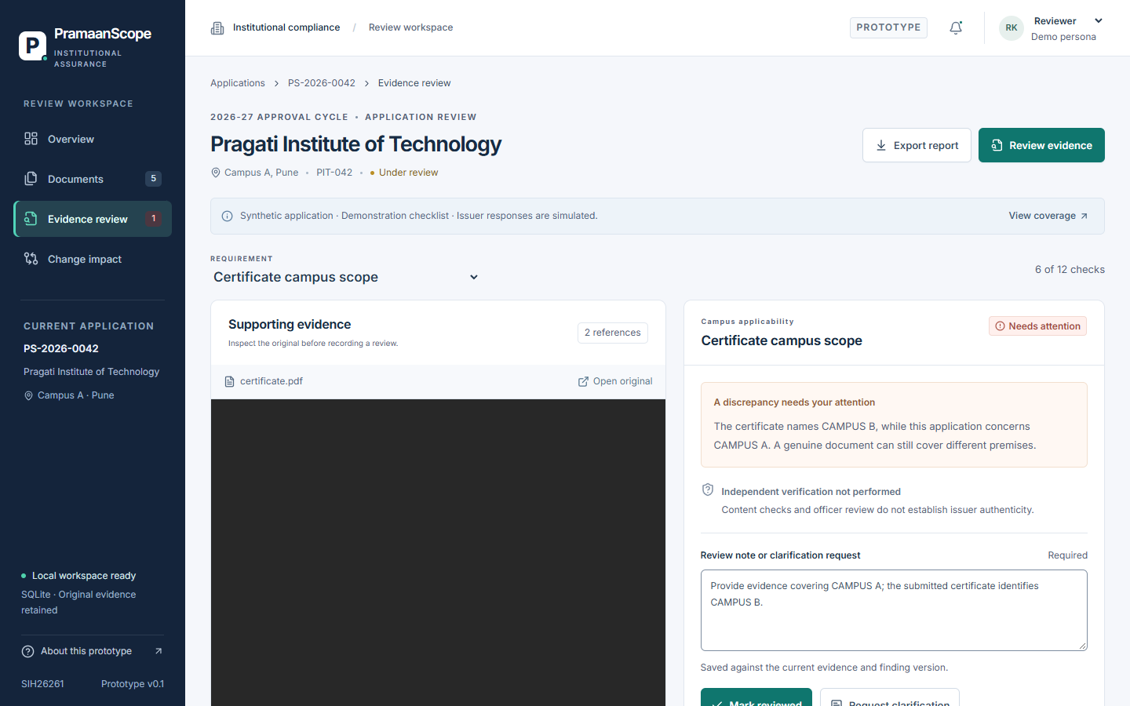
A readable certificate can cover the wrong campus
The reviewer needs to know whether the evidence supports this particular application.
Application: Campus A
Certificate: Campus B
The system links the discrepancy to the original page and requests the specific missing evidence.
PramaanScope / SIH26261 / Synthetic-data prototype
2 / 6
Notes:
The campus example is synthetic, not an allegation about any real institution. Verification does not itself determine reliance: https://www.w3.org/TR/vc-data-model/ . Actual prototype screen, generated document, and deterministic rule evaluation.

Slide 3
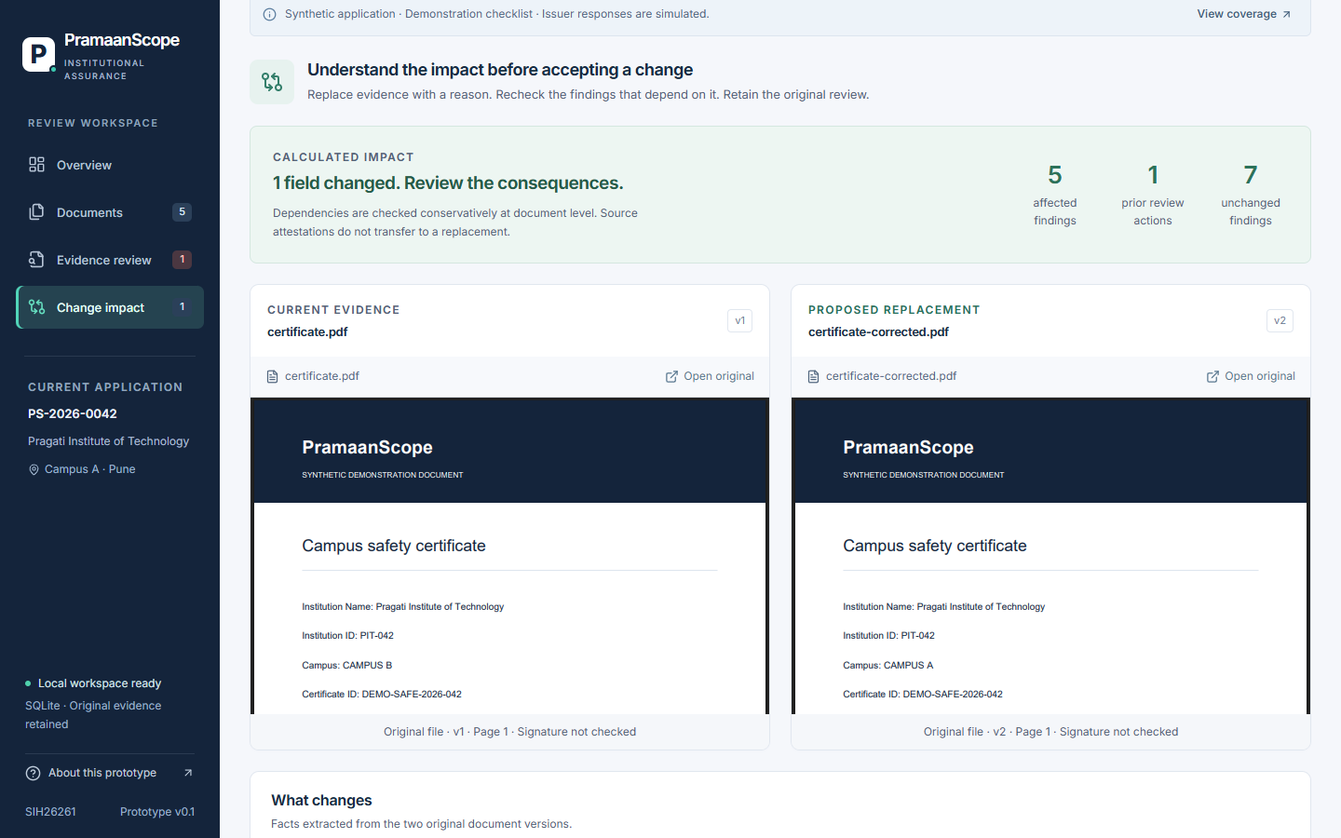
Corrections show their impact before acceptance
A changed document must not silently inherit an earlier review.
1. Propose replacement evidence
2. Inspect affected findings
3. Recalculate and re-review
Original files, finding snapshots, and review reasons remain accessible.
PramaanScope / SIH26261 / Synthetic-data prototype
3 / 6
Notes:
Counts are computed from document dependencies, not hardcoded. Prior art includes evidence-triggered re-evaluation: https://kloom.ai/continuous-due-diligence-kyc/ . This is an AICTE-specific implementation opportunity, not a worldwide-first claim.

Slide 4
A local application with clear verification boundaries
CompliScan provides the OCR and evidence-handling foundation.
Layer | Working implementation
Interface | React, TypeScript, Vite, local fonts
Checks and evidence | Express API, deterministic rules, SHA-256 originals
Processing | Actual PDF extraction and local Tesseract OCR
Persistence | SQLite transactions and private original files
External verification | Explicitly simulated issuer adapter
PramaanScope / SIH26261 / Synthetic-data prototype
4 / 6
Notes:
Implementation: current pramaanscope source, shared contracts, server rules/store, and client OCR module. Production authentication and digital-signature validation are not implemented. CompliScan checkout remains unchanged.

Slide 5
Executed checks support a repeatable demonstration
These results describe synthetic tests, not national deployment accuracy or staff time savings.
Executed validation | Observed result | Coverage
Rule and API tests | 24 passed | Identity, dates, versioning, stale previews, reviews
Browser checks | 5 passed | Workflow, OCR, responsive layout, interface accessibility
Generated PDF cases | 12 expected outcomes | Actual extraction followed by deterministic checks
The accessibility scan excludes native PDF contents and is not certification.
PramaanScope / SIH26261 / Synthetic-data prototype
5 / 6
Notes:
Evidence: npm test (24 tests passed), npm run test:e2e (5 tests passed), submission/evaluation-results.json and CSV (12 synthetic PDF packet outcomes). The tests do not measure real-world accuracy, a held-out national dataset, or officer time savings.

Slide 6
The next step is an authorized institutional pilot
Preserve the distinction between working features, simulations, and deployment requirements.
Working prototype | Required for a real pilot
Evidence extraction and linked findings | Validated category rules and applicable amendments
Clarification and correction-impact tracking | Authorized issuer APIs and signature trust validation
Local storage and demo personas | Scoped authentication, PostgreSQL, private object storage
Synthetic regression evaluation | Authorized records and reviewer-based evaluation
PramaanScope / SIH26261 / Synthetic-data prototype
6 / 6
Notes:
Entity Locker is existing infrastructure: https://www.pib.gov.in/PressReleaseIframePage.aspx?PRID=2094574&lang=2&reg=3 . Signature-verification requirements: https://www.cca.gov.in/index.php/signature_verification.html . No access to these services is assumed in the current prototype.

