Slide 1

A3-PS036-TC176
Measuring the Cost and Benefit of Merkle Tree Ladder Mode for Post-Quantum DNSSEC: A Reproducible Benchmark
Akshaj Shimoga ,D Harini ,Aiman Suhana Khan
akshajshimoga.cy24@rvce.edu.in ,dharini.cy24@rvce.edu.in, aimansuhanak.cy25@rvce.edu.in
AIORI Hackathon 3
October 13, 2026

Slide 2
AIORI 3 Abstract
Problem Description
DNSSEC signs DNS answers so clients can spot forged ones. RSA and ECDSA signatures would not survive a large quantum computer.
Post-quantum signatures are far bigger, from tens to over a hundred times an ECDSA signature.
DNS likes answers that fit in one UDP packet (about 1,200 bytes). Bigger ones get fragmented, which many networks drop, or retried over TCP.
MTL mode is meant to cut the signature bytes sent per answer. What it costs in signing time, verification time and cache is the open question we measure.
Sizes from FIPS 204/205 parameter sets [2]
• Akshaj Shimoga ,D Harini ,Aiman Suhana Khan • A3-PS036-TC176 • October 13, 2026
2 / 11

Slide 3
AIORI 3 Background
Background
1
DNSSEC
2
The size problem
3
MTL mode
A signature on each DNS answer lets a resolver check it was not forged [1]. Today the algorithms are RSA and ECDSA.
SLH-DSA signatures run to several KB [2]. A UDP answer should stay near 1,200 bytes [4], or it fragments or falls back to TCP.
A shared Merkle ladder is signed once. Each answer carries a short authentication path instead of a full signature [3].
This project measures an existing MTL implementation. It does not design new cryptography or claim any security proof.
• Akshaj Shimoga ,D Harini ,Aiman Suhana Khan • A3-PS036-TC176 • October 13, 2026
3 / 11

Slide 4
AIORI 3 Literature & RFC Review
Literature & RFC Review
Source | Type | Why it matters here
[1] RFC 4033, 4034, 4035 | Standards | The DNSSEC model: how signatures, keys and validation fit together
[2] FIPS 205 (SLH-DSA) | NIST standard | Hash-based PQC signature with large signatures
[3] draft-harvey-cfrg-mtl-mode | IETF draft | Defines the Merkle Tree Ladder mode
[4] RFC 9715 | RFC | Why DNS over UDP should avoid IP fragmentation
The drafts are work in progress, so the report will pin the exact version and commit we test against.
• Akshaj Shimoga ,D Harini ,Aiman Suhana Khan • A3-PS036-TC176 • October 13, 2026
4 / 11

Slide 5
AIORI 3 Proposed Solution
Proposed Solution
1 Pin
2 Generate
3 Run
4 Measure
5 Report
Docker image pinned by digest, exact commits, hardware recorded
Three dataset sizes from a fixed random seed
Same records and algorithm, with and without MTL
Sign time, verify time, bytes sent, memory; 30+ trials after warm-up
Medians, confidence intervals, measured vs estimated cache, limits
• Akshaj Shimoga ,D Harini ,Aiman Suhana Khan • A3-PS036-TC176 • October 13, 2026
5 / 11

Slide 6
AIORI 3 Solution Optimization
Optimization Proposed
Metric | Without MTL (baseline) | With MTL (under test) | How we measure it
Transmitted bytes | Full PQC signature with every answer | Short authentication path per answer; ladder signed once | Bytes per answer, definition agreed with mentor
Signing time | One signature per record set | Ladder built and signed, cost shared across answers | Median of 30+ trials, warm-up discarded
Verification time | One signature check | Path check against the ladder | Same trials, with confidence intervals
Cache / memory | Little extra state | Ladder and paths have to be kept | Peak memory measured; formula estimate kept separate
The expected direction (fewer bytes, some extra state) is a hypothesis from the drafts, not a result. We report whatever the measurements show.
• Akshaj Shimoga ,D Harini ,Aiman Suhana Khan • A3-PS036-TC176 • October 13, 2026
6 / 11

Slide 7
AIORI 3 Architecture Design (UML Diagram)
Solution Architecture & Design
Docker image (pinned by digest)
results/*.csv
bench.yaml
config
Dataset generator
(fixed seed)
Python runner
MTL sign / verify
Metrics collector
time, bytes, memory
Analysis + plots
stats, estimates
Non-MTL sign / verify
PDF report + demo
Reference implementation: mentor-supplied, commit pinned
• Akshaj Shimoga ,D Harini ,Aiman Suhana Khan • A3-PS036-TC176 • October 13, 2026
7 / 11

Slide 8
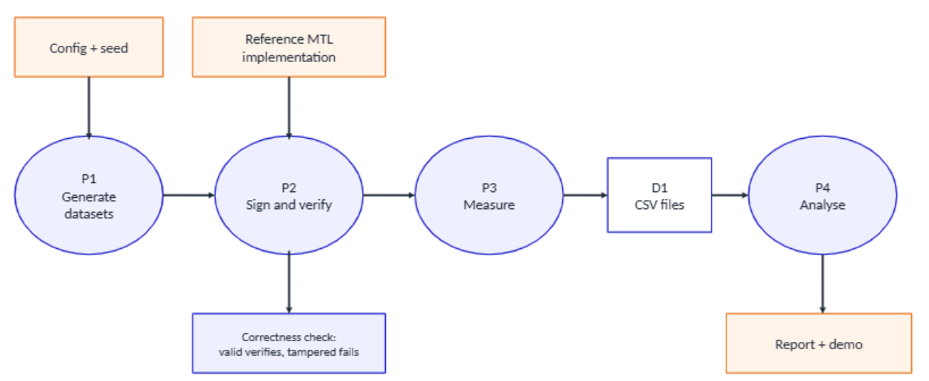
AIORI 3 Data Flow Diagram
Data Flow Diagram
• Akshaj Shimoga ,D Harini ,Aiman Suhana Khan • A3-PS036-TC176 • October 13, 2026
8 / 11

Slide 9
AIORI 3 Deployment Timeline
Deployment Timeline
1
Unblock
2
First run
3
Full benchmark
4
Results
5
Report + demo
Owner: All
Owner: A
Owner: B
Owner: C
Owner: All
Date: 7–9 Oct
Review the project brief, literature, MTL draft and reference implementation. Finalise the problem statement, algorithm and benchmark requirements.
Date: 10–12 Oct
Set up the Docker environment and Python runner. Test signing and verification with and without MTL on a small dataset.
Date: 13–16 Oct
Run tests on three dataset sizes with warm-up runs and 30+ trials. Measure transmitted bytes, signing time, verification time and memory usage.
Date: 17–19 Oct
Analyse benchmark results, create comparison tables and plots, calculate confidence intervals, and compare MTL with the baseline.
Date: 20–22 Oct
Complete the final report, verify the results, rehearse the demonstration and prepare the final presentation.
A: environment and implementation. B: harness and measurement. C: analysis, report, demo. Everyone reviews someone else's work. Dates are added once the hackathon schedule is fixed.
• Akshaj Shimoga ,D Harini ,Aiman Suhana Khan • A3-PS036-TC176 • October 13, 2026
9 / 11

Slide 10
AIORI 3 Bibliography
Bibliography
[1] R. Arends et al., "DNS Security Introduction and Requirements," RFC 4033; "Resource Records for the DNS Security Extensions," RFC 4034; "Protocol Modifications for the DNS Security Extensions," RFC 4035. IETF, 2005.
[2] NIST, "Stateless Hash-Based Digital Signature Standard," FIPS 205, 2024. Also FIPS 204 (ML-DSA) for the size comparison.
[3] Internet-Draft draft-harvey-cfrg-mtl-mode (Merkle Tree Ladder mode). Work in progress.
[4] K. Fujiwara and P. Vixie, "IP Fragmentation Avoidance in DNS over UDP," RFC 9715. IETF, 2025.
• Akshaj Shimoga ,D Harini ,Aiman Suhana Khan • A3-PS036-TC176 • October 13, 2026
10 / 11

Slide 11
Thank You for Your Attention!
Questions welcome

