Slide 1

DIVING DEEP INTO
HEALTHCARE ANALYTICS
Team Name: MedHealth Analysts

Slide 2



Overview of Analysis
Analyzing hospital data parameters is crucial as it helps identify patterns, trends, and areas for improvement, ultimately leading to better patient outcomes and a more efficient healthcare system.
Impact of Surgery Type on other parameters
Other demography-based findings from the hospital dataset
Effect of Pre-Operative Lab results
Notes:
1. Have a box that summarizes demography of data: Avg min, max of age, percentage of women and men in data, avg BMI
2. Variation in LoHS based on age group

Slide 3
SECTION - 1
What impact do the Pre-operative results have on different parameters?
Notes:
Understanding the distributions of abnormal values can help clinicians assess the overall health status of patients before surgery and identify potential risk factors that may impact surgical outcomes

Slide 4
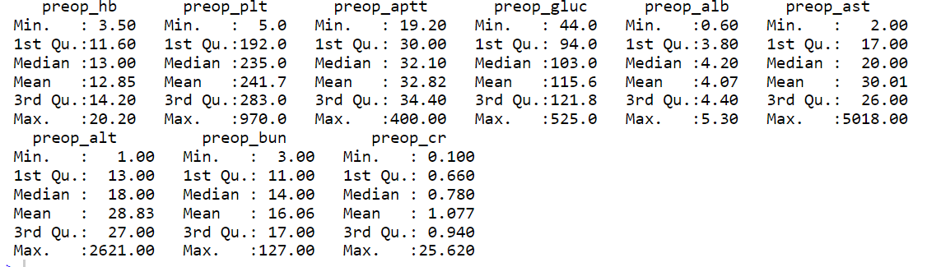
Summary of the Pre-Operation Lab parameter values
activated partial thromboplastin time
hemoglobin platelet count
glucose
albumin
GOT
creatinin
blood urea nitrogen
Key Takeaways:
Preop-ast and preop-alb, there is significant different between the 3rd quartile and maximum value, this indicates outliers on the higher distribution end in the dataset.
Preop-plt has outliers in the lower end of distribution due to the difference between minimum value and 1st quartile.
GPT

Slide 5
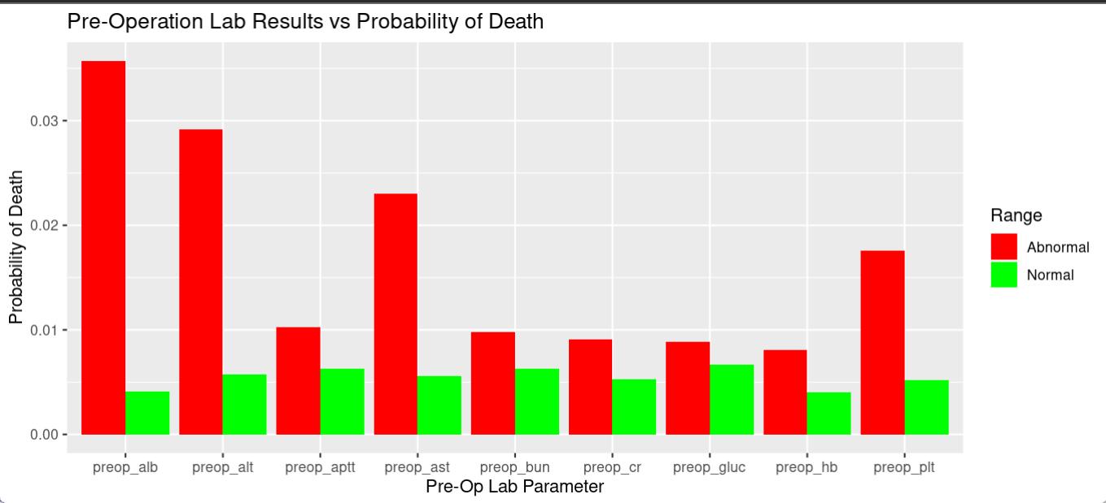
Are there any preop variables affecting mortality?
1. preop_alb
The analysis shows significant probability of death difference between normal and abnormal values of preop_alb
Albumin levels are indicative of nutritional status and plays a role in maintaining immune function
It is essential to monitor patients with low albumin levels closely for signs of infection or other complications
Provide nutritional support to patients with low albumin levels to improve their nutritional status and overall health

Slide 6
Are there any preop variables affecting mortality?
2. preop_alt and preop_ast
AST and ALT levels outside the normal range may be at higher risk of developing complications during surgery and in the post-operative period
This could include bleeding problems, infections, or issues with wound healing
Screen patients for AST and ALT levels before surgery to identify those at higher risk of complications
Collaborate with liver specialists for post-operative treatments

Slide 7
Are there any preop variables affecting mortality?
3. preop_plt
The analysis shows a higher probability of death due to abnormal level of preop_plt
Abnormal preop_plt may lead to higher risk of developing hemorrhage (excessive bleeding), which can be dangerous and require immediate medical intervention
Ensure that the hospital is prepared for potential hemorrhage cases, including the availability of blood products for transfusion.

Slide 8
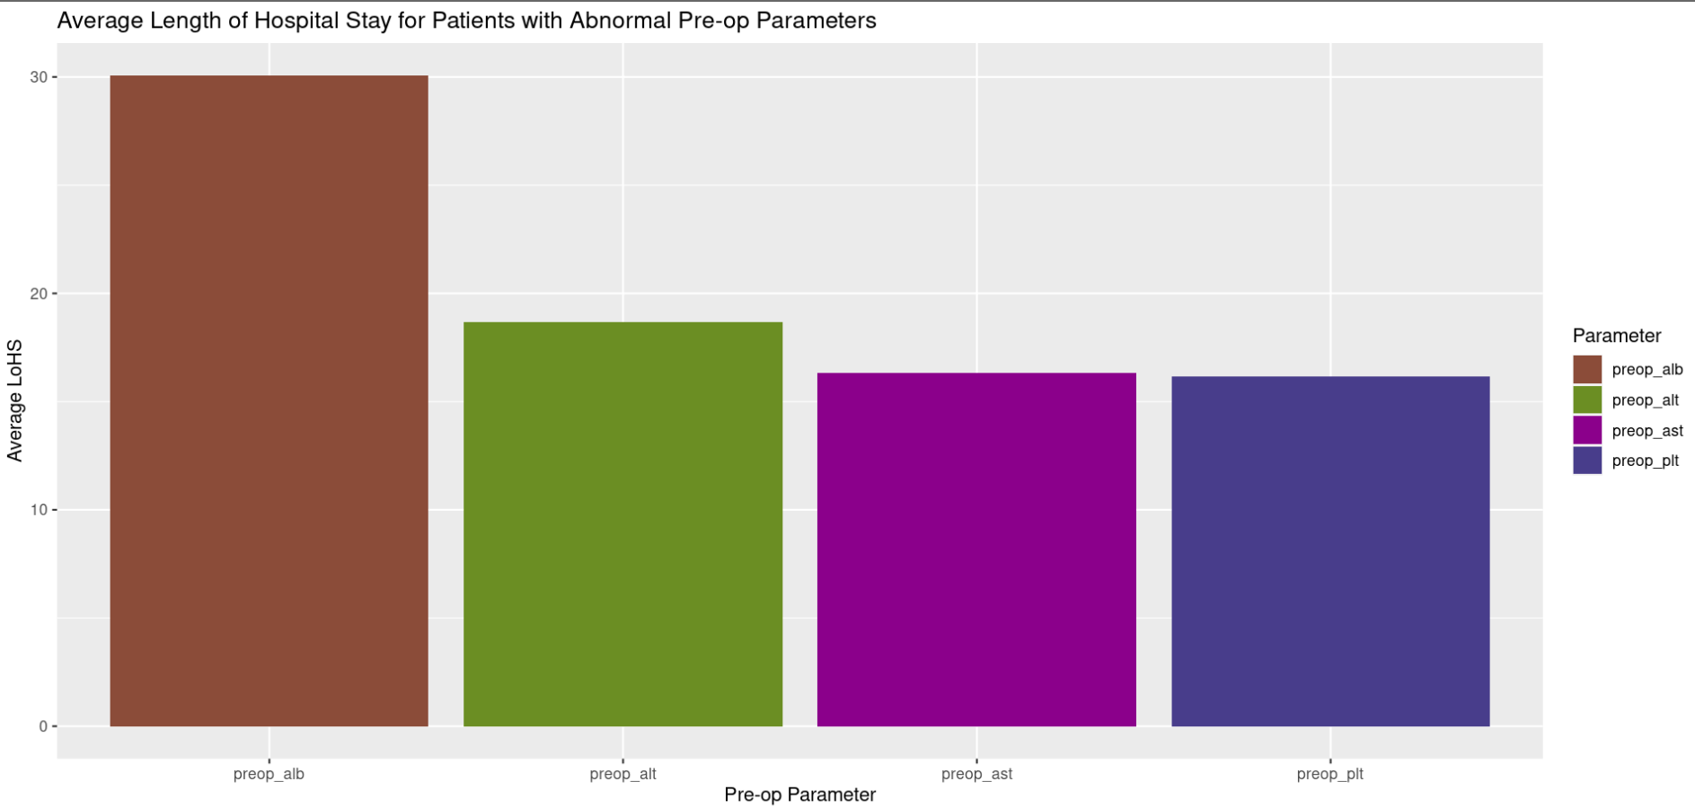
Which preop variable in abnormal range has the highest average Length of Hospital Stay?
Patients with abnormal preop_alb levels may experience slower recovery times due to potential complications or the need for additional medical interventions, prolonging their hospital stay
This may result in increased healthcare resource utilization and well as increased exposure to healthcare-associated infections

Slide 9
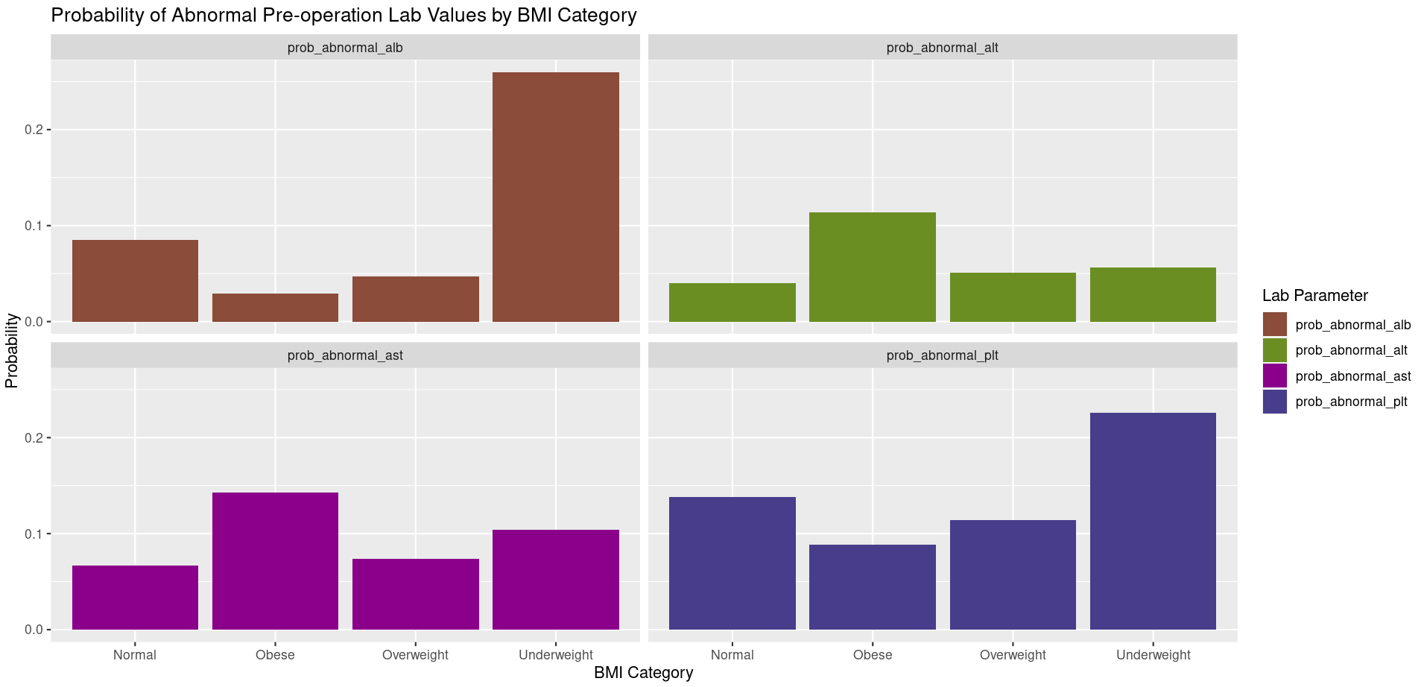
Which category of BMI affects the preop variables value?
This analysis suggests that patients with underweight BMI are more likely to have abnormal preop_alb and preop_plt levels

Slide 10
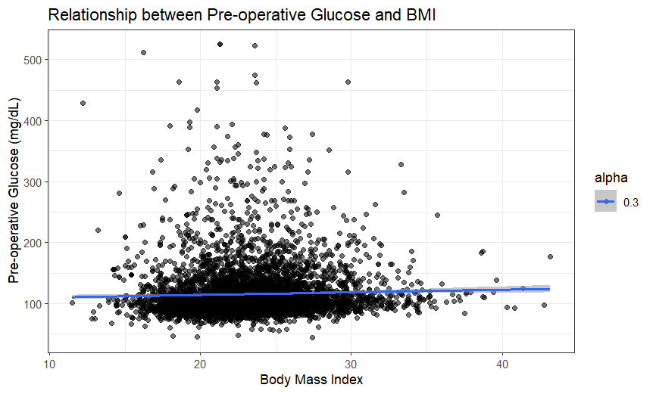
Relationship between Pre-operative Glucose and BMI
There is a positive correlation between pre-operative blood glucose level and body mass index (BMI). This means that as BMI increases, pre-operative blood glucose levels also tend to increase.
However, the scatter is wide, indicating that there is a lot of variability in the data. This means that not everyone with a high BMI will have high blood glucose levels, and not everyone with a low BMI will have low blood glucose levels

Slide 11
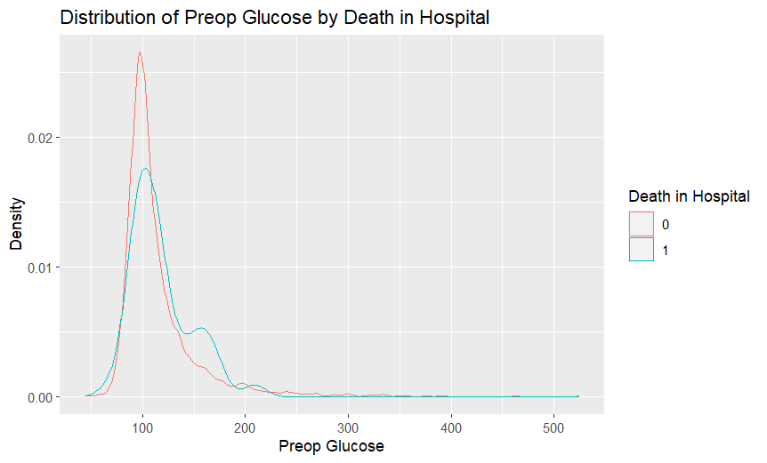
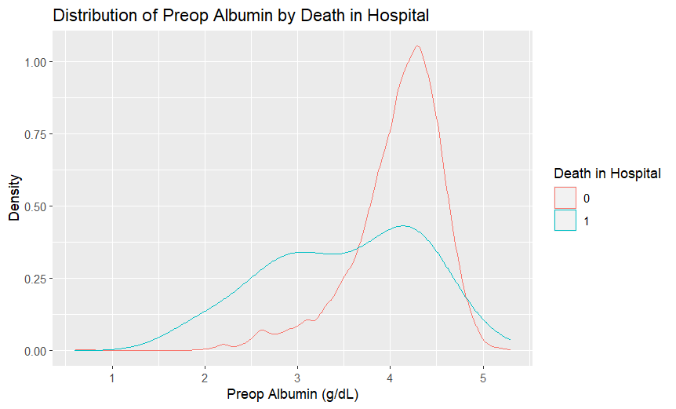
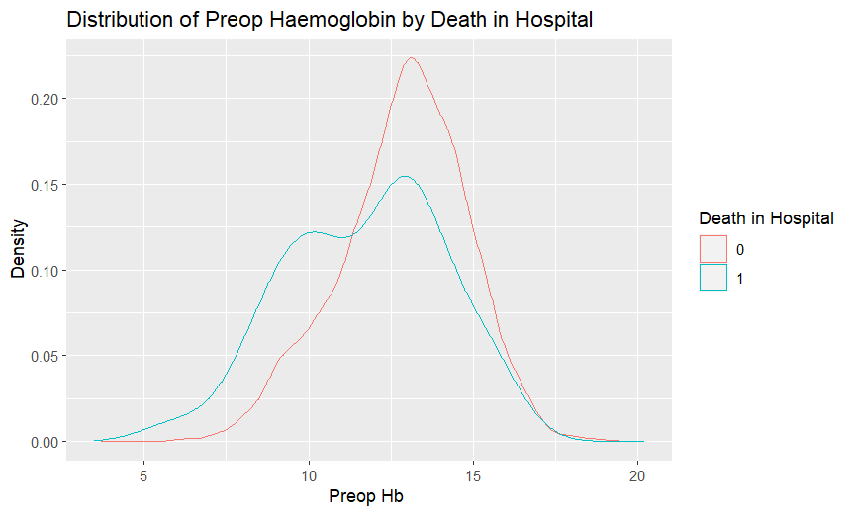
Association between pre-operative blood test results and death in the hospital
All three plots show a similar pattern, with a higher proportion of patients who died in the hospital having lower pre-operative blood test results.
The plots for albumin and hemoglobin show a particularly strong association between low pre-operative levels and death in the hospital.
It is important to note that there is a significant overlap in the distributions of the two groups in all three plots - There were some patients who died in the hospital despite having normal pre-operative blood test results, and there were also patients who survived who had low pre-operative blood test results.
Notes:
ggplot(clinical_data, aes(x = preop_alb, color = factor(death_inhosp))) +
geom_density() +
labs(title = "Distribution of Preop Albumin by Death in Hospital",
x = "Preop Albumin (g/dL)",
y = "Density",
color = "Death in Hospital")
ggplot(clinical_data, aes(x = preop_hb, color = factor(death_inhosp))) +
geom_density() +
labs(title = "Distribution of Preop Haemoglobin by Death in Hospital",
x = "Preop Hb ",
y = "Density",
color = "Death in Hospital")
ggplot(clinical_data, aes(x = preop_gluc, color = factor(death_inhosp))) +
geom_density() +
labs(title = "Distribution of Preop Glucose by Death in Hospital",
x = "Preop Glucose",
y = "Density",
color = "Death in Hospital")

Slide 12
SECTION - 2
What impact does the Surgery Type have on different parameters?
Notes:
Understanding the distributions of abnormal values can help clinicians assess the overall health status of patients before surgery and identify potential risk factors that may impact surgical outcomes

Slide 13
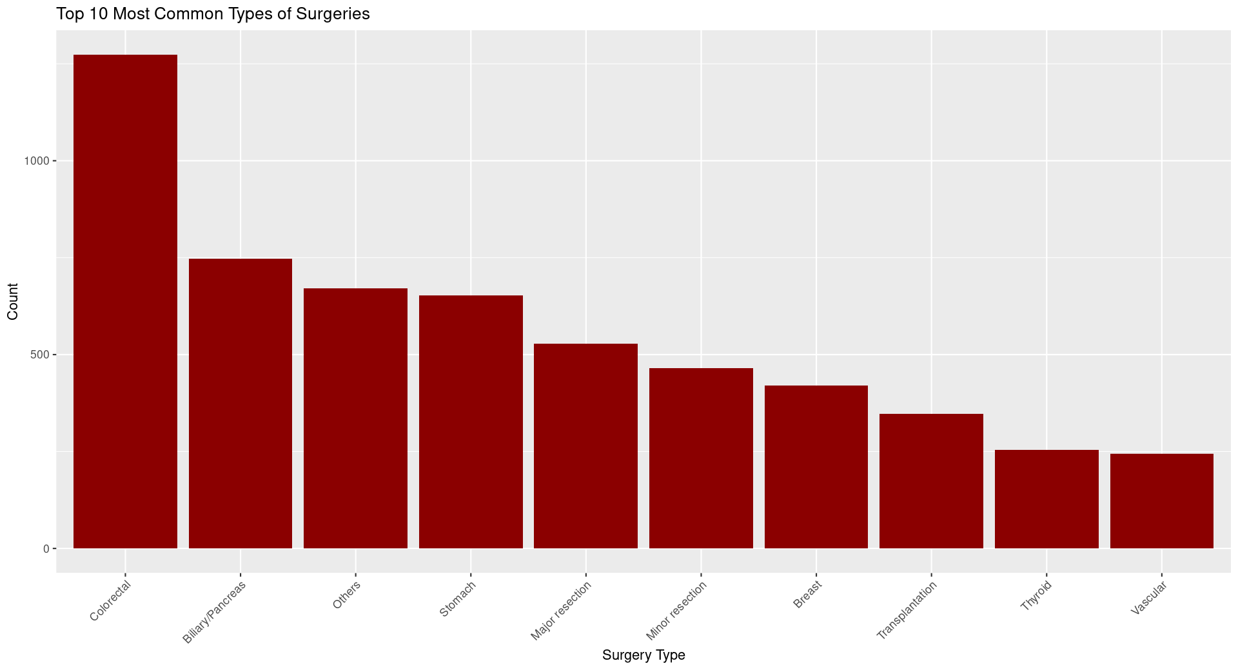
What are the most common types of surgeries performed in healthcare?
Colorectal surgeries are the most common type of surgeries being performed, followed by Biliary surgeries.
There were more than three times as many colorectal surgeries as there were stomach surgeries.
This would help healthcare providers allocate resources more efficiently to handle the most common procedures.

Slide 14
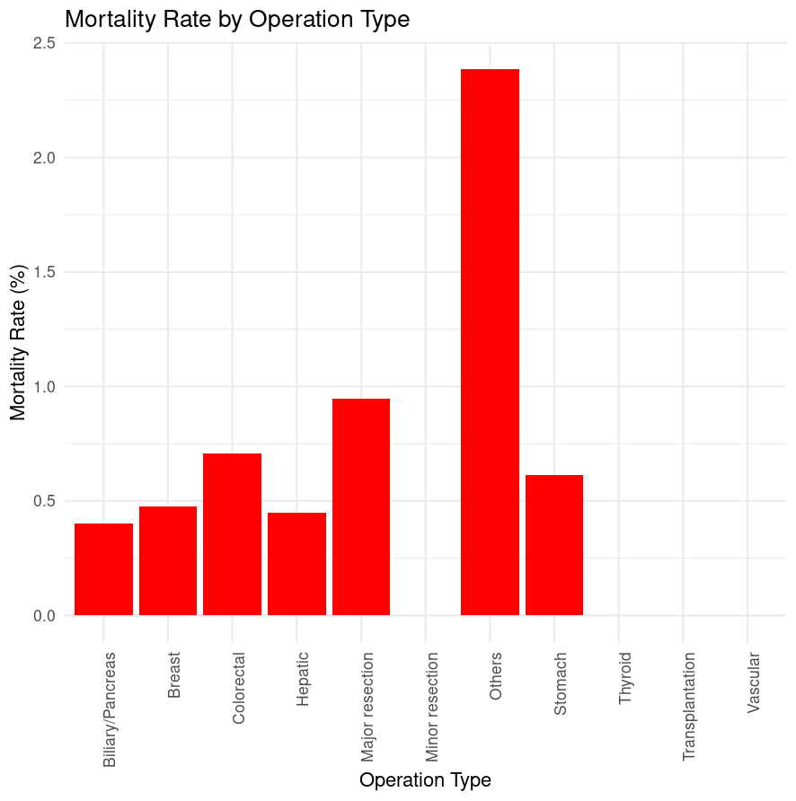
How does different surgery types affect Probability of Mortality?
Graph shows the probability of death based on surgery type, indicating which operations are dangerous to perform
From the graph we can analyze, Major resection, colorectal, stomach and breast related surgeries could have complications
Thus, it is important for hospitals to employ skilled doctors for these procedures

Slide 15
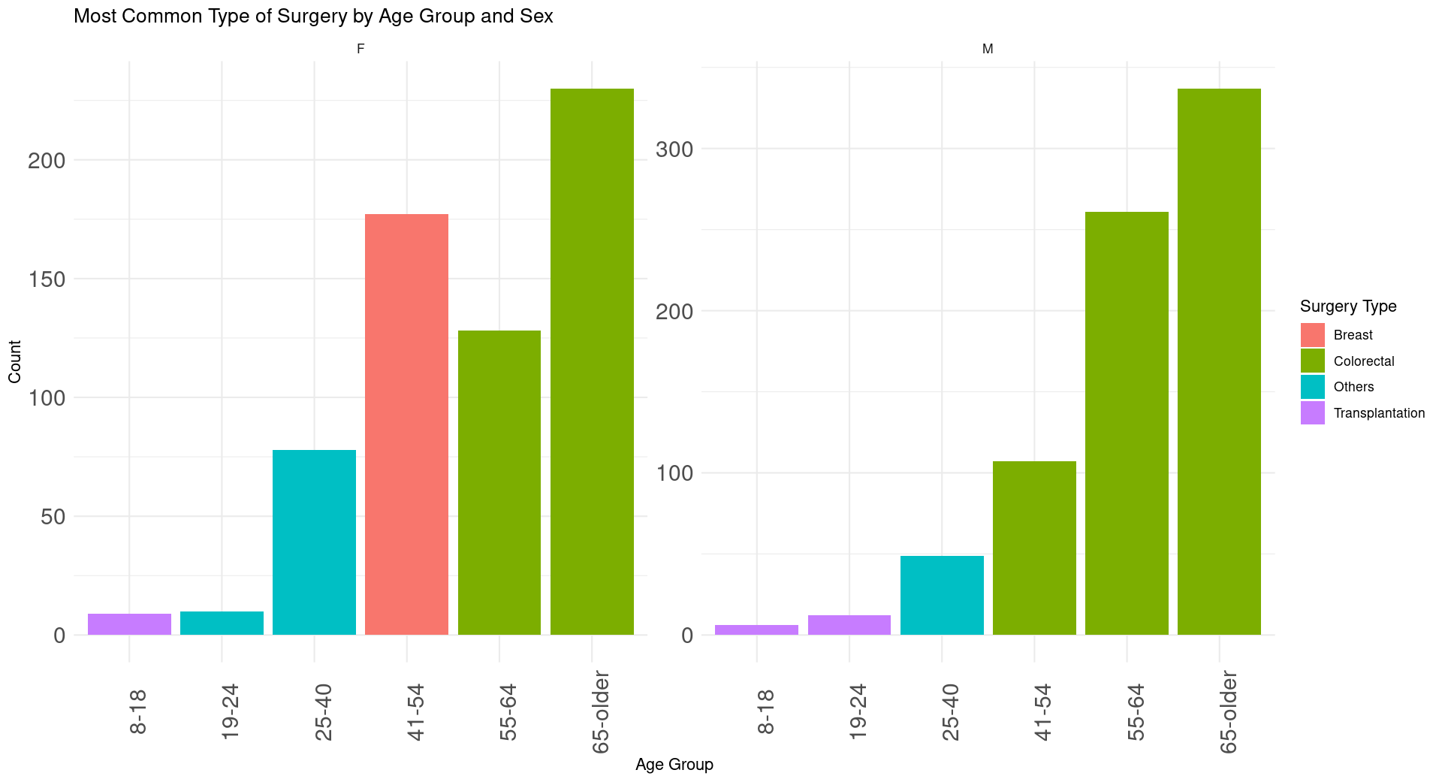
What is the most common type of surgery across different age groups and sex?
Colorectal surgery is the most common type of surgery for men of most age groups except young adults.
Surgery rates increase with age for all types of surgery except breast surgery.

Slide 16
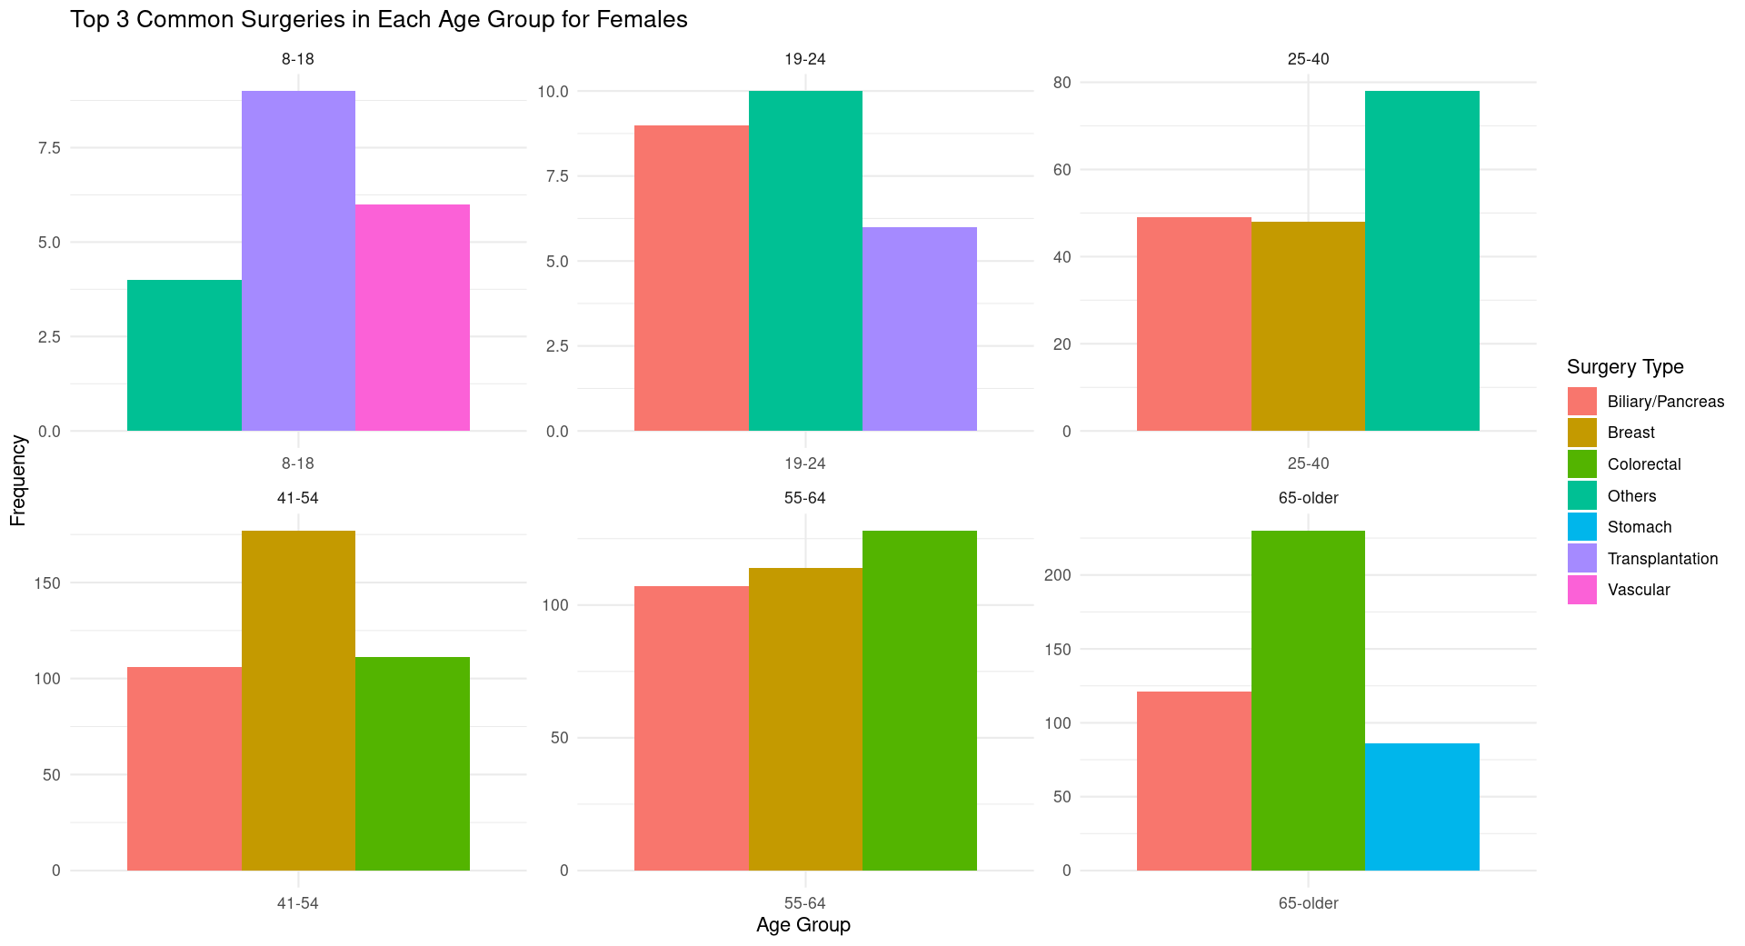
Can we analyze female healthcare analytics by age group?
Breast surgery is one of the most prevalent types of surgeries among women in the ages of 25-64. This presents an opportunity to address the disparity between breast surgery prevalence and female representation in clinical trials.
This allows for targeted prevention and screening programs, to improve overall health outcomes in different demographics. Using this analysis, clinical trials can be made more accurate by targeting the affected patient segment.

Slide 17
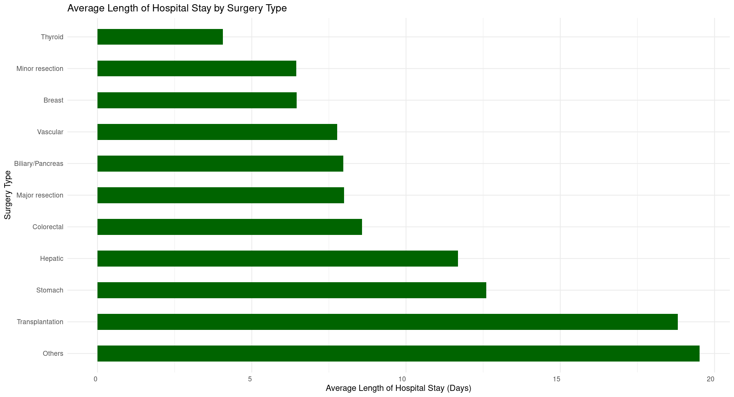
What is the association between different surgery types and LoHS?
The average length of hospital stay varies across different surgery types. The shortest stays are for minor thyroid resections (around 2 days), while the longest stays are for major transplantations (around 20 days).
Understanding the typical length of hospital stay for various surgeries enables hospitals to optimize resource allocation, including bed availability, staffing levels, and scheduling of surgeries.
Notes:
The financial implications of different lengths of stay. Longer hospital stays are more expensive for both patients and insurance companies.
The impact of length of stay on patient outcomes. Shorter lengths of stay can lead to faster recovery times and lower rates of complications.
The role of new technologies and practices in reducing length of stay. Minimally invasive surgery and ambulatory care can help to reduce hospital stays.
Comparisons of length of stay across different countries or hospitals. This could help to identify areas for improvement.

Slide 18
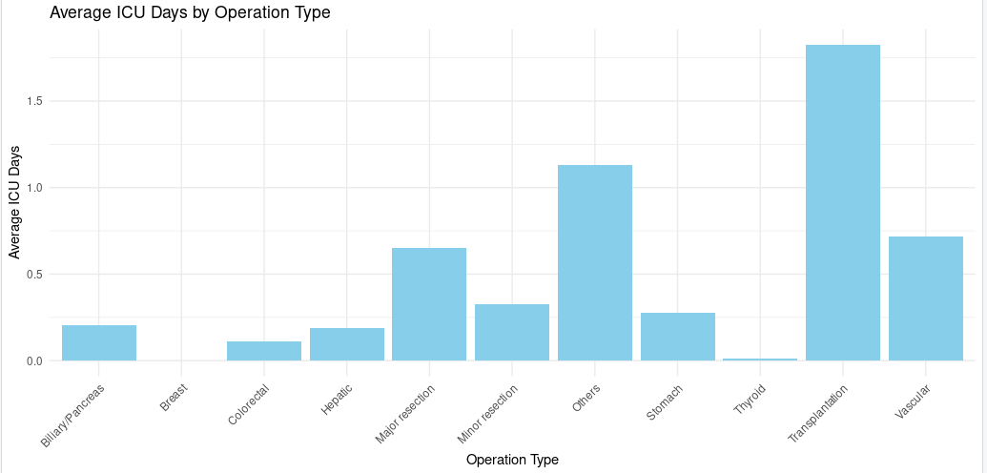
How does Operation Type affect Average days spent in ICU?
Graph shows how different types of operations cause extended days stay in ICU
From the graph we can analyze, Transplantation, Major Resection and Vascular related surgeries have extended ICU stays
This signifies that these procedures require extended care for the patient post-op to ensure they are recovering well

Slide 19
SECTION - 3
Other demography-based findings from the hospital dataset
Notes:
Understanding the distributions of abnormal values can help clinicians assess the overall health status of patients before surgery and identify potential risk factors that may impact surgical outcomes

Slide 20
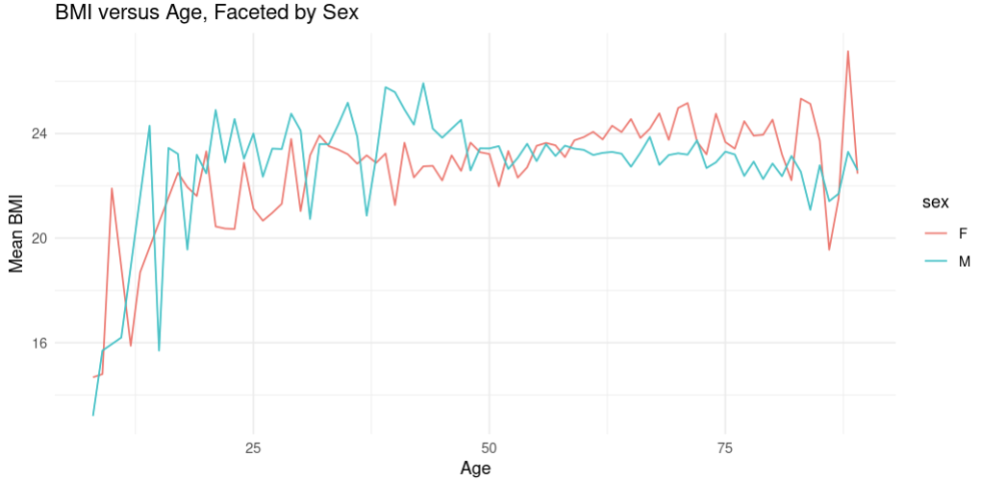
How does BMI impact with Age and Sex of a patient?
Graph shows the changes in mean BMI with respect to patients Age and Sex
From the graph we can analyze, the difference BMI between the two sexes
Men tend to have a higher BMI until the age of 50
At the age of 50, both categories have similar BMI
Women have lower BMI initially but it increases post the 50 mark

Slide 21
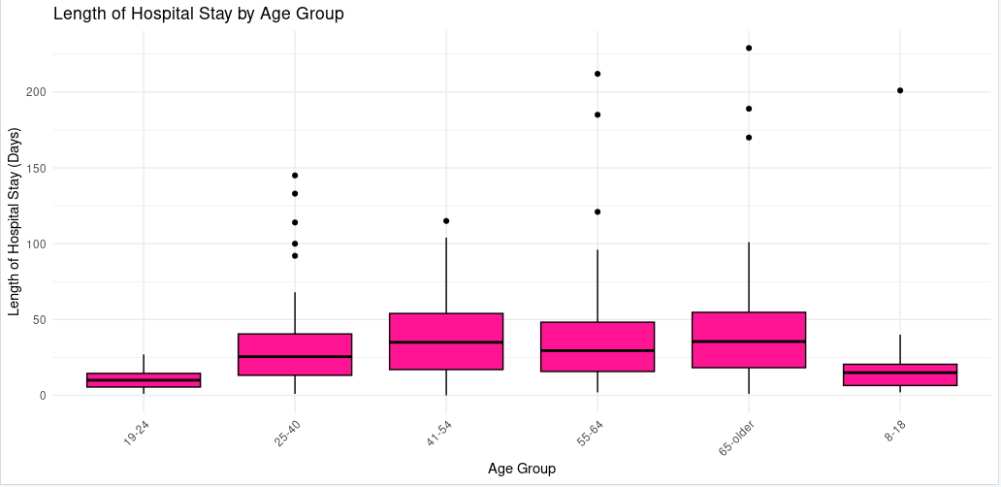
How does Length of Hospital Stay affect different Age Groups ?
Graph shows the changes in Length of Hospital Stay by different Age Groups
From the graph we can analyze, a gradual increase in the mean Hospital Stay duration
Younger age groups have lower stay duration compared to older groups
This signifies that older patients require extended care post-op to recover compared to younger patients
Notes:
age_lohs <- clinical_data %>%
group_by(age_group, LoHS) %>%
summarise(avg_lohs = mean(age_lohs$LoHS, na.rm = TRUE))
ggplot(age_lohs, aes(x = age_group, y = LoHS)) +
geom_boxplot(fill = "deeppink", color = "black") +
labs(title = "Length of Hospital Stay by Age Group", x = "Age Group", y = "Length of Hospital Stay (Days)") +
theme_minimal() +
theme(axis.text.x = element_text(angle = 45, hjust = 1))

Slide 22
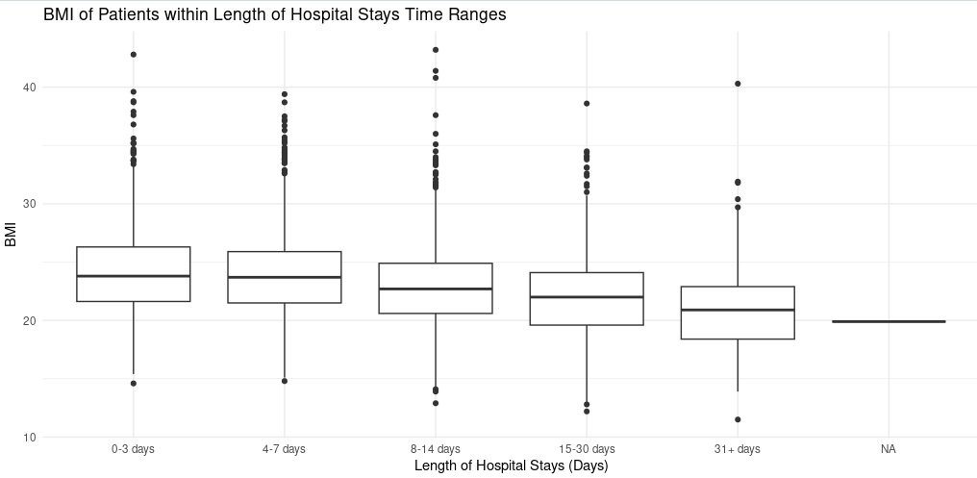
How does BMI affect the Length of Hospital Stay?
Graph shows the changes in Length of Hospital Stay by BMI
From the graph we can analyze, a gradual decrease in BMI amongst patients because of their extended stay
There isn't much shift in mean BMI in the range of (0,7) days
Thus, depicting that BMI of the patient starts decreasing from day 8
Patients who stayed more than 30 days have a significant reduction in mean BMI since they came in
Notes:
bmi_length <- clinical_data %>%
mutate(hospital_stay_range = cut(LoHS, breaks = time_ranges, labels = c("0-3 days", "4-7 days", "8-14 days", "15-30 days", "31+ days")))
# Plot BMI of patients within time ranges
ggplot(bmi_length, aes(x = hospital_stay_range, y = bmi)) +
geom_boxplot() +
labs(title = "BMI of Patients within Length of Hospital Stays Time Ranges", x = "Length of Hospital Stays (Days)", y = "BMI") +
theme_minimal()

Slide 23
Thank You!

Slide 24
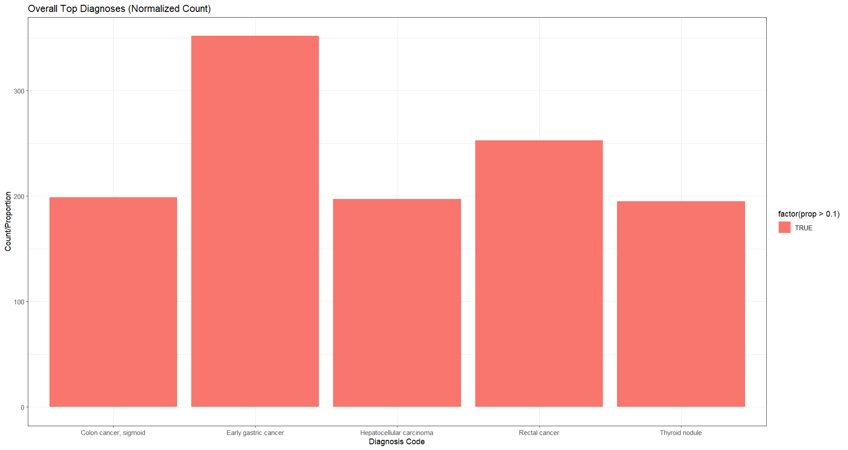
Common types of cancer among the sample population

Slide 25
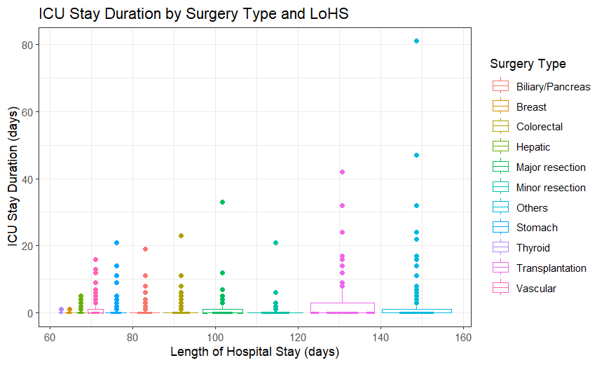
Relationship between Surgery Type, LoHS and ICU Stay Duration

