Slide 1
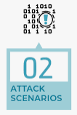








Structured Threat Information Expression (STIX) Attack flow report
Human Language attack/thread scenario description
Technical section contents in CTI report
MITRE ATT&CK Technique mapping report
LLM Attack Scenario analyzer
LLM Technique mapping Verifier
Report generator
Text format summary of the
Attack flow path in the attack scenario
Attack Technique T00xx
…
Attack Technique T00xx
MITRE ATT&CK Technique mapping result
LLM Attack behaviors analyzer
Attack behavior 01
MITRE Tactic Mapper
Attack behavior 02
…
MITRE Technique Mapper
Attack behavior N
LLM MITRE ATT&CK Matrix mapper

Slide 2


Threats To MITRE(CWD, ATT&CK) Mapper
MITRE Background Knowledge prompt
AI-LLM Attack Scenario Analyzer
Text format summary of the
attack flow path in the threats attack scenario
Human Language attack/threats scenario description
LLM conversation chain framework
AI-LLM Vulnerabilities Analyzer
AI-LLM Attack Behaviors Analyzer
AI-LLM MITRE CWE TREE Matcher
AI-LLM MITRE ATT&CK Matrix Mapper
MITRE ATT&CK Technique mapping report
AI-LLM Result Verifier
Report Generator
MITRE CWE Vulnerability matching report
GPT-3.5 Turbo

Slide 3

Threats Scenario Description Source
Human Language attack/threats scenario description
MITRE ATT&CK Mapper workflow
Structured Threat Information Expression (STIX) attack flow report
Technical section contents in CTI report
MITRE CWE matcher workflow
Threats Scenario Description original contents
MITRE ATT&CK Technique mapping report
LLM Technique mapping Verifier
Report generator
LLM Attack Scenario Analyzer
Conversation Chain use GPT3.5 Turbo API
Text format summary of the attack flow path in the threats attack scenario
Attack Technique T00xx
MITRE ATT&CK Technique mapping result
…
Attack Technique T00xx
MITRE ATT&CK background knowledge prompt
Conversation Chain use GPT4 Turbo API
Attack behavior 01
MITRE Tactic Mapper
LLM Attack behaviors analyzer
Attack behavior 02
MITRE CWE background knowledge AI prompt
…
Attack behavior N
MITRE Technique Mapper
LLM MITRE ATT&CK Matrix mapper
MITRE CWE vulnerability matching report
Vulnerability summary 01
LLM Attack Scenario Vulnerabilities analyzer
Vulnerability summary 02
…
Match explanation report generator
MITRE CWE Matcher
Vulnerability summary N
LLM MITRE CWE Tree matcher

Slide 4
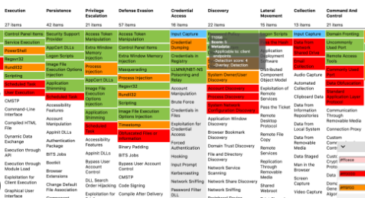
MITRE CWE Framework
MITRE ATT&CK Framework
CWE-74
Matching between the Vulnerabilities(CVE) and the related Attack Technology (TTP)
CWE-79
Child of
CVE-1999-0067
…
Enterprise
Mobile
ICS
CVE-2006-3295
CWE-352
CVE-2014-5198
Peer of
CVE-2009-3520
Techniques
…
…
Matrix
Tactics
CVE-2020-3580
T1143
Parent of
CWE-87
TA0043
MITRE
Adversarial Tactics, Techniques,
&nd Common Knowledge
MITRE
Common
Weakness
Enumeration
Category Base System
…
T1531
CVE-2021-1879
CVE-2002-0738
…
…
TA00xx
Member of
CWE-xxx
T1087
CWE-137
CVE-2024-xxx
.001
.002
.003
…
CVE-2024-xxx
MITRE CWE categorize System
MITRE Att&ck navigator
APT-xxx
A New Common Vulnerabilities and Exposures (CVE)
APT (Advanced Persistent Threat)

Slide 5
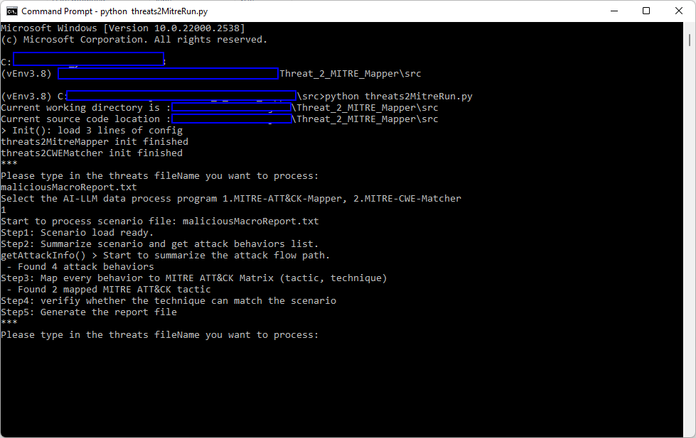
Type in the LLM module you want to use:
Map threats to MITRE-ATT&CK
Match threats to MITRE-CWE
Type in the threat's description source file name

Slide 6
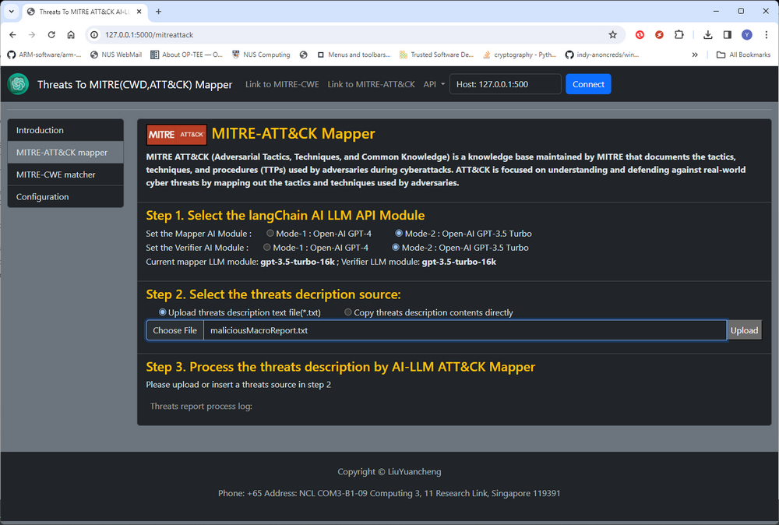

Slide 7
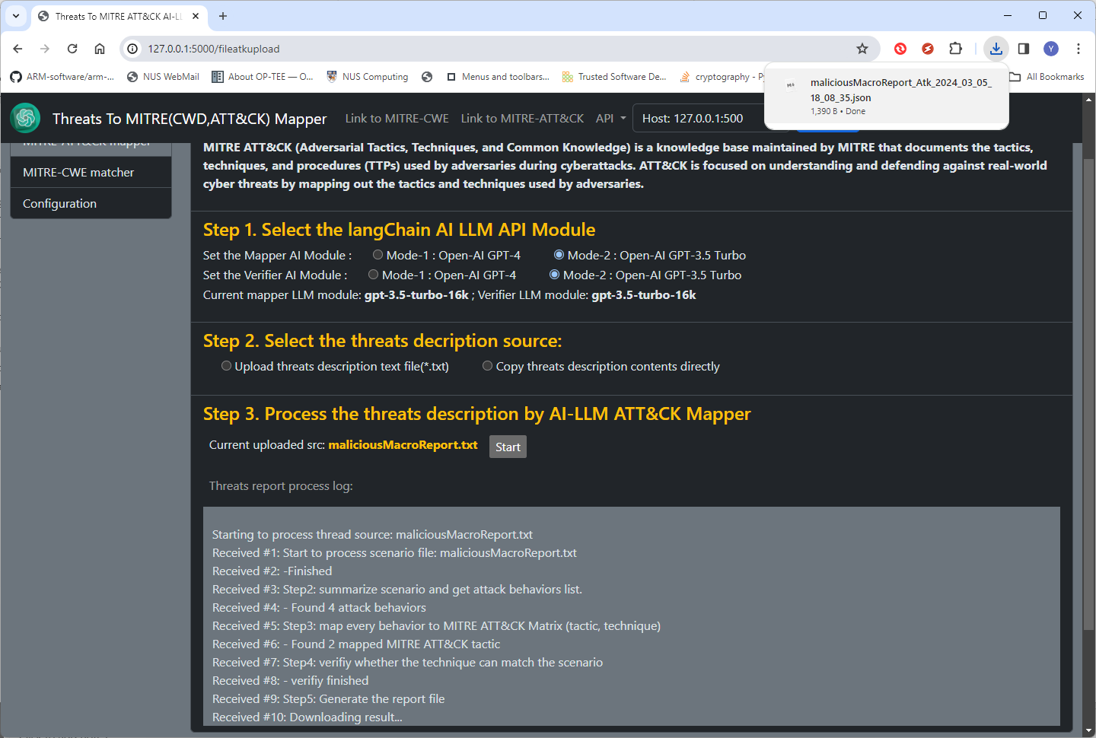
Report will be automated download
Process progress log

Slide 8
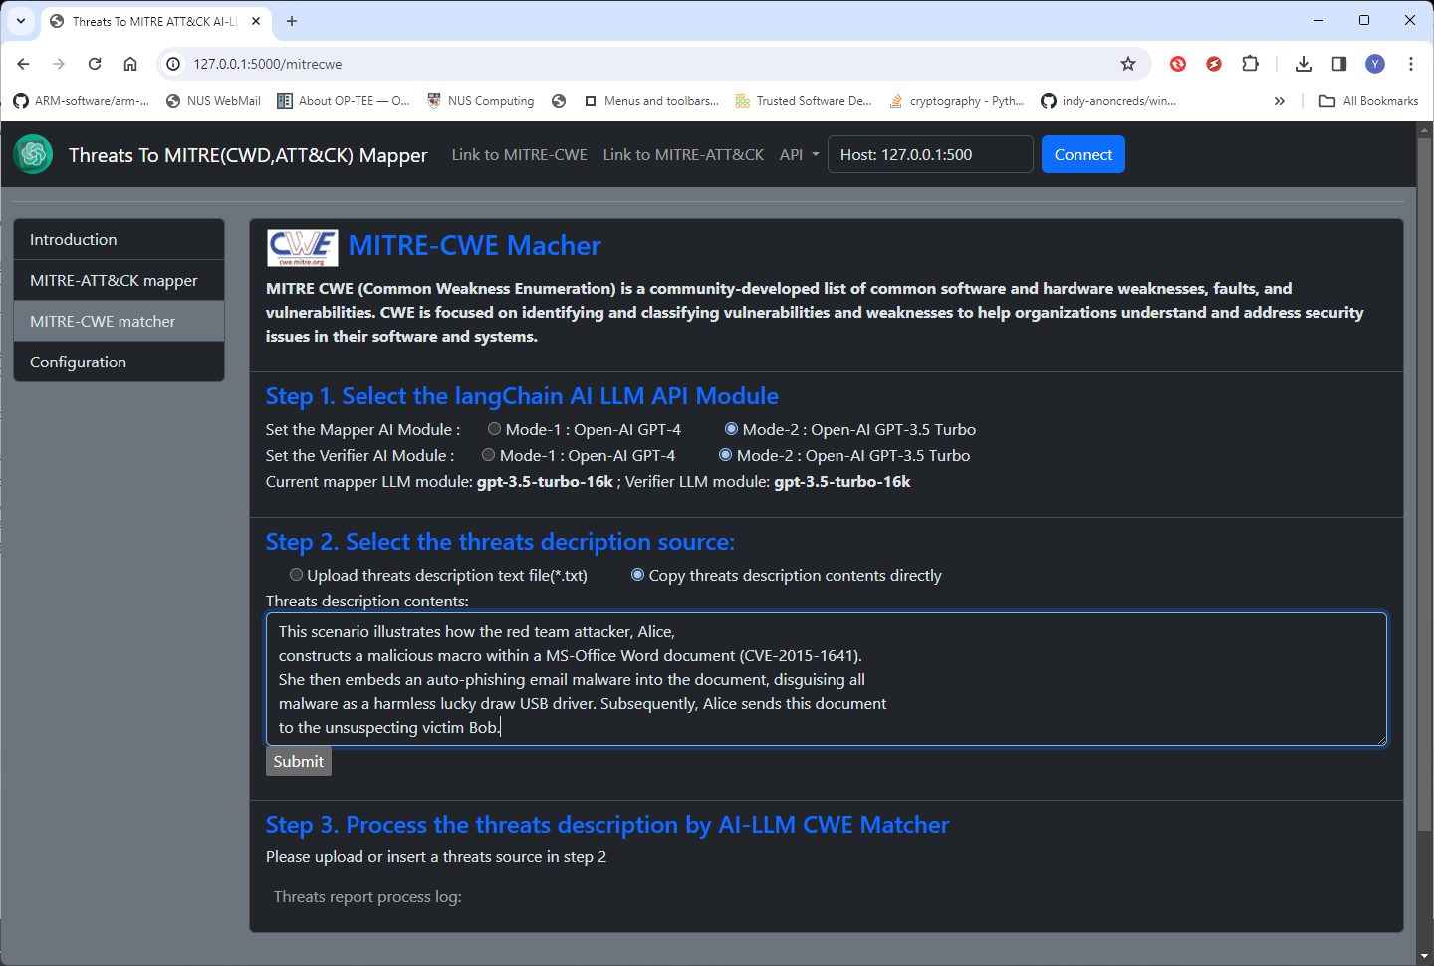

Slide 9
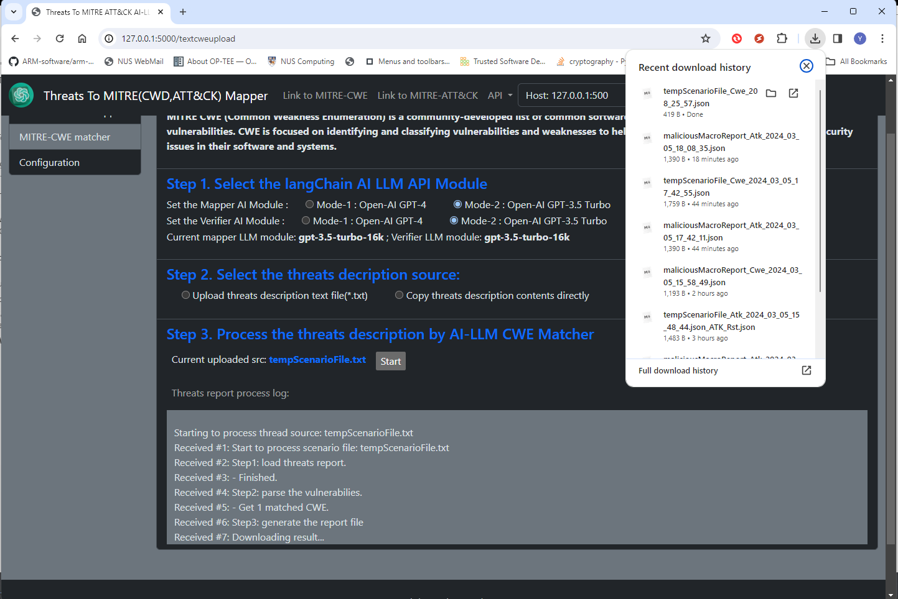
Report will be automated download
Process progress log

Slide 10
