Slide 1
Quick Introdction

Slide 2
Technologies
Java
Matlab
Java RMI (remote method invocation)

Slide 3
structure
One (or more) client
One Server
Two or More (workers)

Slide 4
Client
Sends Image and Processing Commands Via RMI
Server
Server cuts it into two pieces sends each piece to Workers with processing information Via RMI
Worker1
Worker2
Process the images using Matlab and send back to Server

Slide 5
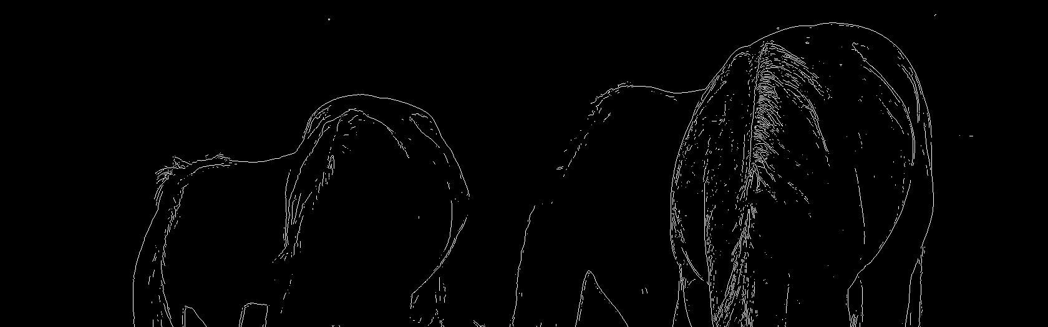
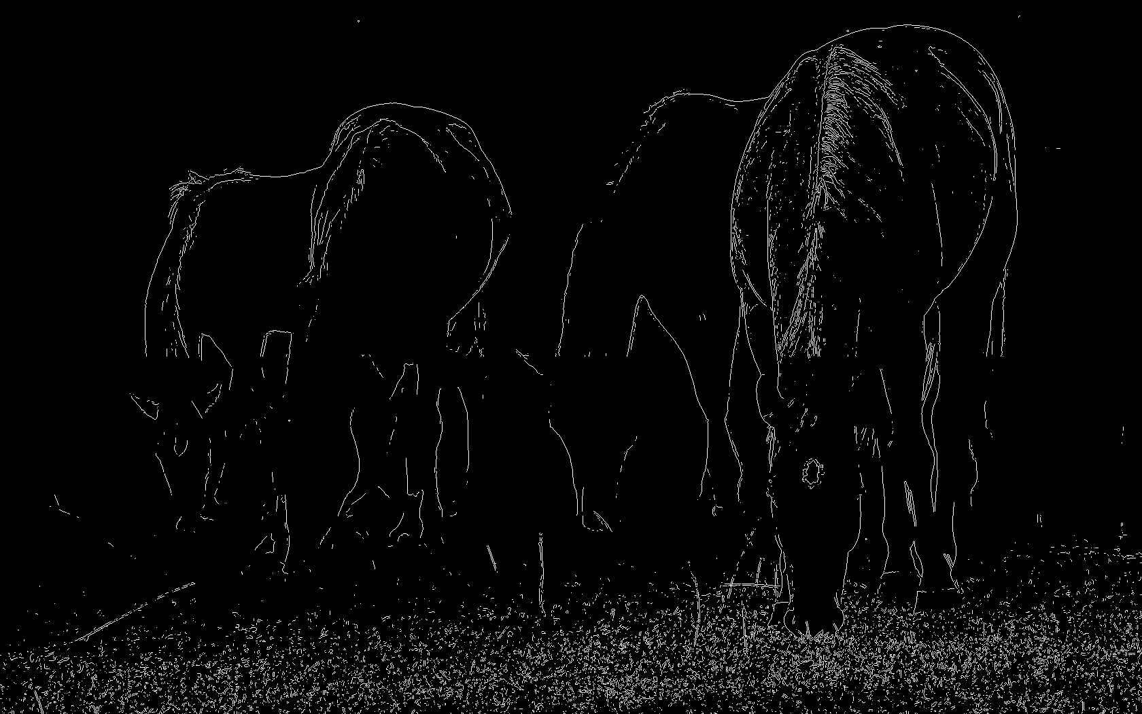

Problems
We are spatially dividing the image. Several operations on image rely on the global data. Image filtering for example relies on the knowledge of “pixel neighborhood”. If we divide the image into multiple parts the gobal data is incomplete for each worker hence the particular operation like “Edge Detection” will not be effective. Especially at places where the image was cut.
Edge Detection using Sobel Filter

Slide 6
Cant do flip
Flipping an image can not be done by dividing it.

Slide 7
Contid
Operations like color inversion however can be calculated without any issue by fragmenting the image

Slide 8
Setup Instruction
Trying it on a single machine first
Get a pen drive
Put the given folder matlabIP on the pen drive
Change the pen drive letter to “I:\”
Keep the color.png file on the “i:\”

Slide 9
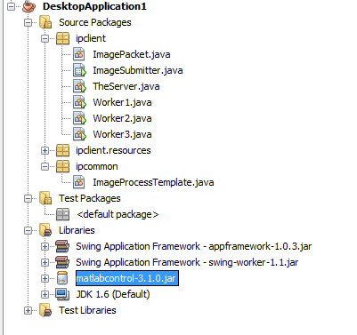
Code Files Open the Project in Netbeans
Make sure you can see all these files and they don’t show any errors

Slide 10
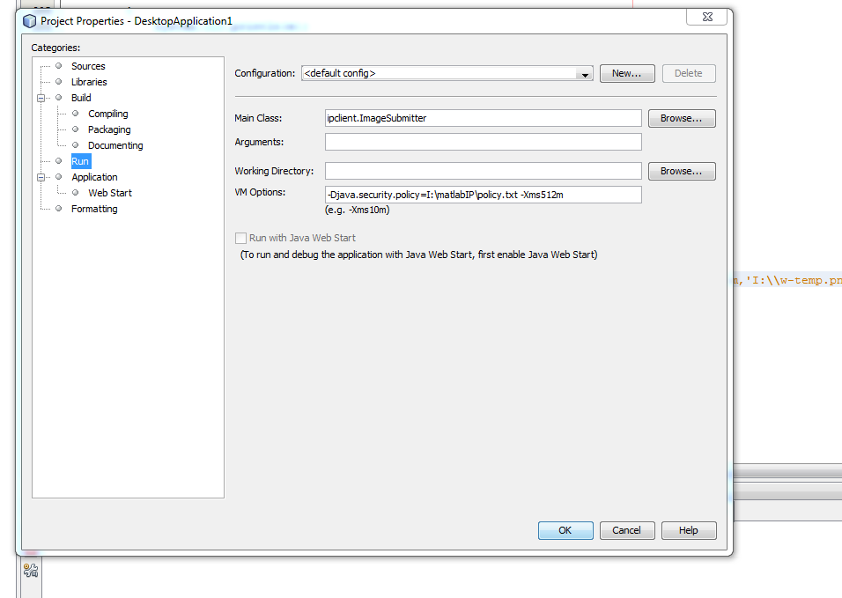
Setup
Right click on the project and select Properties
In the window opened select “Run” Make sure it looks like below

Slide 11
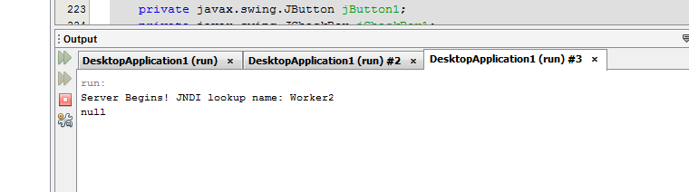
Running the Code
Right Click and run “TheServer”
Right Click and Run “Worker1”
Right Click and Run “Wroker2”
You should see the netbeans output window similar to :

Slide 12
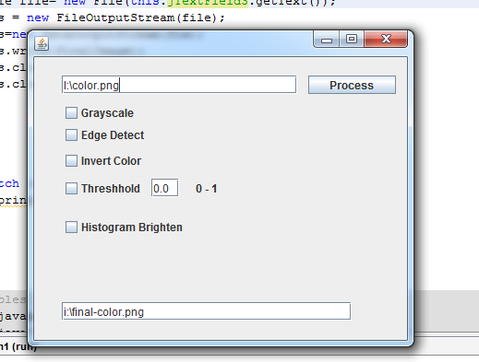
Running the GUI
Run the ImageSubmitter.java file to get the GUI

Slide 13
Note that
It is good idea to select only one option at a time.
It will work with multiple images as well but the results will be difficult to understand.

Slide 14
Running on multiple PCs
I will need 4 machines.
Get 4 pen-drives
Put the matlabIP folder into each of them.
Put each pen-drive into one machine
Rename Drive letter to I:// (or else replace I:// to the letter of your choice in all code files )

Slide 15
The Server Machine
Run the file “TheServer.java” only on this machine.
Note the IP address of this machine. Called SERVER_IP henceforth

Slide 16
The Workers
Run Worker1.java on machine
Run Worker2.java on another machine
Before that Change the line number 27
Registry registry = LocateRegistry.getRegistry(1099);
With
Registry registry = LocateRegistry.getRegistry(“SERVER_IP”,1099);
(the IP address to be passed as String)

Slide 17
The Client machine
Make similar changes to ImageSubmitter.java
On line 169

Slide 18
On All machines
In the file “ImagePacket.java” on “ALL” machines
Replace the line Registry registry = LocateRegistry.getRegistry(1099);
With
Registry registry = LocateRegistry.getRegistry(“SERVER_IP”,1099);

Slide 19
Call me Up if you face problems

