Slide 1
19CSE314 -SOFTWARE ENGINEERING
GROUP 2
TOPIC: CAB HIRING APPLICATION

Slide 2
TEAM MEMBERS :
ROLL NUMBER | NAME | ROLE
CB.EN.U4CSE19403 | AADITH S | SCRUM MASTER
CB.EN.U4CSE19407 | AKSHARA S NAIR | DEVELOPER
CB.EN.U4CSE19424 | GOKULDAS D | TESTER
CB.EN.U4CSE19447 | HARSHVARDHAN | DEVELOPER
CB.EN.U4CSE19452 | RADHIKA RAJALAL | DEVELOPER

Slide 3
ABSTRACT
An online car booking management system is created to help manage hiring cabs with an online portal. The system is intended to help the cab agencies monitor, run and grow their companies. The user interface will contain all necessary customer information including personal details as well as details regarding needs of the customer. The agencies can use the system to efficiently provide cabs by easily assigning an available cab at a nearby location, to the customer. The cab booking system will be able to compile this information and make improvements to their quality of service. The system will help categorize locations, timings, frequent customers and more. This will inevitably organize and consolidate the data collect by the agencies and help manage their customer base and employees more effectively.

Slide 4
Initially when the user installs the app, they will be asked to create an account to book the cab. Once the account is created the user can then continue to book a cab. All details of the available cabs will be provided to the customer so they can choose according to their necessities. They will also then be able to track and analyze how much time it will take the cab to reach their destination, how much distance there is from the departure point, the on-time satellite direction tacking and so on. Once the cab drops the customer at the desired destination, payment can be handled in both online and offline methods.

Slide 5
ACTIVITIES
Registration Page
Name
User Id
Phone Number
Password
Login Page
User Id
Password
Forgot Password
Create and edit profile
Edit email
Edit phone number
Add Profile pic
Make Booking
Date
Time
Booking Id
cancel booking
Select location
Pickup location
Dropoff location

Slide 6
ACTIVITIES
Passenger Details
Number of passengers
Name of primary passenger
User id of primary passenger
View Car Details
Model
Color
Seating capacity
Car Id (number plate)
View Driver Details
Name
Driver’s Current location
Phone number
Make Payment
Payment id
amount
Payment mode
Provide Review Information
Car review
Driver review
Rating
comments

Slide 7
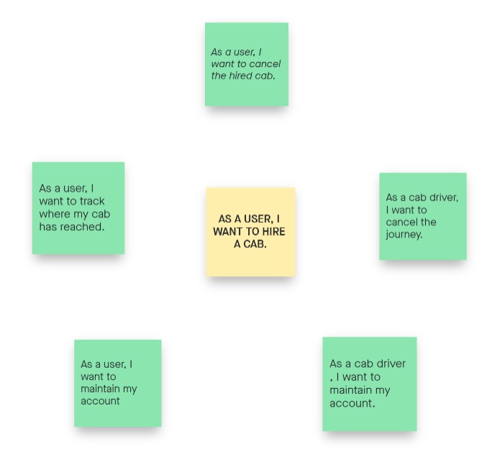
EPICS

Slide 8
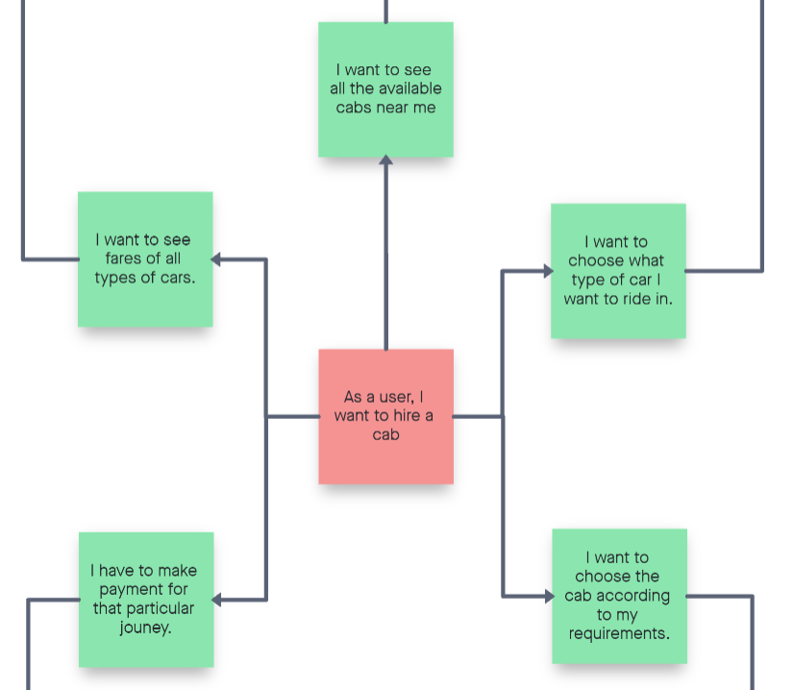
USER STORY 1
AADITH S

Slide 9
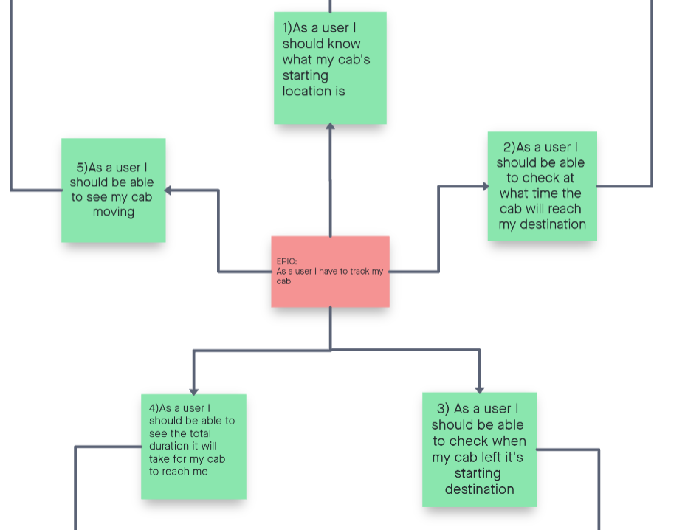
USER STORY 2
RADHIKA

Slide 10
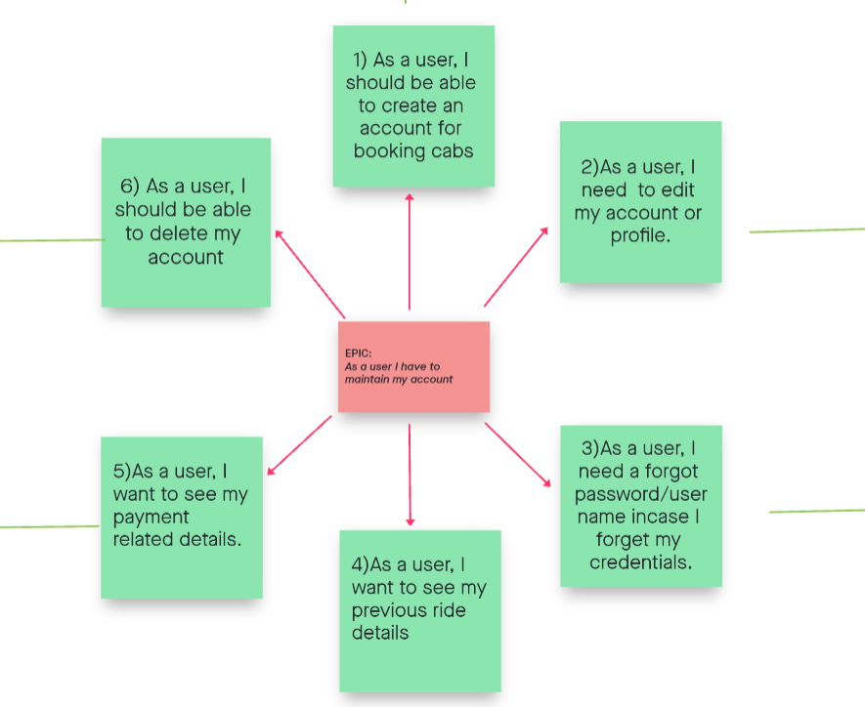
USER STORY 3
AKSHARA

Slide 11
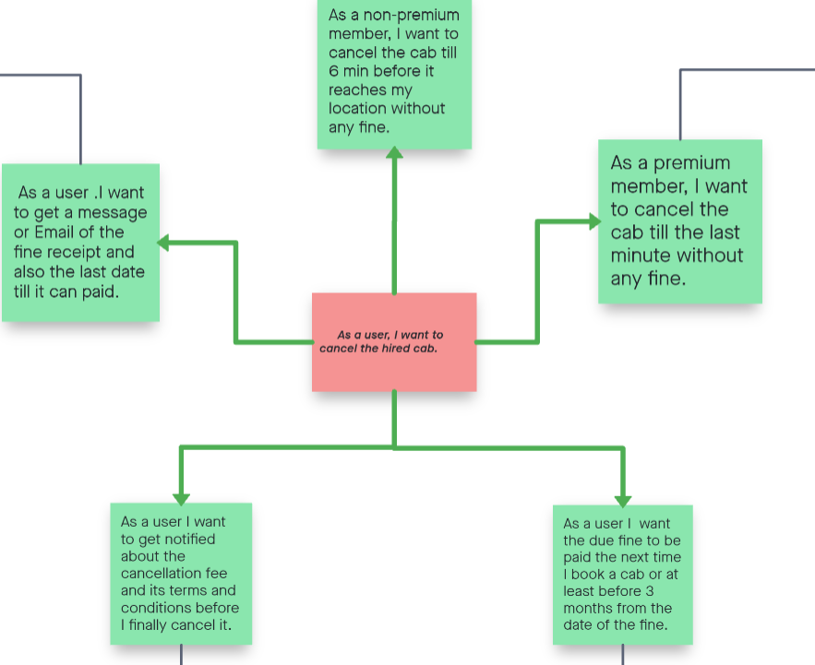
USER STORY 4

Slide 12
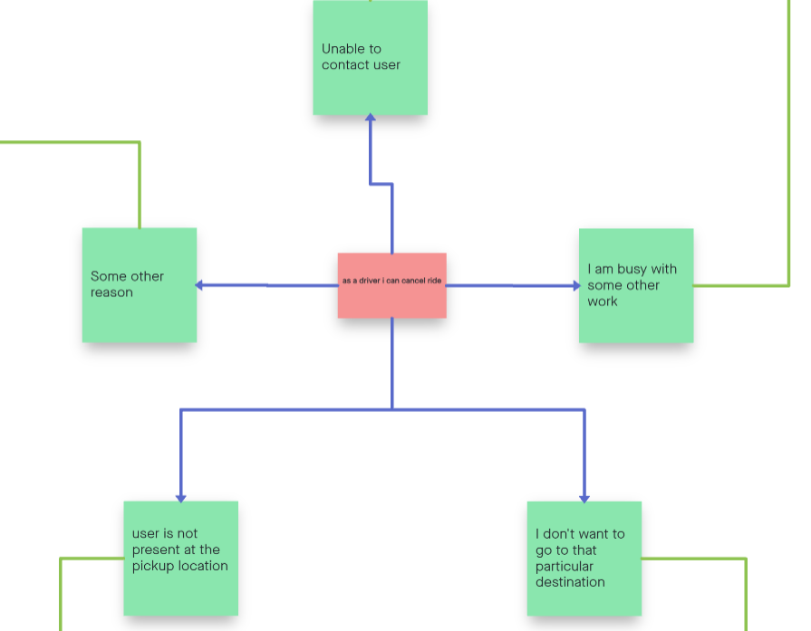
USER STORY 5
HARSHVARDHAN

Slide 13
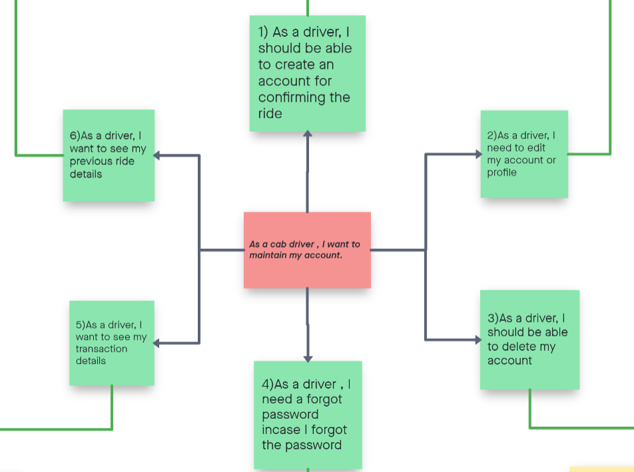
USER STORY 6
GOKULDAS

Slide 14
LINKS :
ABSTRACT :
https://docs.google.com/document/d/1V2hnMwZh6n_go-gBaxci0MPa8H0VCINh/edit
CHART USING INVISION APP :
https://aadith259023.invisionapp.com/freehand/Cab-Hiring-Software-HnCWMTATd

Slide 15
THANK YOU

