Slide 1
2.3 Macro
S2 BCom

Slide 2
MACRO
A macro is a set of commands or keystrokes that are stored for later use.
An example of a simplemacro is one that enters your address into an open document.
You can use macros to automateboth simple and complex tasks.
Macros are very useful when you have to repeat the same task in the same way.

Slide 3
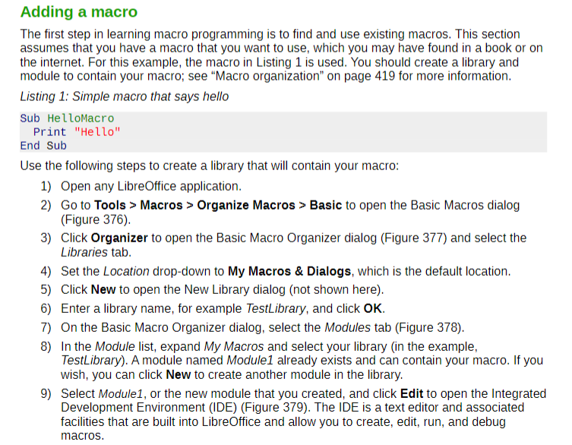

Slide 4
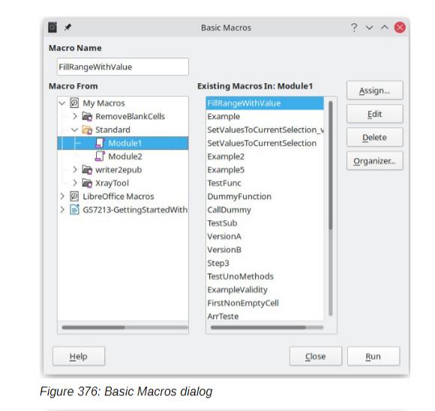

Slide 5
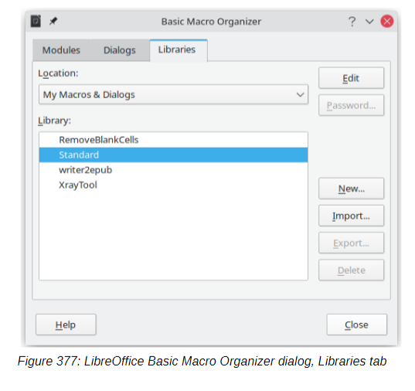

Slide 6
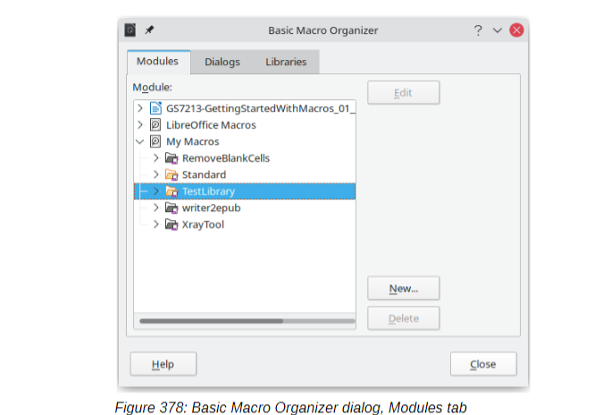

Slide 7
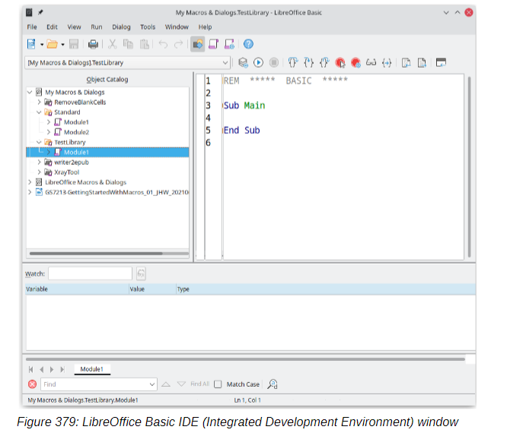

Slide 8
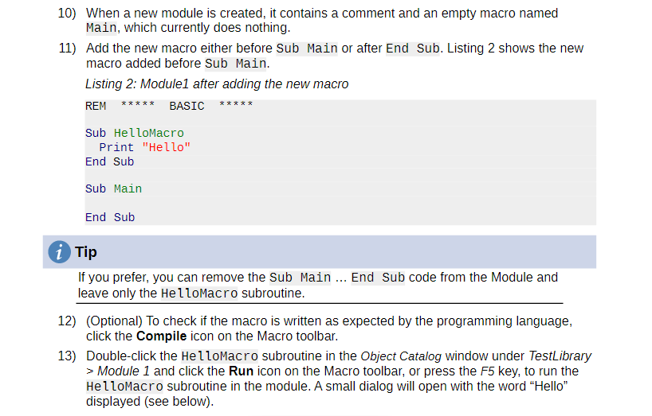

Slide 9
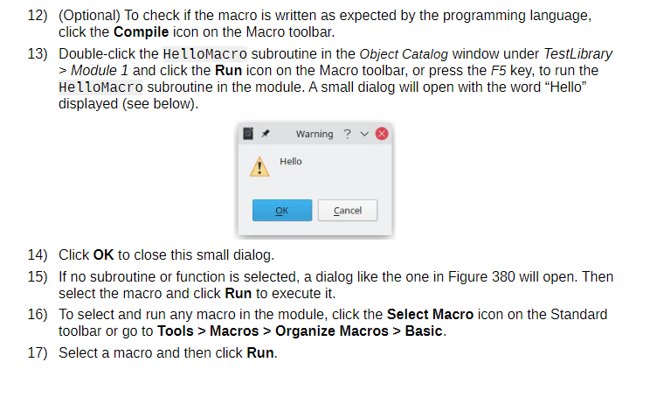

Slide 10
