Slide 1
Module 2.2
S2 bcom

Slide 2
Data representation using charts Introduction
Charts and graphs can be powerful tools for conveying information and Calc offers a variety of ways to present data.
They can be customized to a considerable extent, enabling information to be shown in the clearest manner.

Slide 3
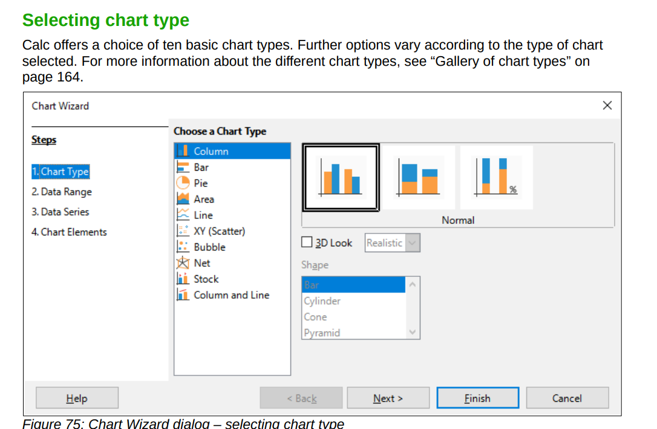

Slide 4
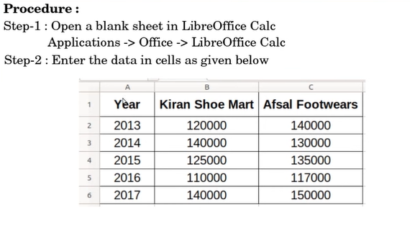

Slide 5
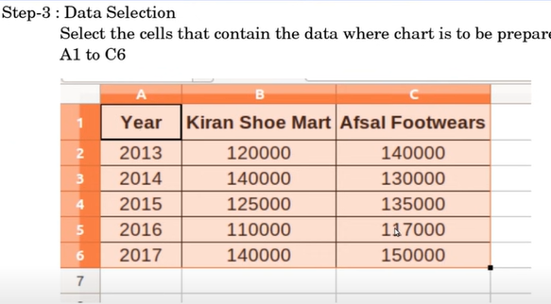

Slide 6
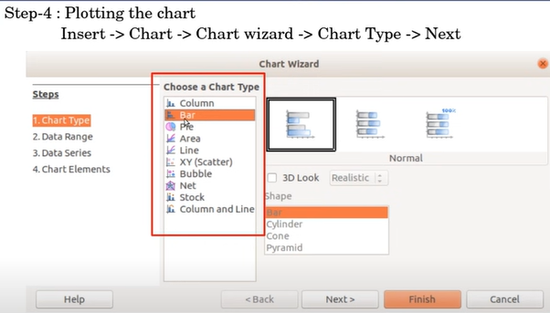

Slide 7
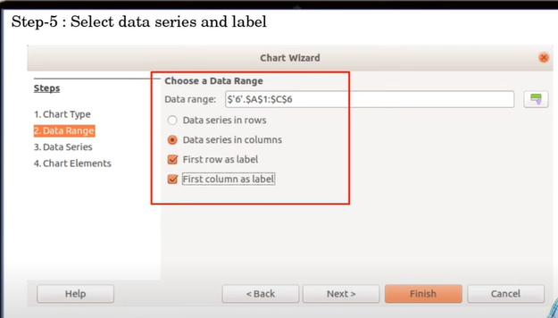

Slide 8
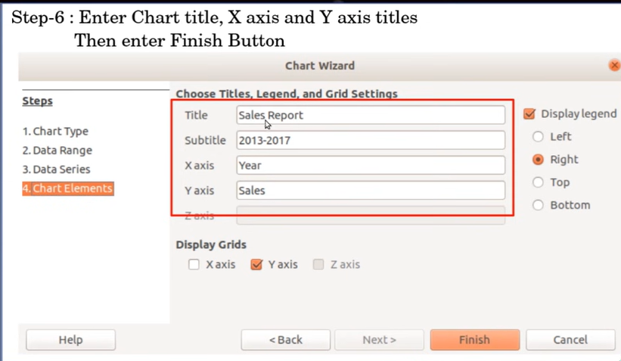

Slide 9
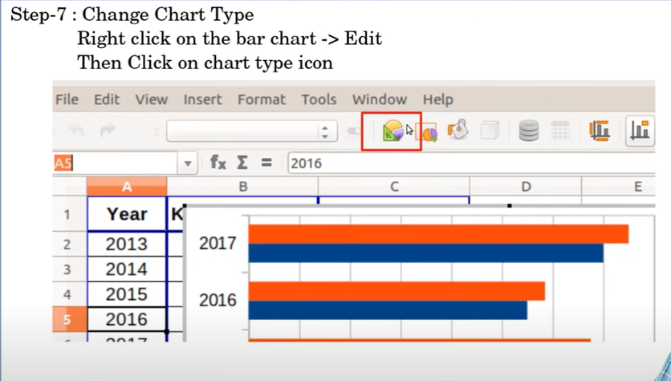
Shortcut key to change type

Slide 10
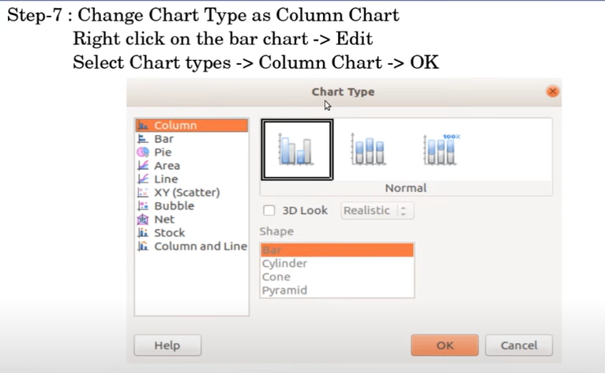

Slide 11
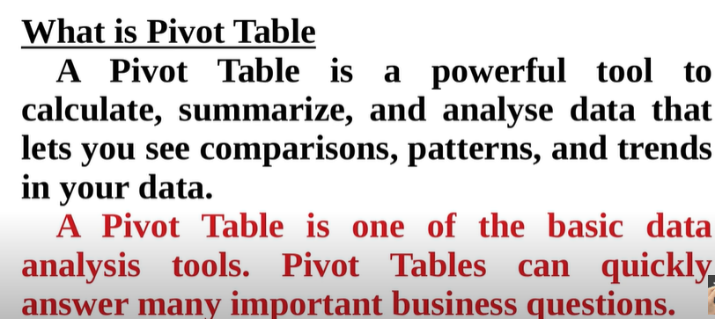

Slide 12
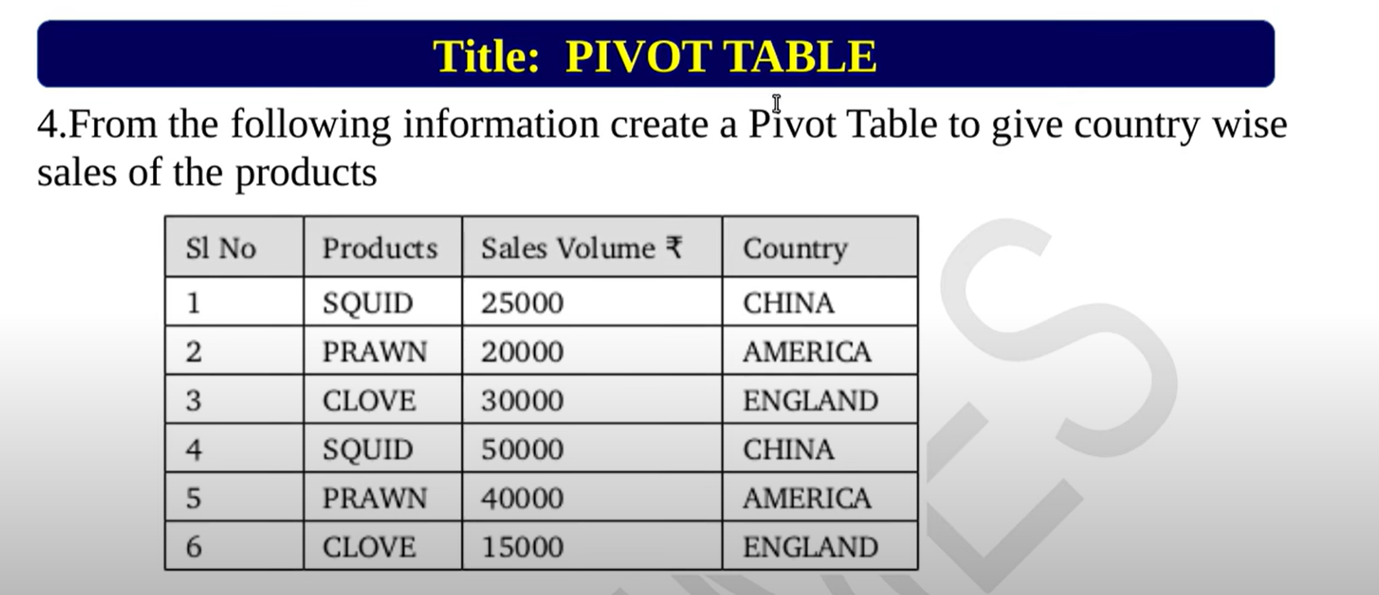

Slide 13


Slide 14
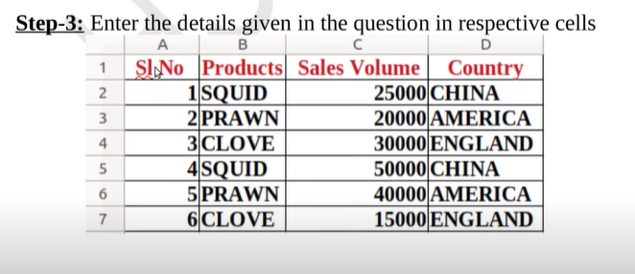

Slide 15


Slide 16
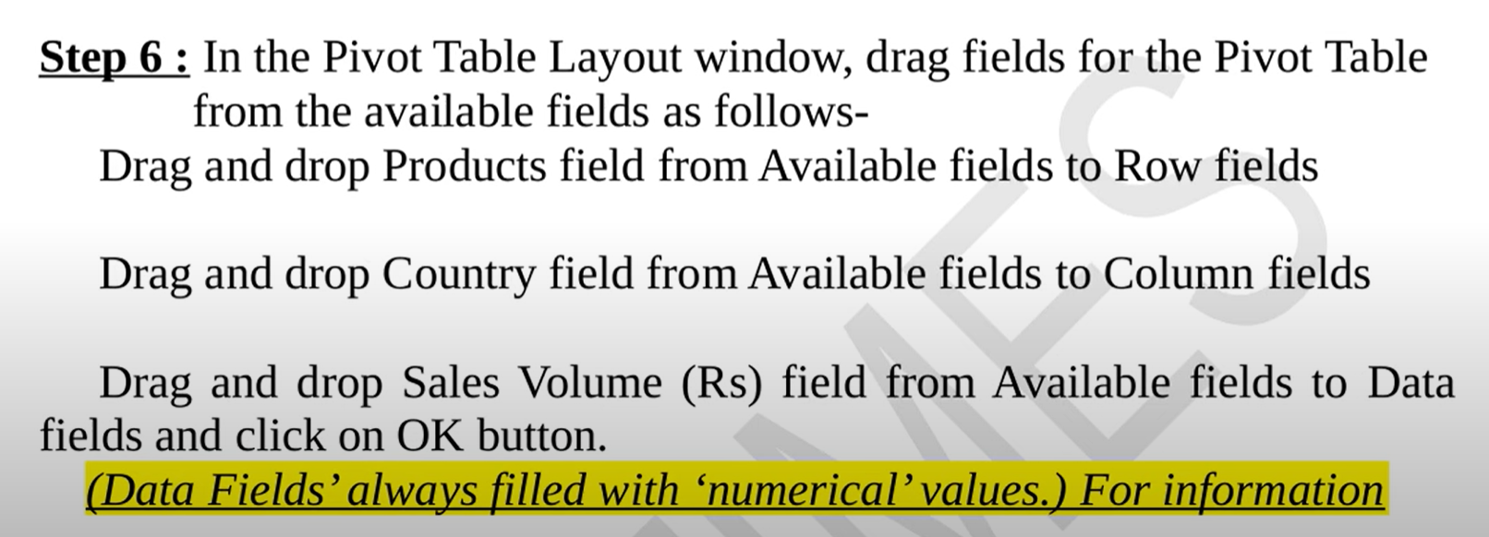

Slide 17
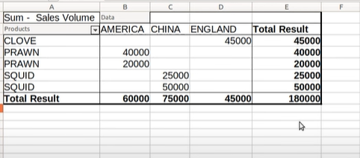

Slide 18


