Slide 1
2.3
S2 B.Com

Slide 2
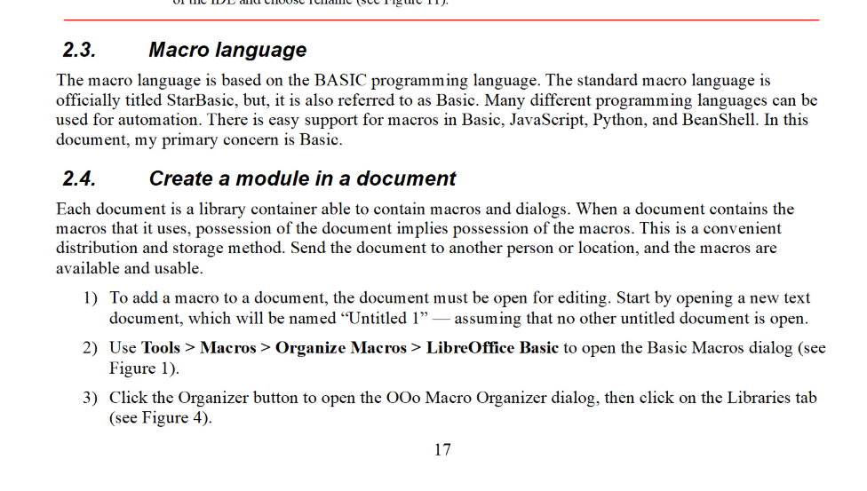

Slide 3
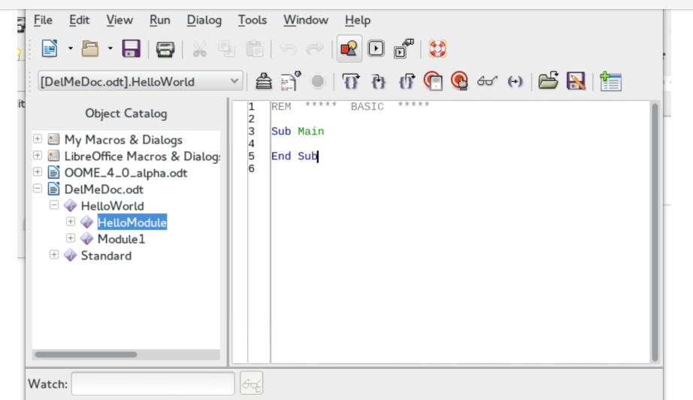
Integrated Debugging Environment
Use the Basic Integrated Debugging Environment (IDE) to create and run macros .The IDE places significant functionality in a little space. The toolbar icons are described in Table 1. The top left corner just above the editing window contains a drop-down list that shows the current library.

Slide 4
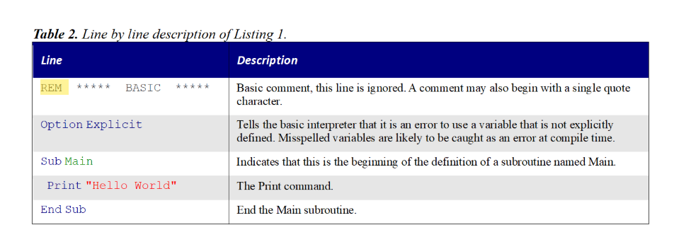

Slide 5
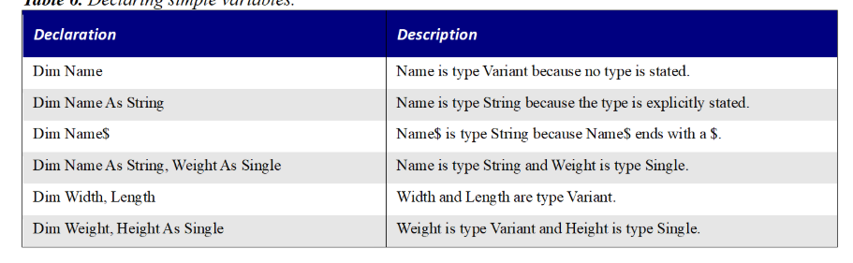

Slide 6
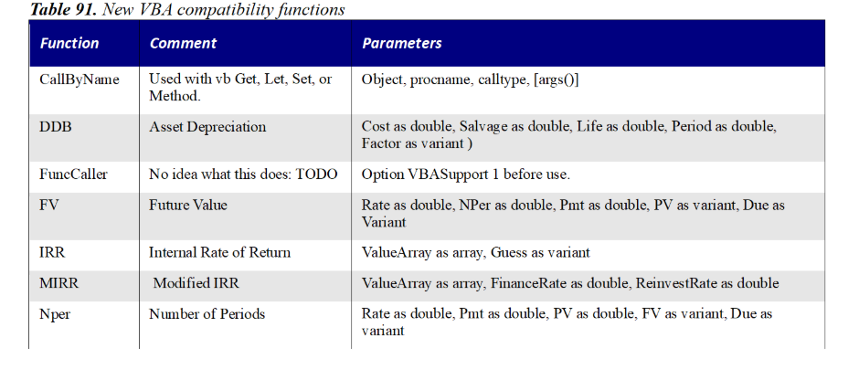

Slide 7
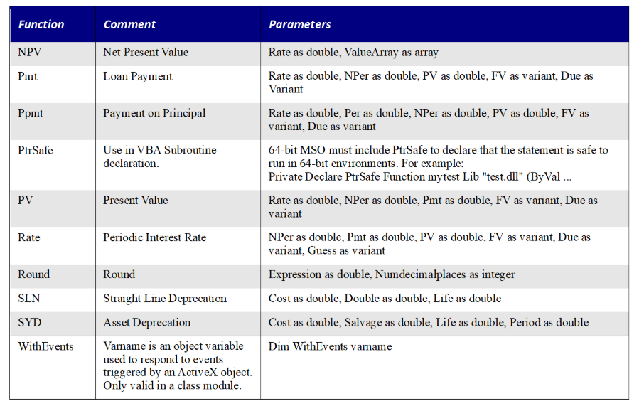

Slide 8
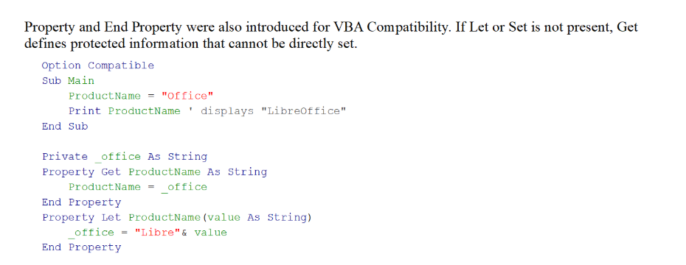

Slide 9
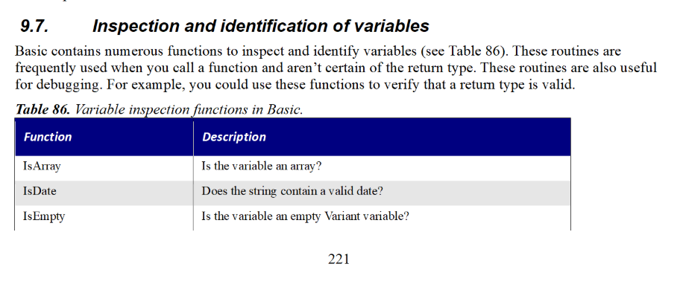

Slide 10
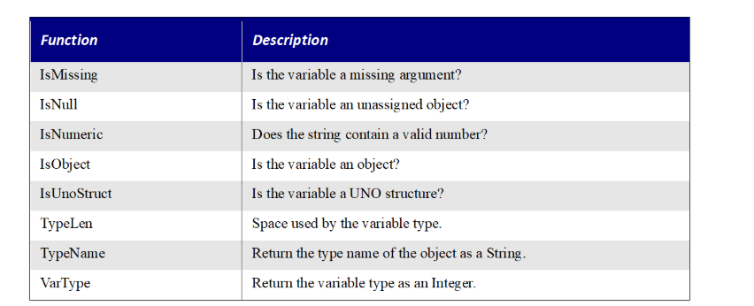

Slide 11
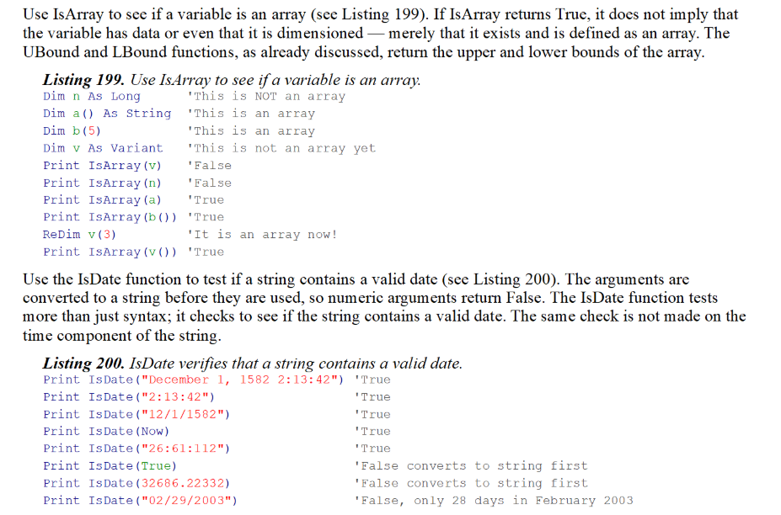

Slide 12
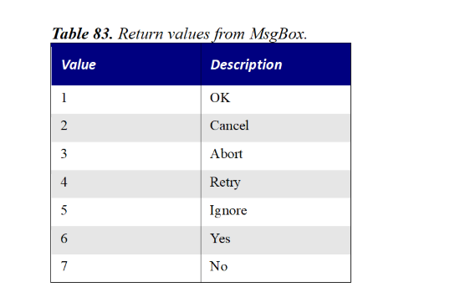

Slide 13
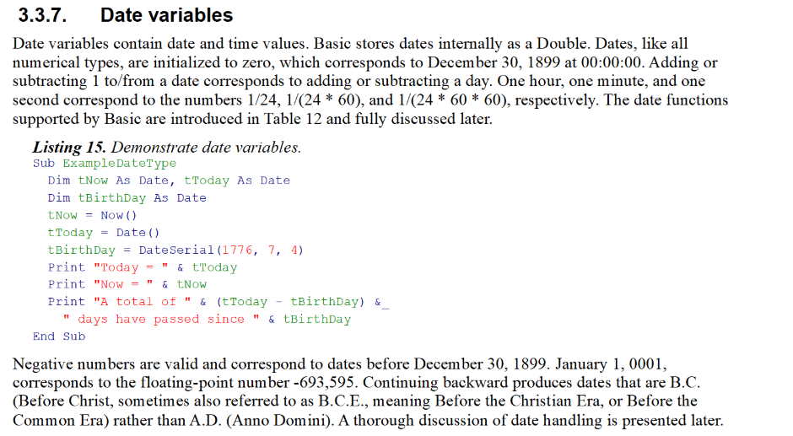

Slide 14


