Slide 1
DOCKER Basic-knowledge
S1 MCA

Slide 2
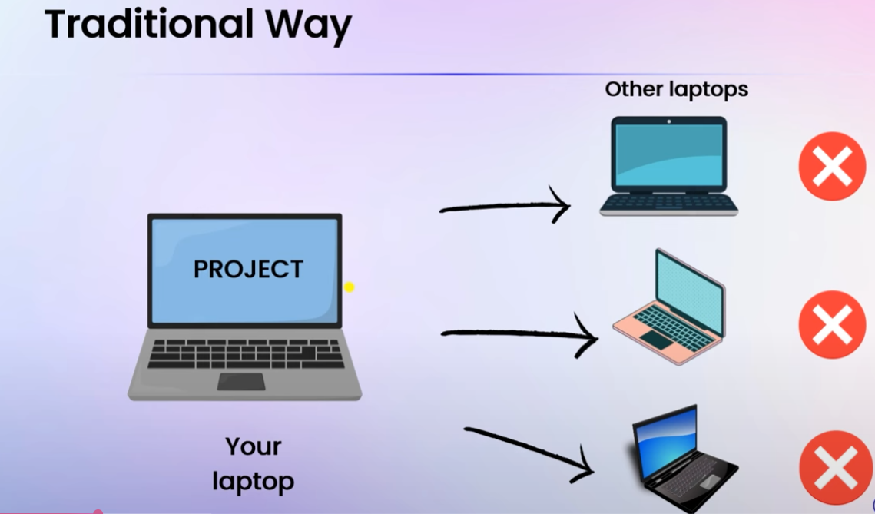

Slide 3
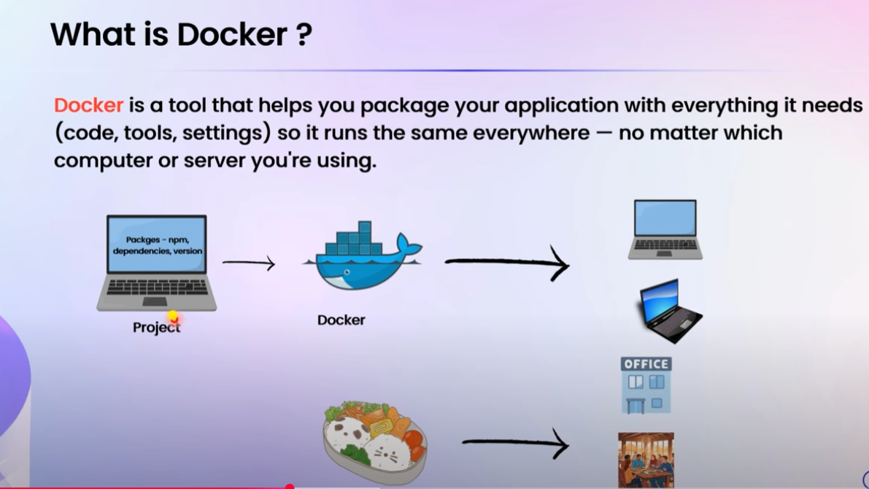

Slide 4
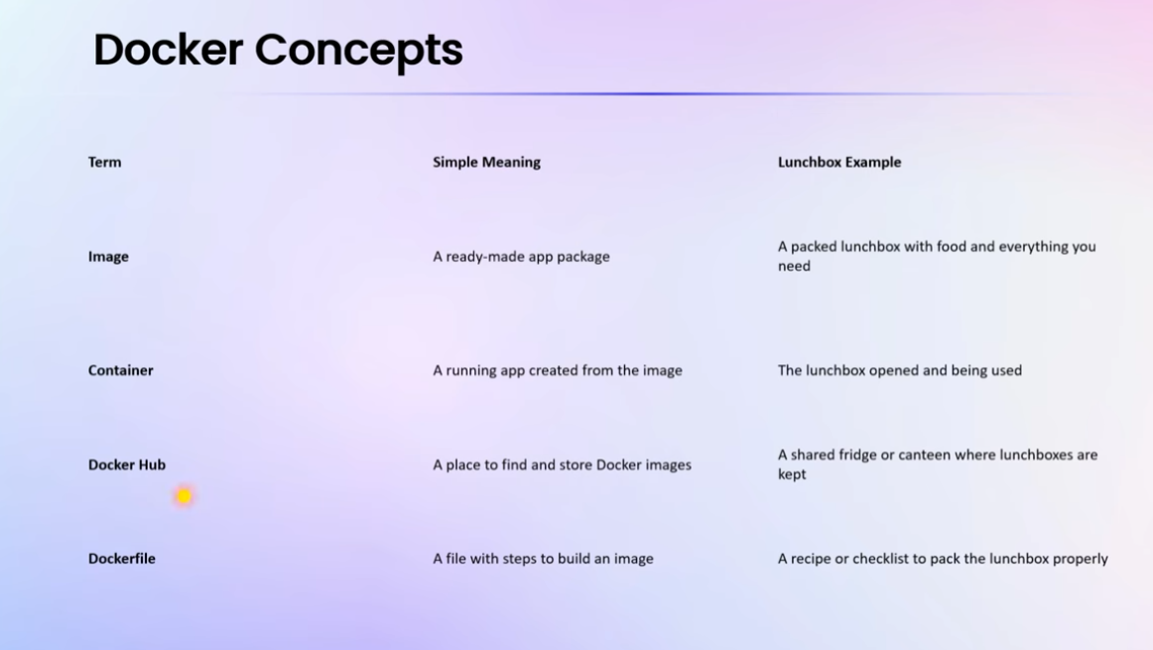

Slide 5
What is Docker Desktop?
A GUI-based application for managing Docker on Windows and macOS
Provides Docker Engine, Docker CLI, and Docker Compose
Enables building, running, and managing containers easily from a desktop environment
Includes Kubernetes integration, container monitoring, and more

Slide 6
What is Docker Hub?
A cloud-based registry where Docker users can share and store container images
Public and private repositories available
Offers official images for popular software (e.g., MySQL, NGINX, Python)
Supports version control for container images

Slide 7
How Docker Works
Docker uses a client-server architecture
Docker CLI (client) interacts with the Docker Daemon (server)
Images are built from a Dockerfile
Docker containers are created from images and run isolated from the host OS
Uses Union File System (UFS) and namespaces for isolation and efficiency

Slide 8
Why Use Docker?
Portability: "Build once, run anywhere" across all environments
Consistency: Same containerized app in dev, test, and production
Efficiency: Faster startup and lower overhead than virtual machines
Scalability: Easily deploy and scale with tools like Kubernetes
Isolation: Each container runs independently, reducing conflicts

Slide 9
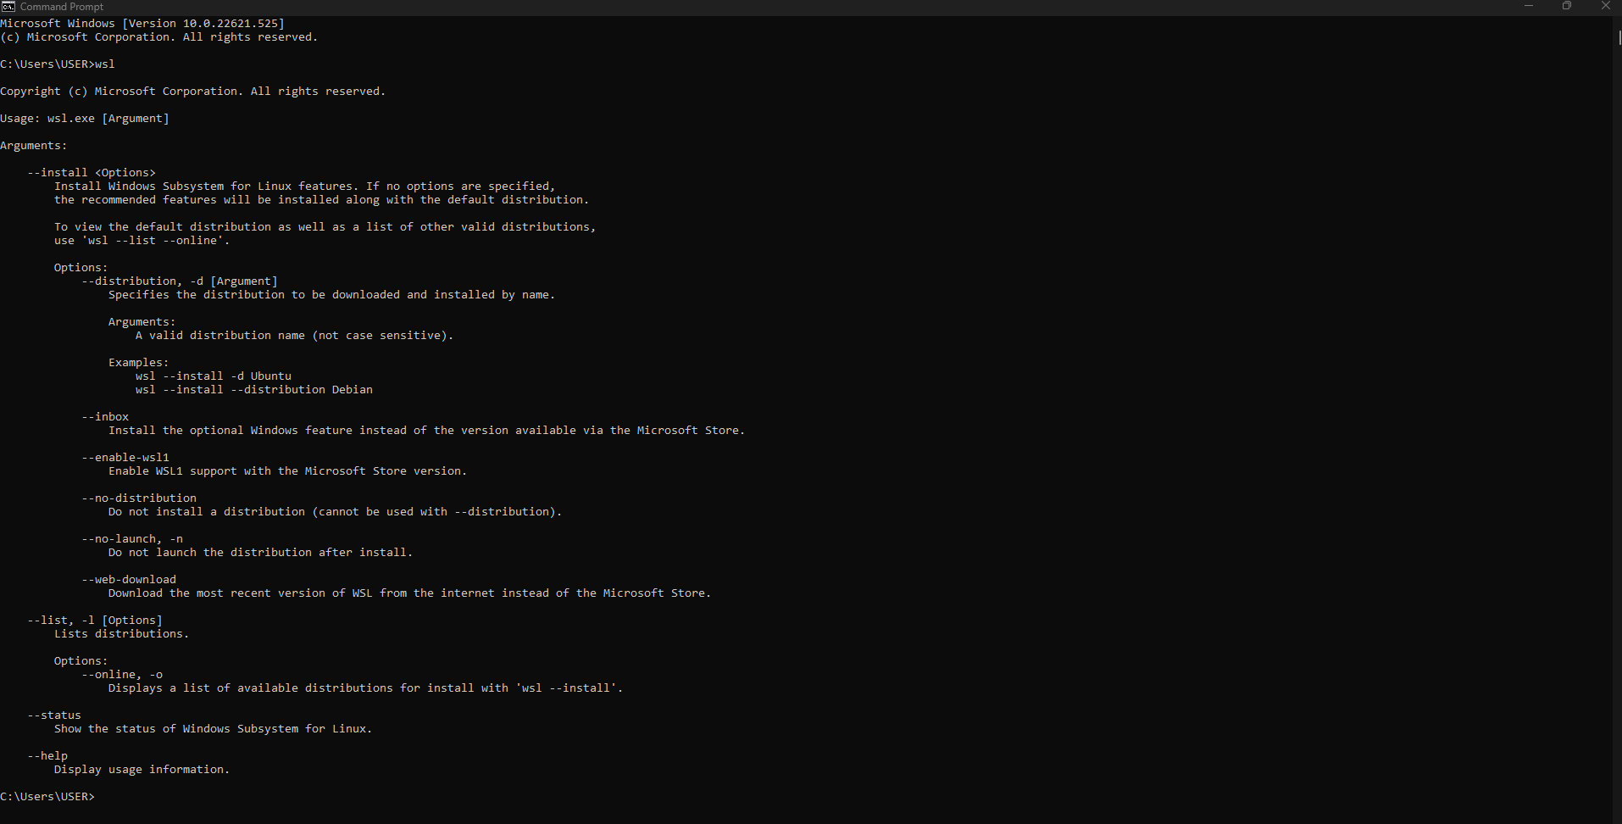
System Specification for Run Docker
Windows Subsystem for Linux (WSL)
is a feature of Windows that allows you to run a Linux environment on your Windows machine, without the need for a separate virtual machine or dual booting

