Slide 1
DJANGO

Slide 2
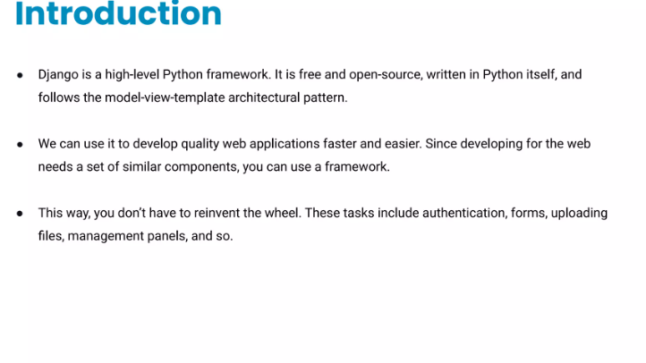

Slide 3
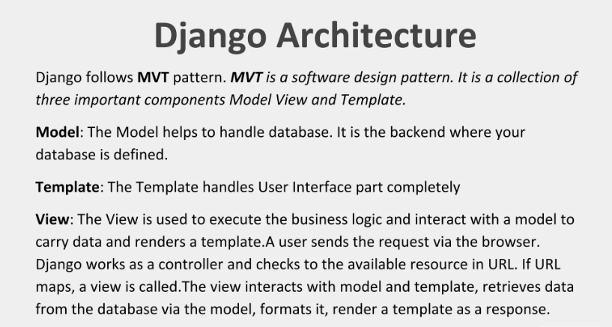

Slide 4
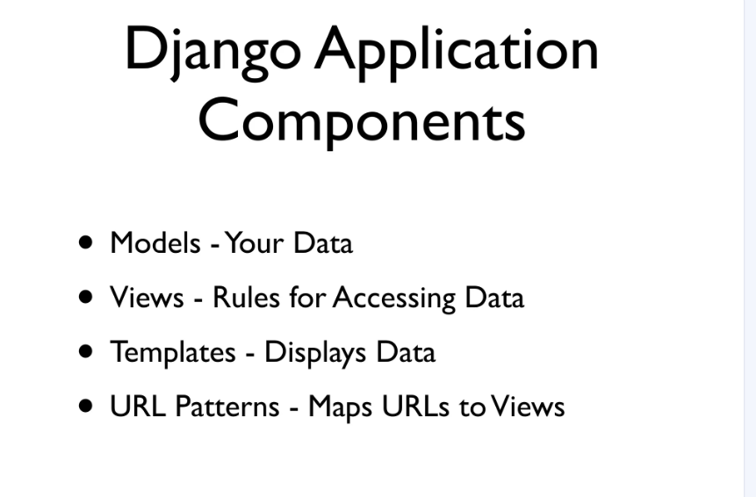

Slide 5
Django is good for making web applications because it is fast, secure, and comes with built-in features like user authentication, admin panel, and database management, which help developers build powerful websites quickly and efficiently.

Slide 6
How to install django:
1. Make sure Python is already installed in our system
python --version
We create an environment to isolate our Django project and its dependencies so that it doesn’t conflict with other projects or system-wide packages.
python –m venv “envname”
Install django by using pip
pip install django

