Slide 1
DJANGO

Slide 2
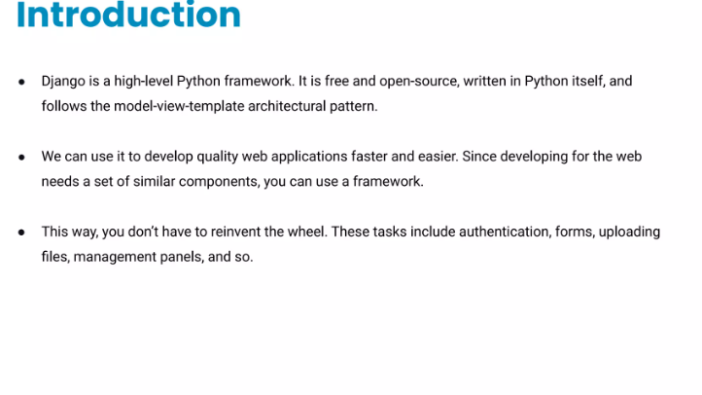

Slide 3
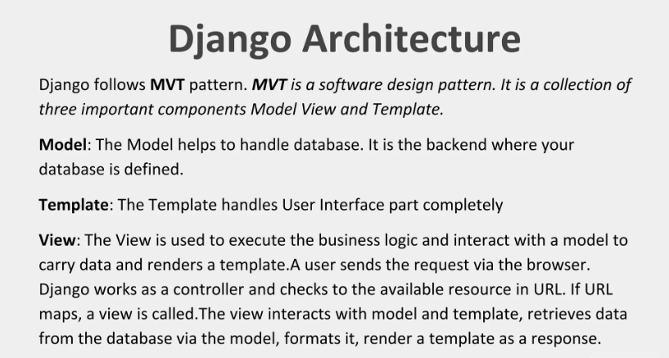

Slide 4
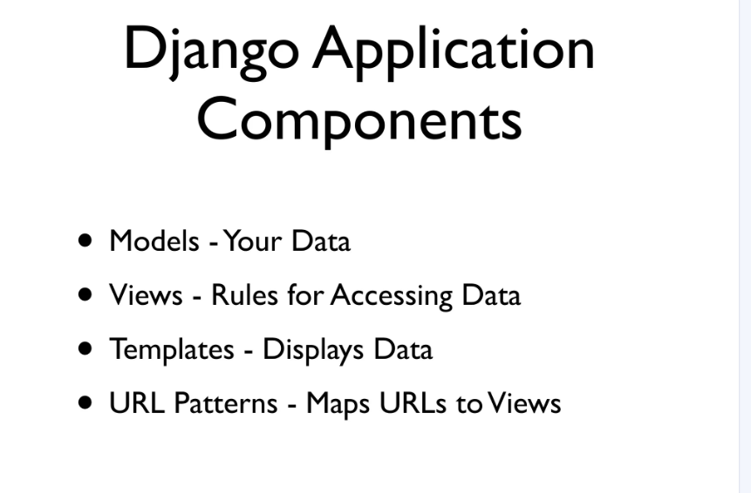

Slide 5
Django is good for making web applications because it is fast, secure, and comes with built-in features like user authentication, admin panel, and database management, which help developers build powerful websites quickly and efficiently.

Slide 6
How to install django:
1. Make sure Python is already installed in our system
python --version
We create an environment to isolate our Django project and its dependencies so that it doesn’t conflict with other projects or system-wide packages.
python –m venv “envname”
Install django by using pip
pip install django
Create a project in django
django-admin startproject projectname
cd Projectname

Slide 7
6.To check if the Django project is installed and running correctly, use:
python manage.py runserver
myproject/ ← 🌟 Base Directory
├── manage.py
├── myproject/ ← Inner project folder (confusingly same name)
│ ├── __init__.py
│ ├── settings.py
│ ├── urls.py
│ └── wsgi.py
7.In the Base Directory
create two folders:
1. template store HTML files only
2.static store CSS,Images,JavaScript files

Slide 8
8.Then ,create app in django project
python manage.py startapp appname
9. So to settings.py
Import os
INSTALLED_APPS=[ ‘eventapp’, app defining
:
: ]
10. TEMPLATES =[
DIRS :[ os.path.join(BASE_DIR,’ template ‘)
]
11.Below STATIC_URL =‘static/’
define :
STATICFILES_DIR =[ os.path.join(BASE_DIR,’ static ‘)

Slide 9
12. In the template folder :
Create html files:
template/
├── base.html
├── index.html
├── about.html
├──events.html
├── booking.html
├── contact.html
static/
├── css
├──js
├──images

Slide 10
13.In event app ,
create a urls.py file
from django.urls import path
from . import views
urlpatterns= [ path(‘’,views.index,name=‘index’)]
14.In event app, views.py
From django.shortcuts import render
Create your view here.
def index(request): uses functions to create views
return render(request,’index.html’)

Slide 11
Base.html
{% block title %}
For adding different titles
{% endblock %}
{% block content %}
For adding different contents
{% endblock %}

Slide 12
load base.html to other html pages by
top of the page :{% extends ‘base.html’ %}
load static files
top of the page : {% load static %}

