Slide 1
COVIDBOT
Susana | Jnanavi | Akshara | Salman

Slide 2
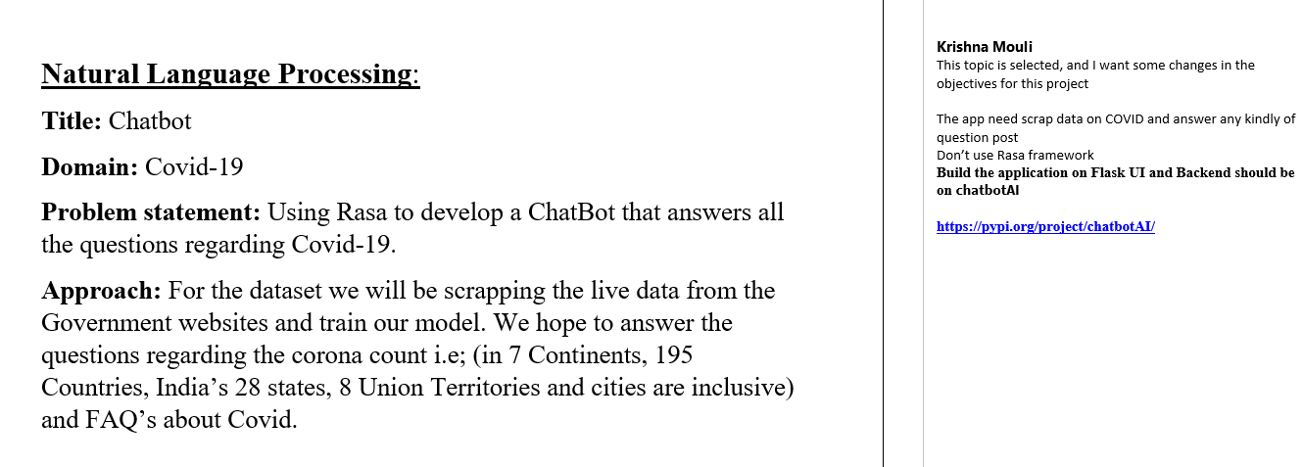
Goal
Using ChatBotAi to develop a ChatBot that answers the questions regarding Covid-19.
2

Slide 3
Dataset
Scrapped Data using chrome driver
Count - https://www.covid19india.org/
News - https://news.google.com/topstories?hl=en-IN&gl=IN&ceid=IN:en
Faq’s – Manual
Google Forms
3

Slide 4
ChatbotAI
Chatbot AI engine is a chatbot builder platform that provides both bot intelligence and chat handler with minimal coding
Template file and python regular expressions
4

Slide 5
Count
User input
Goes to the template file
Searches for the query(country/state/district name)
Passes to the function to display the output
5

Slide 6
News and BERT
Bidirectional Encoder Representations from Transformer
Classification tasks such as sentiment analysis
Question Answering tasks (e.g. SQuAD v1.1)
Named Entity Recognition (NER)
6

Slide 7
BERT-Question Answering
SQUAD Dataset
Question and Reference Text
Tokens
Segment Embedding
7

Slide 8
FAQ’s
8

Slide 9
Conclusion and Future works
9

