Slide 1
STRINGS are arrays of characters
String(Pattern) matching(searching)
(naive or brute force, Rabin-Karp, KMP)
Basic string operations in C
Prerequisite: pointers, arrays

Slide 2
String Matching
What?
find location of a text pattern within a larger text
How?
Naive
Rabin Karp
KMP
Manacher
Why?
Auto-completion... of URL in browser
...of keyword in search engine
...of path in command line
Plagiarism finding

Slide 3
String matching: 1.Brute force or naive method
BruteForceStringMatch(T[0...n-1], P[0...m-1])
for i ← 0 to i < n-(m-1) do
j ← 0
while j < m and P[j] = T[i+j] do
j++
if j = m
return i
return -1
The algorithm can be designed to stop on either the first occurrence of the pattern, or upon reaching the end of the text to find all occurrences of pattern

Slide 4
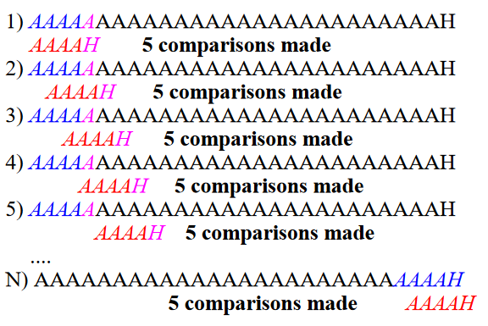
Worst case: mismatch at last character

Slide 5
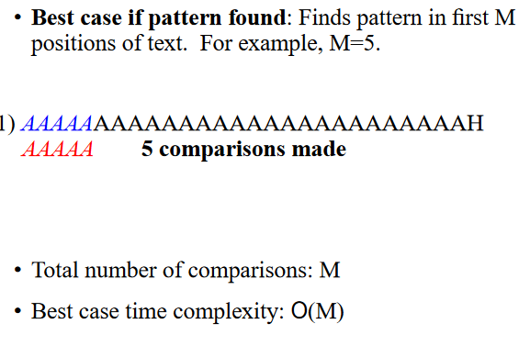
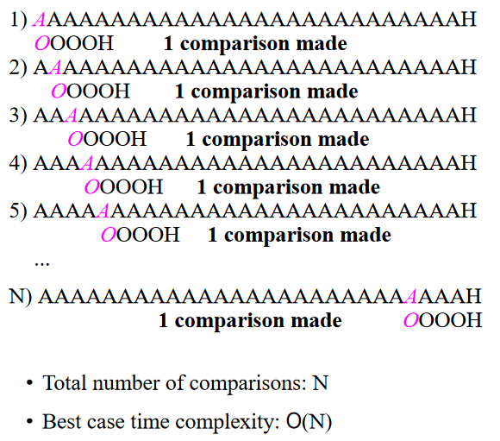
Best cases: 1. pattern found at first character 2. pattern not found, first character mismatch

Slide 6
Brute force or naive method
Find P[0...m-1] in T[0...n-1]
Pattern has size m, so we need not search last (m-1) indices of T; so n-(m-1) searches
effective for short texts and patterns, as O(1) space complexity
If searching for more than one pattern, avoid it as time complexity ≈O(n×m)
Average case: Θ(n) for m << n

Slide 7
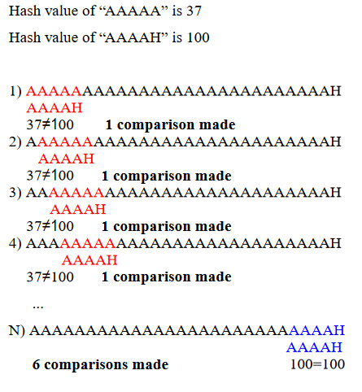
Rabin kARP uses hashing

Slide 8
Rabin karp: uses hashing
Mismatched hash guarantees mismatch
but
Matched hash does not guarantee match, so we call brute force at this stage
Rolling hash function O(1) time creation
ASCII of characters
Use sufficiently large prime number such as 101
Note: how to find ASCII: typecast to int
A:97, A:65 and so on...

Slide 9
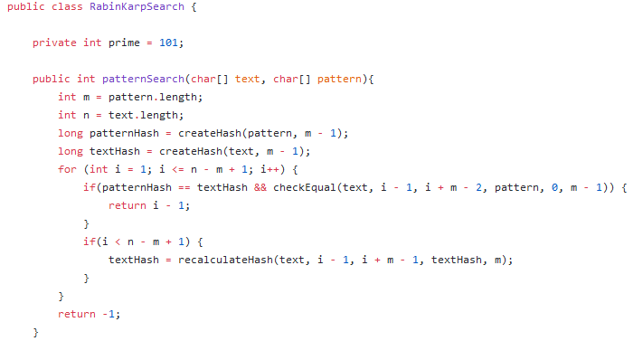
Java code for rabin karp
Call to brute force string match

Slide 10
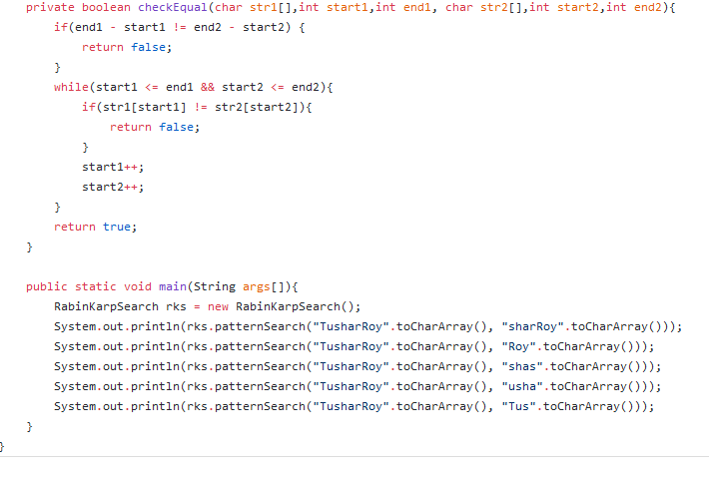
Brute force search in rabin karp
//This method is brute force string match

Slide 11
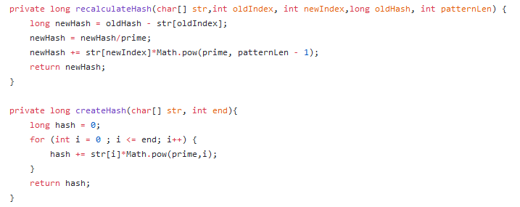
Hash calculation in rabin karp
Example on board:
hash of bcd from hash of abc

Slide 12
Rabin karp complexity
If a sufficiently large prime number is used for the hash function , the hashed values of two different patterns will usually be distinct. On an average, this is the case, searching takes O(n) time, where n is the number of characters in the larger body of text.
It is always possible to construct a scenario with a worst case complexity of O(mn). This, however, is likely to happen only if the prime number used for hashing is small

Slide 13
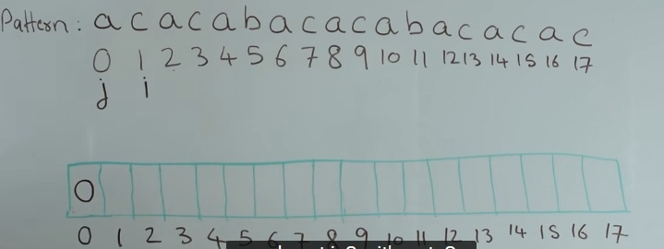
KMP search: Building the prefix array
Basic idea
Every cell of prefix array gives length of longest suffix which is also prefix
Start with filling A[0] as 0 //A is prefix array
if (P[i] != P[j]) { //pattern
A[i] = j;
i++; }
else {
A[i] = j+1;
i++;
j++; }

Slide 14
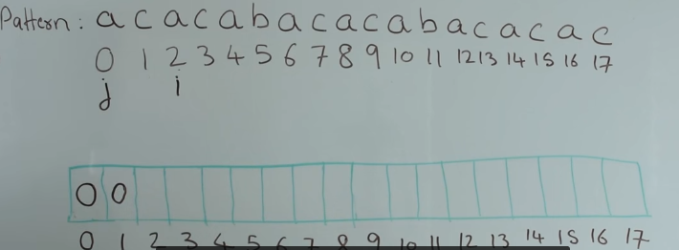
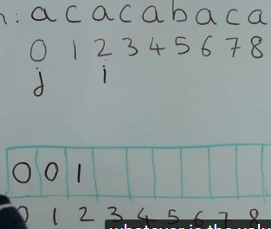
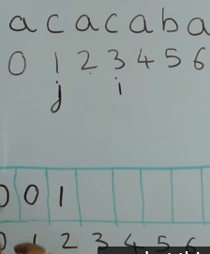
Kmp: Building prefix array
Suffix of length 1 which is also prefix

Slide 15
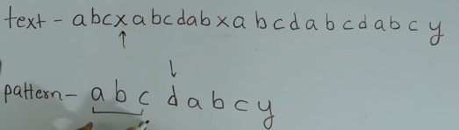
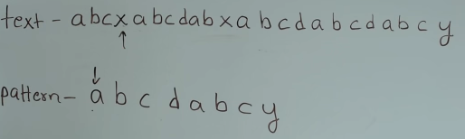
KMP SEARCH
O (m + n)
In partially matched pattern, Is there a suffix which is also a prefix?
if found then move ahead of prefix in pattern, else move ahead in text

Slide 16
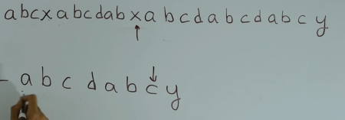
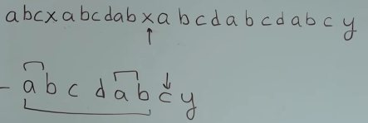
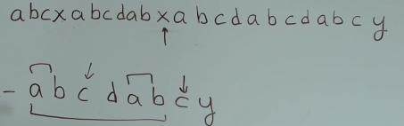

Slide 17
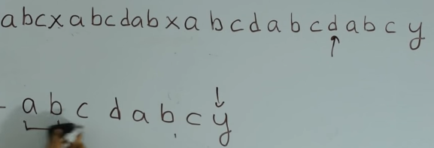
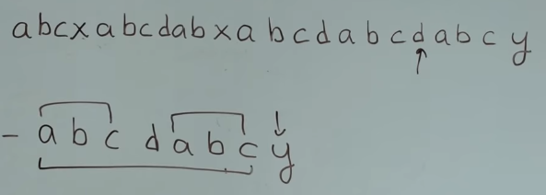

Slide 18
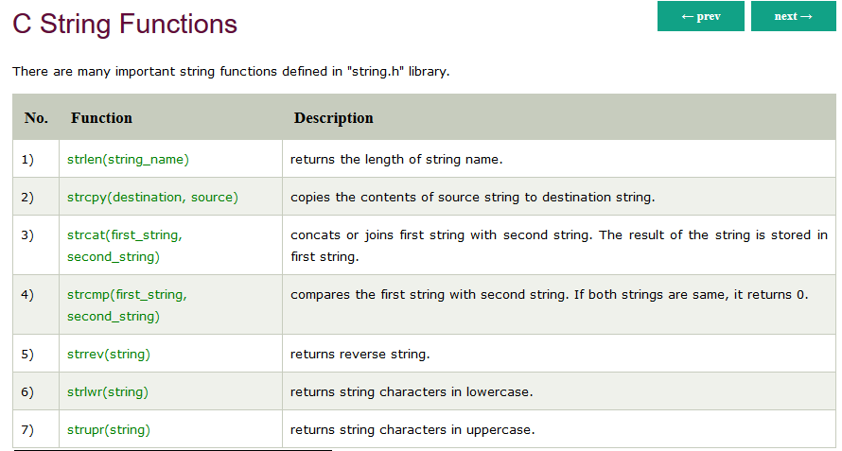
https://www.javatpoint.com/c-string-functions

Slide 19
References
https://github.com/mission-peace/interview/wiki
https://www.youtube.com/watch?v=H4VrKHVG5qI&index=2&list=PLrmLmBdmIlpvm7VaC0NTR27A_3i2sU3zd
https://github.com/mission-peace/interview/blob/master/src/com/interview/string/RabinKarpSearch.java
(some Python codes also available@this repo)
https://github.com/mission-peace/interview/blob/master/src/com/interview/string/SubstringSearch.java
https://stackoverflow.com/questions/16458564/convert-character-to-ascii-numeric-value-in-java
http://www.dcs.gla.ac.uk/~pat/52233/slides/Strings1x1.pdf

Slide 20
Longest palindrome string using Manacher’s algo
https://github.com/mission-peace/interview/blob/master/src/com/interview/string/LongestPalindromeSubstring.java
https://www.youtube.com/watch?v=V-sEwsca1ak
https://github.com/mission-peace/interview/blob/master/src/com/interview/dynamic/LongestPalindromicSubsequence.java
https://www.youtube.com/watch?v=_nCsPn7_OgI

