Slide 1
RESTAURANT
MANAGEMENT SYSTEM

Slide 2
PROJECT OVERVIEW
Abstract
A simple Java application for managing basic restaurant operations.
WHAT THE SYSTEM DOES
JAVA CONCEPTS IN PRACTICE
The Restaurant Management System lets a user view the food menu, place an order, enter quantities, calculate the bill, search for menu items, and sort items by price. It also saves completed orders so they can be viewed later.
The project demonstrates Java foundations, control flow, methods, arrays, object-oriented programming, strings, file handling, collections, and streams. These concepts work together to make ordering and billing more organized and reliable.
Core goal: make menu selection, billing, and order records easier to manage.
02

Slide 3
PROBLEM & SOLUTION
Understanding the Problem Statement
Why a small restaurant can benefit from a simple digital system.
THE PROBLEM
OUR SOLUTION
Manual order-taking and bill calculation can take time. It can also be harder to search menu items, keep totals consistent, and find previous orders.
A menu-driven Java program supports item selection, quantity validation, automatic bill calculation, item searching and sorting, and saving order details to a text file.
MAIN FUNCTIONS
01
View menu
02
Place order & bill
03
Search / sort items
04
Save / view orders
03

Slide 4
CO 1 / MODULE 1
CO 1 |
Computational Thinking & Java Foundations
TOPIC USED
PURPOSE IN OUR CODE
Variables & data types
Store item IDs, prices, quantities, customer names, choices, and bill amounts.
Constants
FILE_NAME fixes the order-file name; the bill currently uses 5% directly for tax.
Arithmetic & assignment operators
Calculate line totals, subtotal, 5% tax, final total, discount, and running totals.
Relational operators & conditions
Check quantities, item IDs, empty menu state, and whether the user selected Exit.
Scanner input & formatted output
Read menu choices and quantities; printf formats prices and bill amounts.
Typecasting & bitwise operator
Convert prices / average to integers for the demo; show a small bitwise AND example.
04

Slide 5
CO 2 / MODULE 2
CO 2
TOPIC USED
PURPOSE IN OUR CODE
if conditions
Use input checks for blank customer names, invalid quantities, missing files, and empty orders.
switch, case & default
Route the selected menu number to display, order, search, sort, demos, history, or exit.
while loop
Keep asking for a valid whole-number input until Scanner receives an integer.
do-while loop
Repeat the main menu and continue order entry until the user chooses to finish.
for & enhanced for loops
Process menu items and prices; print menu items and order lines.
break & continue
Stop order entry when 0 is entered; skip unknown items or invalid quantities.
05

Slide 6
CO 3 / MODULE 3
CO 3 | Methods, Recursion & Arrays
Decomposition with Methods, Recursion & Arrays
TOPIC USED
PURPOSE IN OUR CODE
Modular methods
Separate menu display, placing orders, searching, sorting, saving, and reading orders into tasks.
Parameters & return values
Pass items, quantities, and discount rates; return input values and calculated totals.
Method overloading
Provide calculateTotal() for the regular total and calculateTotal(discountRate) for a discounted total.
1D arrays: traversal, sort & search
Store menu prices, sort them, and use binary search to find the target price.
Recursion
recursiveSum() adds array values; its base case stops when the index reaches the array length.
Average, counting & 2D arrays
Calculate average price; count items by category in the collection demo; add two sample matrices.
06

Slide 7
CO 4 / MODULE 4
CO 4 | OOP Modelling & Exception Handling
Object-Oriented Modelling, Design & Exception Handling
TOPIC USED
PURPOSE IN OUR CODE
Classes & objects
MenuItem, OrderItem, RestaurantOrder, and the main system model menu entries and customer orders.
Constructors & overloading
Initialize objects; MenuItem has constructors with and without a category code.
Encapsulation & accessors
Private fields hold item data; getter methods provide controlled access to values.
Inheritance & abstract class
OrderItem extends MenuItem; RestaurantOrder extends OrderBase and implements its billing behaviour.
Interfaces & overriding
Billable defines billing; Comparable supports price ordering; overridden methods customize behaviour.
Exceptions & try-with-resources
Catch file I/O errors and automatically close the writer and file-line stream.
07

Slide 8
CO 5 / MODULE 5
CO 5 | Strings, Algorithms & File I/O
Strings, Library Algorithms & File I/O
TOPIC USED
PURPOSE IN OUR CODE
String operations & validation
Trim customer names and search text; handle blank names and compare item names ignoring case.
Concatenation & case conversion
Build order records and messages; convert menu names to uppercase in the stream demo.
Searching & sorting algorithms
Search the menu by name, sort menu items with Collections.sort(), and sort/search prices with Arrays.
Comparable interface
MenuItem compares prices so the menu can be sorted by price.
Files, Path & buffered writing
Save customer and item details by appending lines to restaurant_orders.txt.
Reading files & exception handling
Check whether the order file exists, read it line-by-line with Files.lines(), and handle IOException.
08

Slide 9
CO 6 / MODULE 6
CO 6 | Functional Programming & Collections
Functional Programming with Collections & Streams
TOPIC USED
PURPOSE IN OUR CODE
ArrayList, HashMap & HashSet
Store menu/order items, look up menu items by ID, and keep unique menu names.
Generics & typed collections
Use typed lists, maps, and sets so each collection holds the intended kind of data.
Lambda expressions & functional interfaces
Predicate filters items priced at least ₹100; Function converts names to uppercase; Supplier creates a message.
Method references
Print stream results and access menu-item names/category codes without writing separate loops.
Stream filter, map & collect
Filter expensive items and transform menu names into a collected list.
Collectors & file streams
Group and count items by category, join names into one string, and read saved orders as a stream.
09

Slide 10
WRAP-UP
Conclusion
What the project demonstrates.
PROJECT OUTCOME
POSSIBLE FUTURE IMPROVEMENTS
The system combines menu display, order entry, bill calculation, searching, sorting, and order history in one Java application. It also demonstrates how the six modules connect to a practical programming task.
Add a graphical interface, editable menu and stock levels, stronger order-file formatting, and separate staff/customer access. A database could replace the text file as the system grows.
Overall, the project applies core Java concepts to make restaurant ordering and billing clearer and more organized.
10

Slide 11
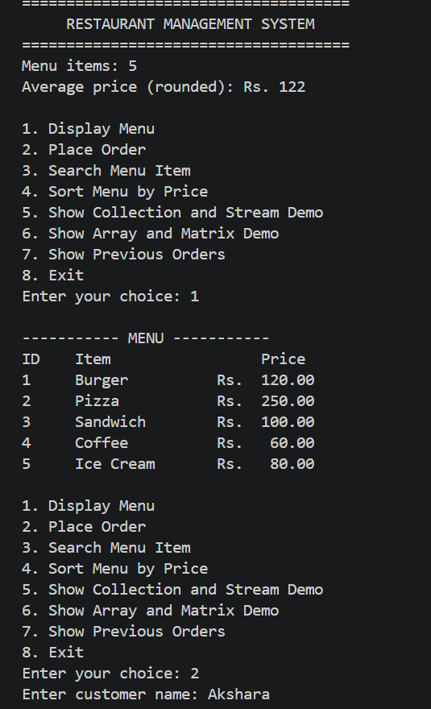
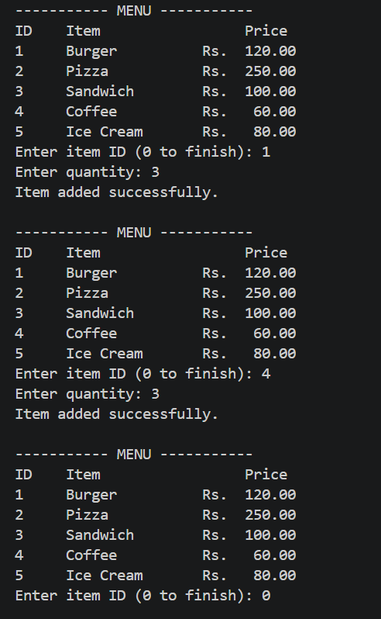
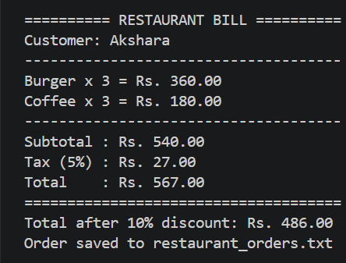
PROJECT EVIDENCE
Output Screenshots
.
11

Slide 12
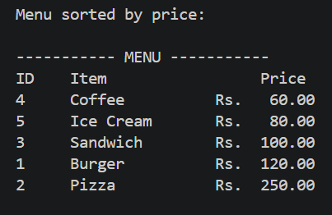
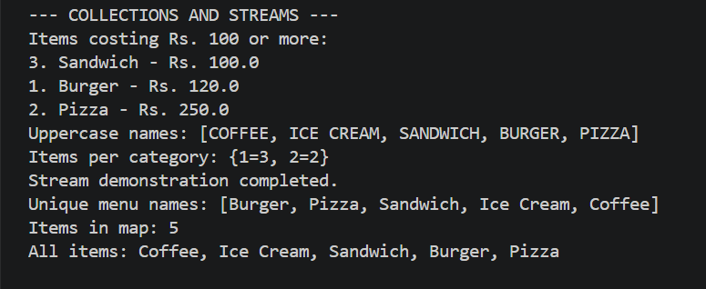

Slide 13
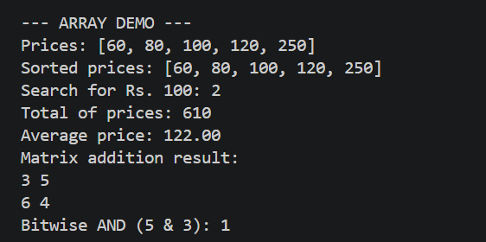
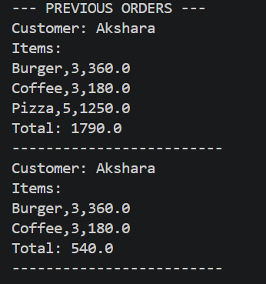


Slide 14
GITHUB LINK

