Slide 1
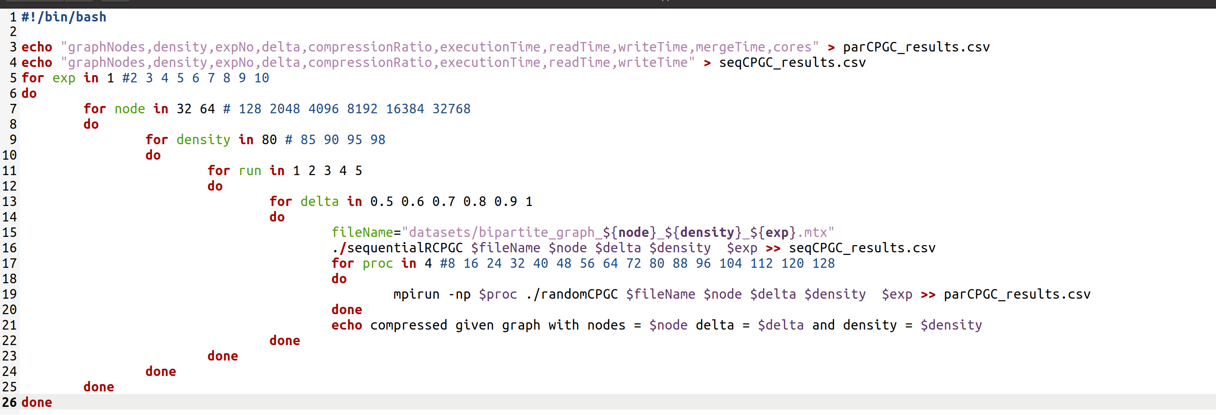
Experiment number
Number of graph vertices/nodes
Density of the input graph
Number of times to run the program with given input graph
Delta value
Number of Processors

Slide 2
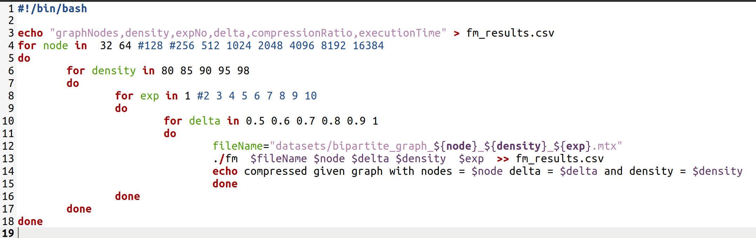
Number of graph vertices/nodes
Density of the input graph
Experiment number
Delta value

