Slide 1
Prolog
Prolog stands for programming in logic

Slide 2
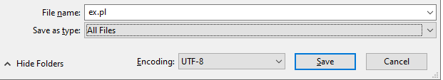
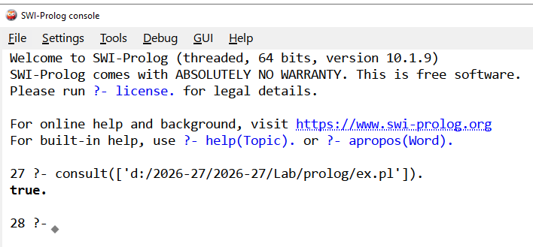
Prolog – Get Started
Install swi-prolog
Write the prolog clauses on a notepad and save it as file.pl (NB: choose save as type:
Open swi-prolog -> file -> consult (choose the file.pl).
Enter your queries

Slide 3
Ex1
Consult likes.pl
likes(john, pizza).
likes(john, pasta).
likes(mary, sushi).
likes(mary, pizza).
likes(X, Y) :- likes(X, Z), likes(Z, Y). % A simple rule
grandfather(X, Y) :- father(X, Z), parent(Z, Y). % A simple rule
?-listing(likes) % to view contents
?-write('\33\[2J'). % To clear a screen
?- likes(mary, X). % to query NB: X is in capital only??
For next enter n
To abort : ctrl C and then enter “a”
?-likes(Y, pizza).
?- family_tree1:listing.

Slide 4
likes(john, mary).
likes(mary, jay).

Slide 5
Ex1
Consult likes.pl
likes(john, pizza).
likes(john, pasta).
likes(mary, sushi).
likes(mary, pizza).
likes(X, Y) :- likes(X, Z), likes(Z, Y). % A simple rule
?- source_file(‘likes.pl'). % is it loaded
listing(likes) % to view contents
?-write('\33\[2J'). % To clear a screen
?- likes(mary, X). % to query
To abort : enter “a”

Slide 6
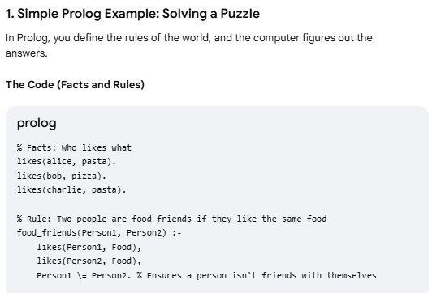
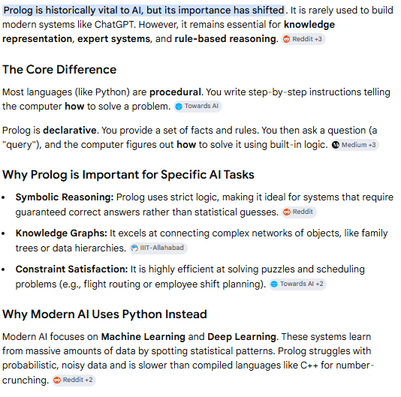
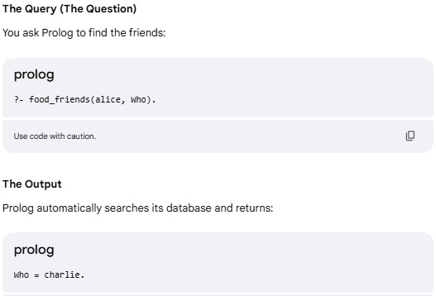
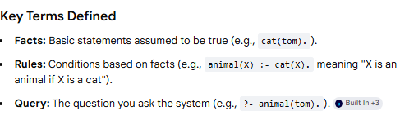

Slide 7
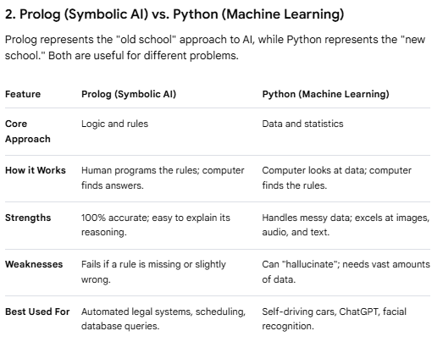

Slide 8
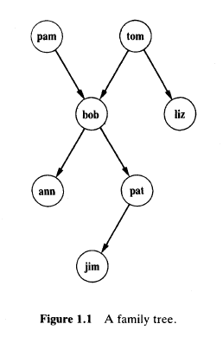
Ex2
The whole family tree of Figure1 .1 i s defined by the following Prolog program:
parent( pam, bob).
parent( tom, bob).
parent( tom, liz).
parent( bob, ann).
parent( bob, pat).
parent( pat, jim).
This program consists of six clauses. Each of these clauses declare one fact
about the parent relation
Store file as family.pl
Consult and display ?listing(family)
?- parent( bob, pat).
?- parent( X, liz).

Slide 9
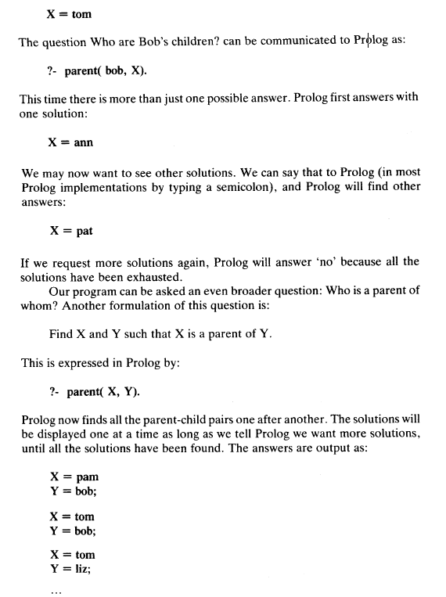
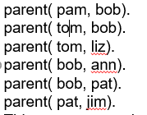
?- parent( X, liz).

Slide 10
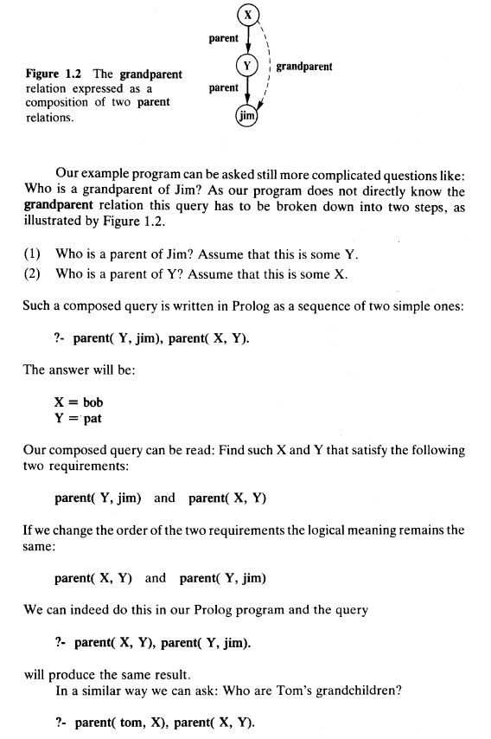
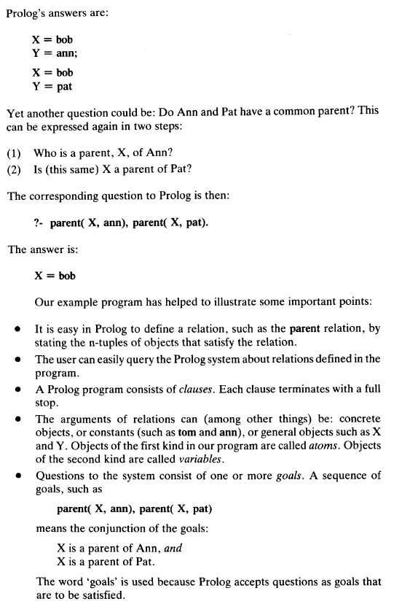

Slide 11
Misc
To clear a screen
?-write('\33\[2J').

