Slide 1
Cyber crime and cyber security

Slide 2
Agenda
Field of digital forensics
Prepare computer investigation and summarize PS and Private Sector investigations
Importance of professional conduct
How to prepare a digital investigation—systematic approach
Procedures for private sector digital investigations
Requirements for data recovery workstations and softwares
Handson

Slide 3
Digital forensics
“[t]he application of computer science and investigative procedures for a legal purpose involving the analysis of digital evidence (information of probative value that is stored or transmitted in binary form) after proper search authority, chain of custody, validation with mathematics (hash function), use of validated tools, repeatability, reporting and possible expert presentation”
: Defining Digital Forensics,” Forensic Magazine, 2007

Slide 4
search warrants
the Pennsylvania Supreme Court addressed expectations of privacy and whether evidence is admissible (Copenhefer, p. 559)
“[E]ven though his computer was validly seized pursuant to a warrant, his attempted deletion of the documents in question created an expectation of privacy protected by the Fourth Amendment.
Agent Johnson’s retrieval of the documents, without first obtaining another search warrant, was unreasonable under the Fourth Amendment and the documents thus seized should have been suppressed”

Slide 5
“A defendant’s attempt to secrete evidence of a crime is not synonymous with a legally cognizable expectation of privacy. A mere hope for secrecy is not a legally protected expectation. If it were, search warrants would be required in a vast number of cases where warrants are clearly not necessary” (Copenhefer, p. 562).

Slide 6
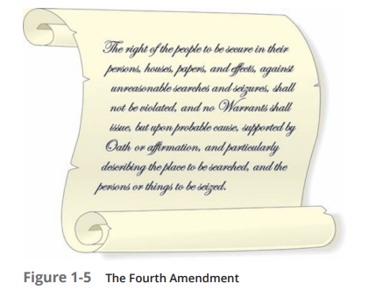
The Fourth Amendment to the U.S. Constitution (and each state’s constitution) protects everyone’s right to be secure in their person, residence, and property from search and seizure.
Find out the equivalent in Indian Constitution.

Slide 7
Digital forensics is also different from data recovery,

Slide 8
In data recovery, typically you know what you’re looking for
Digital forensics is the task of recovering data that users have hidden or deleted, with the goal of ensuring that the recovered data is valid so that it can be used as evidence

Slide 9
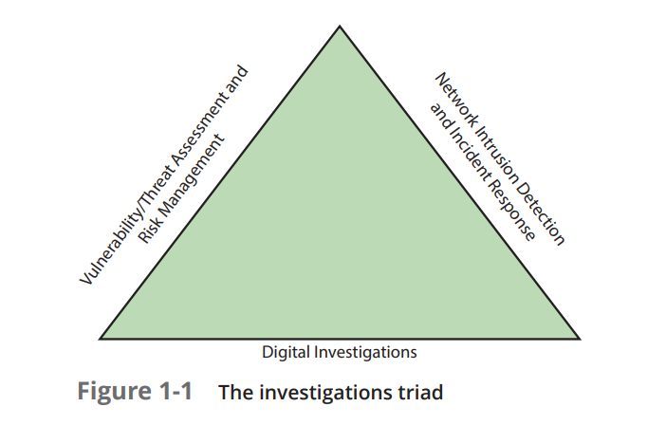

Slide 10
vulnerability/threat assessment and risk management group, you test and verify the integrity of stand-alone workstations and network servers.
network intrusion detection and incident response detects intruder attacks by using automated tools and monitoring network firewall logs
digital investigations group manages investigations and conducts forensics analysis of systems suspected of containing evidence related to an incident or a crime

Slide 11
Crimes
one-half cent crime.

Slide 12
Data retreival
Norton DiskEdit, Xtree Gold

Slide 13
Understanding Case Law
law enforcement can certainly confiscate anything an arrested person is carrying and log that a device, such as a smartphone, was on the person, they don’t necessarily have the right or authority to search the device. These actions are being challenged in courts constantly

Slide 14
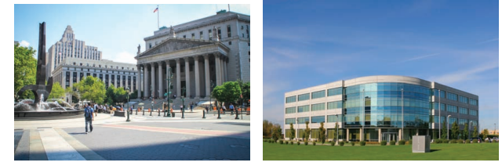
Developing Digital Forensics Resources
Preparing for Digital Investigations

Slide 15
Following Legal Processes
A Digital Evidence First Responder (DEFR) has the skill and training to arrive on an incident scene, assess the situation, and take precautions to acquire and preserve evidence.
A Digital Evidence Specialist (DES) has the skill to analyze the data and determine when another specialist should be called in to assist with the analysis.
submit an affidavit (also called a “declaration”)
which must include exhibits (evidence)

Slide 16
Understanding Private-Sector Investigations
white-collar crimes
industrial espionage, which involves selling sensitive or confidential company information to a competitor.
Establishing Company Policies
a line of authority for conducting internal investigations
Designating an Authorized Requester

Slide 17
Conducting Security Investigations
Three types of situations are common in private-sector environments:
• Abuse or misuse of digital assets
• E-mail abuse
• Internet abuse

Slide 18
Taking a Systematic Approach
Make an initial assessment about the type of case you’re investigating—
Determine a preliminary design or approach to the case
Create a detailed checklist
Determine the resources you need
Obtain and copy an evidence drive
Identify the risks
Mitigate or minimize the risks
Test the design
Analyze and recover the digital evidence
Investigate the data you recover
Complete the case report
Critique the case

Slide 19
Planning Your Investigation
Acquire the USB drive from the IT Department, which bagged and tagged the evidence.
Complete an evidence form and establish a chain of custody.
Transport the evidence to your digital forensics lab.
Place the evidence in an approved secure container.
Prepare your forensic workstation.
Retrieve the evidence from the secure container.
Make a forensic copy of the evidence drive (in this case, the USB drive).
Return the evidence drive to the secure container.
Process the copied evidence drive with your digital forensics tools.

Slide 20
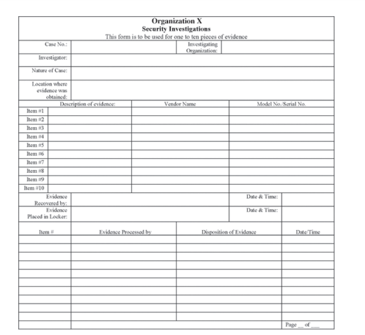
A sample multi-evidence form used in a private-sector environment

Slide 21
Internet Abuse Investigations
u need the following:
• The organization’s Internet proxy server logs
• Suspect computer’s IP address obtained from your organization’s network
administrator
• Suspect computer’s disk drive
• Your preferred digital forensics analysis tool

Slide 22
The following steps outline the recommended processing of an Internet abuse
case:
1. Use the standard forensic analysis techniques and procedures described in this book
for the disk drive examination.
2. Search for and extract all Web page URLs and other associated information.
Contact the network firewall administrator and request a proxy server log
Compare the data recovered from forensics analysis with the network server log data to confirm that they match.
URL data matches the network server log and the forensic disk

Slide 23
E-mail Abuse Investigations (you need)
An electronic copy of the offending e-mail that contains message header data;
consult with your e-mail server administrator
• If available, e-mail server log records; consult with your e-mail server administrator to see whether they are available
• For e-mail systems that store users’ messages on a central server, access to the server; consult with your e-mail server administrator
For e-mail systems that store users’ messages on a computer as an Outlook
.pst or .ost file, for example, access to the computer so that you can perform a forensic analysis on it
• Your preferred digital forensics analysis tool

Slide 24
Setting Up Your Workstation for Digital Forensics
A workstation running Windows 7 or later
• A write-blocker device
• Digital forensics acquisition tool
• Digital forensics analysis tool
• A target drive to receive the source or suspect disk data
• Spare PATA and SATA ports
• USB ports

Slide 25
Additional tools
Network interface card (NIC)
• Extra USB ports
• FireWire 400/800 ports
• SCSI card
• Disk editor tool
• Text editor tool
• Graphics viewer program
• Other specialized viewing tools

Slide 26
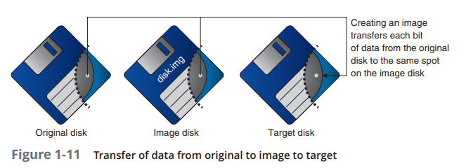
Understanding Bit-stream Copies

Slide 27
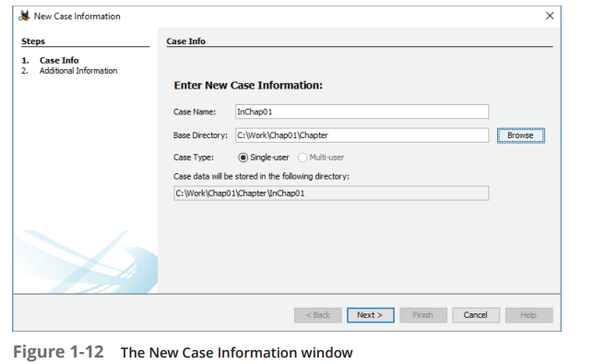
Analyzing Your Digital Evidence
https://sourceforge.net/projects/autopsy/files/autopsy/4.3.0/
Double-click the Ch01InChap01.exe file in File Explorer to uncompress it into Ch01InChap01.dd. Start Autopsy for Windows.
Create a new case

Slide 28
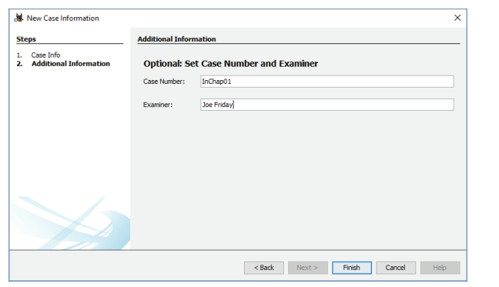

Slide 29
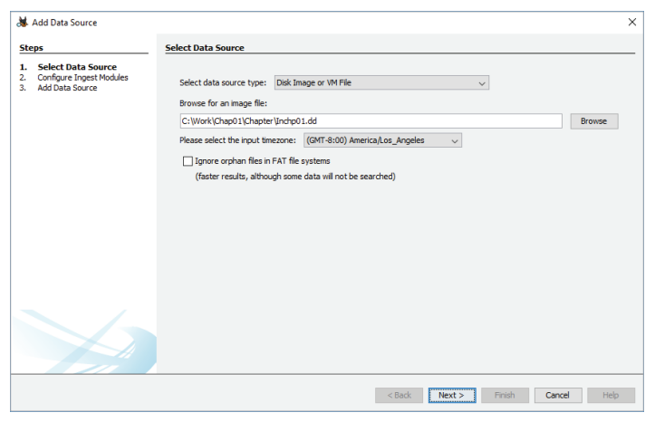

Slide 30
steps to display the contents
In the Tree Viewer pane on the left, click to expand Views, File Types, By Extension,and Documents
2. Under Documents, click Office. In the Result Viewer (upper-right pane), click thefirst file, Billing Letter.doc, to display its contents in the Content Viewer (lower-right pane).
3. Right-click Billing Letter.doc, point to Tag File, and click Tag and Comment.
4. In the Create Tag dialog box, click the New Tag Name button. In the New Tag section, type Recovered Office Documents in the Tag Name text box, click OK, and then click OK again.

Slide 31
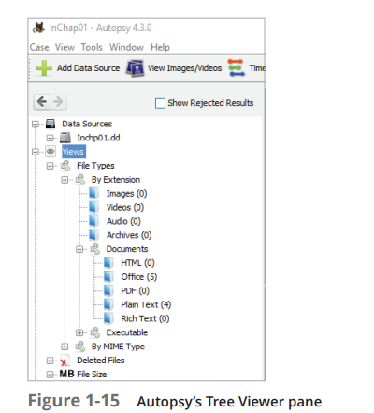
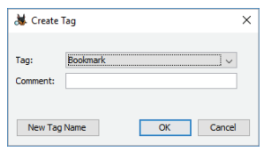
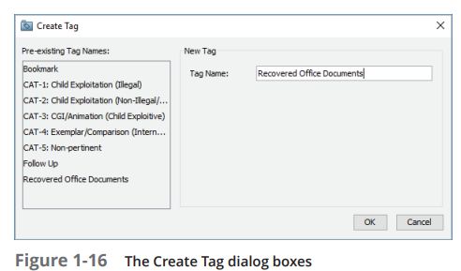

Slide 32
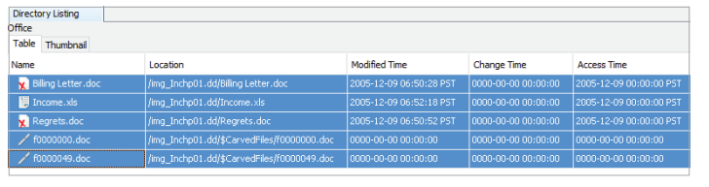
In the Result Viewer pane, Ctrl+click Billing Letter.doc, Income.xls, Regrets.doc, f0000000.doc, and f0000049.doc to select these files, and then release the Ctrl key. Right-click the highlighted files shown in Figure 1-17, point to Tag File and then Quick Tag, and then click Recovered Office Documents.

Slide 33
Under Documents in the Tree Viewer pane, click Plain Text to display more recovered files.
7. In the Result Viewer pane, select the files listed in Step 5 again, right-click the selection, point to Tag File and then Quick Tag, and then click Follow Up. Leave Autopsy running for the next activity

Slide 34
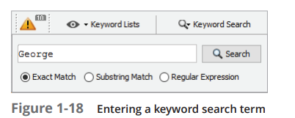
After gathering evidence
Click the Keyword Search button at the far upper right, type George in the text box

Slide 35
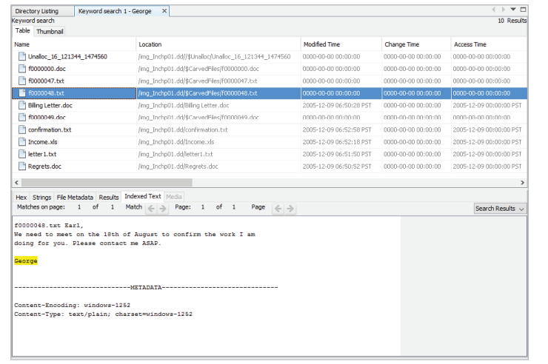
In the Result Viewer pane, a new tab named Keyword search 1 opens. Click each file to view its contents in the Content Viewer (see Figure 1-19). Look for files containing the name “George.”

Slide 36
Closing the case
Click the Keyword Lists button at the far upper right, click the Email Addresses check box, and then click Search.
In the Result Viewer pane, a new tab named Keyword search 2 opens. Click each file to view its contents in the Content Viewer pane and examine all e-mail addresses found in the search.

