Slide 1
Guide to Computer Forensics and Investigations Sixth Edition Chapter 15
Expert Testimony in Digital Investigations
Notes:
Guide to Computer Forensics and Investigations Sixth Edition
Chapter 15
Expert Testimony in Digital Investigations

Slide 2
Objectives
Explain guidelines for giving testimony as a fact witness or an expert witness
Describe guidelines for testifying in court
Explain guidelines for testifying in depositions and hearings
Describe procedures for preparing forensics evidence for testimony

Slide 3
Preparing for Testimony (1 of 4)
Fact witness
Provides facts found in investigation
Explain what evidence is and how it was obtained
Does not offer conclusions, only facts
Expert witness
Has opinions based on observations
Opinions are formed from experience and deductive reasoning
Opinions make the witness an expert

Slide 4
Preparing for Testimony (2 of 4)
For either types of testimony:
Establish communication early with attorney
Learn about the victim, the complainant, opposing experts or fact witnesses, and the opposing attorney
Learn the basic points of dispute
Keep notes in rough draft form and record only facts
Keep opinions to a minimum

Slide 5
Preparing for Testimony (3 of 4)
Confirm your findings with documentation
Corroborate them with other peers
Digital forensics is only now developing a peer review process
Check opposing experts to find strengths and weaknesses
Internet
Curriculum vitae
Deposition banks

Slide 6
Preparing for Testimony (4 of 4)
When preparing your testimony consider the following questions:
What is the client’s overall theory of the case?
What is my story of the case?
What can I say with confidence?
How does my opinion fit into the theory of the case?
What is the scope of the case? Have I gone too far?
Have I identified the client’s needs for how my testimony fits into the overall theory of the case?

Slide 7
Documenting and Preparing Evidence (1 of 3)
Document your steps
To prove them repeatable
Validate your tools and verify evidence with hash algorithms to ensure integrity
Do not use a formal checklist
Do not include checklist in final report
Opposing attorneys can challenge them
Collect evidence and document employed tools
Maintain chain of custody

Slide 8
Documenting and Preparing Evidence (2 of 3)
Collect the right amount of information
Collect only what was asked for
Note the date and time of your forensic workstation when starting your analysis
Keep only successful output
Do not keep previous runs
Search for keywords using well-defined parameters

Slide 9
Documenting and Preparing Evidence (3 of 3)
Keep your notes simple
List only relevant evidence on your report
Define any procedures you use to conduct your analysis as scientific
And conforming to your profession’s standards
List any textbooks, technical books, articles by recognized experts, and procedures from authoritative organizations that you relied on or referenced during examination

Slide 10
Reviewing Your Role as a Consulting Expert or an Expert Witness
Do not record conversations or telephone calls
Federal information requirements
Other cases in which you have testified as an expert witness in the last four years
Ten years of any published writings
Previous compensations for testifying
Evaluate the court’s expert
Brief your attorney on your findings and opinion of the court’s expert

Slide 11
Creating and Maintaining Your CV
Curriculum vitae (CV)
Lists your education, training, and professional experience
Used to qualify your testimony
Show you continuously enhance your skills
List any training, teaching, and experience
Detail specific accomplishments
List basic and advanced skills
Include a testimony log

Slide 12
Preparing Technical Definitions (1 of 2)
Prepare definitions of technical concepts
Use your own words and language
Examples of definitions to prepare ahead of time:
Digital forensics or computer forensics
Hashing algorithms
Image files and bit-stream copies
File slack and unallocated space
File timestamps
Computer log files

Slide 13
Preparing Technical Definitions (2 of 2)
Examples of definitions to prepare ahead of time (cont’d)
Folder or directory
Hardware
Software
Operating system

Slide 14
Preparing to Deal with the News Media
Some legal actions generate interest from the news media
Reasons to avoid contact with news media
Your comments could harm the case and create a record that can be used against you
You have no control over the context of the information a journalist publishes
You can’t rely on a journalist’s promises of confidentiality

Slide 15
Testifying in Court
Procedures during a trial
Your attorney presents you as a competent expert
Opposing attorney might attempt to discredit you
Your attorney guides you through your testimony
Opposing attorney cross-examines you
Your attorney might have an opportunity for redirect examination of material addressed in cross-examination
You could be called later as a rebuttal witness

Slide 16
Understanding the Trial Process
Typical order of trial
Motion in limine
Impaneling the jury
Opening statements
Plaintiff
Defense
Rebuttal
Closing arguments
Jury instructions

Slide 17
Providing Qualifications for Your Testimony
Demonstrates you are an expert witness
This qualification is called voir dire
Attorney asks the court to accept you as an expert on digital forensics
Opposing attorney might try to disqualify you
Depends on your CV and experience

Slide 18
General Guidelines on Testifying (1 of 9)
Be professional and polite
Be conscious of the jury, judge, and attorneys
If asked something you cannot answer, say:
That is beyond the scope of my expertise
I was not asked to investigate that
Avoid overstating opinions
Guidelines on delivery and presentation:
Always acknowledge the jury and direct your testimony to them

Slide 19
General Guidelines on Testifying (2 of 9)
Guidelines on delivery and presentation: (cont’d)
Movement
Turn towards the questioner when asked
Turn back to the jury when answering
Place microphone six to eight inches from you
Use simple, direct language to help the jury understand you
Avoid humor
Build repetition into your explanations

Slide 20
General Guidelines on Testifying (3 of 9)
Guidelines on delivery and presentation: (cont’d)
Use chronological order to describe events
If you’re using technical terms, identify and define these terms for the jury
Cite the source of the evidence the opinion is based on
Make sure the chair’s height is comfortable, and turn the chair so that it faces the jury

Slide 21
General Guidelines on Testifying (4 of 9)
Guidelines on delivery and presentation: (cont’d)
Dress in a manner that conforms to the community’s dress code
Don’t memorize your testimony
For direct examination
State your opinions
Identify evidence to support your opinion
Explain the method used to arrive to that opinion
Restate your opinion

Slide 22
General Guidelines on Testifying (5 of 9)
Prepare your testimony with the attorney who hired you
How is data (or evidence) stored on a hard drive?
What is an image or a bit-stream copy of a drive?
How is deleted data recovered from a drive?
What are Windows temporary files, and how do they relate to data or evidence?
What are system or network log files?

Slide 23
General Guidelines on Testifying (6 of 9)
Using graphics during testimony
Graphical exhibits illustrate and clarify your findings
Your exhibits must be clear and easy to understand
Graphics should be big, bold, and simple
The goal of using graphics is to provide information the jury needs to know
Review all graphics with your attorney before trial
Make sure the jury can see your graphics, and face the jury during your presentation

Slide 24
General Guidelines on Testifying (7 of 9)
Avoiding testimony problems
Recognize when conflict-of-interest issues apply to your case
Conflicting out: an attempt by opposing attorneys to prevent you from serving on an important case
Avoid agreeing to review a case unless you’re under contract with that person
Avoid conversations with opposing attorneys
You should receive payment before testifying

Slide 25
General Guidelines on Testifying (8 of 9)
Avoiding testimony problems (cont’d)
Don’t talk to anyone during court recess
If a juror approaches you, decline to talk with him or her and promptly report the contact to the attorney who retained you
Make sure you conduct any conferences with your attorney in a private setting

Slide 26
General Guidelines on Testifying (9 of 9)
Understanding prosecutorial misconduct
If you have found exculpatory evidence, you have an obligation to ensure that the evidence isn’t concealed
Initially, you should report the evidence to the prosecutor handling the case
Be sure you document the communication
If this information isn’t disclosed to the defense attorney in a reasonable time
You can report it to the prosecutor’s supervisor or the judge

Slide 27
Testifying During Direct Examination (1 of 2)
Techniques
Work with your attorney to get the right language
Be wary of your inclination to be helpful
Review the examination plan your attorney has prepared
Provide a clear overview of your findings
Use a systematic easy-to-follow plan for describing your methods
Practice testifying
Use your own words when answering questions

Slide 28
Testifying During Direct Examination (2 of 2)
Techniques (cont’d)
Make sure you know the following terms before giving testimony:
Independent recollection
Customary practice
Documentation of the case
Present your background and qualifications
Avoid vagueness
When you’re using graphics in a presentation, make sure the jury understands your explanations

Slide 29
Testifying During Cross-Examination (1 of 4)
Recommendations and practices
Use your own words
Keep in mind that certain words have additional meanings
Be aware of leading questions
Never guess when you do not have an answer

Slide 30
Testifying During Cross-Examination (2 of 4)
Recommendations and practices (cont’d)
Be prepared for challenging, pre-constructed questions
Did you use more than one tool?
Rapid-fire questions
Sometimes opposing attorneys declare that you aren’t answering the questions
Keep eye contact with the jury
Sometimes opposing attorneys ask several questions inside one question

Slide 31
Testifying During Cross-Examination (3 of 4)
Recommendations and practices (cont’d)
Attorneys make speeches and phrase them as questions
Attorneys might put words in your mouth
Be patient
Most jurisdictions now allow the judge and jurors to ask questions
Avoid feeling stressed and losing control
Never have unrealistically high self-expectations when testifying; everyone makes mistakes

Slide 32
Testifying During Cross-Examination (4 of 4)
Avoid:
Being argumentative when being badgered by the opposing attorney
Having poor listening skills or using defensive body language
Being too talkative or talking too fast
Being too technical for the jury to understand
Acting surprised and unprepared to respond when presented with unknown or new information

Slide 33
Preparing for a Deposition or Hearing
Deposition differs from trial testimony
There is no jury or judge
Opposing attorney previews your testimony at trial
Discovery deposition
Part of the discovery process for a trial
Testimony preservation deposition
Requested by your client
Preserve your testimony in case of schedule conflicts or health problems

Slide 34
Guidelines for Testifying at Depositions (1 of 4)
Some recommendations
Stay calm, relaxed, and confident
Maintain a professional demeanor
Use name of attorneys when answering
Keep eye contact with attorneys
Be assertive in your responses
Be professional and polite
Use facts when describing your opinion
Being deposed in a discovery deposition is an unnatural process

Slide 35
Guidelines for Testifying at Depositions (2 of 4)
If you prepared a written report, the opposing attorney might attempt to use it against you
If your attorney objects to a question from the opposing attorney
Pause and think of what direction your attorney might want you to go in your answer
Be prepared at the end of a deposition to spell any specialized or technical words you used

Slide 36
Guidelines for Testifying at Depositions (3 of 4)
Recognizing deposition problems
Discuss any problem before the deposition
Identify any negative aspect
Be prepared to defend yourself
Avoid
Omitting information
Having the attorney box you into a corner
Contradictions
Be professional and polite when giving opinions about opposite experts

Slide 37
Guidelines for Testifying at Depositions (4 of 4)
Recognizing deposition problems (cont’d)
To respond to difficult questions that could jeopardize your client’s case
Pause before answering
Keep in mind that you can correct any minor errors you make during your examination
Discovery deposition testimony often doesn’t make it to the jury
It might be presented to the jury, usually as part of an attempt to discredit the witness

Slide 38
Guidelines for Testifying at Hearings
Testifying at a hearing is generally comparable to testifying at a trial
A hearing can be before an administrative agency or a legislative body or in a court
Often administrative or legislative hearings are related to events that resulted in litigation
A judicial hearing is held in court to determine the admissibility of certain evidence before trial
No jury is present

Slide 39
Preparing Forensics Evidence for Testimony (1 of 3)
Use Autopsy for Windows to extract e-mail in a forensic image
See Figures 15-1 and 15-2

Slide 40
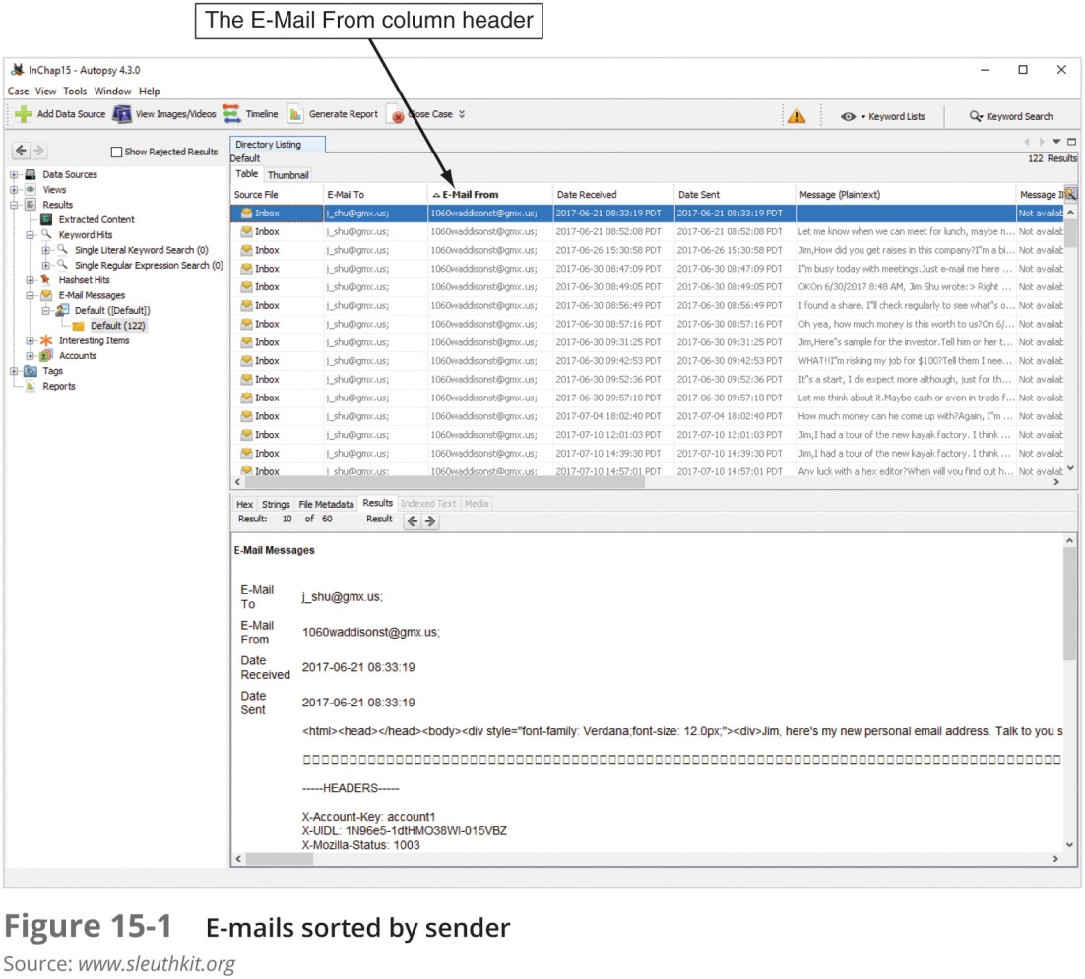
Preparing Forensics Evidence for Testimony (2 of 3)

Slide 41
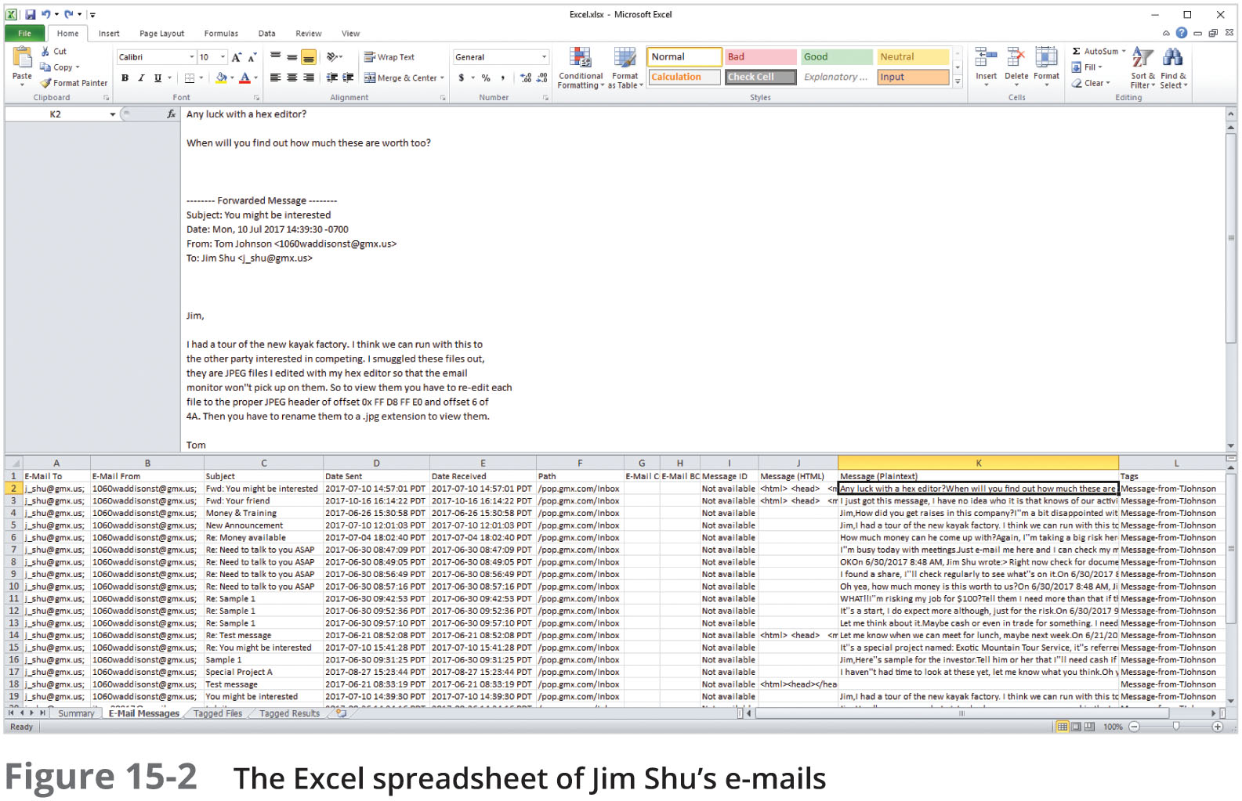
Preparing Forensics Evidence for Testimony (3 of 3)

Slide 42
Preparing a Defense of Your Evidence-Collection Methods
To prepare for testimony
You should prepare answers for questions on what steps you took to extract e-mail metadata and messages
You might also be asked to explain specific features of the computer, OS, and applications (such as Outlook)
And explain how these applications and digital forensics tools work

Slide 43
Summary (1 of 3)
When cases go to trial, you as the forensics expert play one of two roles: a fact witness or an expert witness
If you’re called as a fact or expert witness in a digital forensics case, you need to prepare for your testimony thoroughly
When you’re called to testify in court, your attorney examines you on your qualifications to establish your competency as an expert or a fact witness

Slide 44
Summary (2 of 3)
Make sure you’re prepared for questions opposing counsel might use to discredit you, confuse you, or throw you off the track
Know whether you’re being called as a fact witness or expert witness (or both) and whether you’re being retained as a consulting expert or expert witness
Deposition differs from a trial because there’s no jury or judge

Slide 45
Summary (3 of 3)
Depositions usually fall into two categories: discovery depositions and testimony preservation depositions
Guidelines for testifying at depositions and hearings are much the same as guidelines for courtroom testimony
Make sure you prepare answers for questions on what steps you took to collect and analyze evidence and questions on what tools you used and how they work

