Slide 1
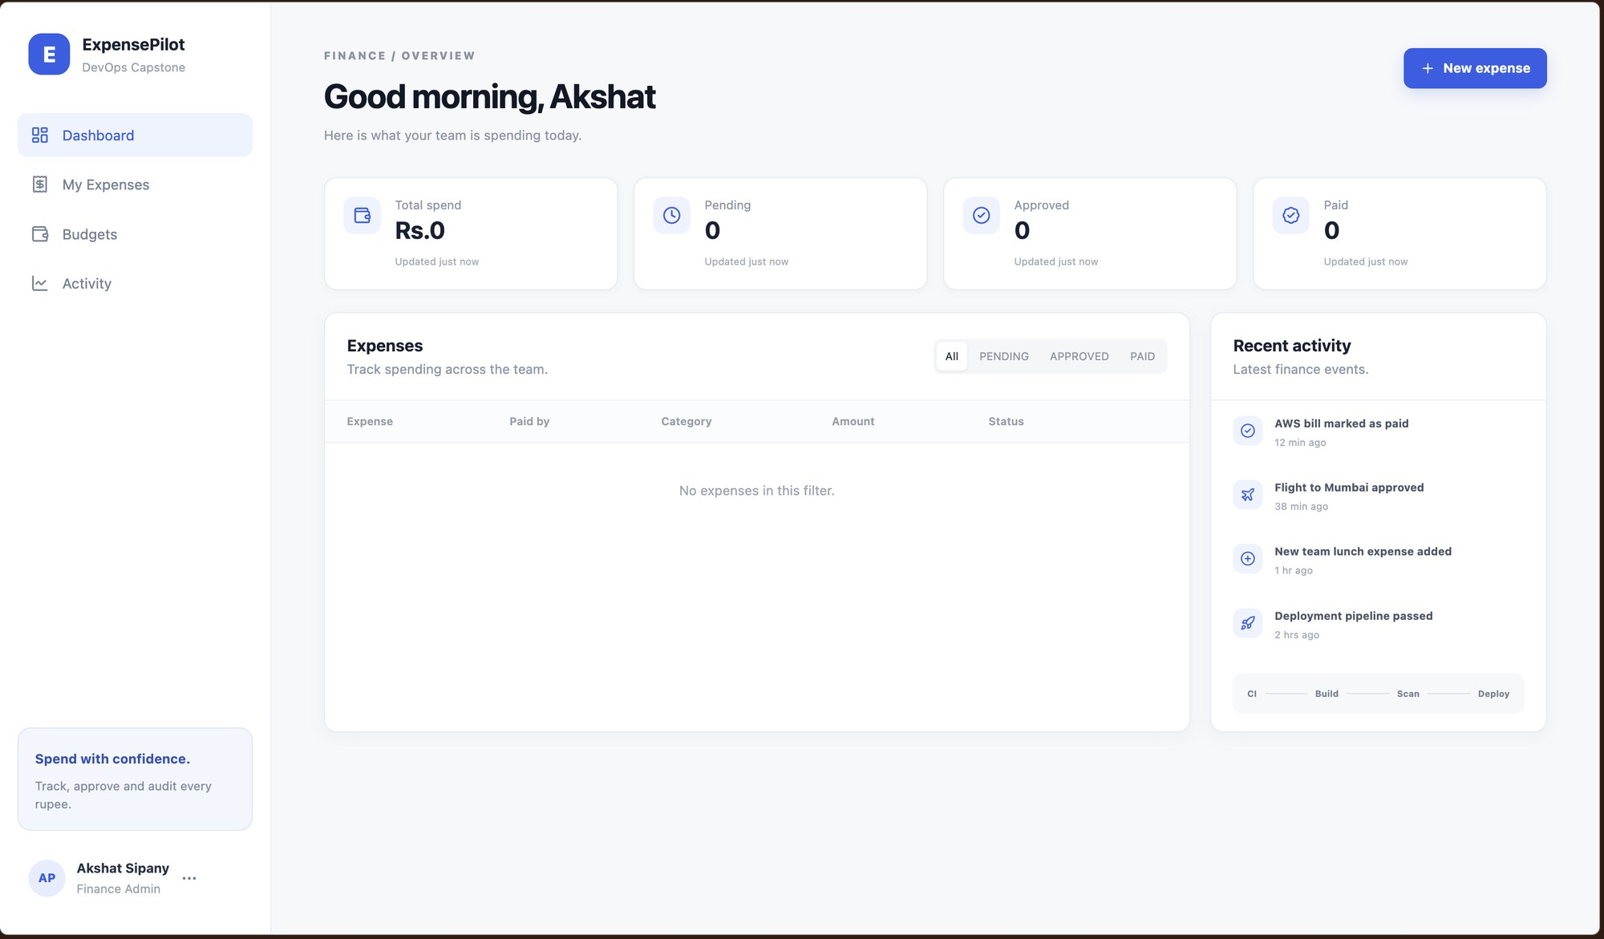
DEVOPS CAPSTONE / FINAL PROJECT
ExpensePilot
A personal expense tracker, taken from a git push all the way to Kubernetes on AWS
Akshat Sipany
github.com/akshat-code21/final-devops-project
fastapi react postgres docker actions trivy terraform eks helm prometheus grafana argocd
Notes:
Hi, I'm Akshat. My project is ExpensePilot, an expense tracker where you log expenses and move them through pending, approved and paid. The app is small on purpose; the point of the project is everything around it: tests, containers, a CI/CD pipeline with security gates, Terraform on AWS, Kubernetes with Helm, and monitoring.

Slide 2
How a commit reaches the cluster
OVERVIEW
git push
branch: main
GitHub Actions
test, scan, build
Trivy gate
HIGH/CRITICAL fails
GHCR
image:<commit sha>
Helm + ArgoCD
upgrade --install
kubernetes / namespace: expensepilot
aws / ap-south-1
/
frontend x2
nginx :8080
Terraform
Ingress
expensepilot.local
VPC 10.20.0.0/16
2 public + 2 private subnets
NAT gateway
EKS 1.31
node group: t3.micro x2
backend x2
fastapi, HPA 2-6
postgres
PVC 5Gi
/api
Prometheus
scrapes /metrics
Grafana
dashboard + alerts
Notes:
This is the whole flow on one slide. A push to main kicks off GitHub Actions: tests, security checks, Docker builds and a Trivy scan. Only if the scan passes do images go to GHCR, tagged with the commit SHA. Helm and ArgoCD then deploy them into the expensepilot namespace. Ingress sends / to the frontend and /api to the backend, the backend talks to Postgres, and Prometheus scrapes the backend for Grafana. On the right is the AWS side that Terraform builds: a VPC and an EKS cluster.

Slide 3

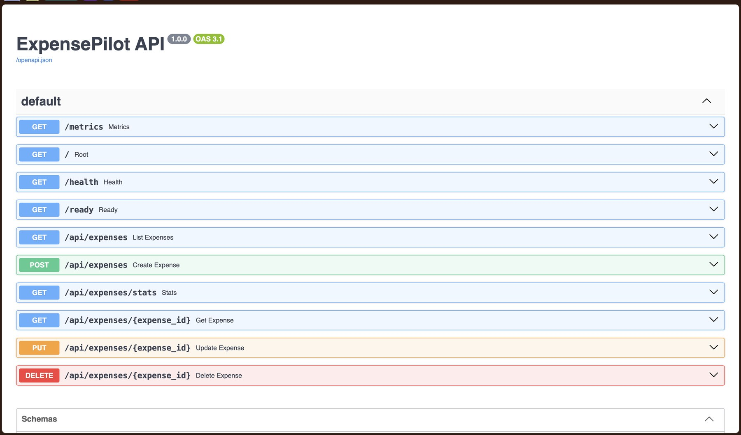


The app: log, approve and pay expenses
M1 · 10 pts
localhost:8000/docs
React 18 + Vite
Dashboard with totals, filters, add / edit / delete
FastAPI on Python 3.12
REST API with OpenAPI docs, /health and /ready probes
PostgreSQL 16 + Alembic
expenses table created by versioned migrations
10
4
2
API routes
CRUD verbs
Alembic migrations
Notes:
The frontend is React with Vite, the backend is FastAPI, and data lives in Postgres with Alembic handling the schema. There are full CRUD routes on /api/expenses plus a stats route that powers the dashboard cards. /health and /ready are used as Kubernetes liveness and readiness probes, and /metrics feeds Prometheus.

Slide 4
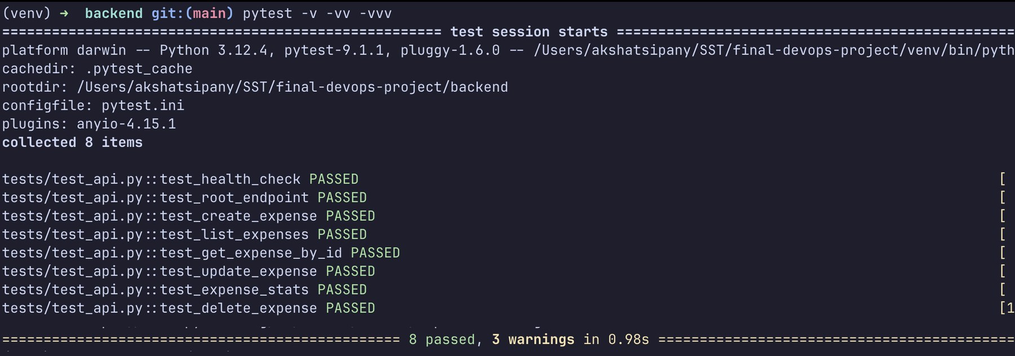
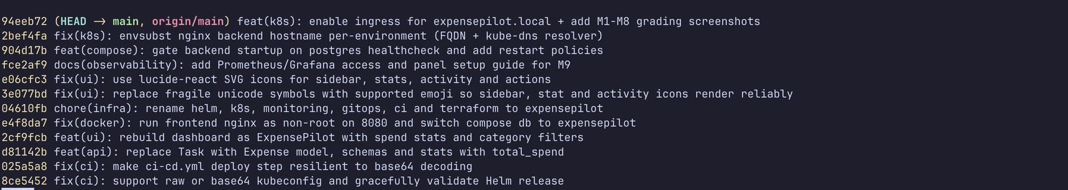
Tests run before anything is built
M2+M3 · 15 pts
8/8
$ pytest -v
pytest cases passing in 0.98s
Covers health, root and all CRUD + stats routes
Uses a throwaway SQLite DB via DATABASE_URL, never the real Postgres
First job in CI, so a red test stops the pipeline
Public repo, 29 commits with feat / fix / chore / docs messages
.gitignore keeps out .env, venv, node_modules, tfstate
$ git log --oneline
Notes:
Eight tests cover the health and root routes and every expense route. The test file points DATABASE_URL at a local SQLite file, so tests never touch the real database. This same command is the first job in the pipeline. For Git, the repo is public and the commit history uses conventional messages like feat and fix, so you can read what changed from the log.

Slide 5
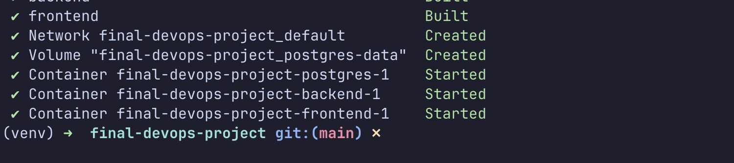
Three containers, one command
M4 · 10 pts
backend/Dockerfile
frontend/Dockerfile
docker-compose.yml
python:3.12-slim
node:22 → nginx:1.27
postgres + api + ui
Runs as non-root UID 10001
OS packages patched at build
alembic upgrade head, then uvicorn
Stage 1 builds the Vite bundle
Stage 2 ships only dist/
Non-root appuser on port 8080
Backend waits for postgres healthcheck
Named volume keeps the data
UI on localhost:3000
$ docker compose up --build
All three services build and start. nginx in the frontend container proxies /api to the backend, so the browser only ever talks to one origin.
Notes:
Backend image is python slim and drops to user 10001 before starting. The frontend is a two stage build: node builds the static files and only the dist folder goes into nginx alpine, running as a non-root user on 8080. Compose brings up postgres, backend and frontend, and the backend waits for the postgres healthcheck so it doesn't crash on startup.

Slide 6
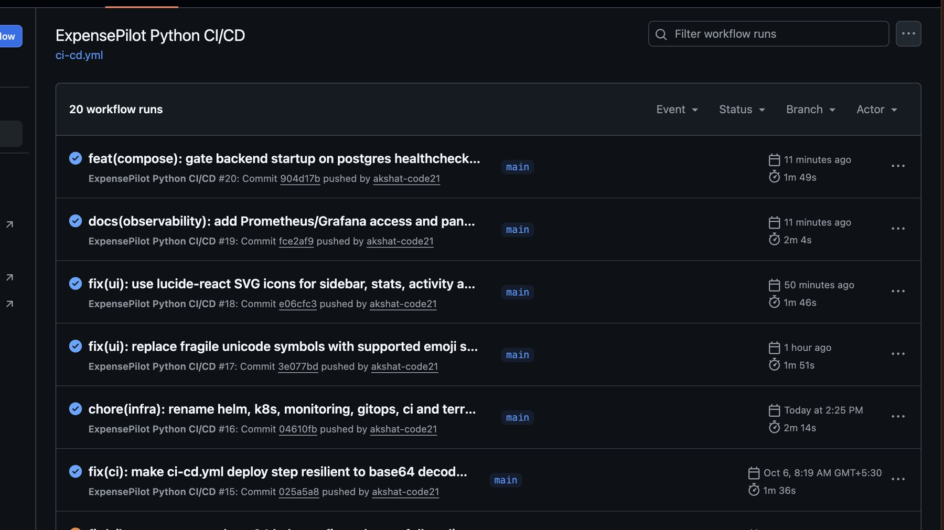
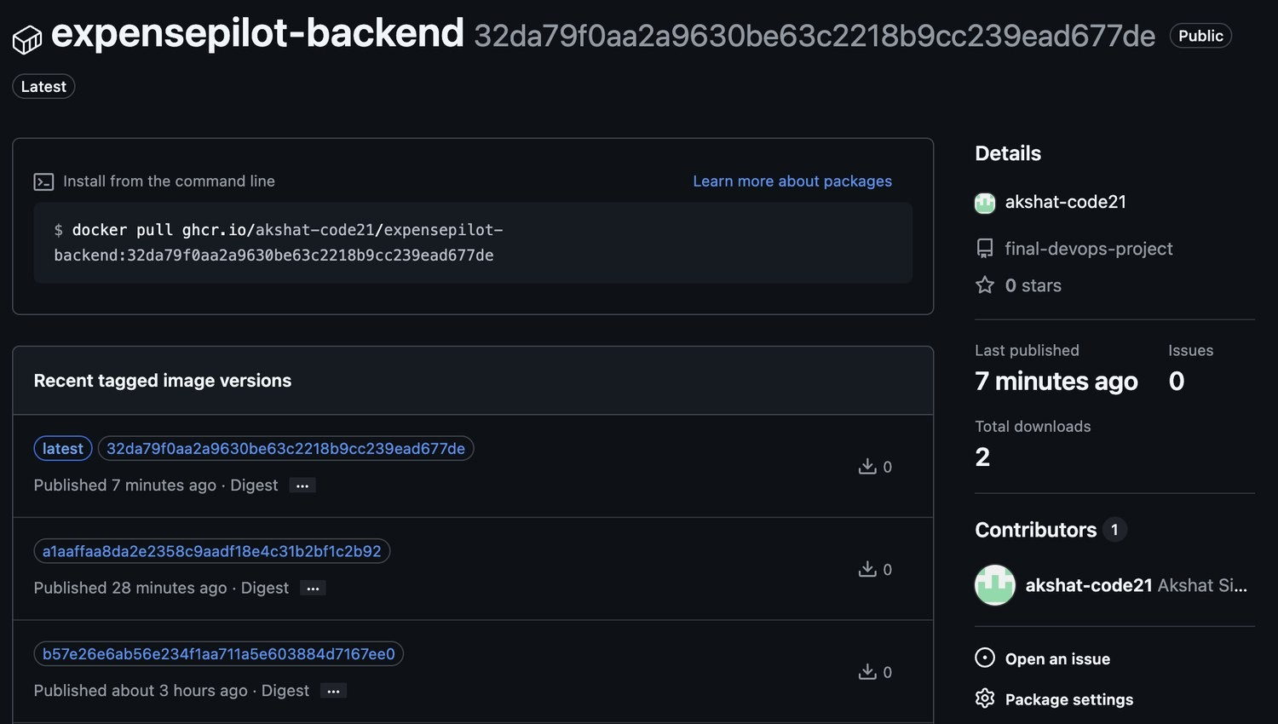
Every push to main runs five chained jobs
M5 · 15 pts
01 Build & test
pytest, npm run build
02 Security checks
gitleaks, bandit, pip-audit
03 Image gate
docker build + trivy
04 Publish
push to GHCR as :sha
05 Deploy
helm upgrade, rollout
Tag = ${{ github.sha }} Deploy sets the Helm image tag to the commit SHA, so every pod traces back to one commit.
github actions: green runs on main
ghcr.io: backend image, one tag per commit
Notes:
The workflow has five jobs linked with needs, so if one fails nothing after it runs. Tests and the frontend build come first, then secret scanning, static analysis and dependency audit, then the image build and Trivy. Only after that do images get pushed to GHCR. The GHCR page shows the backend package with one tag per commit SHA. The deploy step passes that SHA as the Helm image tag, which means I can always tell exactly which commit is running.

Slide 7
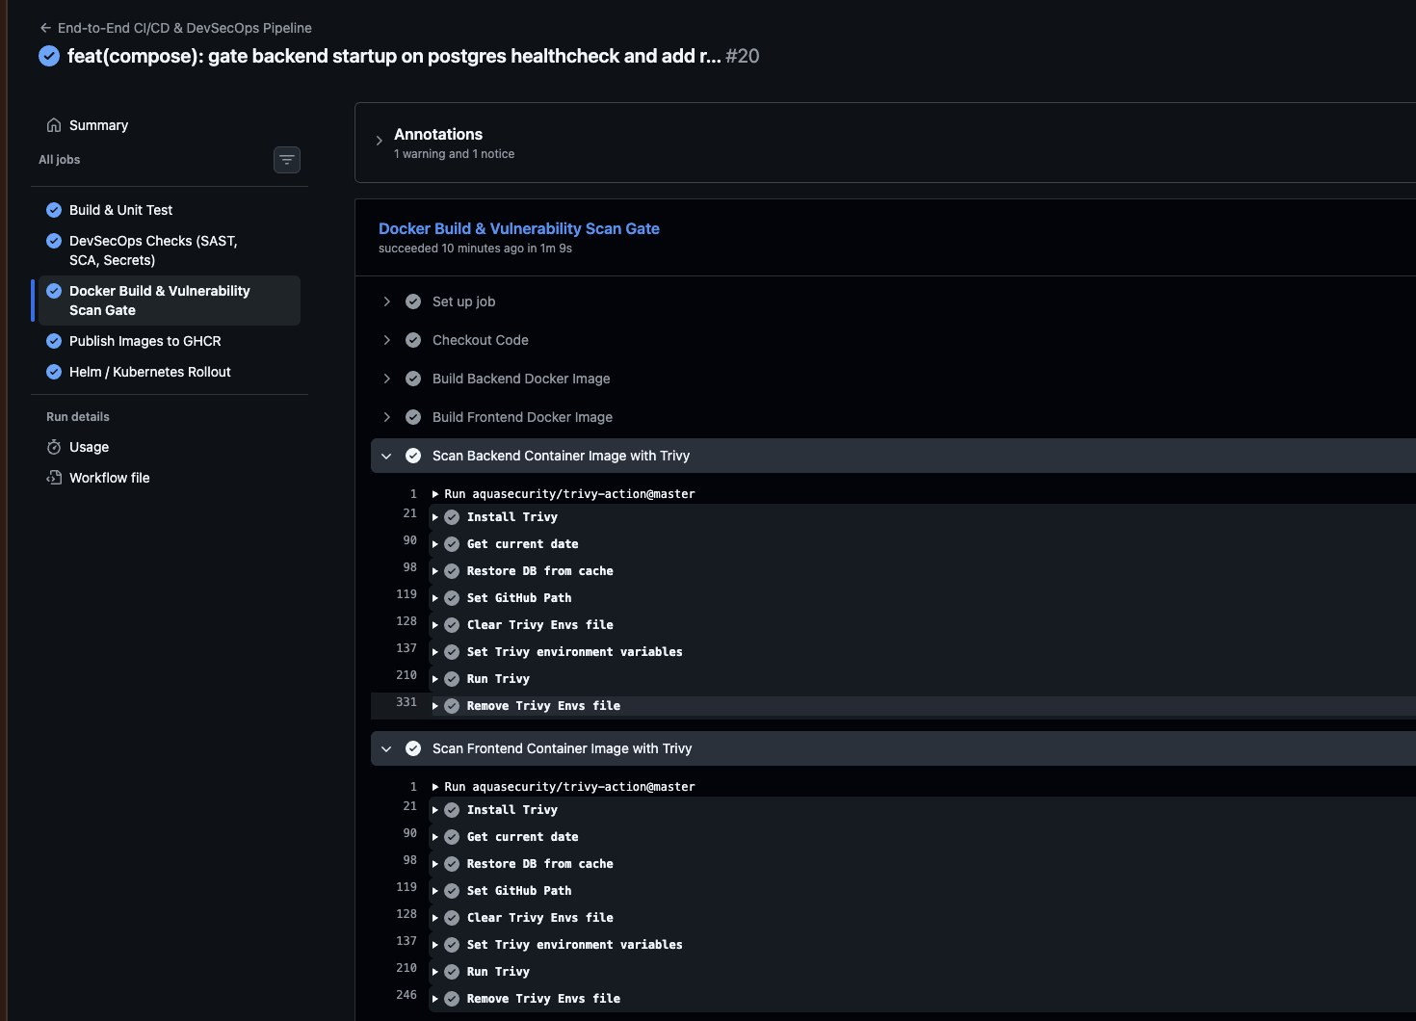
Trivy blocks HIGH and CRITICAL CVEs
M6 · 5 pts
job: Docker Build & Vulnerability Scan Gate
severity: 'CRITICAL,HIGH'
exit-code: '1'
ignore-unfixed: true
vuln-type: 'os,library'
What it caught
The first scan failed on a libpcre2 CVE in the base OS layer of both images. Adding apt-get upgrade and apk upgrade to the Dockerfiles pulled the patched package, and the next scan came back clean.
gitleaks
bandit
pip-audit
npm audit
Also in the pipeline. pip-audit flagged old starlette and pytest pins, both bumped.
Notes:
Trivy scans both the backend and frontend images after they are built. It is set to exit with code 1 on any HIGH or CRITICAL finding that has a fix available, which fails the job and stops the push. On the first run it found a libpcre2 vulnerability in the OS packages of the base images. The fix was to upgrade OS packages during the build. After that both scans passed, which is what the screenshot shows. Ignore-unfixed means we don't block on CVEs nobody can patch yet.

Slide 8
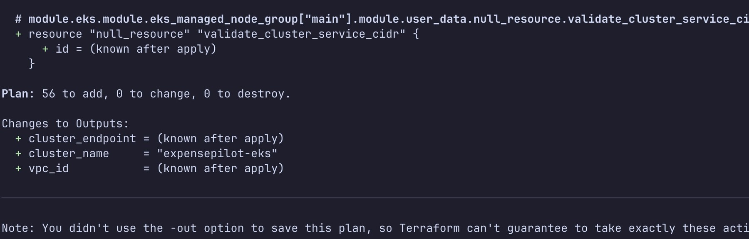
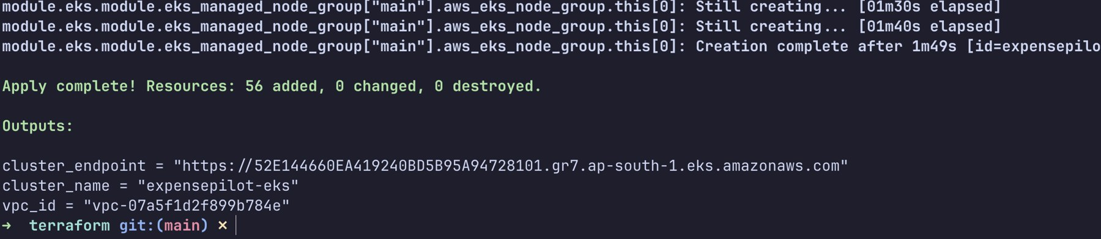
AWS network and EKS, all from Terraform
M7 · 15 pts
$ terraform plan
vpc 10.20.0.0/16 / ap-south-1
ap-south-1a
ap-south-1b
public subnet
10.20.101.0/24 + NAT
public subnet
10.20.102.0/24
private subnet
10.20.1.0/24
private subnet
10.20.2.0/24
$ terraform apply
EKS 1.31 · managed node group
t3.micro, desired 2, max 4
nodes sit in the private subnets
56 resources planned and created
terraform.tfvars.example is committed. Real tfvars and *.tfstate are gitignored, no keys in history.
Notes:
Terraform uses the community VPC and EKS modules. The VPC has two public and two private subnets across two availability zones in Mumbai, with one NAT gateway. EKS 1.31 runs a managed node group of two t3.micro nodes in the private subnets. Plan showed 56 resources to add and apply created all 56, with the cluster endpoint and VPC id as outputs. After evaluation I run terraform destroy so nothing keeps billing.

Slide 9
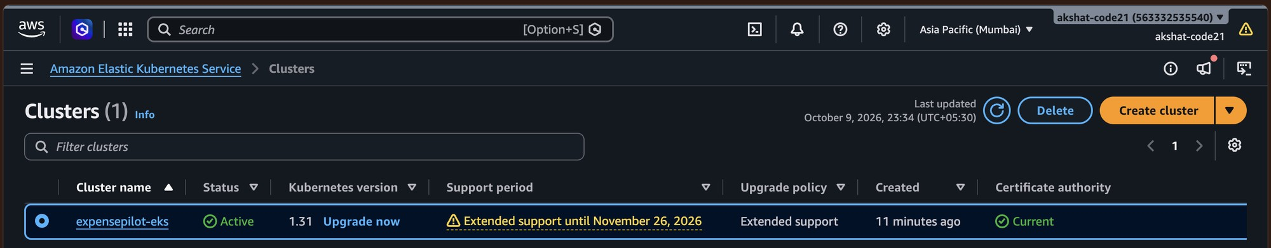
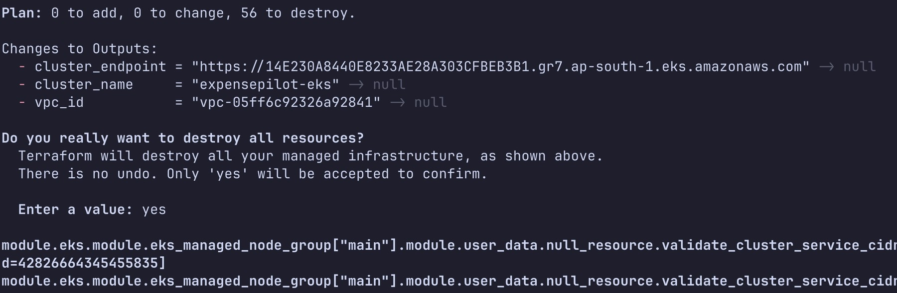
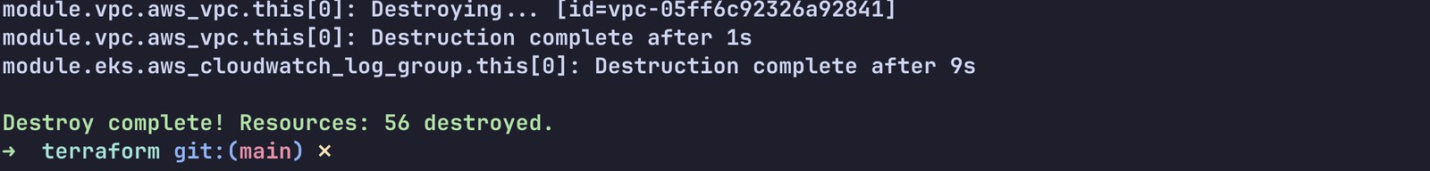
Live on AWS, then torn down
M7 · 15 pts
aws console: EKS clusters, Asia Pacific (Mumbai)
$ terraform destroy
56 planned, 56 destroyed
destroy finished, VPC removed last
Same 56 resources apply created. Nothing left billing.
Notes:
This is the cluster Terraform created, showing Active on Kubernetes 1.31 in the Mumbai region in the AWS console. Once I had the evidence I ran terraform destroy. It planned 56 resources to destroy, the same 56 that apply created, including the VPC and the EKS cluster, and after confirming with yes it finished with Destroy complete, 56 destroyed. The VPC is the last thing removed. There are no running costs left on the account.

Slide 10
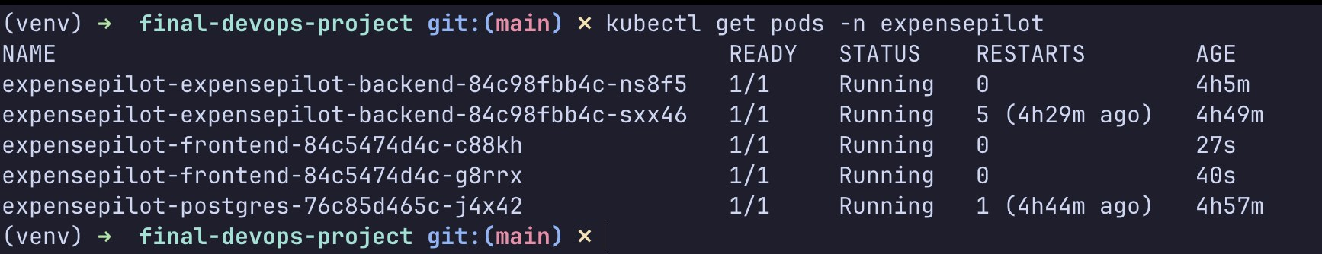
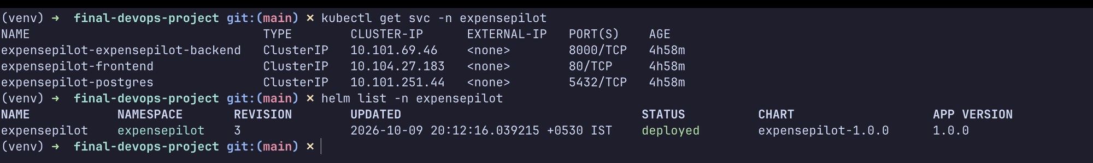
Running on Kubernetes, packaged with Helm
M8 · 15 pts
frontend svc :80
ClusterIP, 2 pods
helm/expensepilot/
├─ Chart.yaml
├─ values.yaml, values-dev.yaml, values-prod.yaml
└─ templates/
backend, frontend, postgres, ingress,
hpa, servicemonitor
$ helm upgrade --install expensepilot \
./helm/expensepilot -n expensepilot
/
Ingress
expensepilot.local
backend svc :8000
ClusterIP, 2 pods, HPA
/api
postgres svc :5432
ClusterIP, PVC 5Gi
$ kubectl get pods -n expensepilot
$ kubectl get svc && helm list
Demo cluster is minikube with ingress-nginx; the same chart installs on EKS.
Notes:
Kubernetes objects are in the Helm chart, with a namespace manifest in k8s. Ingress routes slash to the frontend service and /api to the backend service, both ClusterIP with two replicas each. The backend also has an HPA from 2 to 6 pods at 60 percent CPU. Postgres keeps its data on a 5 gigabyte PVC. All five pods are Running and helm list shows the release as deployed at revision 3.

Slide 11
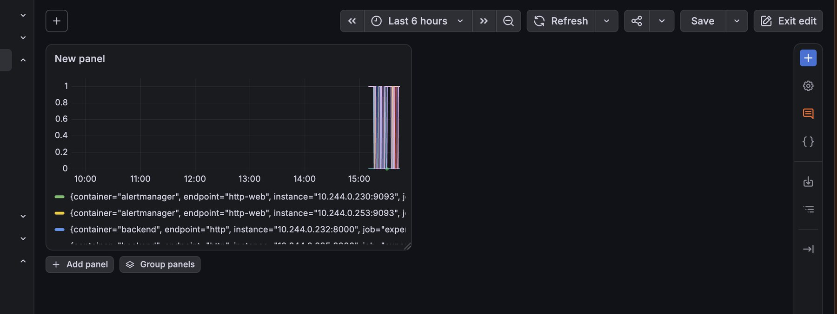
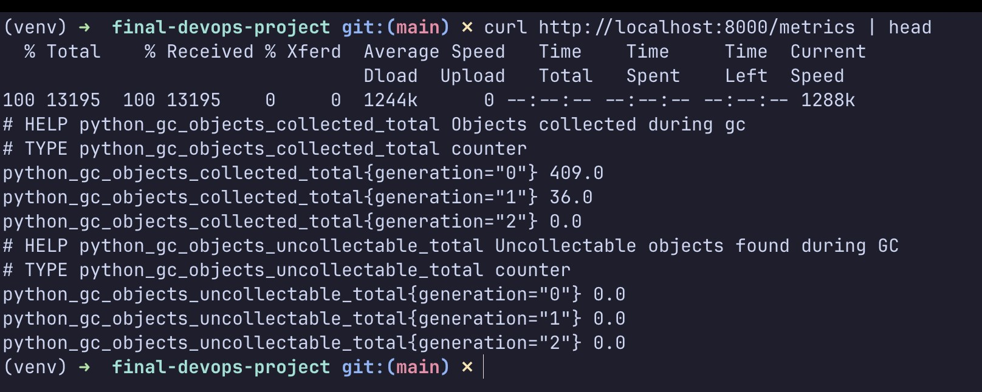
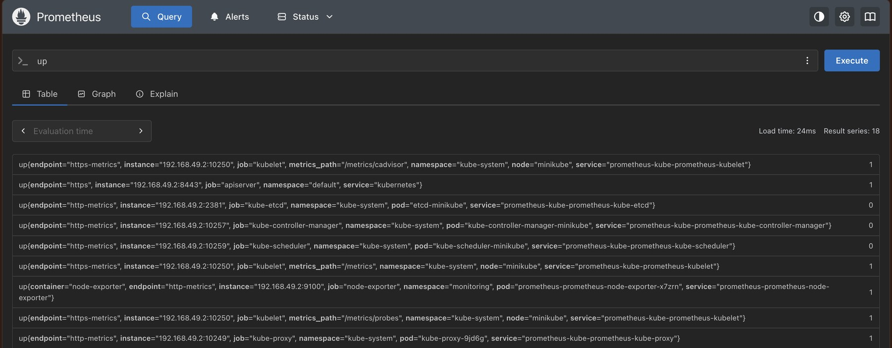
From /metrics to a live Grafana panel
M9 · 10 pts
grafana: live panel on backend metrics
$ curl localhost:8000/metrics | head
prometheus: up{} by target
/metrics
prometheus-fastapi-instrumentator records request count and latency per route
ServiceMonitor
kube-prometheus-stack scrapes the backend every 15s, target is UP
Alert rules
Backend down for 1 min, or 5xx above 5% of traffic
Notes:
The backend uses prometheus-fastapi-instrumentator, which exposes request counts and latency histograms on /metrics. kube-prometheus-stack is installed in the monitoring namespace and a ServiceMonitor tells it to scrape the backend every 15 seconds. In Prometheus the backend target reports up equals 1, and the Grafana panel is reading that live. There are also two alert rules: backend down and high 5xx rate.

Slide 12
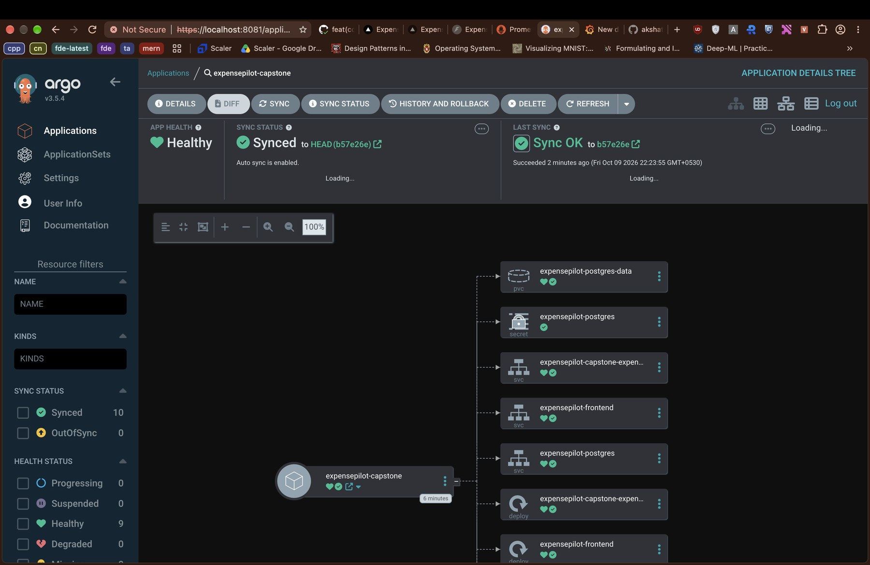
Extra: GitOps and a troubleshooting lab
BONUS
argocd: expensepilot-capstone, Healthy + Synced
Five failures I broke on purpose, then fixed
01
ImagePullBackOff image tag that does not exist
02
CrashLoopBackOff database host unreachable
03
Service, no endpoints selector label mismatch
04
Pod stuck Pending PVC never bound
05
Ingress 502 service port mismatch
ArgoCD watches helm/expensepilot in the repo and reverts any manual kubectl change.
root cause + fix for each: troubleshooting/SOLUTIONS.md
Notes:
Two things beyond the rubric. ArgoCD is pointed at the Helm chart in the repo; it shows Healthy and Synced, and if someone edits a resource by hand it puts it back. I also built a troubleshooting lab with five broken setups, from a bad image tag to an Ingress 502, each with the kubectl commands I used to find the cause and the fix.

Slide 13
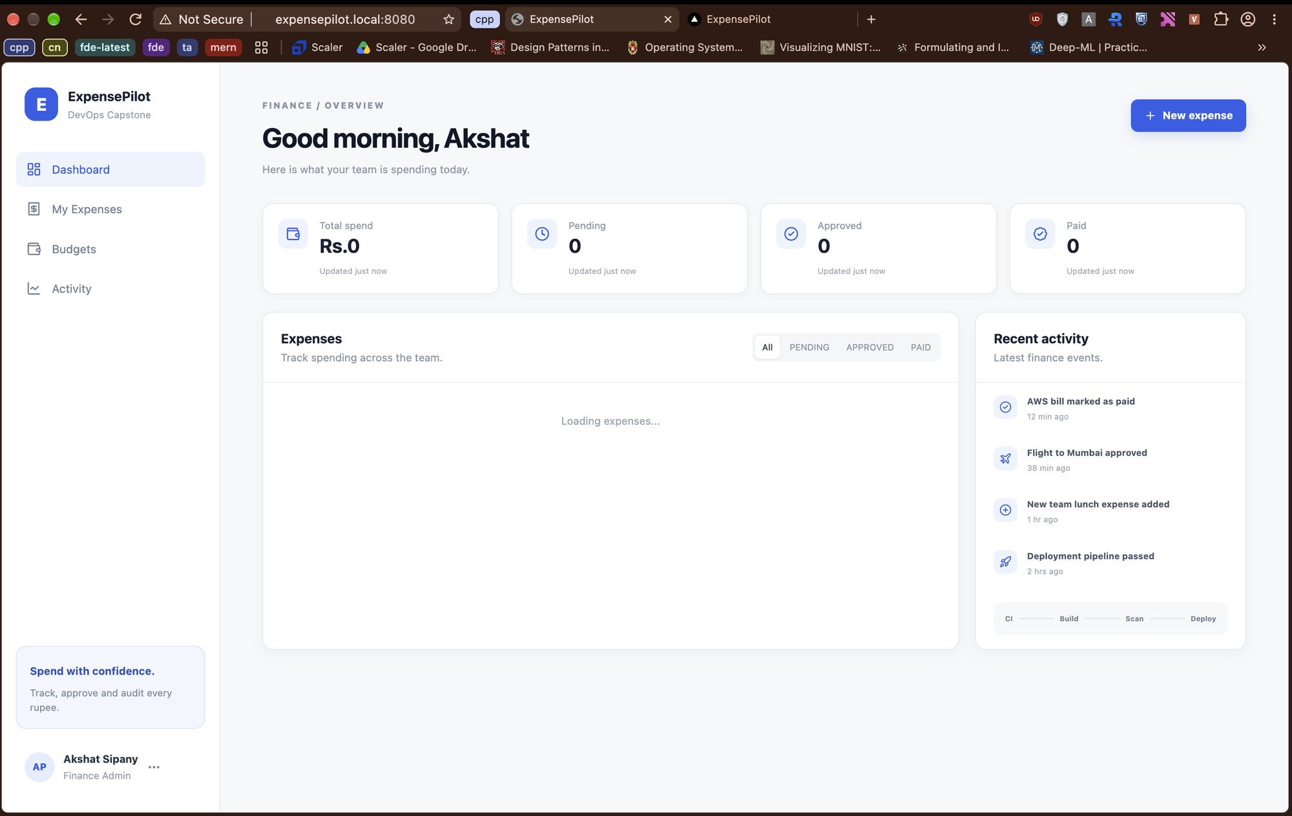
Live demo: one commit, end to end
M10 · 5 pts
expensepilot.local:8080 through Ingress
1
Commit
Change the dashboard heading and push to main
2
Pipeline
Tests and scans pass, new :sha image in GHCR
3
Roll out
helm upgrade with the new tag (or ArgoCD sync); rollout status waits for new pods
4
Verify
Refresh expensepilot.local and the change is live
Thanks! github.com/akshat-code21/final-devops-project
Notes:
For the demo I'll change the heading on the dashboard, commit and push. We watch the Actions run go green and the new SHA tag appear in GHCR. Then I roll it out with helm upgrade using that tag, and kubectl rollout status shows the new pods replacing the old ones. Refreshing expensepilot.local shows the change. The README in the repo has all of these steps and screenshots. Thank you.

