Slide 1

Markdown Madness
Group 5 – HW3
Notes:
Vignesh

Slide 2
What can we learn from the data?
Branded?
Markdown?
Lifecycle Length?
Branded products are marked down more than non-branded
Not much difference in profit or W3 sell-through
Might not be a good product division on its own
Markdown items had high W3 sell-through & unit sales compared to non-markdown
Potential source of lost money
Dollar sales for markdown vs. non-markdown are similar
Longer-life items were marked down earlier, but shorter-life items later
Could manipulating when the markdowns are applied help generate revenue?
Notes:
Vignesh

Slide 3
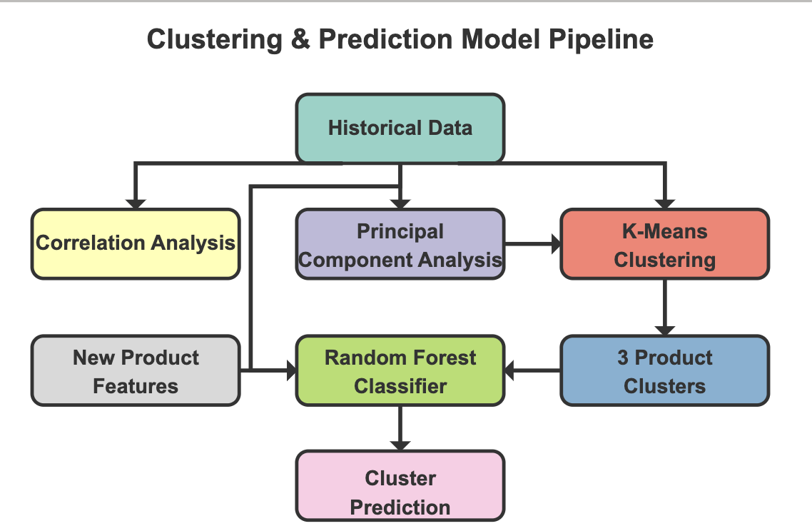
Clustering & Prediction Model
Natural Segmentation Distinct groups with similar behavior. Pattern Discovery Realize hidden relationships between attributes. Scalability Automatic categorization for new products. Predictive Accuracy 90% accuracy in determining the best fit cluster => best markdown policy.
Notes:
Akshat

Slide 4
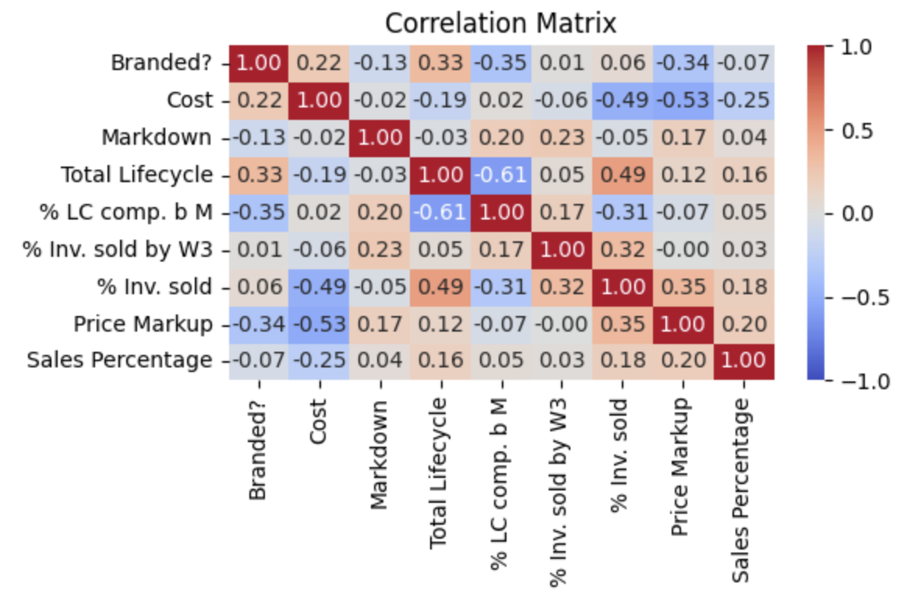
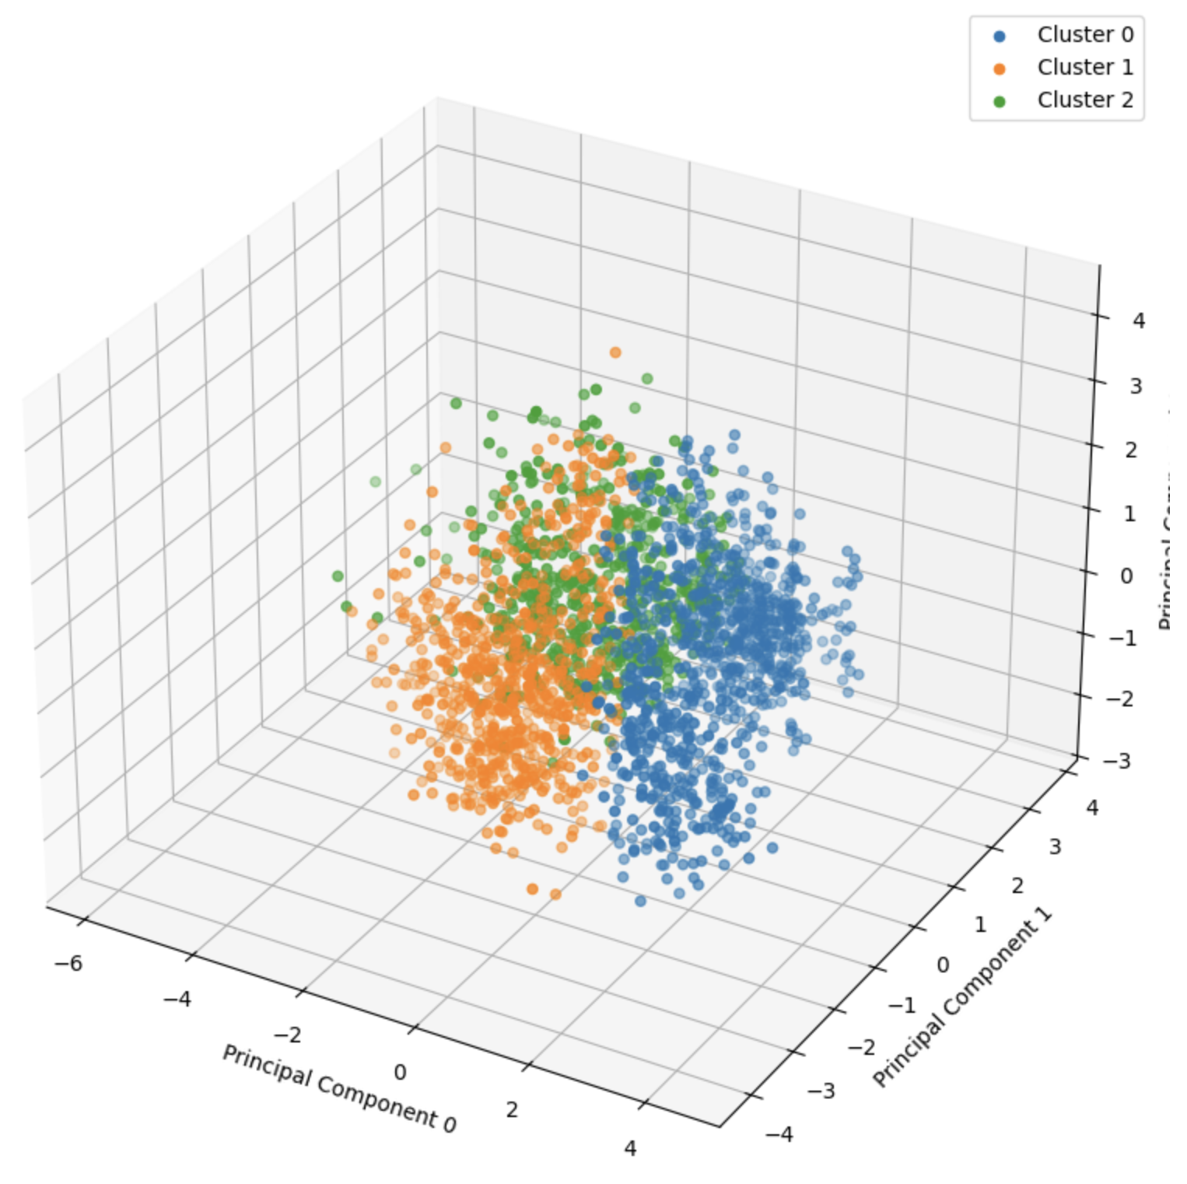
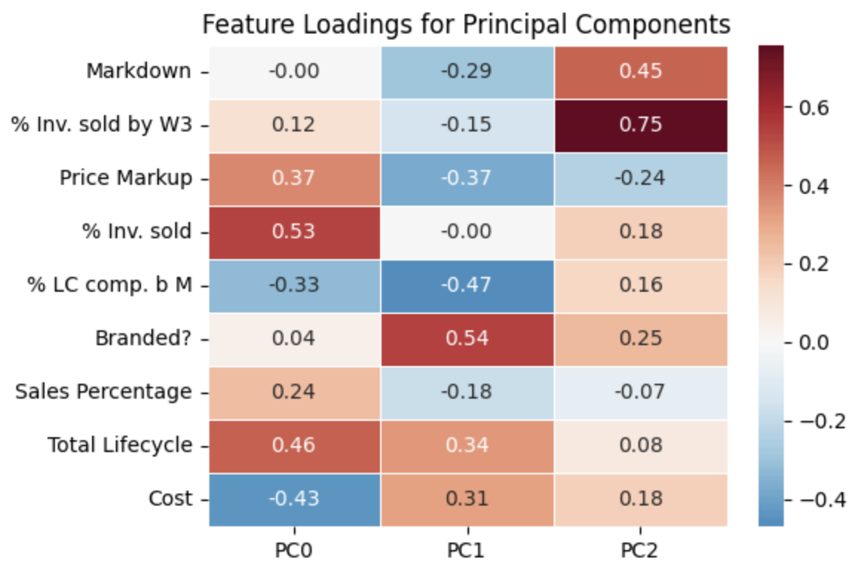
Clustering & Prediction Model
New Product
Random Forest Classifier
Cluster Assignment
% of Inventory Sold Total – Salvaged
% of Inventory Sold by W3
% of the product lifecycle completed before the markdown
% of Sales coming from this product
Notes:
Akshat

Slide 5
Recommendations
Cluster | Analysis | Magnitude | Timeline
0 | >80% inventory is sold | Reduce (to 35%) | Delay
1 | 65% lifecycle finished by markdown | Potentially increase | Advance
2 | Low WTP | Increase (to 55%) | Potentially advance
Notes:
Vidushi

Slide 6
Comparative Policy Analysis
Policy Comparison
Future Improvements
Efficient Alternative to the PO tool
Bottom 20% of Quintile - Not Always
More Centralized decision making
More granular Time Series data of Inventory Sold
Exact Markdown timings and magnitude within cluster
Knowledge of exact product being sold and their attributes
Notes:
Vignesh

Slide 7
Preparing the Business
Ensure seamless transition between old policy and new policy
Thorough training regimen for all employees involved
A/B Testing
Operational Integration
Developing more granular data
Week-to-week data for each product to allow us to understand the impact of markdown
Relying on Machine Learning techniques to automate decisions
Improving the Data
Notes:
Pranav

Slide 8
Secondary Business Effects
Improving Customer Satisfaction
Future Expansion
Optimized Inventory Management
Ensuring price fairness for various buyers by keeping decisions consistent
Using additional revenue to open more stores or scale other operations
Reducing overstock and stockouts
Recouping potential losses
Notes:
Pranav

Slide 9

Thanks!
Do you have any questions?
Notes:
Pranav

