Slide 1
From Clicks to Picks: NetView Trends Uncovered
Akshat, Pranav, Vidushi, Vignesh
1
Notes:
Vidushi

Slide 2
Table of Contents
01
INTRODUCTION
02
METHODS
03
RECOMMENDATION
04
BUSINESS EFFECTS
01
02
Exploratory Data Analysis
Method Results
03
04
Final Recommendation
Potential Effects & Next Steps
2
Notes:
Vidushi

Slide 3
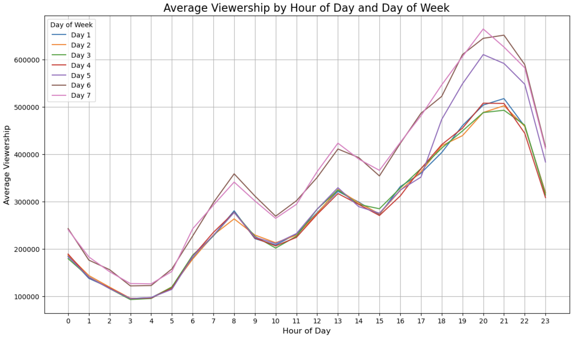
Hourly & Daily Viewing Patterns
Critical Viewing Hours:
Morning news
Lunch breaks
Nightly wind down
Weekend Trends
Same hourly pattern as weekdays
Large increase in users
Friday night acts as a weekend
Lowest Viewership: 12 AM – 6 AM
Max Viewership: Sunday @ 8 PM
*excluding holidays & finales
3
Notes:
Vidushi

Slide 4
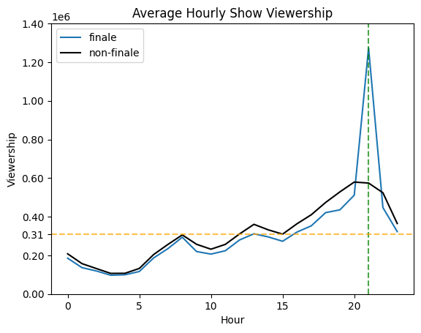
Impacts of Previous Show Finale
Average Viewership
Finale Time
Viewership sees a 4.1x increase during finales against the overall average and a 2.2x increase against the 9PM average
4
Notes:
Vignesh

Slide 5
Simple & Double Exp. Smoothing
SIMPLE EXPONENTIAL SMOOTHING
DOUBLE EXPONENTIAL SMOOTHING
Expected Peak Viewership = 764.3K
Training/Testing Set MAE = 56.2K/53.5K
Optimal Alpha = 1
Expected Peak Viewership = 774.5K
Training/Testing Set MAE = 56.1K/52.9K
Optimal Alpha = 1
Optimal Beta = 0.000432
5
Notes:
Pranav
Mention that it doesn’t account for day of week and finale
Overpredicts b/c the last data point used was on a holiday but the finale won’t be

Slide 6
Multiplying Average by Seasonal Indices
Unseason by DoW
(seasonal index)
Unseason by Holiday
(regression)
Unseason by Hour
(seasonal index)
Unseason by Finale
(event effect)
Calculate hourly average
Season the hourly estimate in reverse
Expected Peak Viewership = 1.57M
Training/Testing MAE = 18.5K/18.2K
6
Notes:
Vidushi

Slide 7
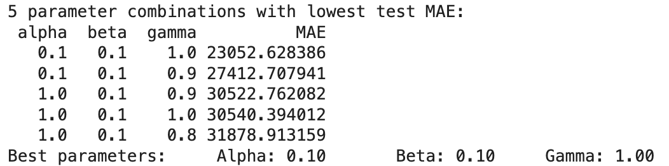
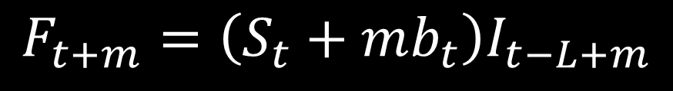

Triple Exponential Smoothing
Incorporating Hourly Seasonality & Trend with Smoothing
$$F_{t+m}=\left(S_{t}+mb_{t}\right)I_{t−L+m}$$
Testing Parameter Options:
$$S: smoothed observation$$
$$m:\# of periods ahead$$
$$b:trend factor$$
$$I:seasonal index$$
$$L:\# of periods in a season$$
Expected Peak Viewership = 1.16M
Training/Testing MAE = 27.5K/9.6K
Optimal Alpha = 0.1 Optimal Beta = 0.1 Optimal Gamma = 1
7
Notes:
Vignesh
Alpha = 0.1, beta = 0.1, gamma = 1 Important: Doesn’t take into account the Holiday and Finale Effect.

Slide 8
SARIMAX
ARIMA
(Autoregressive Moving Average)
Seasonality
(Hourly)
SARIMAX
*Additional Factors: Day of Week, Holiday, Finale
Expected Peak Viewership = 1.44M
Training/Testing MAE = 19.6K/19.2K
8
Notes:
Akshat

Slide 9
Model Comparison
Model | Exp. Peak Viewership | Training MAE | Testing MAE
Simple Exp. Smoothing | 764.3K | 56.2K | 53.5K
Double Exp. Smoothing | 774.5K | 56.1K | 52.9K
Average w/ Seasonality | 1.57M | 18.5K | 18.2K
Triple Exp. Smoothing | 1.16M | 27.5K | 9.6K
SARIMAX | 1.44M | 19.6K | 19.2K
9
Notes:
Akshat

Slide 10
Business Effects & Next Steps
ACCOUNTING FOR VARIANCE
GRANULARIZE THE DATA
UNDERAGE/OVERAGE COSTS
EXPLORE MORE METHODS
Building in excess server capacity
Collecting viewership per show
Implementing other forecasting methods
Ruining CX b/c of buffering
Wasting resources w/ overestimating
10
Notes:
Pranav
They concluded that for every 10% reduction in technical issues there would be a 1.1% increase in total lifetime value from the customer base. If 1 million customers pay $15 per month, that is worth $160,000 per year in additional revenue.

Slide 11
THANKS!
Do you have any questions?
11
Notes:
Pranav

