Slide 1


Capstone Project Employee Management System
Submission type : Individual
Name: Akshat Pareek
Batch : HDFC Batch 1
Program : API Develpment
Date: 27/05/2023

Slide 2

Table Of Contents
Introduction
Project Overview
Architecture Design
Back-end Development
Testing
Deployment
Conclusion
Future Work
References
Appendices

Slide 3
Introduction
The Simple and small Employee Management System is a software solution to access the data securely and efficiently.
The objectives of this project is to design and implement a database solution for storing employee data, create a secure web service to access this data, and develop a client program to interact with the web service.
In today's data-driven world, the security and privacy of sensitive information is of utmost importance. By creating a more efficient and secure way to store and access employee data, this project can help companies better manage their information and protect their employees' privacy.

Slide 4
Project Overview
This application is built using Spring Boot framework, which allows for development of web applications and also provides additional benefits such as minimal configuration, embedded server, easy integration with other Spring frameworks such as Spring MVC etc.
The Rest API is secured using AES – 256 bits to secure Employee data and encryption and decryption is provided so that only the right person can access the data.
For testing the Rest API, Junit is implemented which tests the service layer.
The logging feature records the date-timestamp for every time the web service is called.

Slide 5
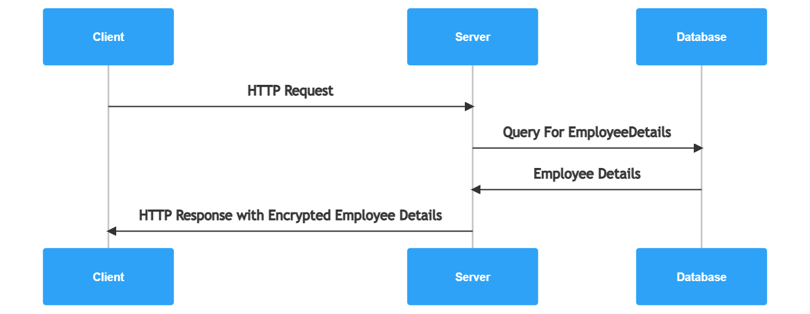
Architecture Design
Sequence Diagram

Slide 6
Back-end Development
A new database was created and one table named employee was created and few columns were filled using My SQL queries.
A new Spring Starter Gradle project was created where an Entity class, a Repository interface, a Service class for business logic and a Rest Controller class with a single GET endpoint for handling the incoming client requests.
The Spring Boot application was deployed to a web server like Tomcat and test the endpoint using a REST client like Postman.

Slide 7
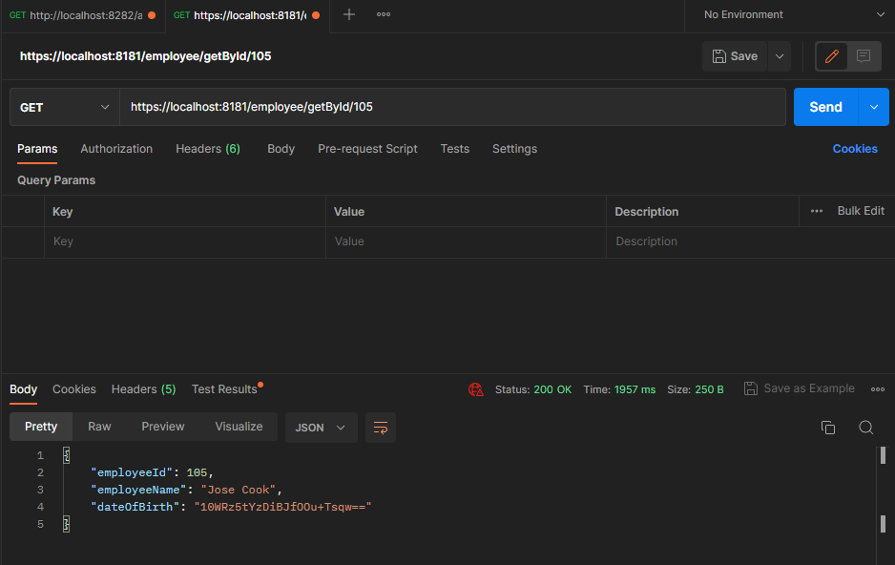
Encrypted Date Of Birth

Slide 8
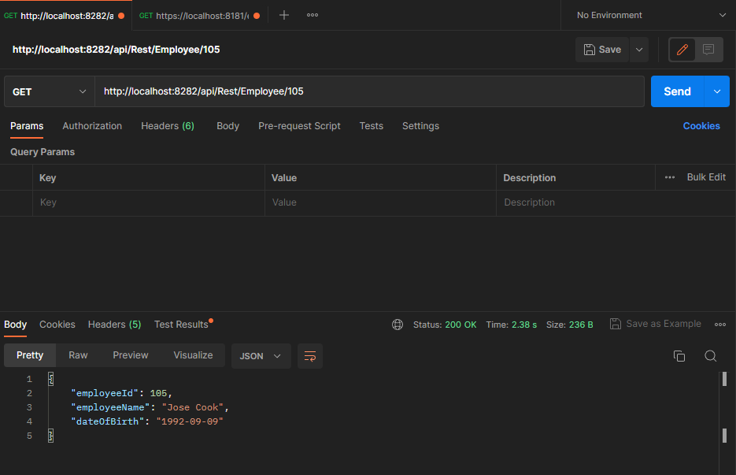
Decrypted Date of Birth

Slide 9
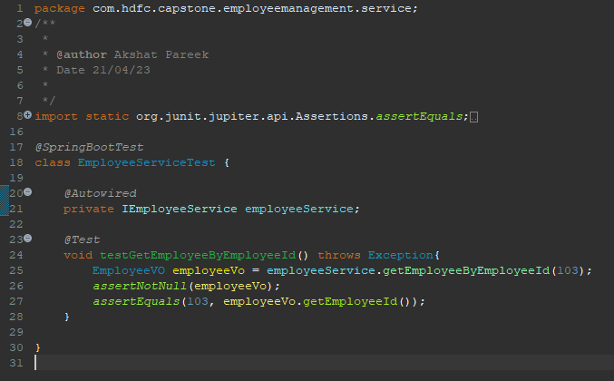
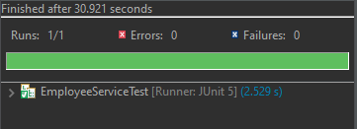
Integration and Testing

Slide 10
Deployment
This section explains the deployment process used to deploy the application to a production environment, including the hosting platform, the deployment process, and the configuration of the environment.
GitHub was used as version control system to store code changes. Jenkins was used which is a popular open-source automation server, to automate build and deployment process. Jenkins is used to compile, test, and package the code, and then deploy it to the target environment.
To make the deployment process more efficient and easier to manage, Docker was used to create containerized versions of the application. Containers provide a lightweight and portable way to package and deploy software applications. Kubernetes was also used which is an open-source container orchestration platform, to automate the deployment, scaling, and management of my containers.

Slide 11
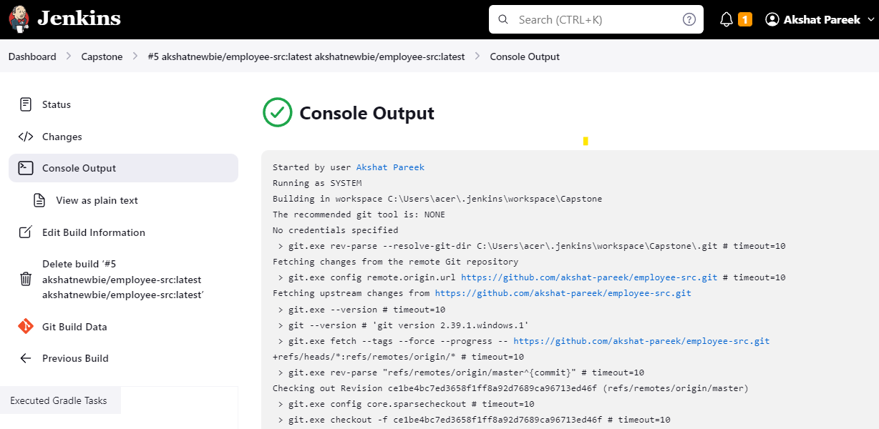
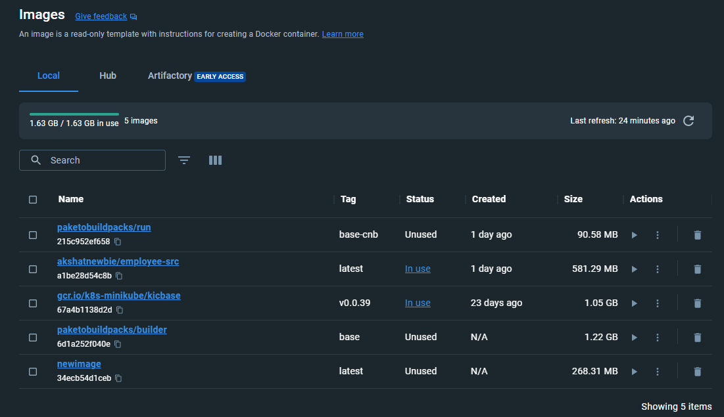

Slide 12
Conclusion
The capstone project successfully achieved the goal of creating a RESTful web service that queries a single record from a database and returns a response containing all relevant employee information.
Spring boot and Jenkins were utilized for continuous integration and deployment.
The security was secured by using HTTPS with a self-signed certificate and encrypting sensitive information with AES-256.
Overall, this capstone project provided valuable experience in developing and deploying a secure, scalable, and containerized web service, while also learning how to overcome challenges in a development environment.

Slide 13
Future Work
Implement a User Interface - Although the current application is designed as a back-end service, creating a user interface will provide better usability and accessibility for end-users.
Integration with Third-Party Services - The application can be enhanced by integrating it with third-party services such as payroll management, performance management, or attendance management systems.
Optimize Containerization and Deployment - As the application scales and more instances of the container are added, optimizing the deployment and containerization process can improve the overall performance and efficiency of the application.

Slide 14
References
Javeed Sir's notes
Spring framework documentation(2022)
Https self-signed certificate reference
AES256 encryption-decryption
Jenkins automation tool
Docker Documentation
Kubernetes Documentation

Slide 15
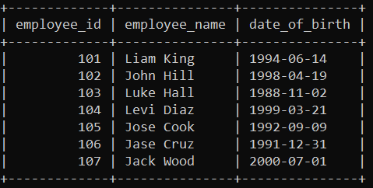
Appendices
Employee Table

