Slide 1

Capstone Project Employee Management Application
Submission Type: Individual
Name: Akshat Pareek
Batch: HDFC Batch 1
Program: API Development
Date: 11/05/2023

Slide 2
Table of Contents
Introduction
Project Overview
Architecture Design
Back-end Development
Testing
Deployment
Conclusion
Future Work
References
Appendices

Slide 3
Introduction
Software solution to access the data securely and efficiently
Implement a database solution for storing employee data
Create a secure web service to access this data
Develop a client program to interact with the web service
Manage the information and protect their employees privacy

Slide 4
Project Overview
Built using Spring Boot framework
Secured using AES – 256
For testing , Junit is implemented
The logging feature records the date-timestamp
Jenkins used to compile, test and package the code
Docker for image creation
Kubernetes for deployment

Slide 5
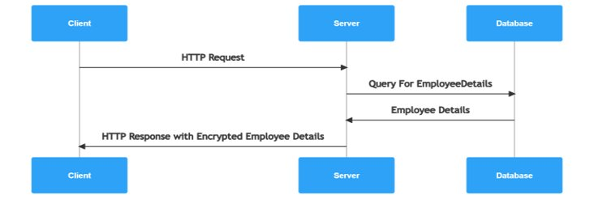
Architecture Design
Sequence Diagram

Slide 6
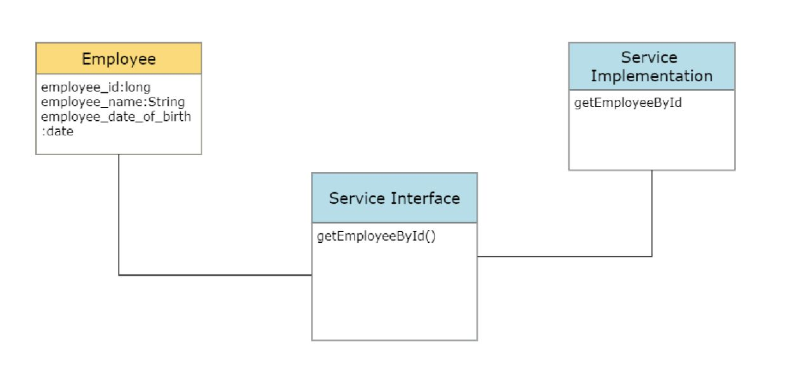
Class Diagram

Slide 7
Back-end Development
New Database (capstone project) created
Table inside the database (employee)
Columns in the table (employee id, employee name, date of birth)
Primary Key (employee id)
New Spring Starter Gradle Project
Entity Class (Employee)
Repository Interface (Employee Repository)
One service Interface (I Employee Service) and one service implementation class (Employee Service Implementation)

Slide 8
Configuration class (AES Encryption) consisting encryption method
Date of birth Encrypted using the configuration class in Service Implementation class
2 Exception classes (Employee Not Found Exception and Invalid Employee Id Exception)
Global Exception Handler to handle both exceptions at one place
Controller Class (Employee Rest Controller)
Security secured by HTTPS using JKS certificate (https-employee.jks)
Deployed to Tomcat web server
Endpoint tested using Postman

Slide 9
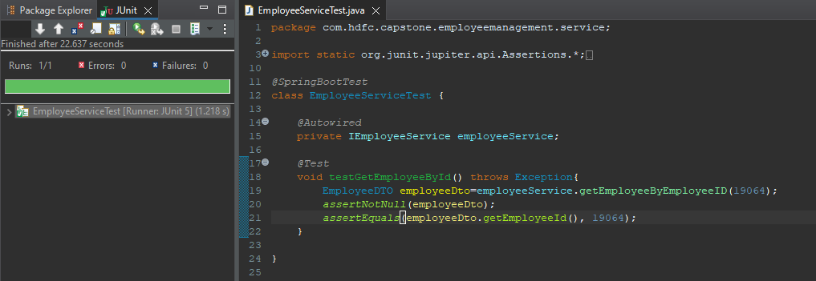
Integration and Testing

Slide 10
Deployment
GitHub used to store code changes.
Jenkins used to compile, test and package the code via GitHub repository.
Jenkins used also for image creation using the docker credentials.
Kubernetes used for deployment, scaling and managing the containers.
5 YML files were created (Employee Deployment, Employee Service, MySQL Deployment, MySQL Service and MySQL PVC) for Kubernetes

Slide 11
Conclusion
RESTful web service queries a single record from database and returns relevant employee information
Jenkins utilized for CI and CD
Security secured by HTTPS
Sensitive Information encrypted with AES 256
Deployed using Kubernetes
Provided valuable experience in developing and deploying a secure, scalable, and containerized web service

Slide 12
Future Work
Implement a User-Interface
Integration with third party services
Optimize Containerization and Deployment

Slide 13
References
Spring framework documentation(2022)
Https self-signed certificate reference
AES256 encryption-decryption
Jenkins automation tool
Docker Documentation
Kubernetes Documentation

Slide 14
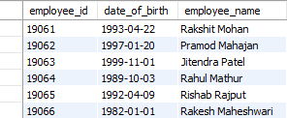
Appendices
Employee table

Slide 15
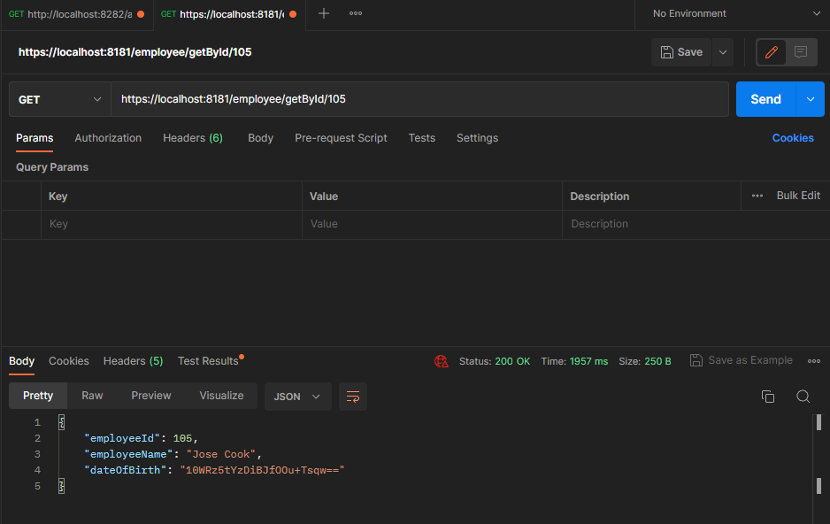
Encrypted Date of Birth

Slide 16
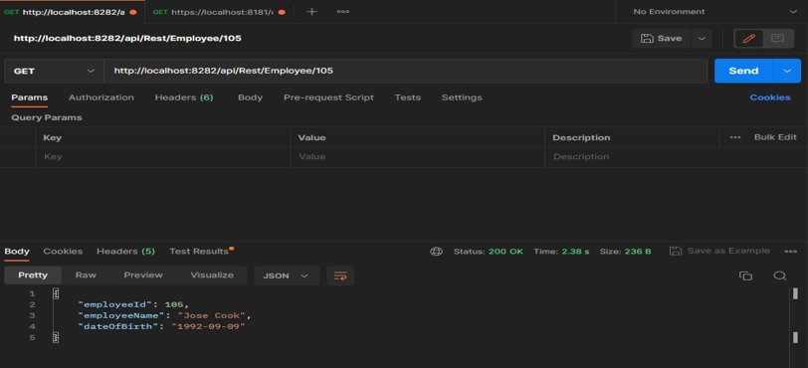
Decrypted Date of Birth

Slide 17
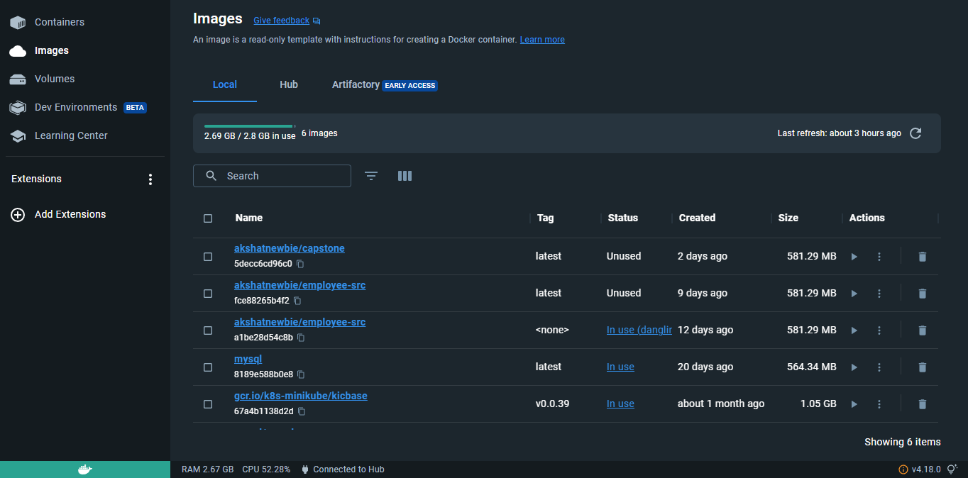
Docker Images

Slide 18
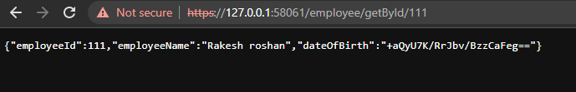
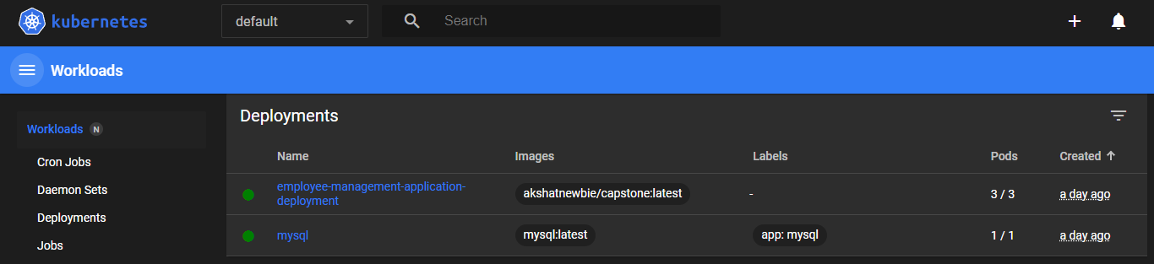
Kubernetes Output and Dashboard

