Slide 1
Library Management System
Submitted By: Akshat Pareek
Submission Type: Individual
Program: HDFC API Development
Date: 21-April-2023

Slide 2
CONTENTS
Introduction
Architecture Design
Database
UML Diagrams
Class Diagram
API Backend Development
Unit Testing
Conclusion

Slide 3
INTRODUCTION
The Simple and Small Library Management System Application is a software solution that is designed to manage library resources effectively. The objective of this system is to simplify the library management process, reduce administrative overhead, and improve the overall user experience. This business requirement document outlines the functional and non-functional requirements of the Simple and Small Library Management System Application.

Slide 4
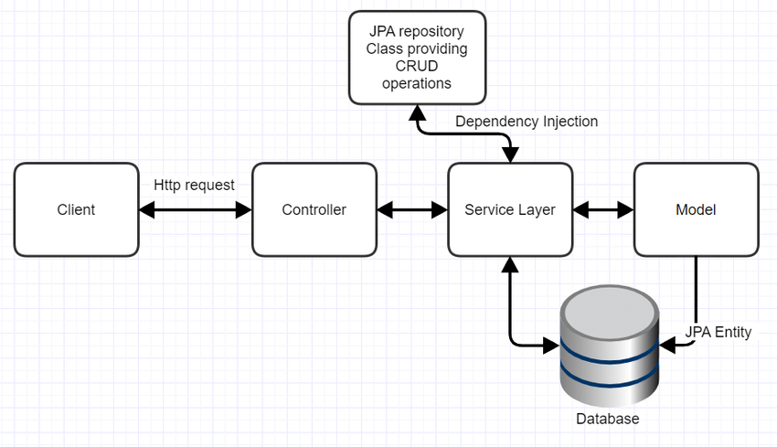
ARCHITECTURE DESIGN

Slide 5
DATABASE
Database named library_management was created in MySQL.
Six Tables named user, book, borrowing, loan_management, reports and reservation were created.
Some columns were filled using MySQL queries in all the tables.
Tables borrowing, loan_management and reservation were having foreign keys as user_id and book_id.

Slide 6
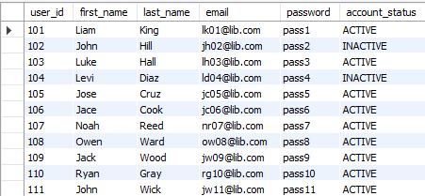
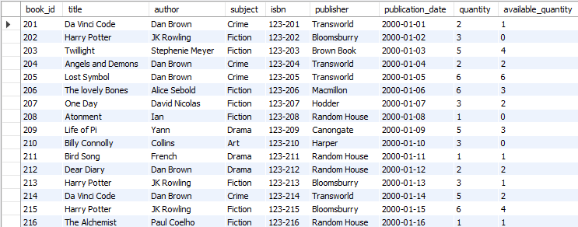

Slide 7
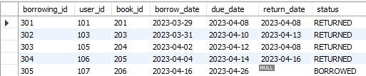

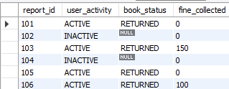


Slide 8
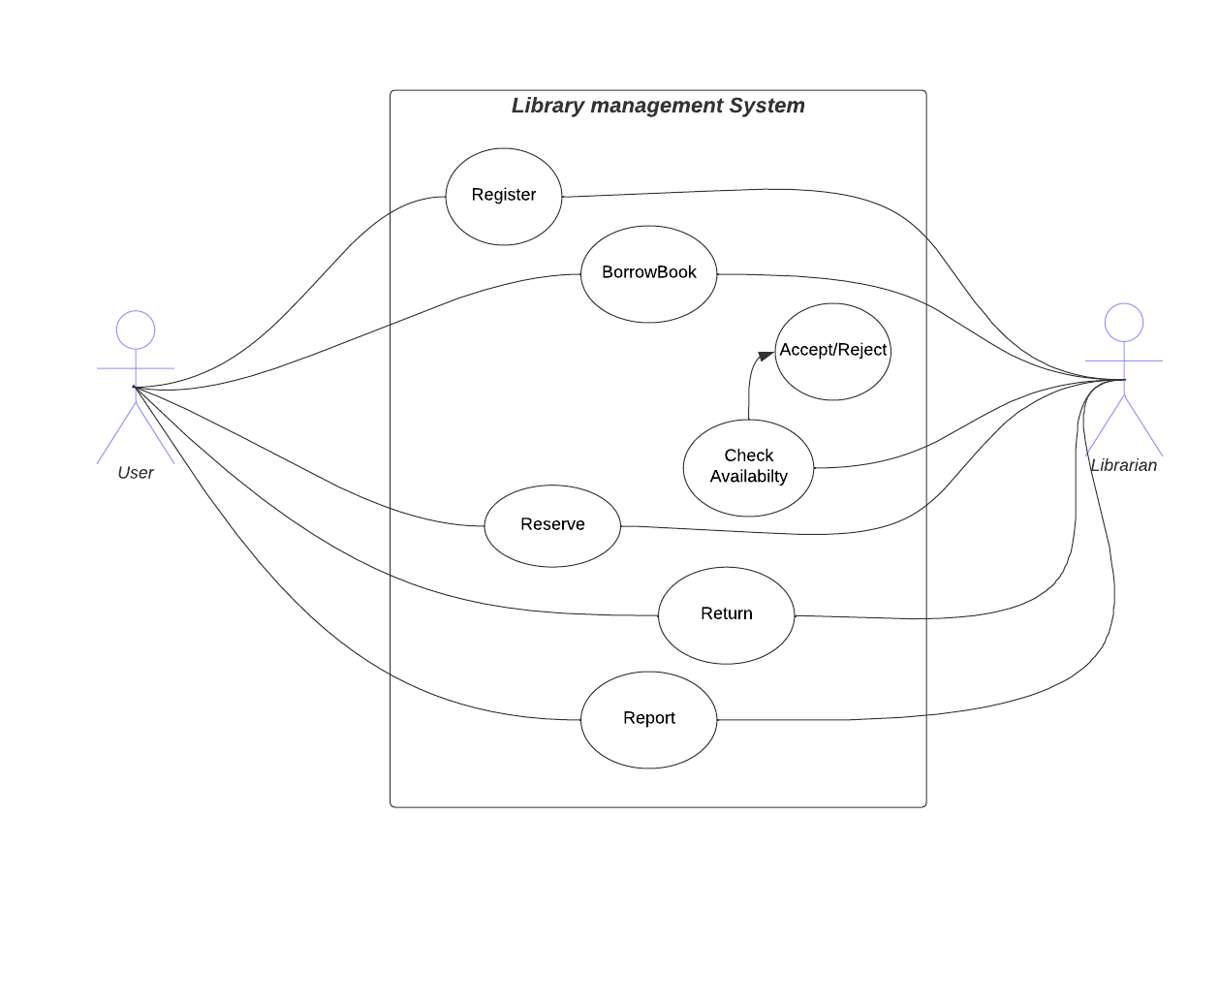
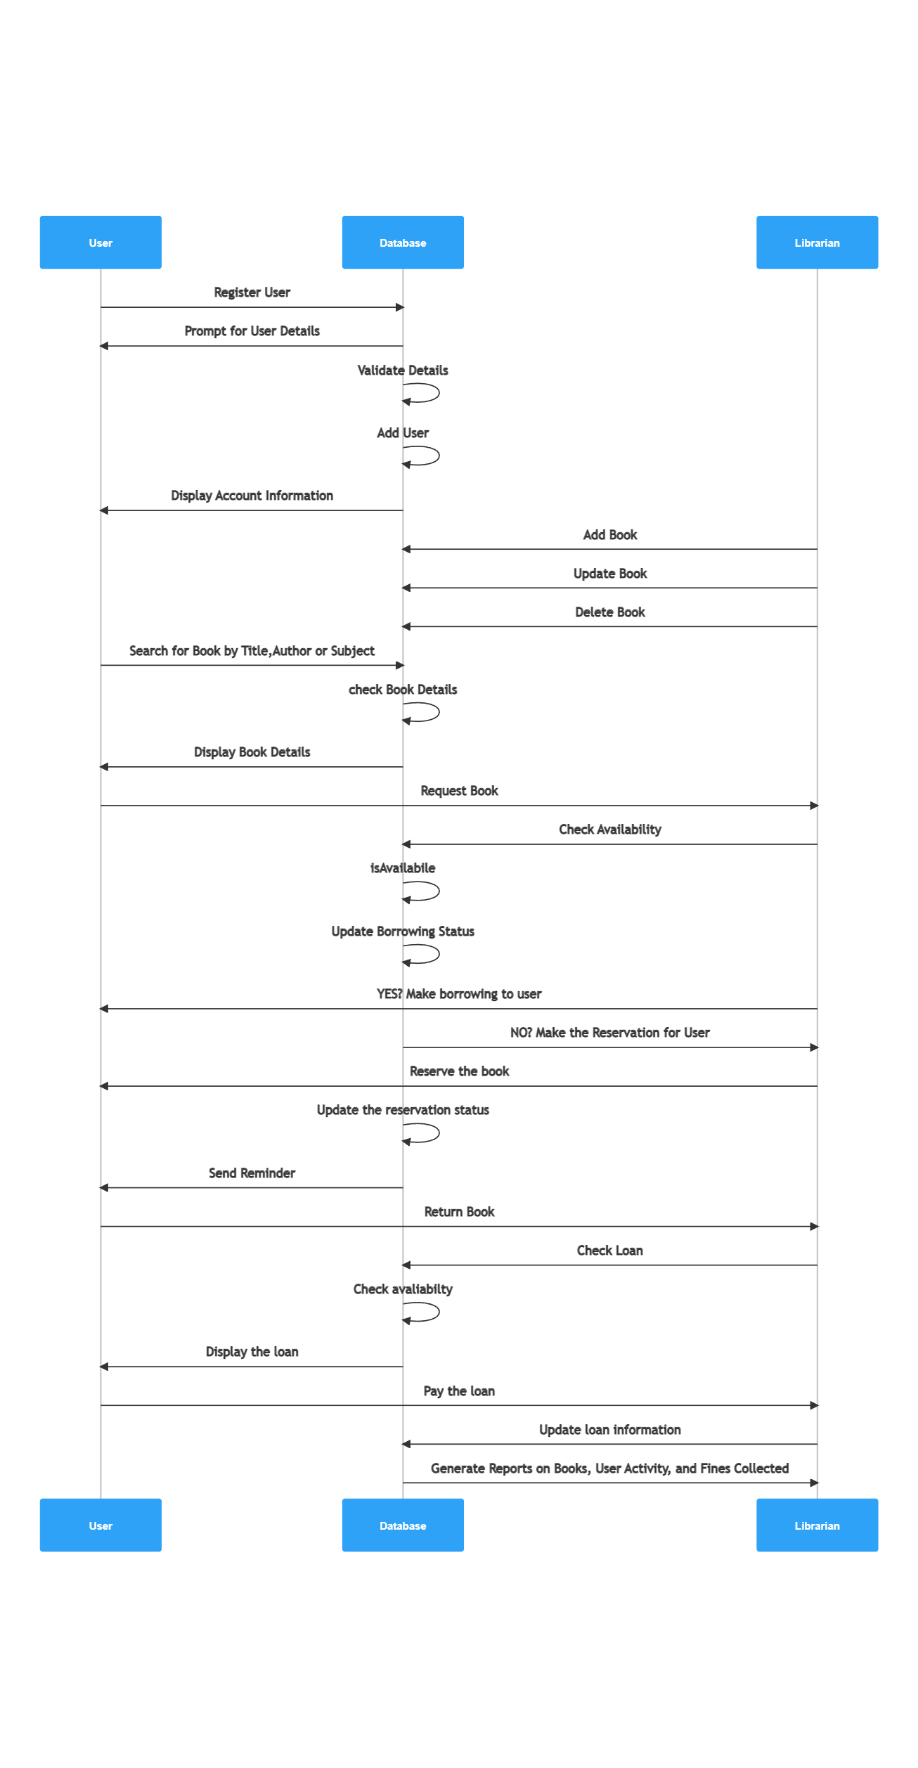
UML DIAGRAMS

Slide 9
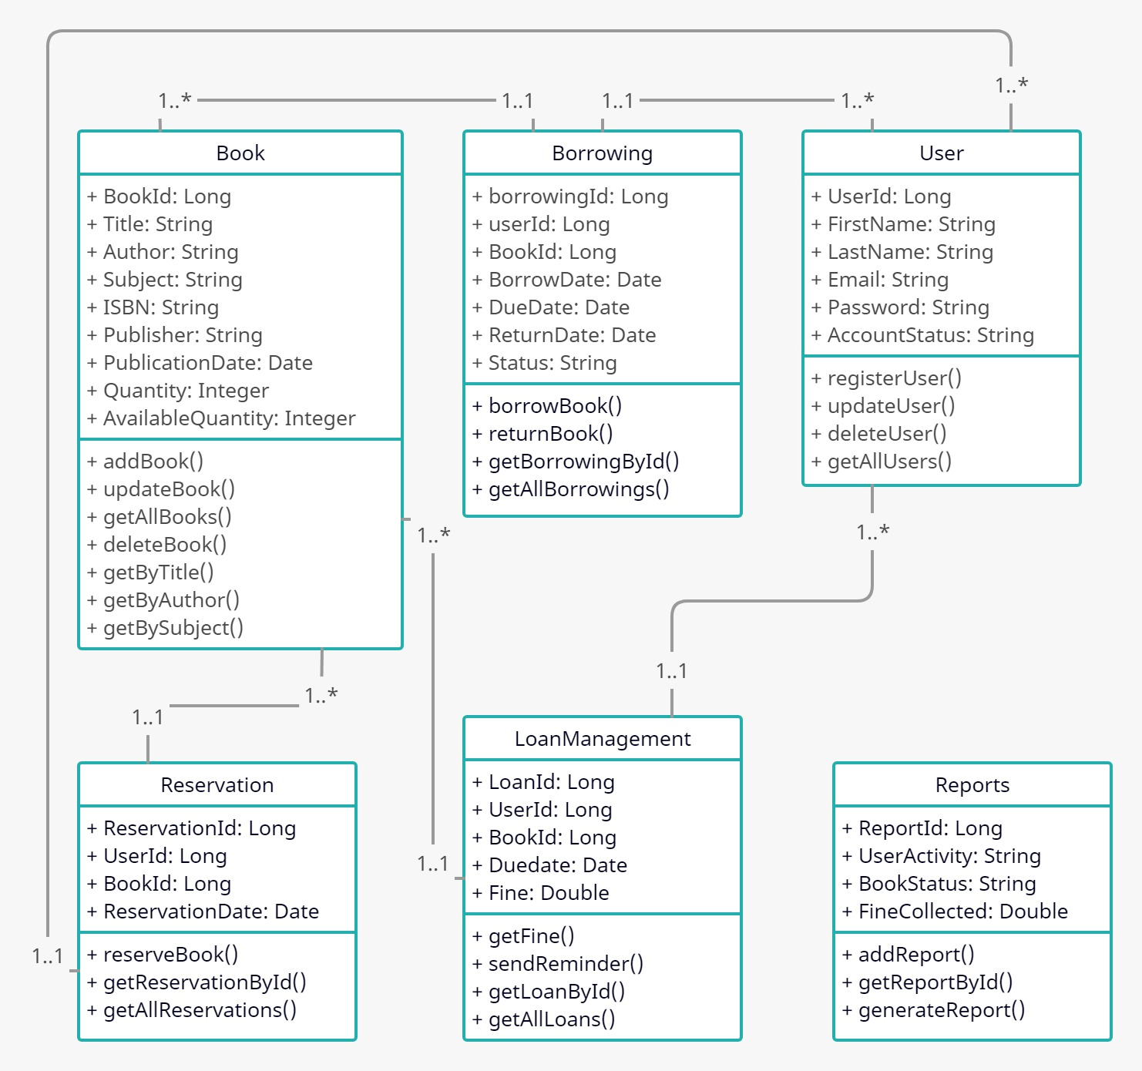
CLASS DIAGRAM

Slide 10
API BACKEND DEVELPMENT
Six Entity Classes were created named User, Book, Borrowing, LoanManagement, Reports and Reservation.
Borrowing, LoanManagement and Reservation have user and book objects which are mapped using @ManyToOne.
Repository Interface which extends to JpaRepository, Service class and Controller class were created to interact with user.
These classes have all the required methods to make the project functional.

Slide 11
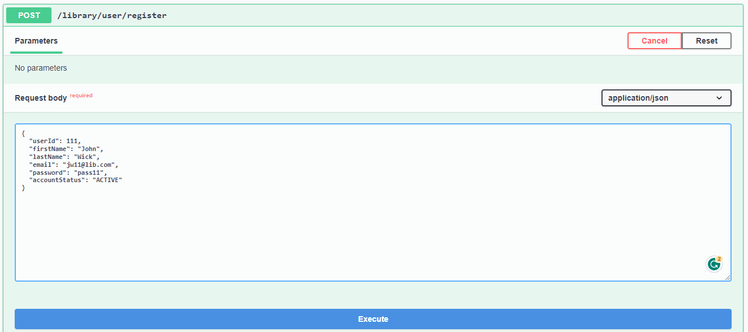
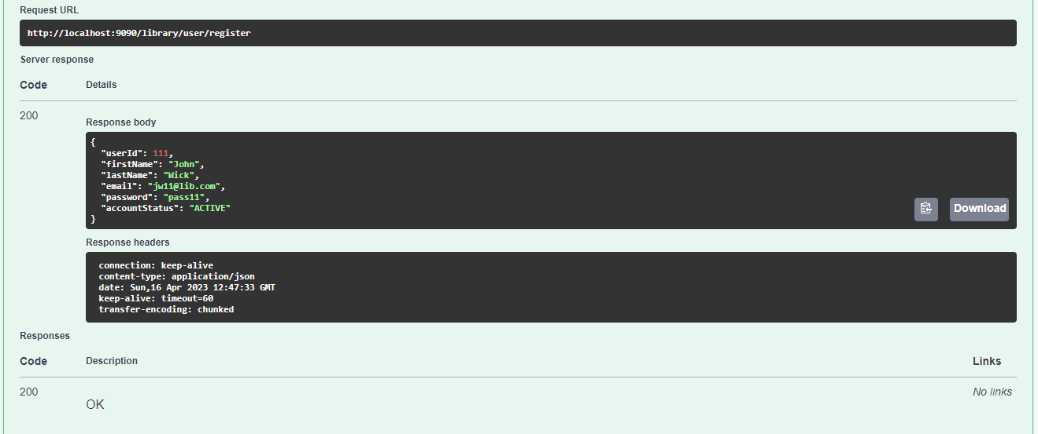
1)User

Slide 12
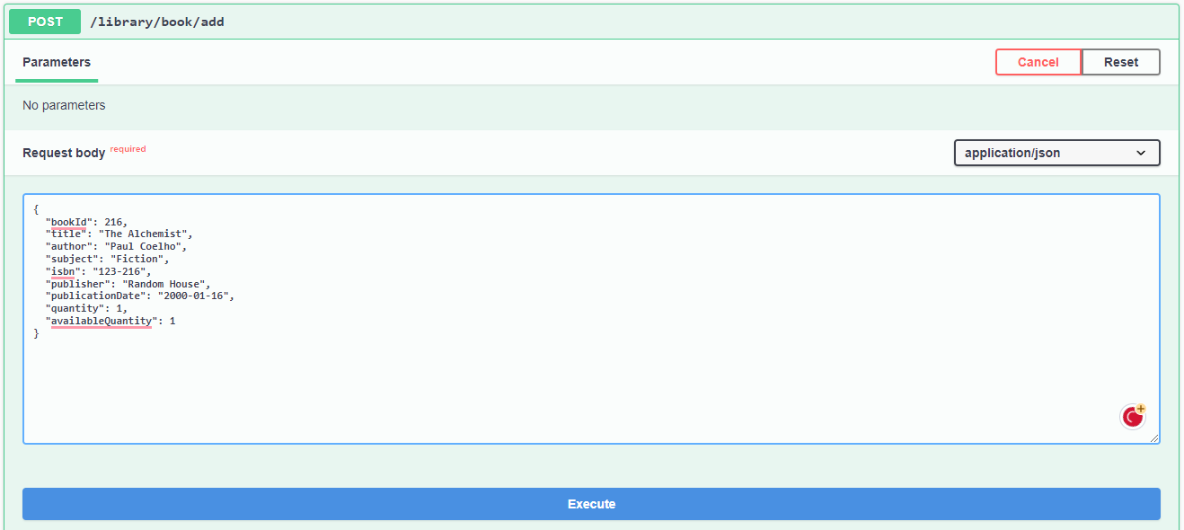
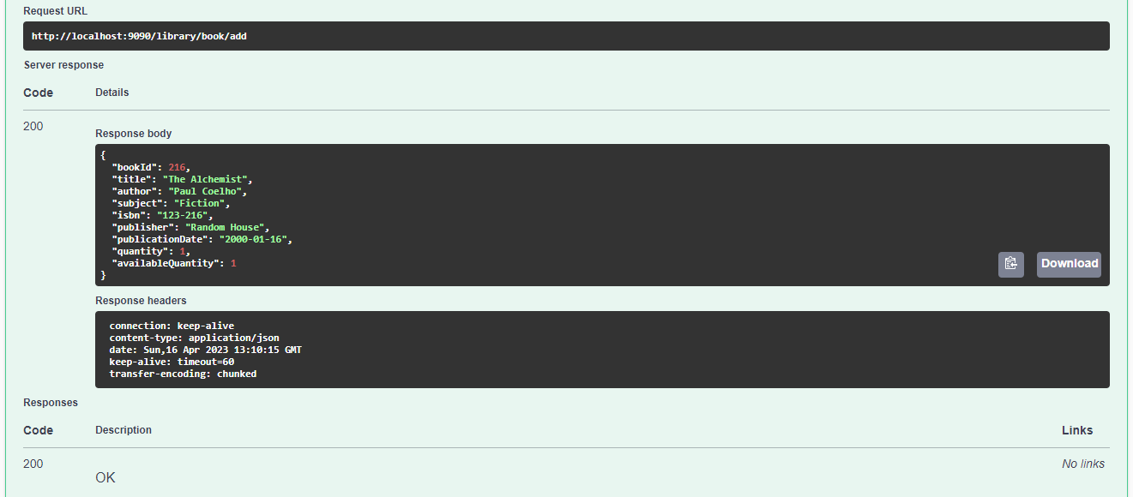
2)Book

Slide 13
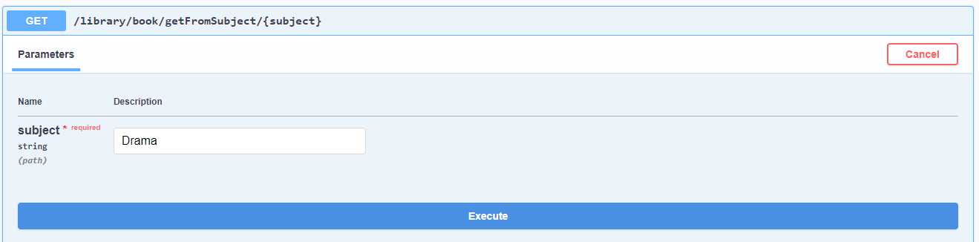
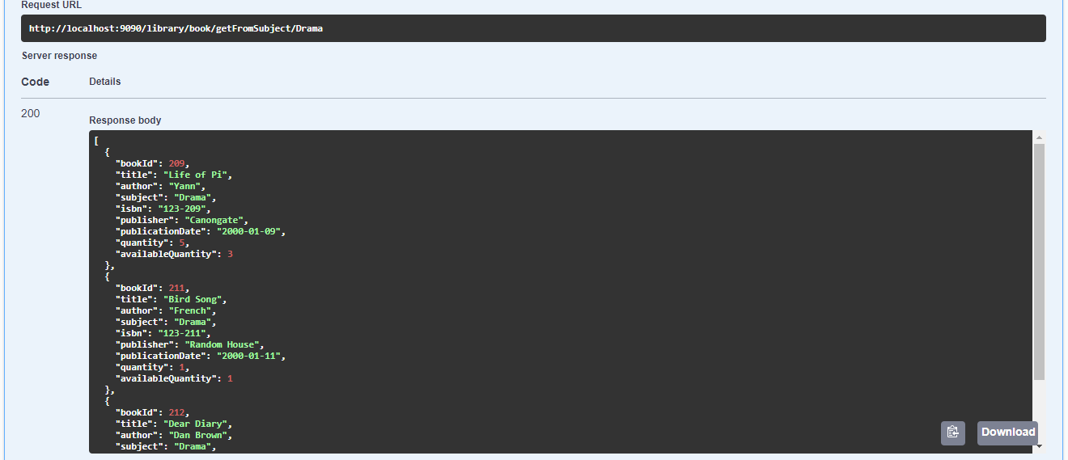

Slide 14
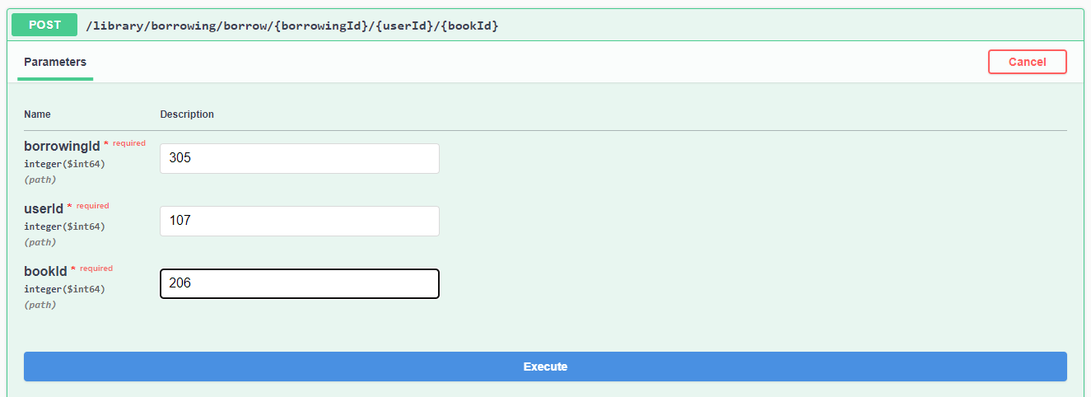
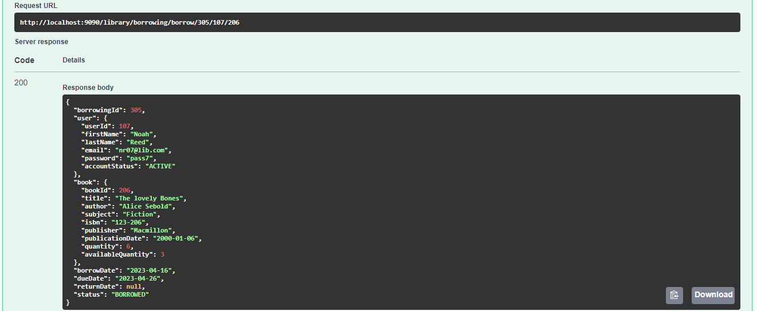
3)Borrowing

Slide 15
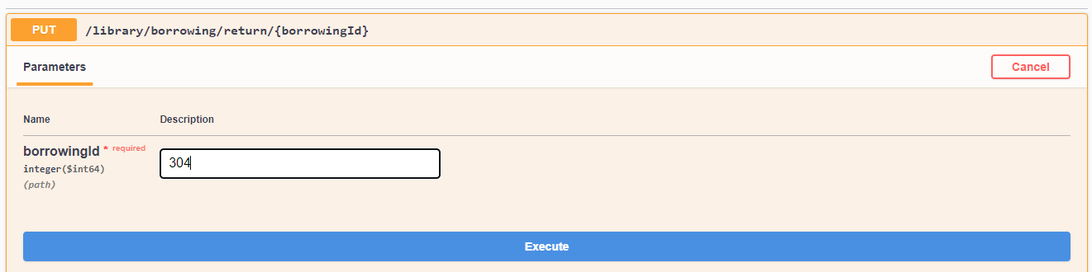
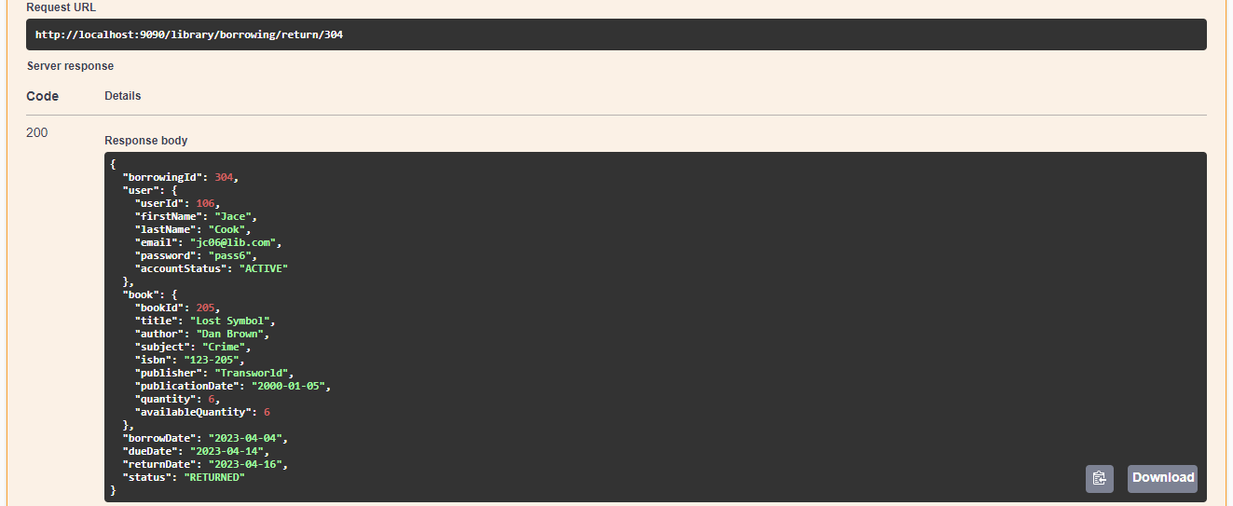

Slide 16
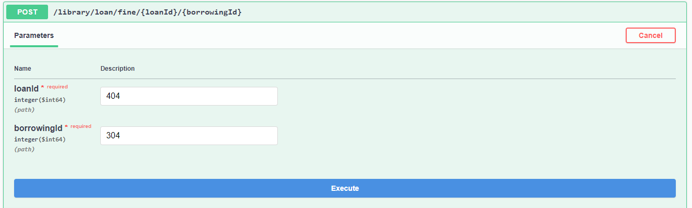
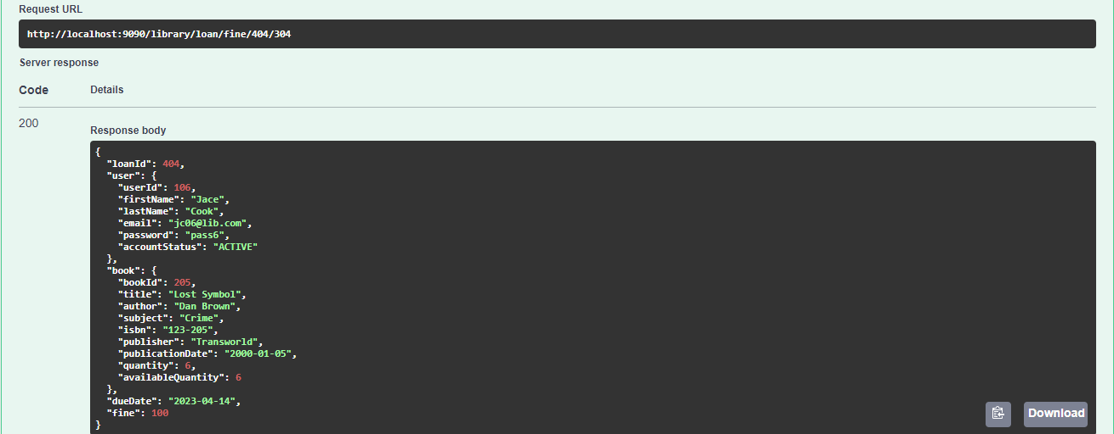
4)LoanManagement

Slide 17
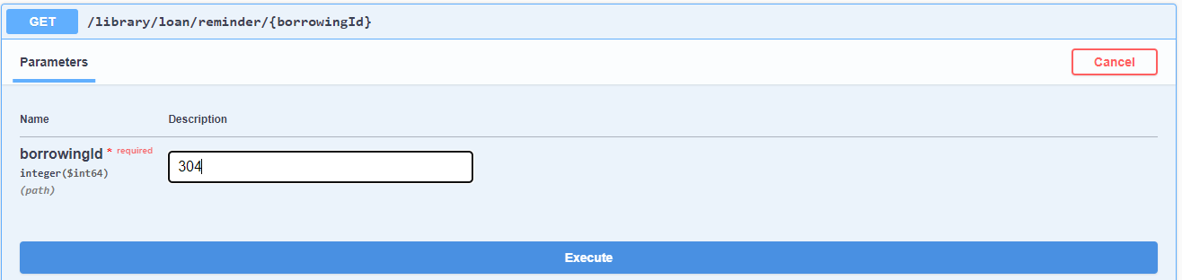
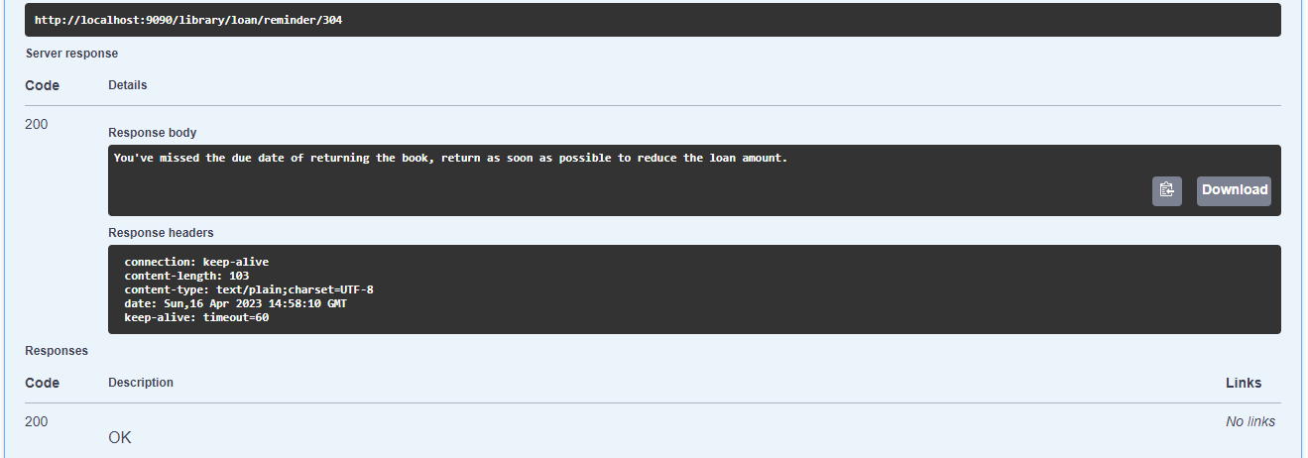

Slide 18
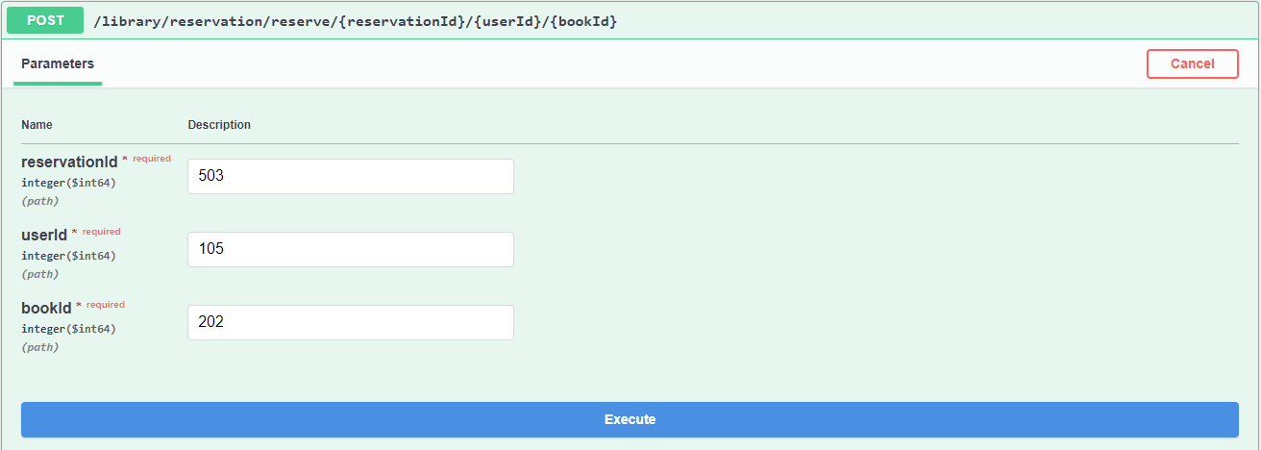
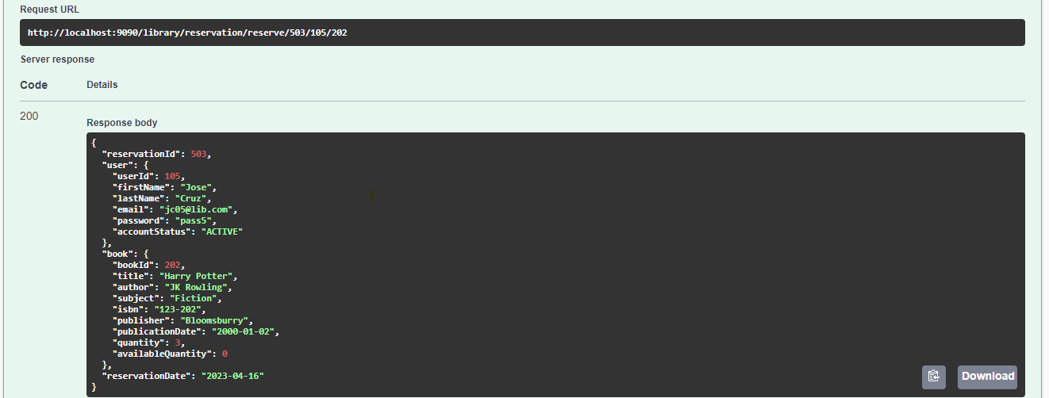
5)Reservation

Slide 19
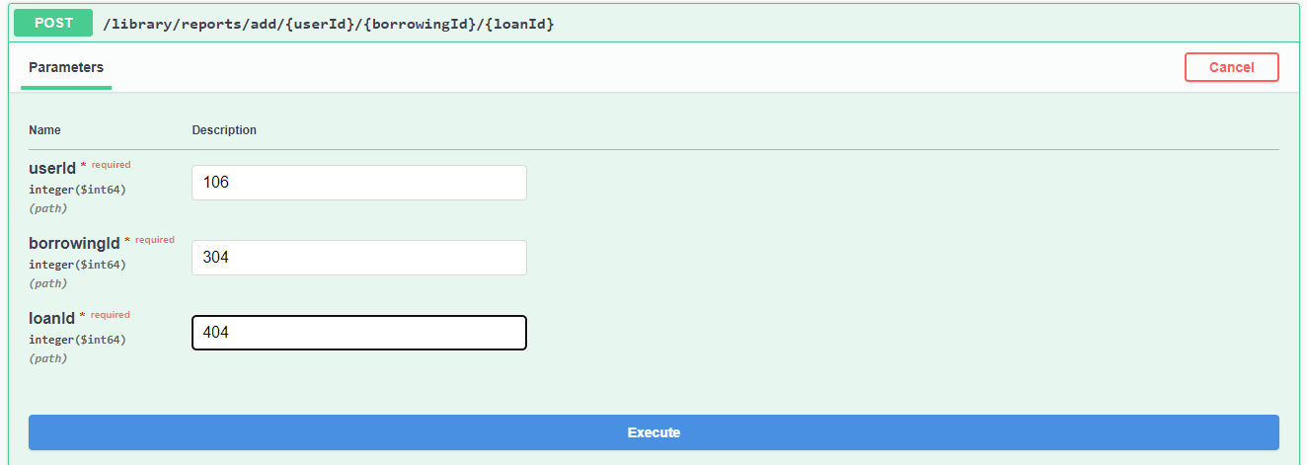
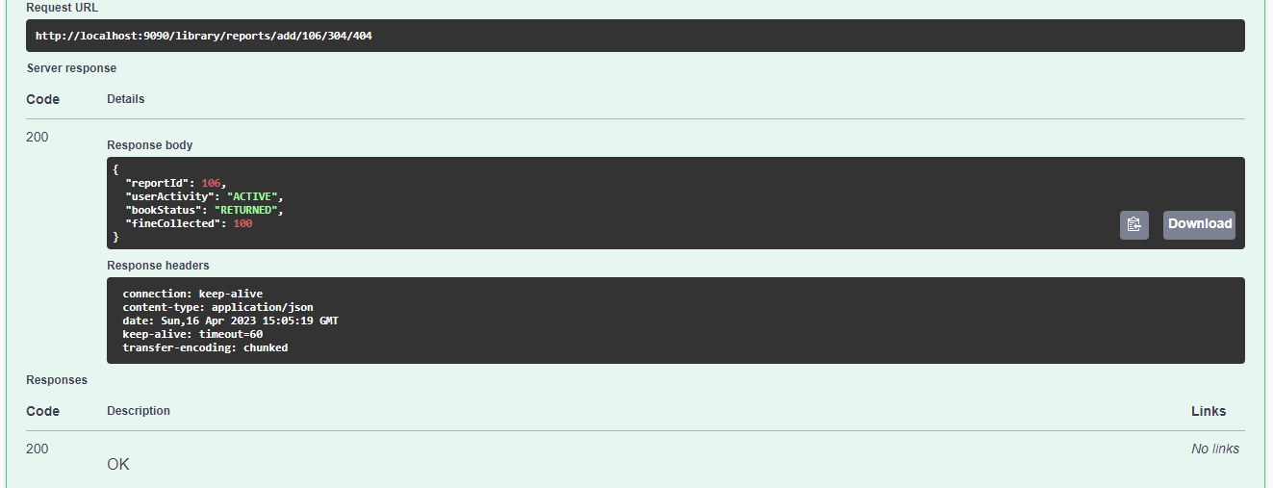
6)Reports

Slide 20
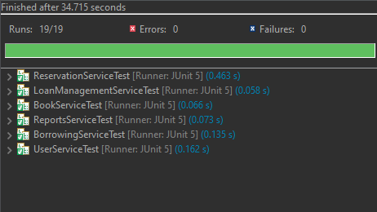
UNIT TESTING

Slide 21
CONCLUSION
The Library Management System is a necessary software solution designed to manage library resources effectively, reduce administrative overhead, and improve the overall user experience.
By implementing this system, librarians will be able to manage library resources more efficiently, while users will be able to search for books, borrow them, and reserve them with ease.
The system's scalability, security, performance, usability, and compatibility ensure that it can handle an increasing number of users and book transactions while protecting user data and ensuring a positive user experience.

