Slide 1


Exploring Adversarial Attacks and Defenses in AI-Powered Cybersecurity
Presented by: Akshat Patil
TE_A_43
Guided by: Prof. R.D.More
Notes:
NOTE:
To change the image on this slide, select the picture and delete it. Then click the Pictures icon in the placeholder to insert your own image.

Slide 2


Introduction
Adversarial attack is a growing threat in the AI and ML research community.The most common reason is to cause a malfunction in a machine learning model; an adversarial attack might entail presenting a model with inaccurate or misrepresentative data as its training or introducing maliciously designed data to deceive an already trained model.
Adversarial attacks exploit vulnerabilities in AI systems and manipulate input data to deceive AI models, leading to incorrect predictions or compromised security measures.

Slide 3

For example, an adversarial attack could involve feeding a model false or misleading data while training or adding maliciously prepared data to trick an already trained model.
At its core, adversarial attacks are those malicious attacks on the data which may seem okay to a human eye but causes misclassification in a machine learning pipeline. These attacks are often made in the form of specially designed “noise,” which can elicit misclassification.

Slide 4
Adversarial attacks can be further divided into two categories:
⚫Black Box Attacks
In black box attacks, the attacker does not have access to the model’s parameters.
In adversarial machine learning, black box attacks assume that the adversary can only acquire outputs for given inputs and does not know the model structure or parameters.
⚪White Box Attacks
In white box attacks, the attacker has access to the model’s parameters.
White box attacks are based on the assumption that the adversary can access the model’s parameters and obtain labels for the inputs provided.

Slide 5
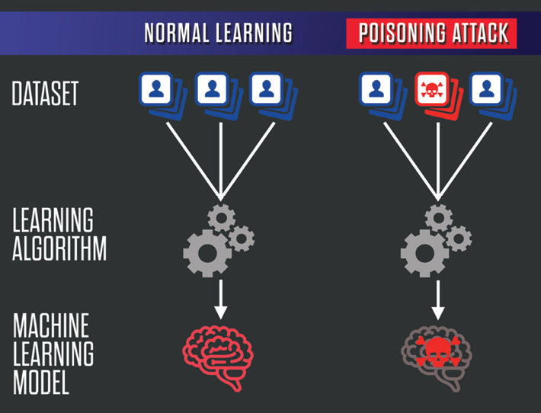
Types of adversarial attacks in the context of machine learning and artificial intelligence:
►Poisoning Attacks
Poisoning is the contamination of the training dataset. Given that datasets impact learning algorithms, poisoning possibly holds the potential to reprogram algorithms. Serious concerns have been highlighted, particularly about user-generated training data, such as for content recommendation or natural language models, given the prevalence of false accounts.

Slide 6
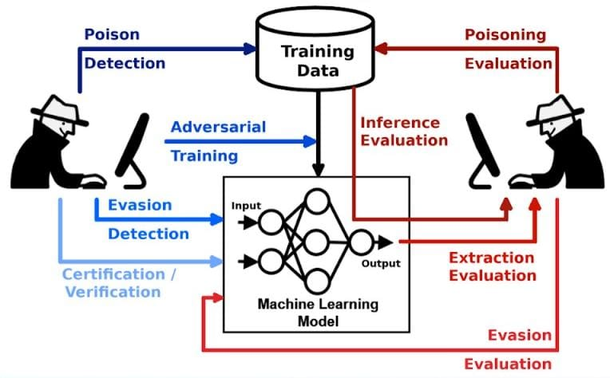
►Evasion Attacks
Evasion attacks include taking advantage of a trained model flaw. In addition, spammers and hackers frequently try to avoid detection by obscuring the substance of spam emails and malware. For example, samples are altered to avoid detection and hence classified as authentic.
Image-based spam is a prime example of evasion, where the spam content is embedded within an attached image to avoid textual examination by anti-spam filters. Spoofing attacks on biometric verification systems are another type of evasion.

Slide 7
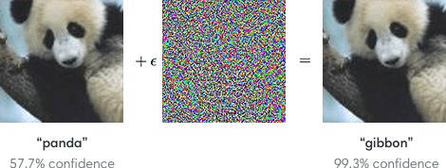
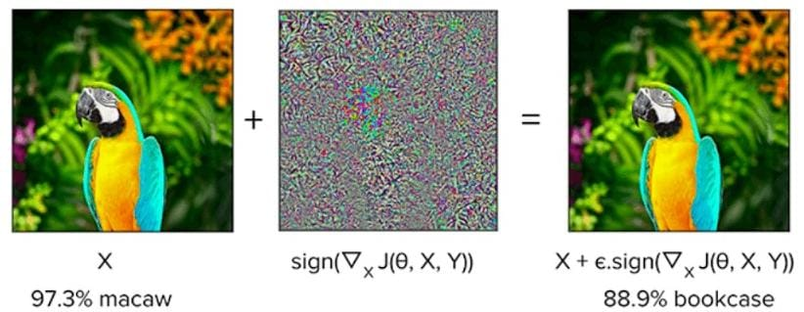
►Fast Gradient Sign Method
FGSM (Fast Gradient Sign Method): FGSM is a type of adversarial attack that perturbs the input data by adding a small, carefully crafted perturbation to it. This perturbation is calculated based on the gradient of the loss function with respect to the input data.
FGSM is typically used to create adversarial examples that can fool machine learning models into making incorrect predictions.

Slide 8
Literature Review
1. Adversarial Attacks and Defenses (Goodfellow):
- This pioneering paper introduced the concept of adversarial attacks and discussed the generation of adversarial examples.
- It laid the foundation for subsequent research in this area.
2. Fast Gradient Sign Method (FGSM) (Goodfellow):
- FGSM is a fundamental technique for crafting adversarial examples.
- The paper explains how small, targeted perturbations can mislead neural networks.
3. Targeted vs. Untargeted Attacks:
- Research has explored both targeted attacks (aimed at causing a specific misclassification) and untargeted attacks (just trying to induce misclassification).

Slide 9
4. Adversarial Attacks in Various Domains:
- Adversarial attacks have been studied not only in image classification but also in natural language processing, reinforcement learning, and other domains.
5. Robustness and Adversarial Training:
- Papers discuss techniques for improving model robustness through adversarial training, where models are trained with adversarial examples to make them more resistant to attacks.
6. Evasion vs. Poisoning Attacks:
- The distinction between evasion attacks (perturbing input data) and poisoning attacks (manipulating training data) has gained attention.

Slide 10
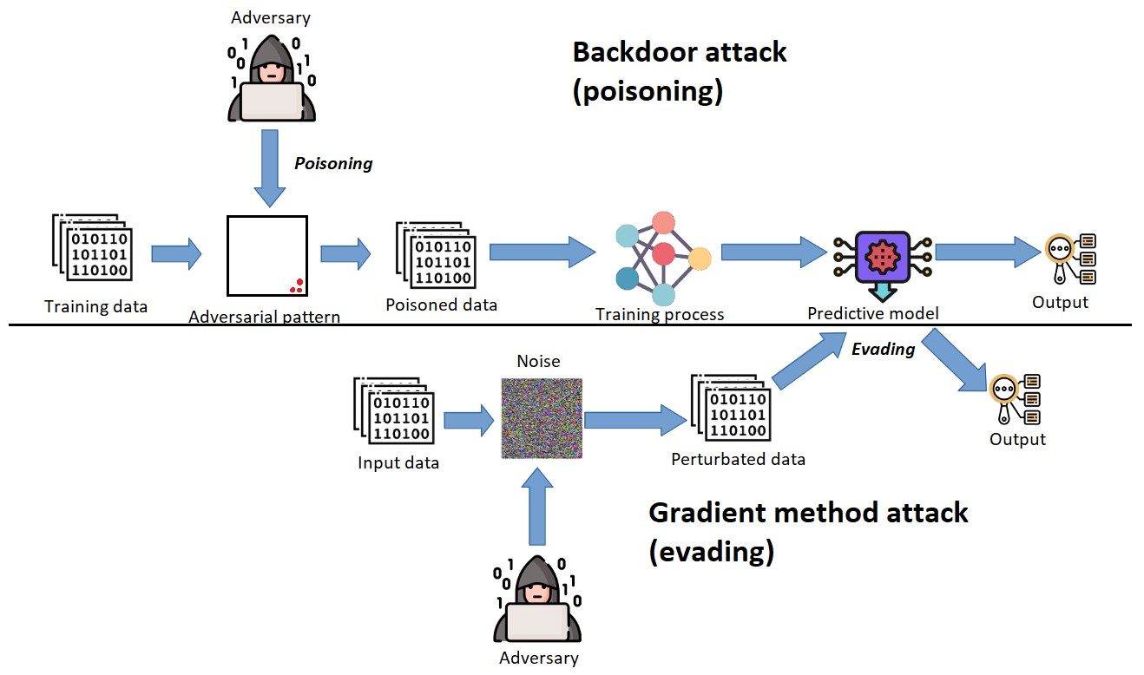
Adversarial Attacks Workflow

Slide 11

Algorithm
Algorithm for defending against Adversarial attacks in AI-Powered Cybersecurity:

Slide 12
1. Threat Modeling:
- Define the attacker's goals and capabilities concerning the target system.
- Identify potential vulnerabilities and entry points the attacker may exploit.
2. Attack Simulation:
- Formalize the optimization problem the attacker aims to solve.
- Explore various attack strategies, considering possible input perturbations and evasion tactics.
3. Attack Impact Evaluation:
- Assess the potential impact of successful attacks on the system's integrity and functionality.
- Quantify the damage or compromise that could occur if an attack is successful.

Slide 13
4. Countermeasure Design:
- Develop robustness mechanisms tailored to the specific domain and model.
- Implement adversarial training, input preprocessing, or other defense techniques to enhance model resilience.
5. Noise Detection (For Evasion-Based Attack):
- Implement noise detection algorithms to identify unusual patterns or perturbations in input data.
- Set thresholds for detecting potential adversarial examples.
6. Information Laundering (For Model Stealing Attacks):
- When sharing models or responses, alter the information received by potential adversaries.
- Apply data obfuscation or response aggregation to protect sensitive model information.

Slide 14
Applications
1. Image Classification
- Adversarial Attack: Crafting misleading images that are misclassified by image classification models.
- Defense: Adversarial Training - Retraining models using adversarial examples to improve resistance to such attacks.
2. Autonomous Vehicles (Object Recognition)
- Adversarial Attack: Manipulating traffic signs or objects to mislead autonomous vehicle perception systems.
- Defense: Certified Robustness - Using algorithms with mathematical guarantees to ensure robust object recognition.

Slide 15
3. Healthcare (Medical Image Analysis)
- Adversarial Attack: Altering medical images to mislead diagnosis models.
- Defense: Input Augmentation - Adding variations to medical images during training for improved model robustness.
4. Finance (Algorithmic Trading)
- Adversarial Attack: Manipulating market conditions to disrupt algorithmic trading systems.
- Defense: Reinforcement Learning - Adapting trading algorithms through adaptive learning to resist adversarial actions.

Slide 16
5. IoT Security (Smart Home Devices)
- Adversarial Attack: Hacking IoT devices to gain unauthorized access.
- Defense: Device Authentication - Implementing strong authentication mechanisms to protect against unauthorized access.
6. Online Advertising (Click Fraud Detection)
- Adversarial Attack: Generating fake clicks to defraud online advertising campaigns.
- Defense: Real-time Monitoring - Continuously monitoring click patterns for unusual behavior.

Slide 17
Summary
Adversarial machine learning is a new and growing research field that presents many complex problems across the fields of AI and ML.
Currently, it is difficult to determine completely, and most importantly, there are no silver bullets for defending models against adversarial attacks.
Many techniques and strategies are being explored in machine learning and AI. The future will likely hold some solutions to protect from adversarial attacks.
Encourage AI and ML researchers to get involved and design methods for preventing adversarial examples, in order to close this gap between what designers intend and how algorithms behave.

Slide 18




References
IEEE
DOI: 10.1109/MITP.2022.3180330
Analytics Vidhya
Machine Learning: Adversarial Attacks and Defense - Analytics Vidhya
Open AI
Attacking machine learning with adversarial examples (openai.com)

Slide 19
THANK YOU !!
Name of Student: Akshat Vijay Patil
Email: akshatvvpatil2003@gmail.com
Department of Artificial Intelligence and Data Science Engineering
K. K.Wagh Institute of Engineering Education & Research, Nashik

