Slide 1
GitHub Actions Performance Optimizer
A machine-learning, dependency-graph-aware study of CI/CD pipelines, evaluated on real workflow history
Repository
>
Graph
>
Features
>
Predictions
>
Scheduler
>
Proposed workflow
Progress review with Prof. Pushpa Lakshmi R, SCOPE
Akshat Singh (23BKT0005) Aditya Choubey (23BCE2274) BCSE497J, VIT Friday 16 October 2026
Every figure is labelled ESTIMATED or MEASURED; interim figures are as of 14 October 2026
Notes:
Simple opening. Our aim was a system that reads the history of a GitHub Actions pipeline, predicts which jobs fail or run long, and re-orders the pipeline to make CI faster. Today I will show what was built, what the measurements say (including the negative results), and what is still open. I will say clearly which numbers are final and which are interim.

Slide 2
Where the project stands
A working system, and an honest evaluation that is mostly negative on speed
1
Models beat a naive guess only in some repositories
2
Our improved model missed the bar we set in advance
Significant gain in fastapi and pydantic; never significantly worse elsewhere
2 of 9 repositories beaten; the pre-registered bar was 3
3
Scheduling is not faster by default
4
Real failures follow patterns
0% estimated; a measured -15% critical path on one simple pipeline
About half of failed jobs in poetry and fastapi are repeat alerts, not new problems
Notes:
One slide of the whole story. We built the full chain and tested it on nine real repositories. The honest result is mixed: the models help only in some repositories, our improvement attempt missed the bar we set beforehand, and scheduling is not faster by default. The solid contributions are the evaluation method, the failure triage and a working, tested system.

Slide 3
How the system works
From repository to a reviewable proposal, with real data only
Ingest
Graph
Features
Models
Scheduler
Proposal
runs, jobs, logs, diffs from GitHub
files, jobs, steps, cache keys, needs
diff reach, history, change type
failure, duration, cache miss
needs-safe, fail-fast order
new YAML plus a diff
Real data
Honest history
Safe output
Nine repositories; no synthetic values shown as results
A run is visible to later runs only after it finished
Original workflow never edited; needs rules kept
Notes:
Walk left to right. We read real run history, build a graph linking source files, jobs and cache keys, turn that into features, predict failure, duration and cache misses, schedule the jobs while respecting the needs rules, and write a PROPOSED workflow plus a diff. The original file is never changed. If there is too little real history the system refuses to predict instead of guessing.

Slide 4
The evidence base: real CI history
Nine repositories, about 4,600 runs, about 72,000 job rows
Only information available when a run started is used: history comes from runs that had already finished
Tests always run on later runs (rolling origin), never a random split
Five repositories were never used to make a choice; plans were written first
Results are always shown next to a naive baseline
Notes:
Nine real repositories, about 4,600 runs and 72,000 run-and-job rows. Several are very different in size, so intervals are wide for the small ones. The important points are in the right column: we only use information that existed when a run started, we test on later runs, and we wrote the plans for the held-out repositories before looking at their results.

Slide 5
Do the models beat a simple guess?
Only in some repositories, and never significantly worse
+0.085
fastapi: interval excludes 0
+0.110
pydantic (held out): interval excludes 0
poetry, prometheus, dubbo: not distinguishable from the baseline
Notes:
The baseline is the simplest possible predictor: this job's own recent failure rate. PR-AUC measures how well failures are ranked; higher is better. Our default failure model is clearly better than the baseline in fastapi, and in the held-out pydantic repository, and it is not distinguishable in the others. It is never significantly worse, which is why it is the default. Be careful with the claim: a gain in two repositories is not a general result.

Slide 6
The improvement attempt missed its bar
Pre-registered criterion not met; the pooled model is not holding up on fresh data
2 of 9
3 of 9
1 of 3
repositories beaten by the v2 model; the bar was 3 (not met)
pooled model on old data: exploratory, designed after seeing results
pooled model on fresh data so far: would be rejected if final
What this means
We report the miss as a miss; the rule and the bar were not changed after seeing results
Fresh-data verdicts are fixed for 21 October (logistic default) and 26 October (pooled model); today's numbers are interim
Notes:
We tried to improve the failure model with 15 new features and a stricter, more realistic protocol. Before looking at test results we wrote down the success criterion: beat the baseline in at least 3 of 9 repositories with none worse. We got 2. A pooled model trained on all repositories reached 3, but we designed it after seeing results, so it only counts as a lead. We froze it and tested it on fresh data. After two days of fresh data it wins in 1 of 3 judged repositories; if the final run looked like this it would be rejected. That is not final: the rule needs about two weeks, so the verdict stays open until 26 October.

Slide 7
A failure score is not a probability
Recalibrating did not help, so the dashboard reports observed rates instead
Top group over-confident: fastapi predicted 0.49, observed 0.37
Platt scaling and an isotonic map did not improve the Brier score in 3 of 4 repositories
poetry's main test job scored 0.91, above any score seen on unseen rows (highest 0.58)
So the dashboard shows base rate and observed rate beside the score
Notes:
A model score of 0.91 does not mean a 91 percent chance of failure. We measured this. In every repository the baseline had an equal or lower Brier score, and the model is a little over-confident in its top group, for example fastapi predicted 0.49 and saw 0.37. We tried two recalibrations; neither helped in three of four repositories. So we do not apply a fix. The dashboard shows the score next to the job's own failure rate and the failure rate actually seen on unseen rows with similar scores, and flags scores above anything seen before.

Slide 8
Does scheduling make CI faster?
Measured on one simple pipeline; about zero on mature ones
-15.1%
+4.1%
critical path, p = 0.013
billable time, not significant
Default plan: 0% estimated saving; replay on 9 repositories: about 0%
Skipping unreached jobs saves 12-17% but hides 3-10% of failures: advisory only
Generated workflow ran identically on real runs (+0.3%, p = 0.92)
Notes:
The default plan keeps the structure of the workflow, so the estimated saving is zero; we say so. One opt-in option removes a needs link only when we can prove it is safe. On the project's own lint-then-test pipeline we measured it with real runs, six against six, alternating order: the critical path fell from 159.5 to 135.5 seconds, about 15 percent, p equals 0.013, while billable time rose about 4 percent, not significant. That is one simple pipeline. Replayed on the history of nine mature repositories the gain is about zero, because their slow part is the test and build jobs themselves. Skipping jobs the graph says a diff cannot reach saves 12 to 17 percent of billable time in two repositories but would hide 3 to 10 percent of failing runs, so it is an advisory only. A separate real run showed the generated workflow behaves identically.

Slide 9
What real CI failures look like
About half of failed jobs in poetry and fastapi only repeat an upstream failure
10-25%
of red runs in four repositories needed no code fix
Classes: repeat alert, flaky, pre-existing, fixed later, persistent, unrelated
Limits: flakiness under-counted; classes are heuristics, not checked against developers
Notes:
We classify every failed job from recorded outcomes. In poetry and fastapi about half of all failed jobs are aggregator jobs, the final status job that only repeats an upstream failure, so raw failure counts overstate independent failures by about a factor of two. In four repositories 10 to 25 percent of red runs needed no code change at all: every independent failure was pre-existing, flaky or unrelated. Be honest about limits: flakiness is under-counted because a re-run overwrites the earlier attempt, the classes are heuristics, and nobody has checked them against what developers did.

Slide 10
Predicting live, before jobs finish
Interim, after two days: neither model beats the baseline on uv
46
43
runs with outcomes
failing jobs of 739
Old logistic vs baseline: -0.173 (excludes 0); v2: -0.082 (includes 0)
ruff: no failures; prometheus: cannot be scored
A demonstration, not a significance test
Notes:
This is the prospective test: predictions are written to a tamper-evident ledger when a run is queued, before any job finishes, and judged afterwards. After about two days only uv has enough outcomes: 46 runs, 739 job predictions, 43 failures. Neither model beats the simple baseline there; the old logistic model is significantly worse, the new model is indistinguishable. ruff had no failures, and prometheus cannot be scored because its runs finish before our first poll. This is a demonstration of the method and a small sample, not a significance test. The final evaluation is scheduled for 19 October.

Slide 11
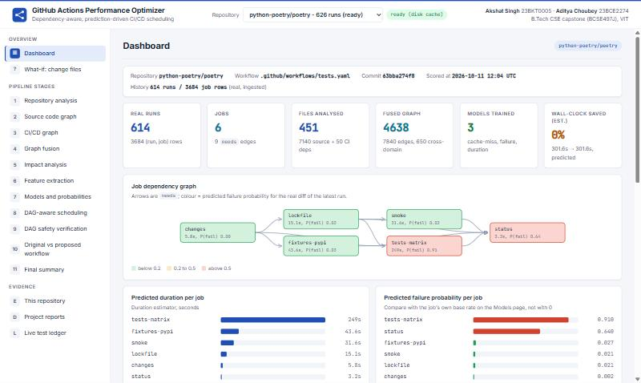
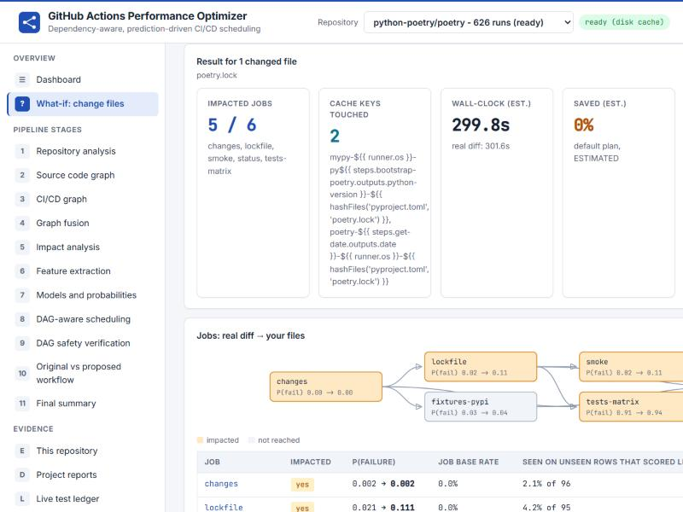
The dashboard
One page per stage, what-if scoring, and the evidence behind every claim
Repository selector; a repository without enough history shows why it declined
Score shown beside the job's base rate and the observed rate; original vs proposed workflow side by side
Notes:
Live demo if possible: start with the poetry dashboard, open Models and probabilities to show the score next to the base rate, then What-if and pick a dependency file. Everything on these pages comes from real runs; the evidence pages simply show rows of the reports we generated. If a repository has too little history the page says why and shows no numbers.

Slide 12
Engineering rigour
Same inputs, same numbers; the system refuses to guess
Reproducible
428 tests
Scoring time is an explicit input; two full runs were byte-identical
427 pass, 1 skipped; lint clean; fixtures are data, not results
Tamper-evident
Refuses to guess
Live predictions are hash-chained; editing one breaks the chain
Declines when real history is too thin: 3 of 9 repositories now
Notes:
Four things to point at. First, reproducibility: the same repository used to give different numbers at different hours because the hour of the day is a model feature and it was read from the clock; scoring time is now an explicit input, and two full runs gave byte-identical output. Second, 428 automated tests. Third, the tamper-evident prediction ledger. Fourth, the system refuses to predict when history is too thin; before we back-filled job logs, five of nine repositories were declined, now three are.

Slide 13
What is still open, and when
Final verdicts are fixed by the pre-registered rules
15 Oct
Automated refresh of the interim figures in this deck
Limits we state ourselves
Nine repositories, 5-7 weeks of history each
Few failures in several repositories: wide intervals
Relaxed gates measured on one pipeline only
Triage not checked against developer actions
Live sample is small
19 Oct
Live test: final evaluation of the ledgers
21 Oct
Logistic default: fresh-data verdict (interim: 2 judged, both pass)
26 Oct
Pooled model: fresh-data verdict (interim: would be rejected)
Notes:
Everything final is scheduled and automated. Thursday evening the interim results are refreshed so today's numbers are not stale. The live test ends on 19 October, the logistic-default verdict is on 21 October, the pooled-model verdict on 26 October. Be upfront about the limits on the right.

Slide 14
What we claim, and what we do not
We claim
We do not claim
A rigorous evaluation method with pre-registered tests
Honest negative and mixed results, with data
A working, tested pipeline that refuses to guess
A failure triage from real outcomes
A general speed-up of CI
Calibrated failure probabilities
That the pooled model works
That triage advice matches developers
Guidance we would like
Frame the write-up as an evaluation and negative-results study?
Add more repositories now, or accept nine and state the limit?
Which venue or report format should the final submission target?
Notes:
Close with the honest position. We claim a rigorous evaluation method, honest negative results, a working tested system and a useful failure triage. We do not claim a general speed-up, calibrated probabilities, or that the pooled model works. Then ask for guidance on the three decisions.

